Slide 1
Multivariat Data Analysis

Slide 2
Agenda
Pengenalan
3
Konsep
4
Jenis-jenis
6
11
14

Slide 3
Pengenalan
3

Slide 4
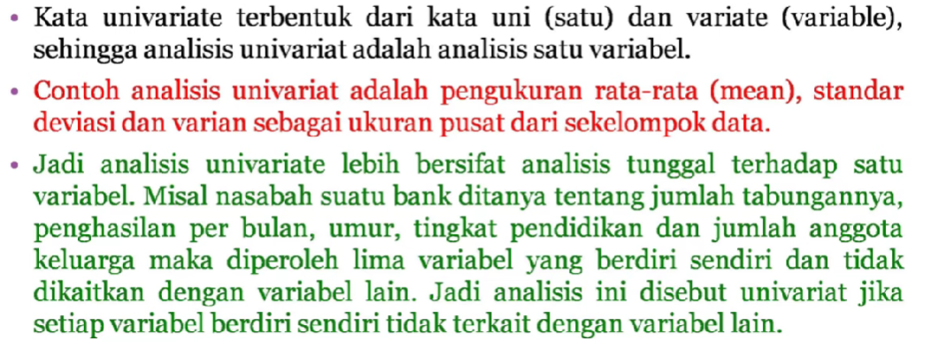
Analisis Univariat

Slide 5
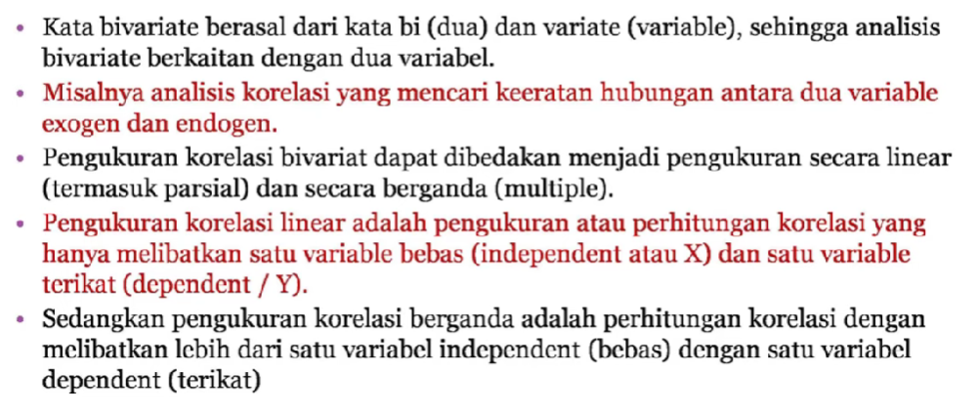
Analisis Bivariat

Slide 6
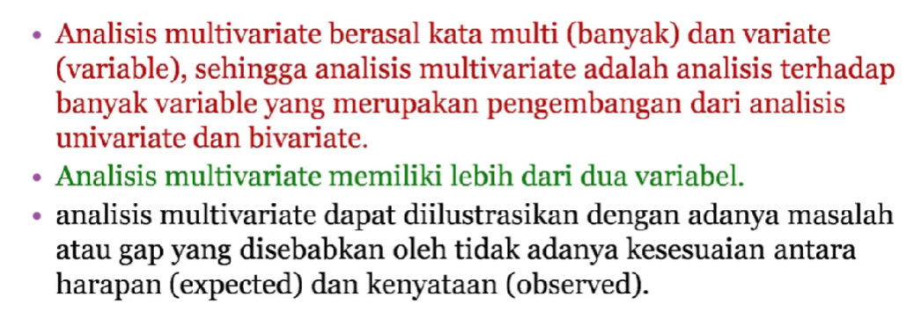
Analisis Multivariat
 | B2B | Supply chain | ROI | E-commerce
Q1 | 4.5 | 2.3 | 1.7 | 5.0
Q2 | 3.2 | 5.1 | 4.4 | 3.0
Q3 | 2.1 | 1.7 | 2.5 | 2.8
Q4 | 4.5 | 2.2 | 1.7 | 7.0

Slide 7
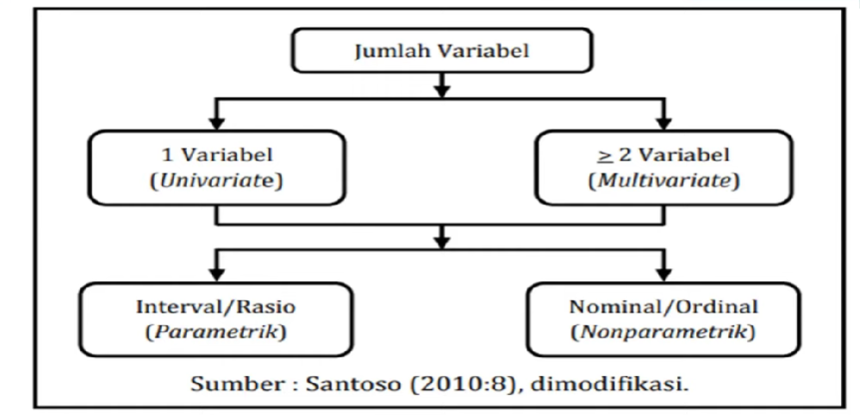
Metode Statistik Berdasarkan Jumlah Variabel

Slide 8
Uji Statistik Multivariat
Officer

Slide 9
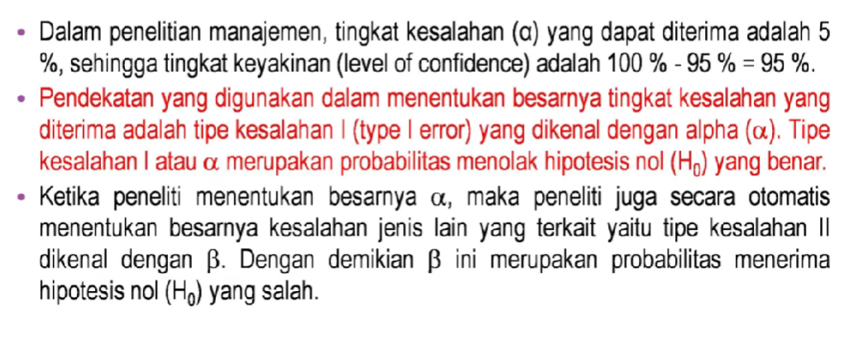
Uji Statistik Multivariat
Officer

Slide 10
Uji Statistik Multivariat
Officer

Slide 11
Uji Statistik Multivariat
Officer

Slide 12
Teknik Analisis Multivariat
Takuma Hayashi
Mirjam Nilsson
Flora Berggren
Rajesh Santoshi
President
Chief Executive Officer
Chief Operations Officer
VP Marketing

Slide 13
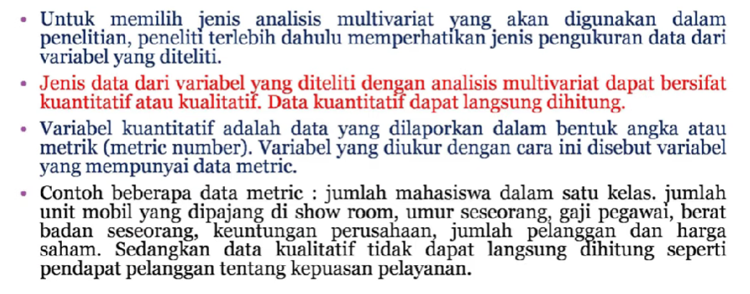
Teknik Analisis Multivariat
Takuma Hayashi
Mirjam Nilsson
Flora Berggren
Rajesh Santoshi
President
Chief Executive Officer
Chief Operations Officer
VP Marketing

Slide 14
Teknik Analisis Multivariat
Takuma Hayashi
Mirjam Nilsson
Flora Berggren
Rajesh Santoshi
President
Chief Executive Officer
Chief Operations Officer
VP Marketing

Slide 15
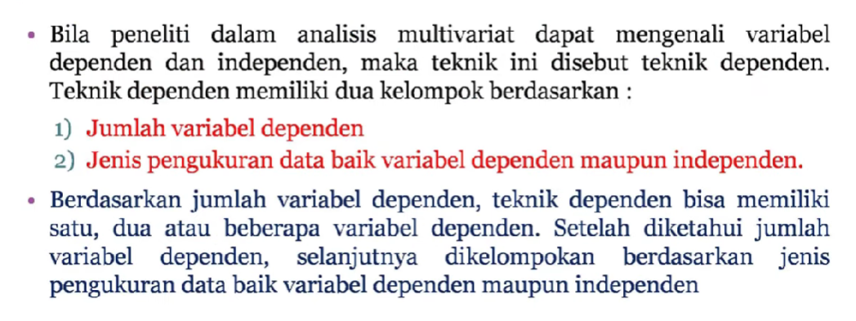
Teknik Dependen
Deploy strategic networks with compelling e-business needs
Planning
Synergize scalable e-commerce
Marketing
Disseminate standardized metrics
Design
Coordinate e-business applications
Foster holistically superior methodologies
Launch
Strategy

Slide 16
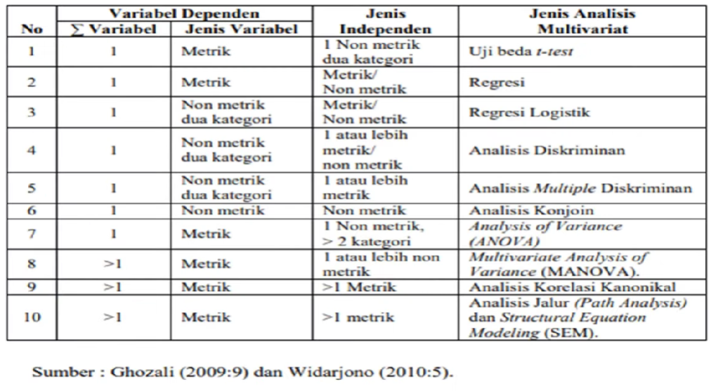
Jenis-Jenis Analisis Multivariat
Sep
Nov
Jan
Mar
May
Synergize scalable e-commerce
Disseminate standardized metrics
Coordinate e-business applications
Foster holistically superior methodologies
Deploy strategic networks with compelling e-business needs

Slide 17
Teknik Interdependen
B2B market scenarios
Cloud-based
opportunities
Develop winning strategies to keep ahead of the competition​
Capitalize on low-hanging fruit to identify a ballpark value​
Visualize customer directed convergence
Iterative approaches to corporate strategy
Establish a management framework from the inside

Slide 18
Jenis-Jenis Interdependen
ROI
Niche markets
Supply chains
Envision multimedia-based expertise and cross-media growth strategies​
Visualize quality intellectual capital​
Engage worldwide methodologies with web-enabled technologies​
Pursue scalable customer service through sustainable strategies​
Engage top-line web services with cutting-edge deliverables
Cultivate one-to-one customer service with robust ideas​
Maximize timely deliverables for real- time schemas

Slide 19
Teknik Persamaan Struktural
At Contoso, we believe in giving 110%. By using our next-generation data architecture, we help organizations virtually manage agile workflows. We thrive because of our market knowledge and great team behind our product. As our CEO says, "Efficiencies will come from proactively transforming how we do business."​
​

Slide 20
Teknik Persamaan Struktural
At Contoso, we believe in giving 110%. By using our next-generation data architecture, we help organizations virtually manage agile workflows. We thrive because of our market knowledge and great team behind our product. As our CEO says, "Efficiencies will come from proactively transforming how we do business."​
​

Slide 21
Contoh
At Contoso, we believe in giving 110%. By using our next-generation data architecture, we help organizations virtually manage agile workflows. We thrive because of our market knowledge and great team behind our product. As our CEO says, "Efficiencies will come from proactively transforming how we do business."​
​

Slide 22
Contoh
At Contoso, we believe in giving 110%. By using our next-generation data architecture, we help organizations virtually manage agile workflows. We thrive because of our market knowledge and great team behind our product. As our CEO says, "Efficiencies will come from proactively transforming how we do business."​
​

Slide 23
Contoh
At Contoso, we believe in giving 110%. By using our next-generation data architecture, we help organizations virtually manage agile workflows. We thrive because of our market knowledge and great team behind our product. As our CEO says, "Efficiencies will come from proactively transforming how we do business."​
​

Slide 24
Contoh
At Contoso, we believe in giving 110%. By using our next-generation data architecture, we help organizations virtually manage agile workflows. We thrive because of our market knowledge and great team behind our product. As our CEO says, "Efficiencies will come from proactively transforming how we do business."​
​

Slide 25
Contoh
At Contoso, we believe in giving 110%. By using our next-generation data architecture, we help organizations virtually manage agile workflows. We thrive because of our market knowledge and great team behind our product. As our CEO says, "Efficiencies will come from proactively transforming how we do business."​
​

Slide 26
Contoh
At Contoso, we believe in giving 110%. By using our next-generation data architecture, we help organizations virtually manage agile workflows. We thrive because of our market knowledge and great team behind our product. As our CEO says, "Efficiencies will come from proactively transforming how we do business."​
​

Slide 27
Contoh
At Contoso, we believe in giving 110%. By using our next-generation data architecture, we help organizations virtually manage agile workflows. We thrive because of our market knowledge and great team behind our product. As our CEO says, "Efficiencies will come from proactively transforming how we do business."​
​

Slide 28
Contoh
At Contoso, we believe in giving 110%. By using our next-generation data architecture, we help organizations virtually manage agile workflows. We thrive because of our market knowledge and great team behind our product. As our CEO says, "Efficiencies will come from proactively transforming how we do business."​
​

Slide 29
Contoh
At Contoso, we believe in giving 110%. By using our next-generation data architecture, we help organizations virtually manage agile workflows. We thrive because of our market knowledge and great team behind our product. As our CEO says, "Efficiencies will come from proactively transforming how we do business."​
​

Slide 30
Contoh
At Contoso, we believe in giving 110%. By using our next-generation data architecture, we help organizations virtually manage agile workflows. We thrive because of our market knowledge and great team behind our product. As our CEO says, "Efficiencies will come from proactively transforming how we do business."​
​

Slide 31
Thank you
Mirjam Nilsson​
mirjam@contoso.com
www.contoso.com

