Slide 1
Tools Big Data
Yudy Yunardy S.E., M.M.

Slide 55
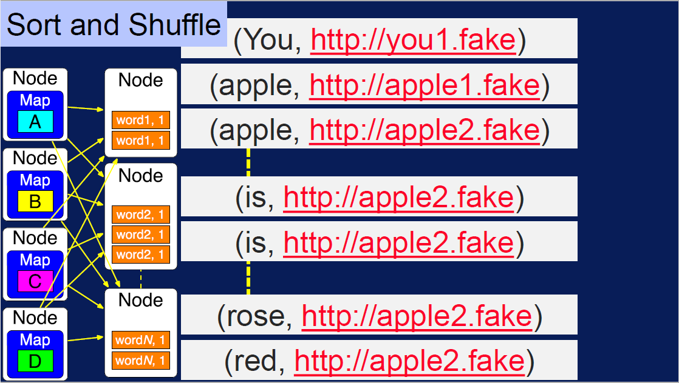

Slide 61
Data

Slide 62
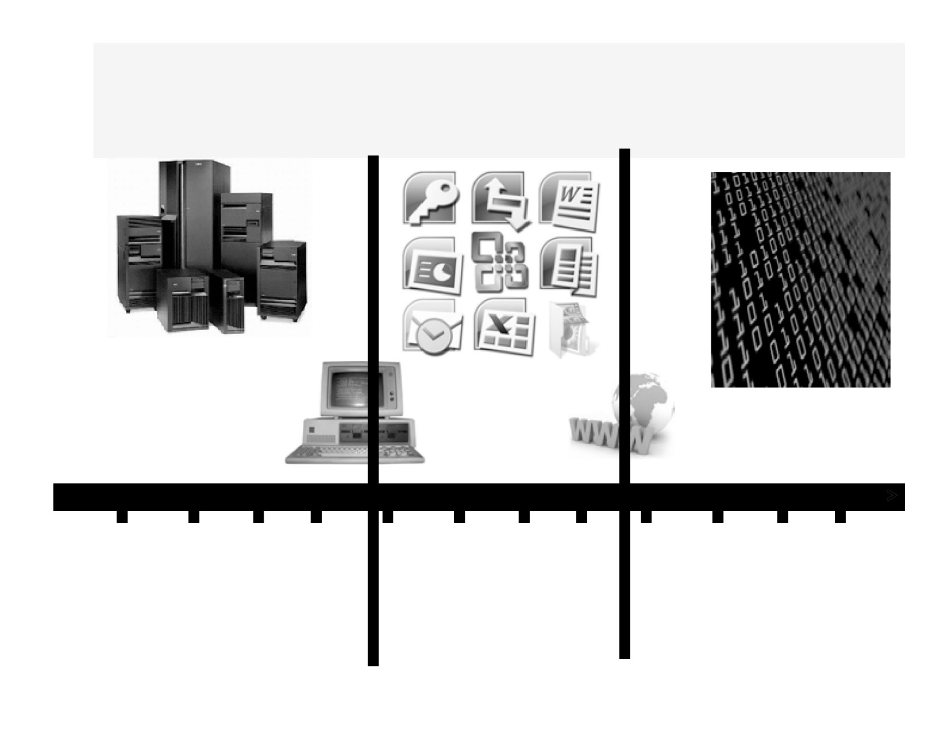
The Revolution in the Marketplace - The Shift
1955 1960 1965
1970 1975 1980 1985 1990
1995 2000 2005 2010
Hardware
Software
Data is the
Was King
Becomes King
New King
21

Slide 63
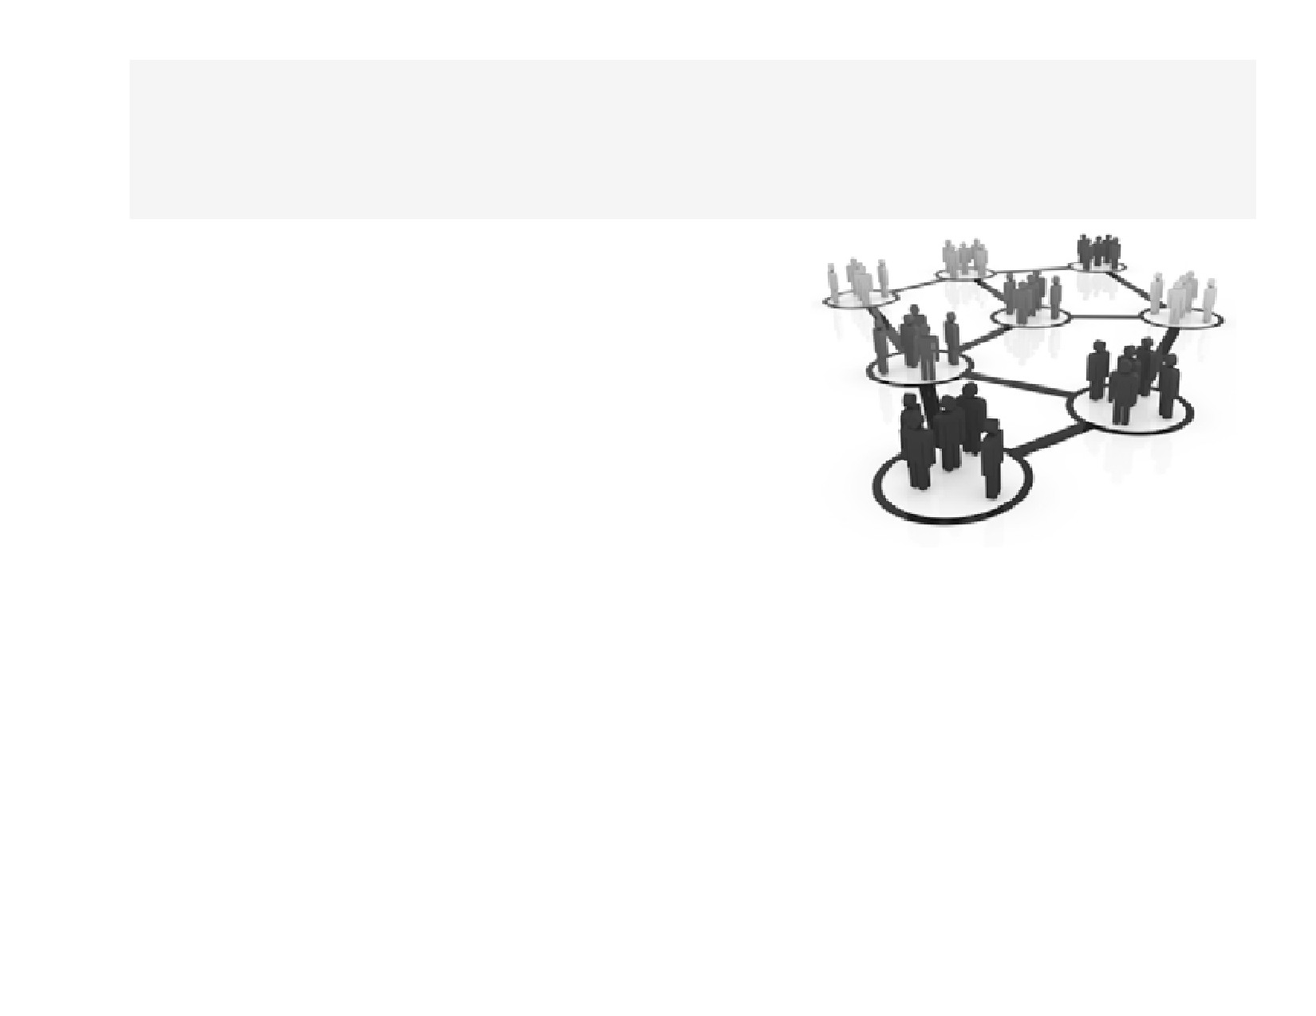
What are Data Driven
Organizations?
A data driven organization
that acquires data,
that processes data,
and leverages data in a timely fashion to create efficiencies,
iterate on and develop new products and navigate the competitive landscape
22

Slide 64
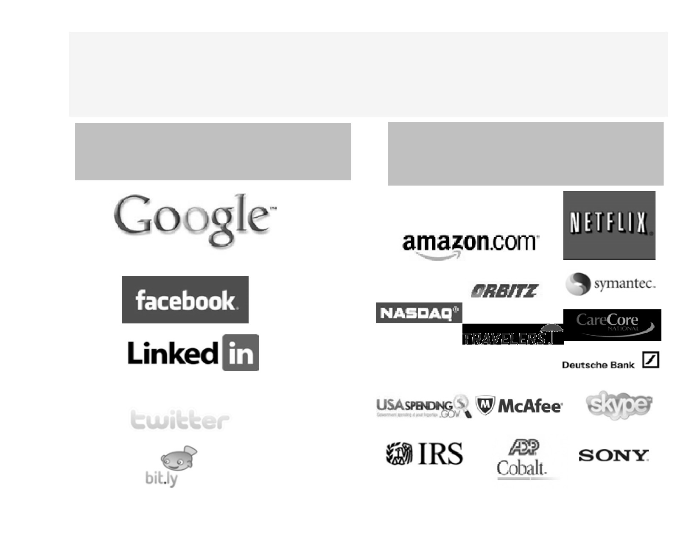
Data Driven Organizations Use Data
Effectively
Data Driven
Organizations that use Data to
Organizations
augment their Business
23

Slide 65
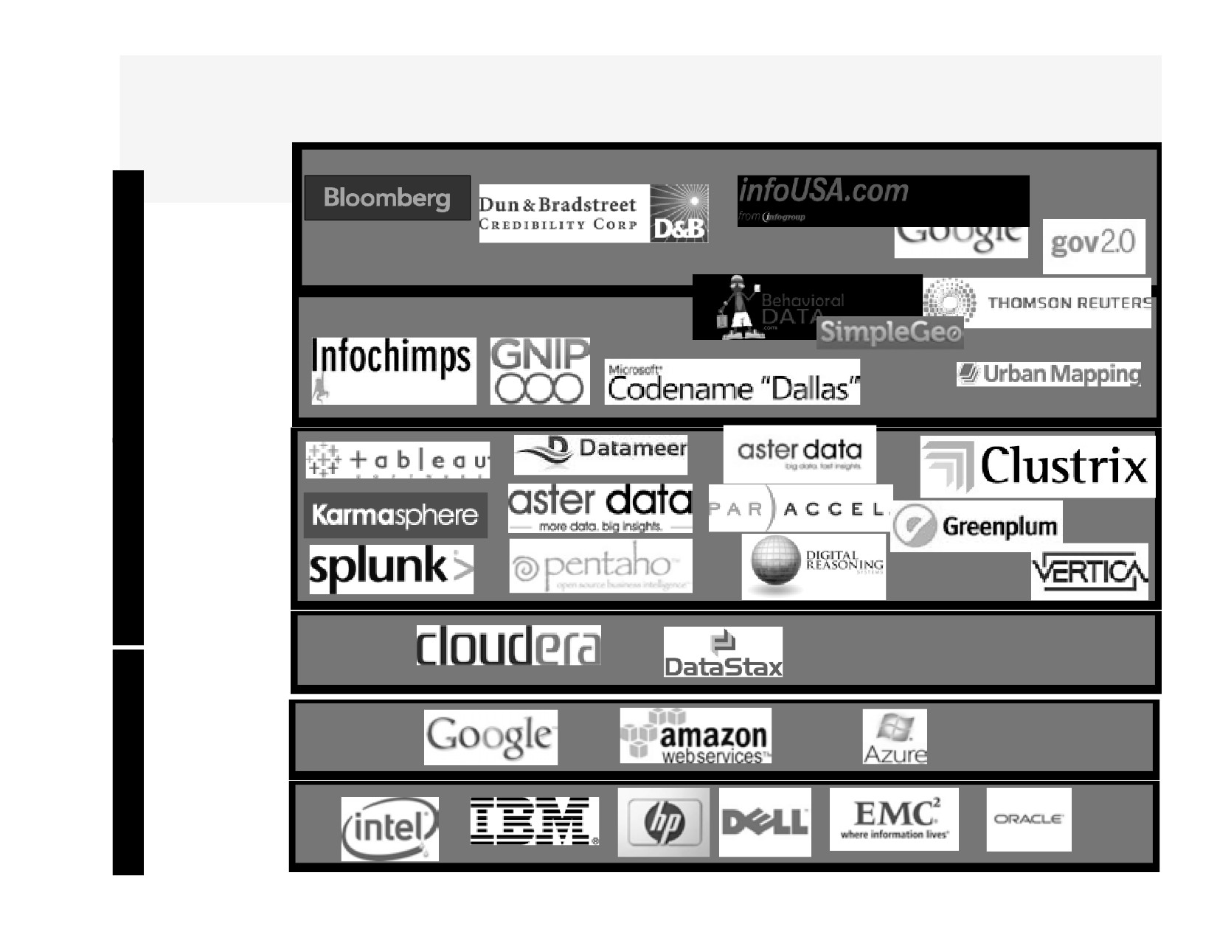
Big Data Business is Big Business
Data
Data
Generators +Aggregators
As
A
Ser
-vice
Data
Aggregators
+Enablers
Big Data BI
P
+ Data
A
Analytics sw + ToolVendors
A
S
Big Data
Cloud Platform
Software
Big Data
public Cloud
Platform
I
Providers
A
(hw+sw)
A
Big Data
S
Hardware Manufactures

Slide 66
Information Science Is Affecting
Every Industry
Biotech/Healthcare
Linguistics
Mining
http://www.youtube.com/watch? v=1-C0Vtc-sHw
http://www.youtube.com/watch? v=VwgkT34g61w
http://www.cloudera.com/blog/2012/01/ seismic-data-science-hadoop-use-case/
Finance
Journalism/Visualization
Education
http://www.youtube.com/watch?
http://www.youtube.com/watch?
v=GWF2SU7UWs8
v=uuUa4FEGvzo
25

Slide 67
Wake up - This is a Data Economy!
• We are in the midst of Information Science in the making.
• Not long ago data was expensive. There wasn’t much of it. Data was the bottleneck for much of
human endeavor.
• No limit to how much valuable data we can collect!
• We are no longer data-limited, but insight limited. The people who know how to work with data are in
short supply.
26

Slide 68
Big Data Computing in the Modern World

Slide 69
Modern Computing Benefits/Trends
• Faster processing (CPU) and more memory
- Thanks to Moore’s law
• Storage has become cheaper
- Organizations are buying more storage devices to deal with
huge amounts of data
• Distributed systems design has matured
- Hadoop movement, NoSQL movement
• Prevalence of Open-source software
- A movement that started 20 years ago has yielded some of the
best software, even better than proprietary software
• More and more Commodity hardware
- Systems of commodity servers rather than supercomputers
• Public Cloud computing
- Companies like Amazon, Google are providing cloud options
42

Slide 70
Tugas
Carilah 1 Contoh Kasus penggunaan Hadoop pada bisnis tertentu:
Jelaskan Langkah-Langkah Proses analisis big datanya?
Apa kelebihan dan kelemahan Hadoop pada bisnis tersebut
Jelaskan cakupan data yang dapat diproses pada kasus tersebut!
Bagaimana model bisnisnya pada penggunaan Hadoop tersebut!

Slide 71
00:00:00
TERIMA KASIH
Jangan lupa mengikuti kuis karena sekaligus merupakan absensi

