Slide 1
Hadoop
Pengolah Big Data

Slide 3
Hadoop
An effective open source framework for storing large amounts of datasets.
Not only storing, but this framework can also process data
ranging from gigabytes to petabytes efficiently.
Although the data processed is large, the process is faster
because it uses more computers.
Data is processed in a distributed manner at the same time, so
the processing speed can be shorter.

Slide 4
Hadoop
This framework has four main modules, namely HDFS, YARN,
MapReduce, and Hadoop Common.
1. Hadoop Distributed File System (HDFS): A distributed file
system that operates on both standard and low-end hardware.
2. Yet Another Resource Negotiator (YARN): A system that
manages and monitors cluster nodes and resource usage.
3. MapReduce: A framework that helps programs to compute
data in parallel.
4. Hadoop Common: A Java library provider that can be used
by all modules.

Slide 5
How Hadoop
Works
Hadoop is a
framework that
works by
These data are
distributing large
processed at the same time.
datasets across
several different machines.
HDFS is used to store the data and
Meanwhile, YARN
MapReduce processes the data.
serves to divide
tasks.

Slide 6
The
Hadoop
ecosystem
Hadoop Ecosystems includes tools and applications that help with the collection, storage, analysis, and management of big data. Some of the popular applications or software based
on this framework are:
1. Spark
2. Presto
3. Hive
4. H-Base

Slide 7
Spark is an open-source distributed processing system.
1. SPARK
This system, which is part
of the Hadoop ecosystem,
is used for big data and is able to operate quickly.
Spark can perform batch processing, streaming analytics, machine
learning, graph databases, and ad hoc queries.

Slide 8
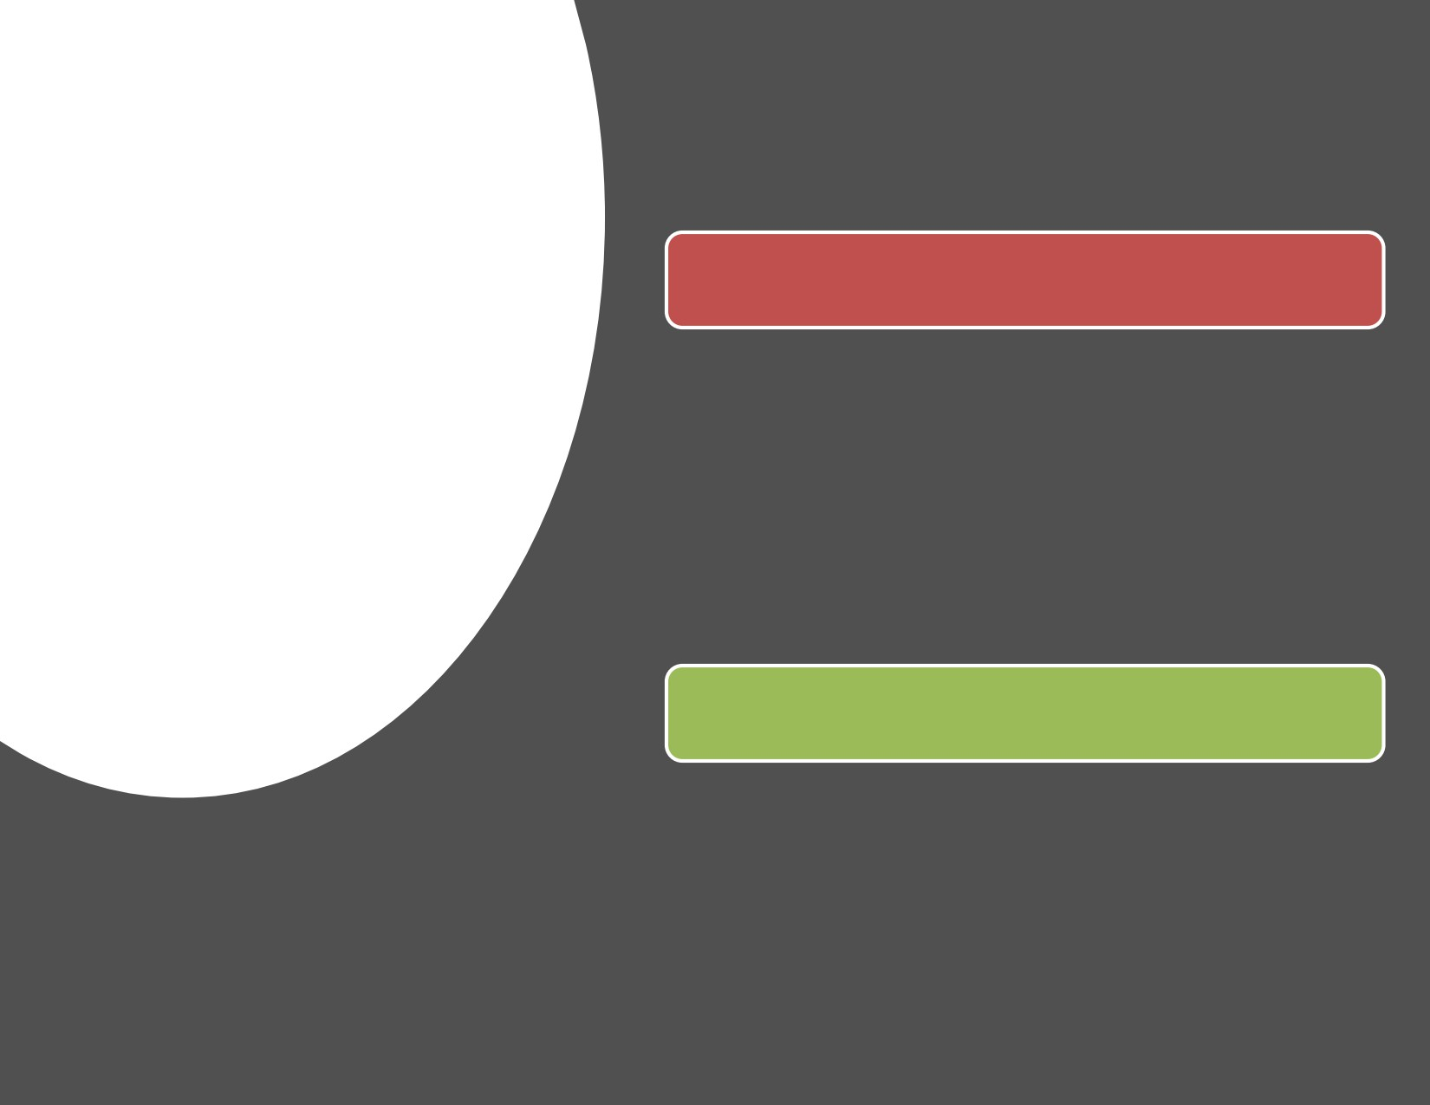
2.Presto &
3.Hive
2. Presto
• Like Spark, Presto is also open source.
• Presto is a distributed SQL query
engine used for low-latency ad hoc data analysis.
• With Presto, you can process data from a variety of sources, including HDFS
and Amazon S3.
3. Hive
• Hive is used for MapReduce with SQL interface.
• So, this tool is suitable for large
amount of data analysis.

Slide 9
HBas
• HBase is the database Amazon
S3 and HDFS use.
• This tool is designed to process
tables with a very large number
of rows.
In addition to the four software or
applications, there are also Apache
Impala, Pig, Zookeeper, Sqoop, and
Oozie.

Slide 10
1.
Hadoop is a technology that provides solutions to
Capacity
traditional systems.
can be
increasedTraditional systems have limited data storage,
while Hadoop can be increased in capacity.
Because, as you already know, this framework
works in a distributed manner.
Benefit
2. HDFS as part of the Hadoop ecosystem is Durability considered to have high resilience and minimize
Hadoop
the risk of hardware or software failure.
Even if a node is damaged or experiencing problems, HDFS can provide backup data to
continue the process.
3. Data can be stored in any format, either
Flexibility structured or unstructured.
So, you can access data from any source and of
any type.

Slide 11
Data

Slide 12
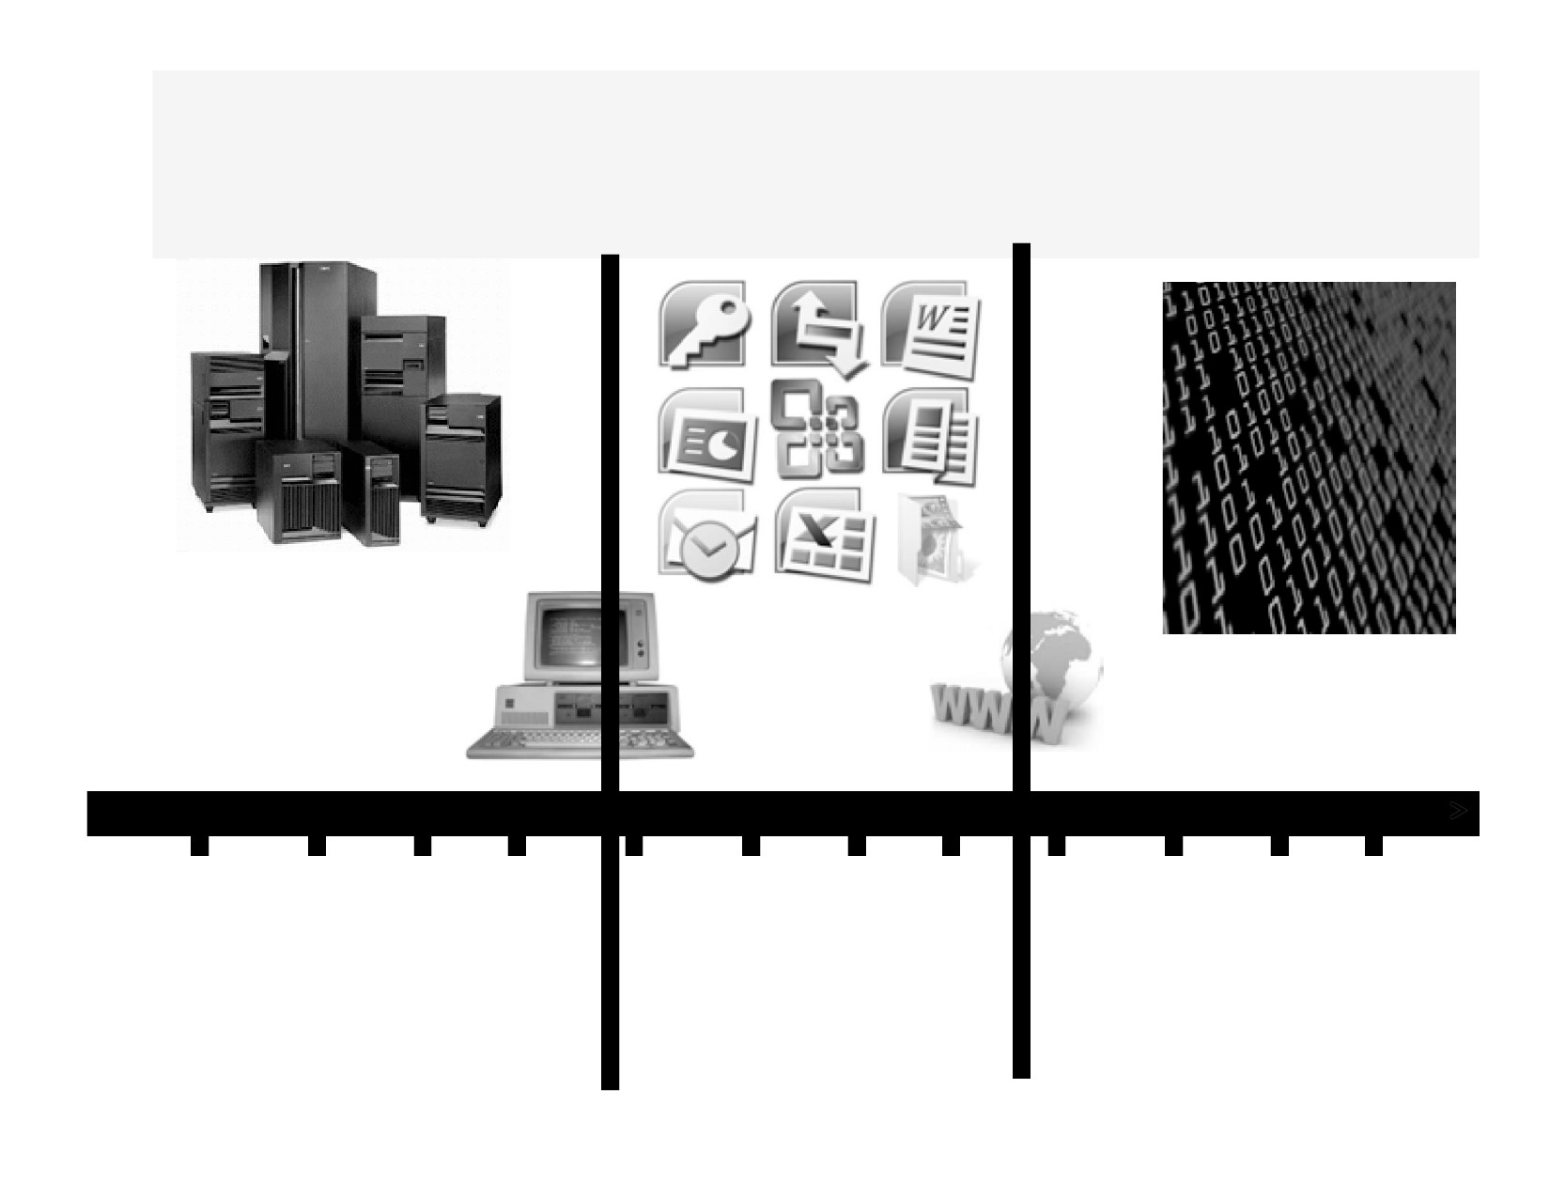
The Revolution in the Marketplace - The Shift
1955 1960 1965
1970 1975 1980 1985 1990
1995 2000 2005 2010
Hardware
Software
Data is the
Was King
Becomes King
New King
21

Slide 13
What are Data Driven
Organizations?
A data driven organization
that acquires data,
that processes data,
and leverages data in a timely fashion to create efficiencies,
iterate on and develop new products and navigate the competitive landscape
22

Slide 14
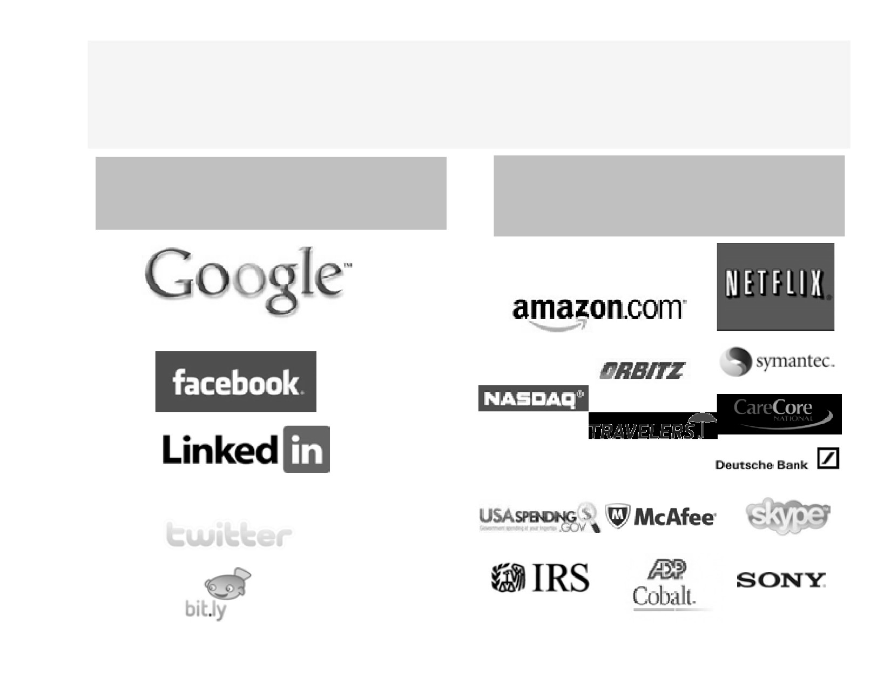
Data Driven Organizations Use Data
Effectively
Data Driven
Organizations that use Data to
Organizations
augment their Business
23

Slide 15
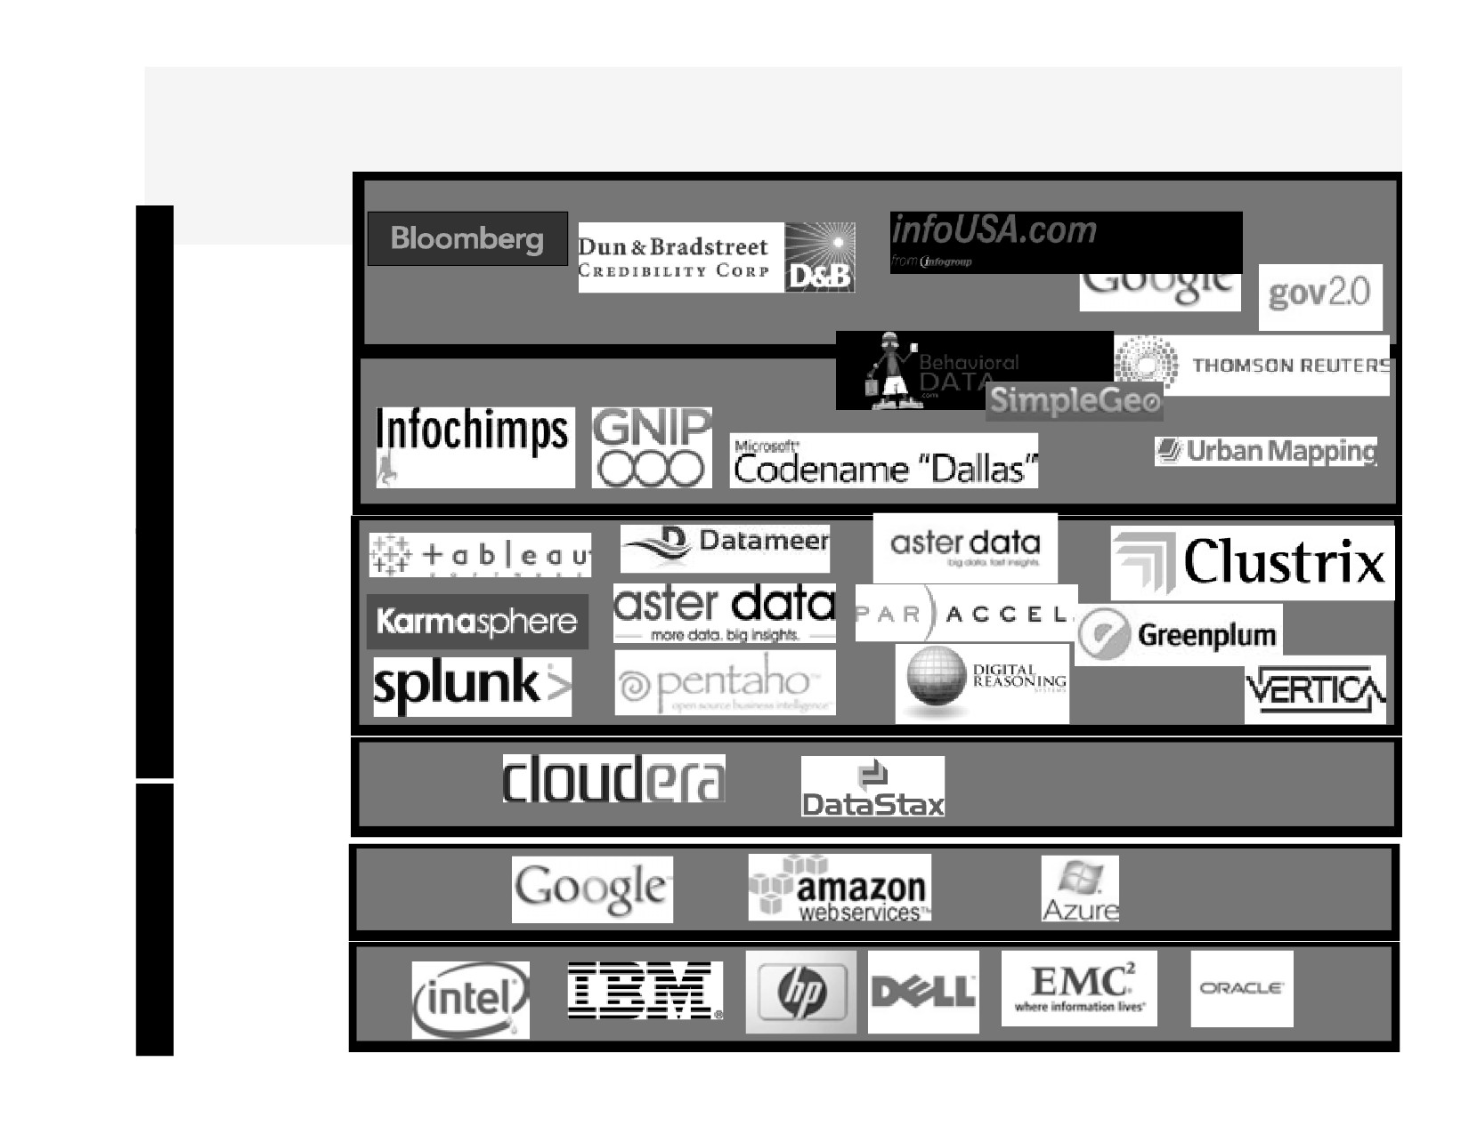
Big Data Business is Big Business
Data
Data
Generators +Aggregators
As
A
Ser
-vice
Data
Aggregators
+Enablers
Big Data BI
P
+ Data
A
Analytics sw + ToolVendors
A
S
Big Data
Cloud Platform
Software
Big Data
public Cloud
Platform
I
Providers
A
(hw+sw)
A
Big Data
S
Hardware Manufactures

Slide 16
Information Science Is Affecting
Every Industry
Biotech/Healthcare
Linguistics
Mining
http://www.youtube.com/watch? v=1-C0Vtc-sHw
http://www.youtube.com/watch? v=VwgkT34g61w
http://www.cloudera.com/blog/2012/01/ seismic-data-science-hadoop-use-case/
Finance
Journalism/Visualization
Education
http://www.youtube.com/watch?
http://www.youtube.com/watch?
v=GWF2SU7UWs8
v=uuUa4FEGvzo
25

Slide 17
Wake up - This is a Data Economy!
• We are in the midst of Information Science in the making.
• Not long ago data was expensive. There wasn’t much of it. Data was the bottleneck for much of
human endeavor.
• No limit to how much valuable data we can collect!
• We are no longer data-limited, but insight limited. The people who know how to work with data are in
short supply.
26

Slide 18
Big Data Computing in the Modern World

Slide 19
Modern Computing Benefits/Trends
• Faster processing (CPU) and more memory
- Thanks to Moore’s law
• Storage has become cheaper
- Organizations are buying more storage devices to deal with
huge amounts of data
• Distributed systems design has matured
- Hadoop movement, NoSQL movement
• Prevalence of Open-source software
- A movement that started 20 years ago has yielded some of the
best software, even better than proprietary software
• More and more Commodity hardware
- Systems of commodity servers rather than supercomputers
• Public Cloud computing
- Companies like Amazon, Google are providing cloud options
42

Slide 20
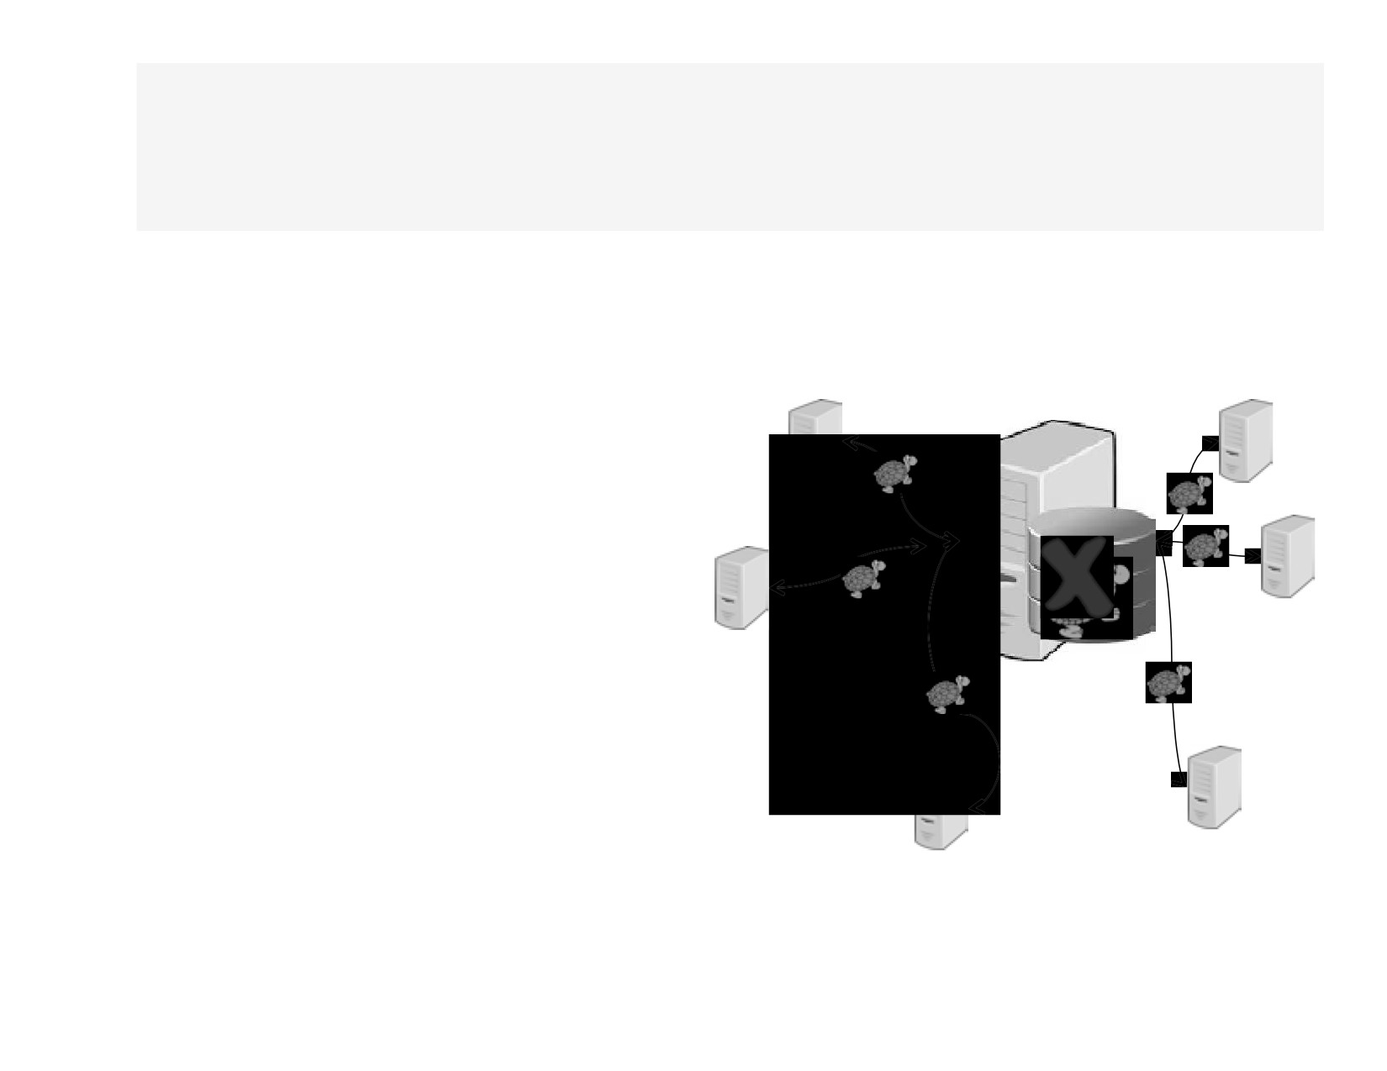
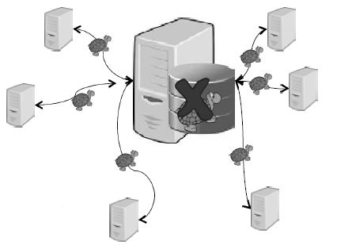
Modern Computing Challenges
• Disks I/O is slow
- Servers typically use cost effective
mechanical disks which are slow
• Disks fail
- Wear and tear, manufacturing issues
stuff happens…
• Not enough network bandwidth within data
centers to move all the bits
around
Once the data is read, transmitting data within datacenter or across is
slow
43

Slide 21
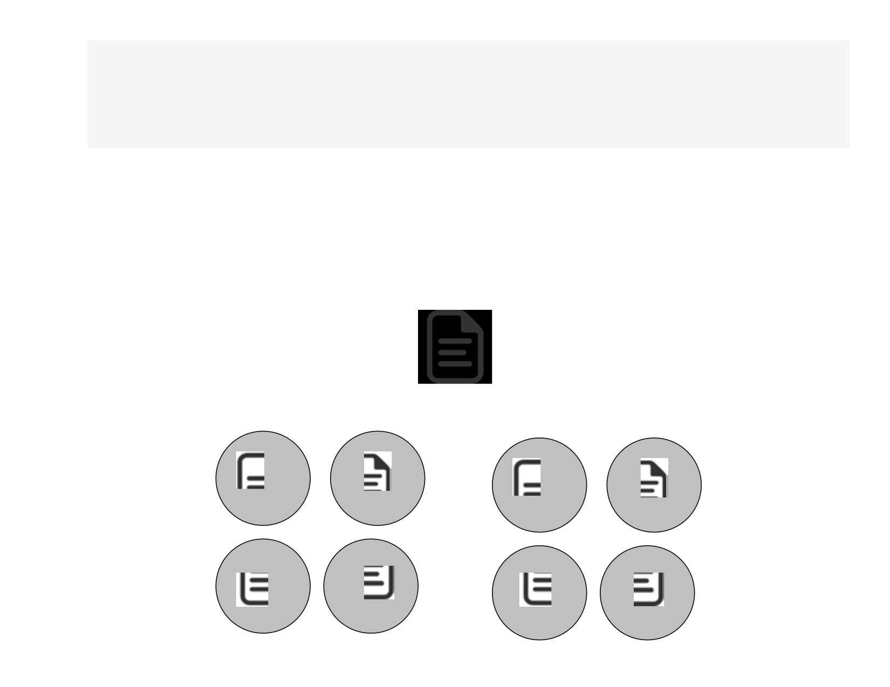
Solutions to Disk/IO Challenges
• Organizations use striping and mirroring together called RAID configuration
- RAID stands for Redundant Array of Inexpensive disks
- Use Striped (RAID0) and Mirrored (RAID1) configuration
Striped
Mirrored
44

Slide 23
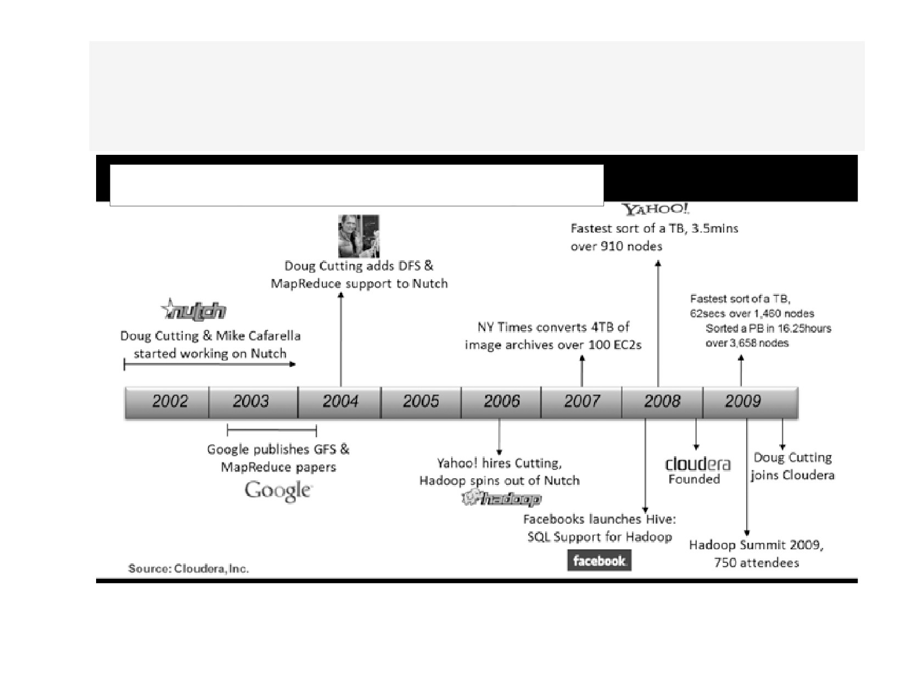
Hadoop History Timeline

Slide 24
What is Apache Hadoop?
• An open source project to manage “Big Data”
• Not just a single project, but a set of projects that work together
• Deals with the three V’s
• Transforms commodity hardware to
- Coherent storage service that lets you store petabytes of data
- Coherent processing service to process data efficiently
56

Slide 25
Key Attributes of Hadoop
• Redundant and reliable
- Hadoop replicates data automatically, so when machine goes
down there is no data loss
• Makes it easy to write distributed applications
- Possible to write a program to run on one machine and then
scale it to thousands of machines without changing it
• Runs on commodity hardware
- Don’t have to buy special hardware, expensive RAIDs, or
redundant hardware; reliability is built into software
57

Slide 26
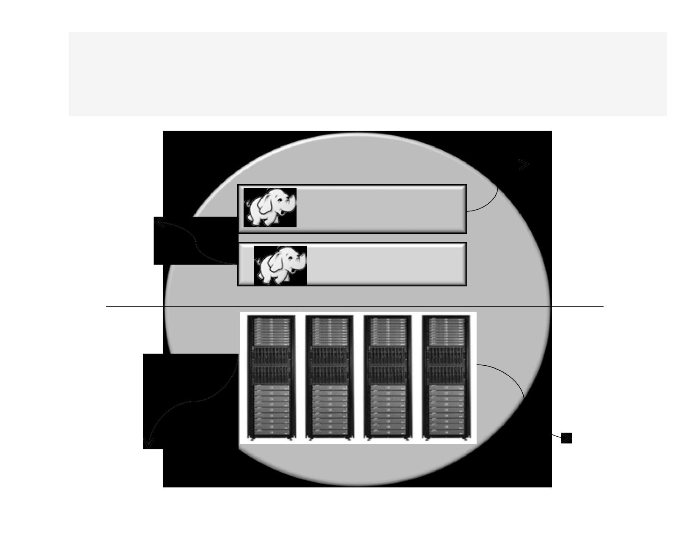
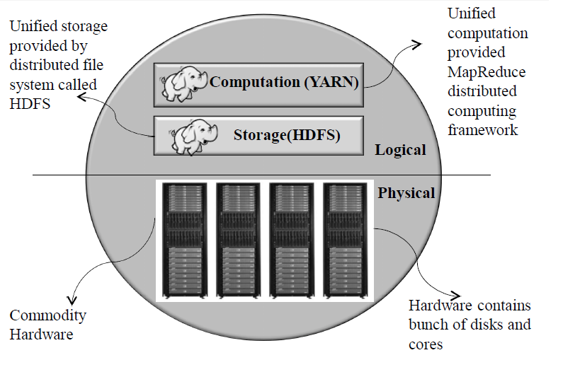
Hadoop - The Big Picture
Unified
Unified storage provided by distributed file
computation
provided
Computation (YARN)
MapReduce distributed
system called
HDFS
computing
Storage(HDFS)
framework
Logical
Physical
Hardware contains
Commodity
bunch of disks and cores
Hardware
58

Slide 27
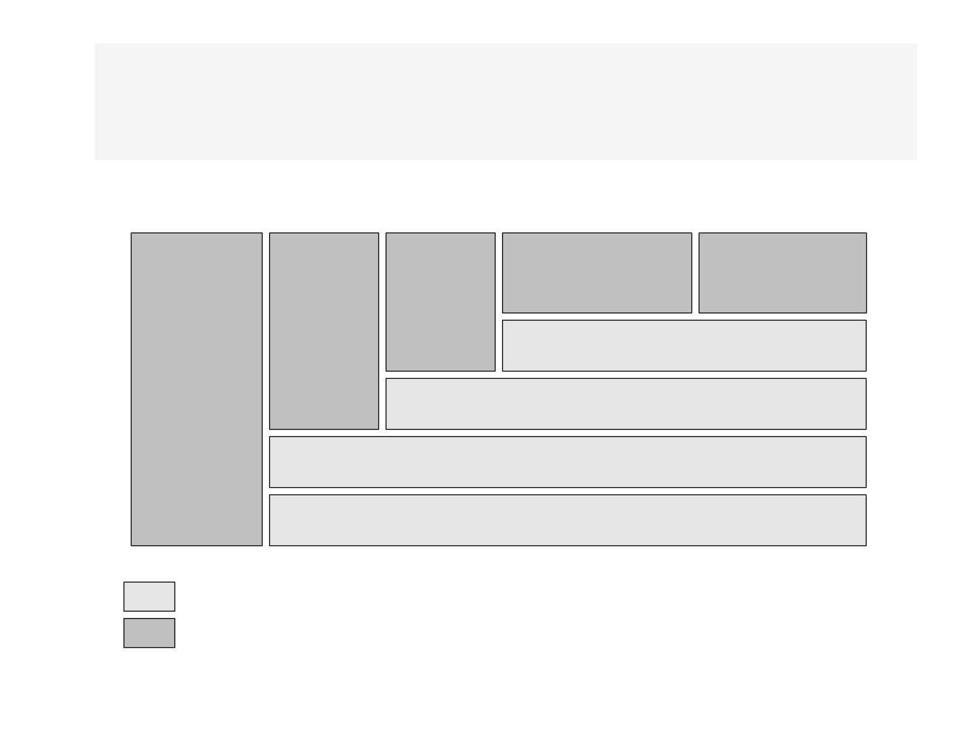
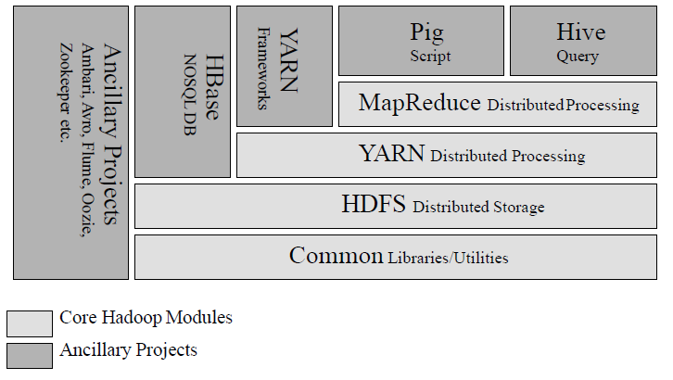
Hadoop Technology Stack
Pig
Hive
Script
Query
MapReduce DistributedProcessing YARN Distributed Processing
HDFS Distributed Storage Common Libraries/Utilities
Core Hadoop Modules
Ancillary Projects
59

Slide 28
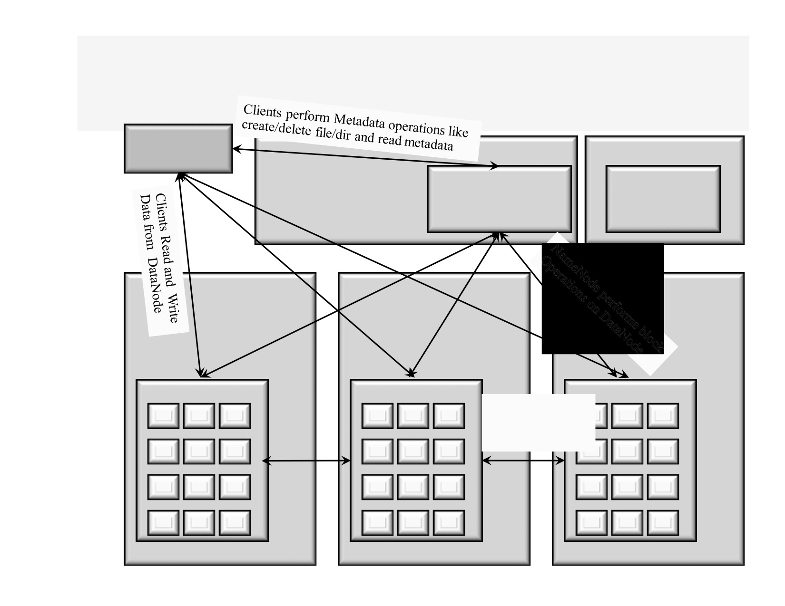
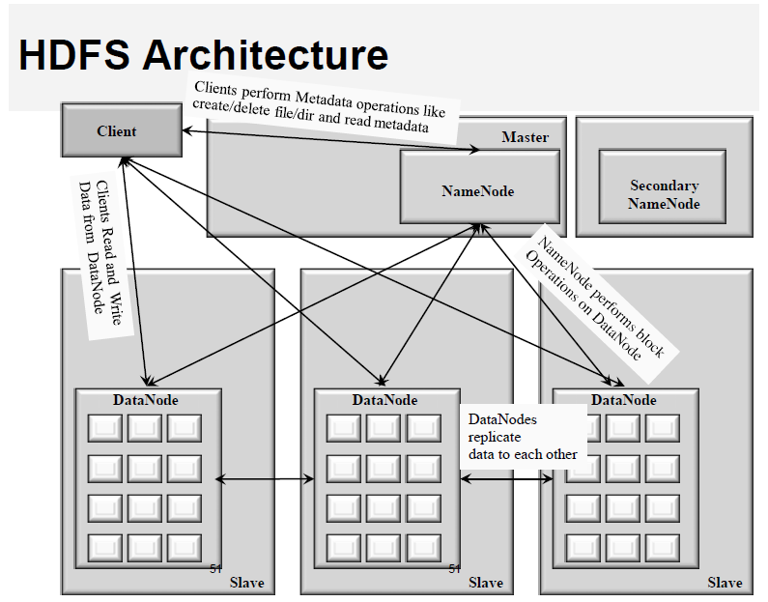
HDFS Architecture
Client
Master
NameNode
Secondary
NameNode
DataNode
DataNode
DataNode
DataNodes
replicate
data to each other
51
51
51
Slave
Slave
Slave

Slide 29
YARN Architecture

Slide 30
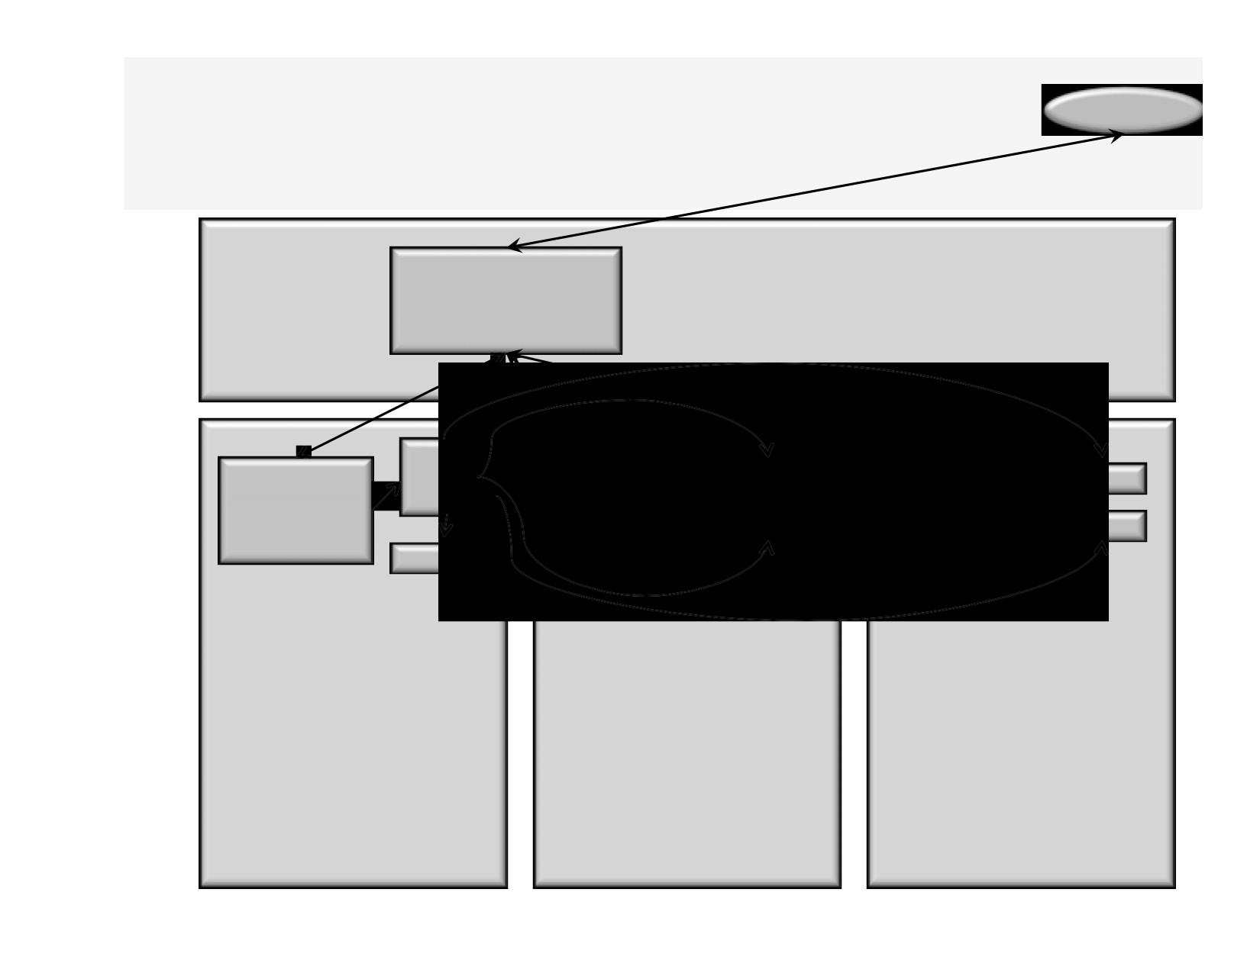
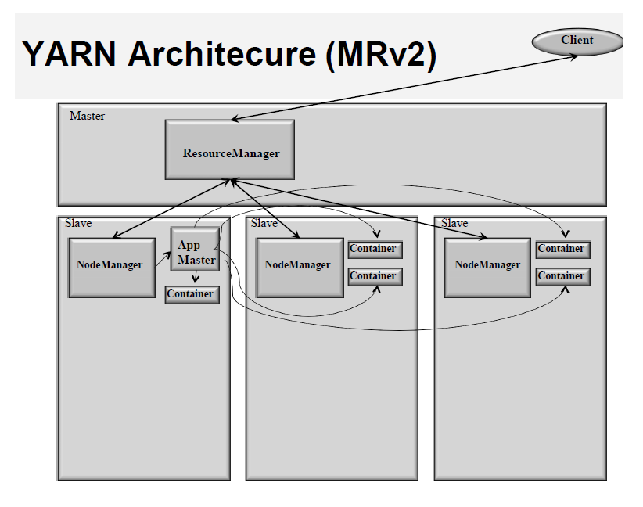
YARN Architecure (MRv2)
Client
Master
ResourceManager
Slave
Ap
ner
M
NodeManager
ner
Cont
62

Slide 31
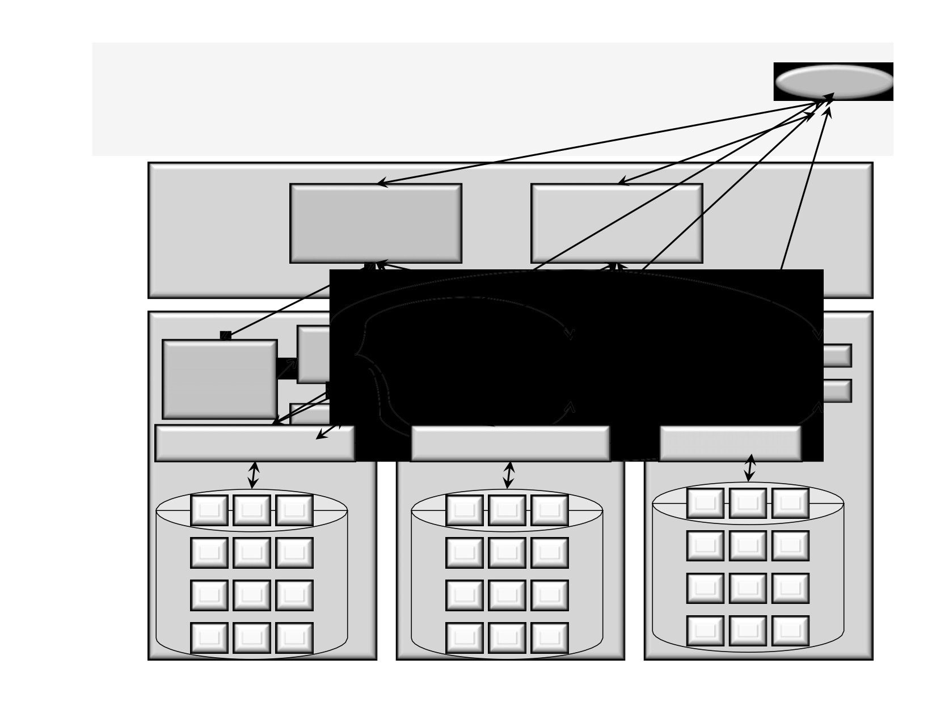
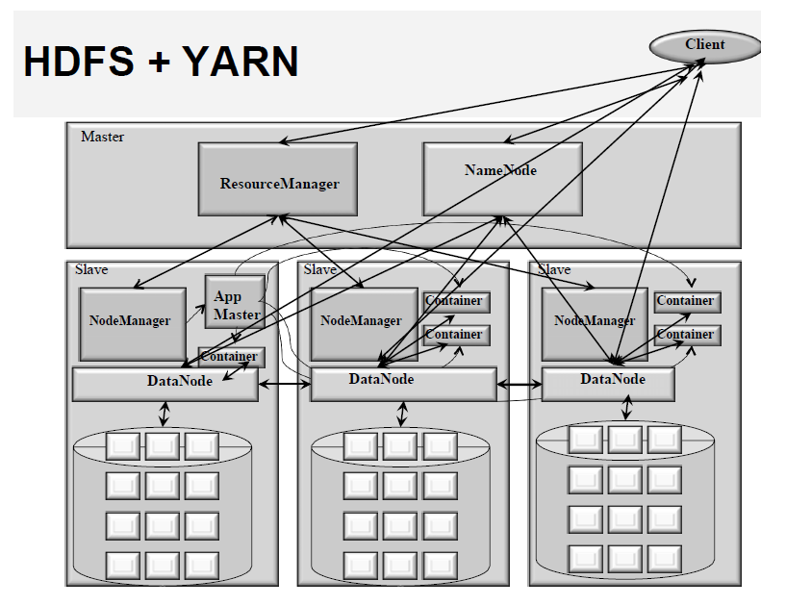
HDFS + YARN
Client
Master
ResourceManager
NameNode
Slave Slave
Ap
ner
Ma
NodeManager
ner
Container
DataNode
DataNode DataNode
63

Slide 33
Key Principles behind Hadoop
• Break disk read barrier
• Scale-Out rather than Scale-UP
• Bring code to data rather than data to code
• Deal with failures
• Abstract complexity of distributed and concurrent applications
56

Slide 34
Break Disk Read Barrier
• Storage capacity has grown exponentially but read speed has not kept up
-
1990:
• Disk Store 1,400 MB
• Transfer speed of 4.5MB/s
• Read the entire drive in ~ 5 minutes
-
2010
• Disk Store 1 TB
• Transfer speed of 100MB/s
• Read the entire drive in ~ 2.5 hours
• What does this mean?
- We can process data very quickly, but we cannot read fast
enough, so the solution is to do parallel reads
• Hadoop - 100 drives working at the same time can read 1TB of data in 2 minutes
57
Source: Tom White. Hadoop: The Definitive Guide. O'Reilly Media. 2012

Slide 35
Scale-Out Instead of Scale Up
• Harder and more expensive to scale-up
- Add additional resources to an existing node (CPU, RAM)
Moore’s Law couldn’t keep up with data growth
- New units must be purchased if required resources can not be
added
- Also known as scale vertically
• Scale-Out
- Add more nodes/machines to an existing distributed
application Software Layer is designed for node additions or
removal
- Hadoop takes this approach - A set of nodes are bounded
together as a single distributed system
- Very easy to scale down as well
58

Slide 36
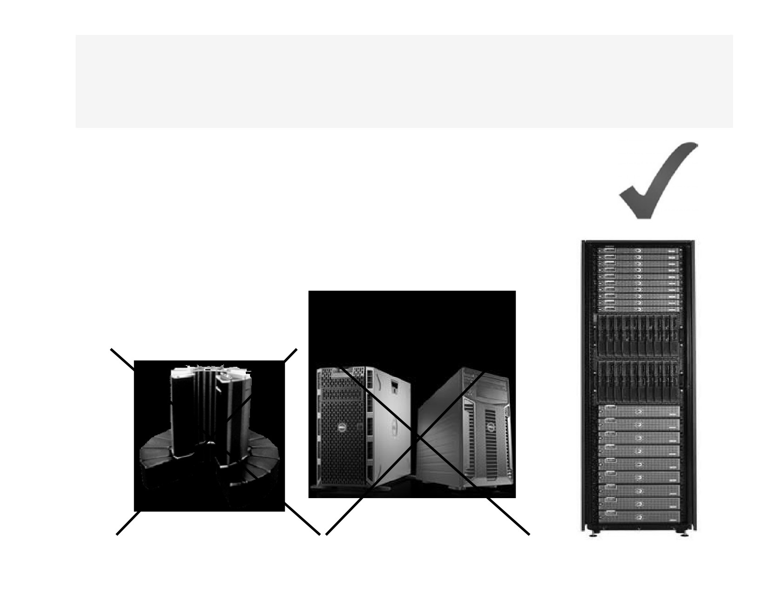
Use Commodity Hardware
•
“cheap” Commodity Server Hardware
- Definition of “cheap” changes on a yearly basis
- Today, it would cost about $5000
• 32GB RAM, 12 1 TB hard drive, quad core CPU
• No need for super computers with high-end storage, use commodity
unreliable hard
- Not desktops!
NOT
BUT
Super-computers with high end storage
Rack of Commodity Servers
59

Slide 37
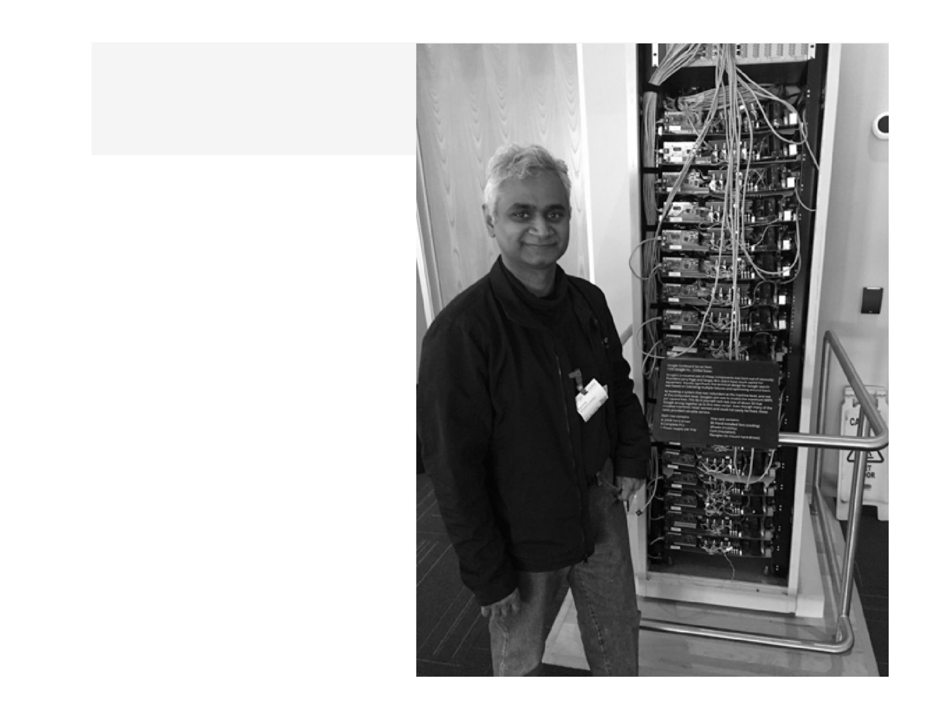
Googles’s
Original
Chalkboard
Server Rack
69

Slide 38
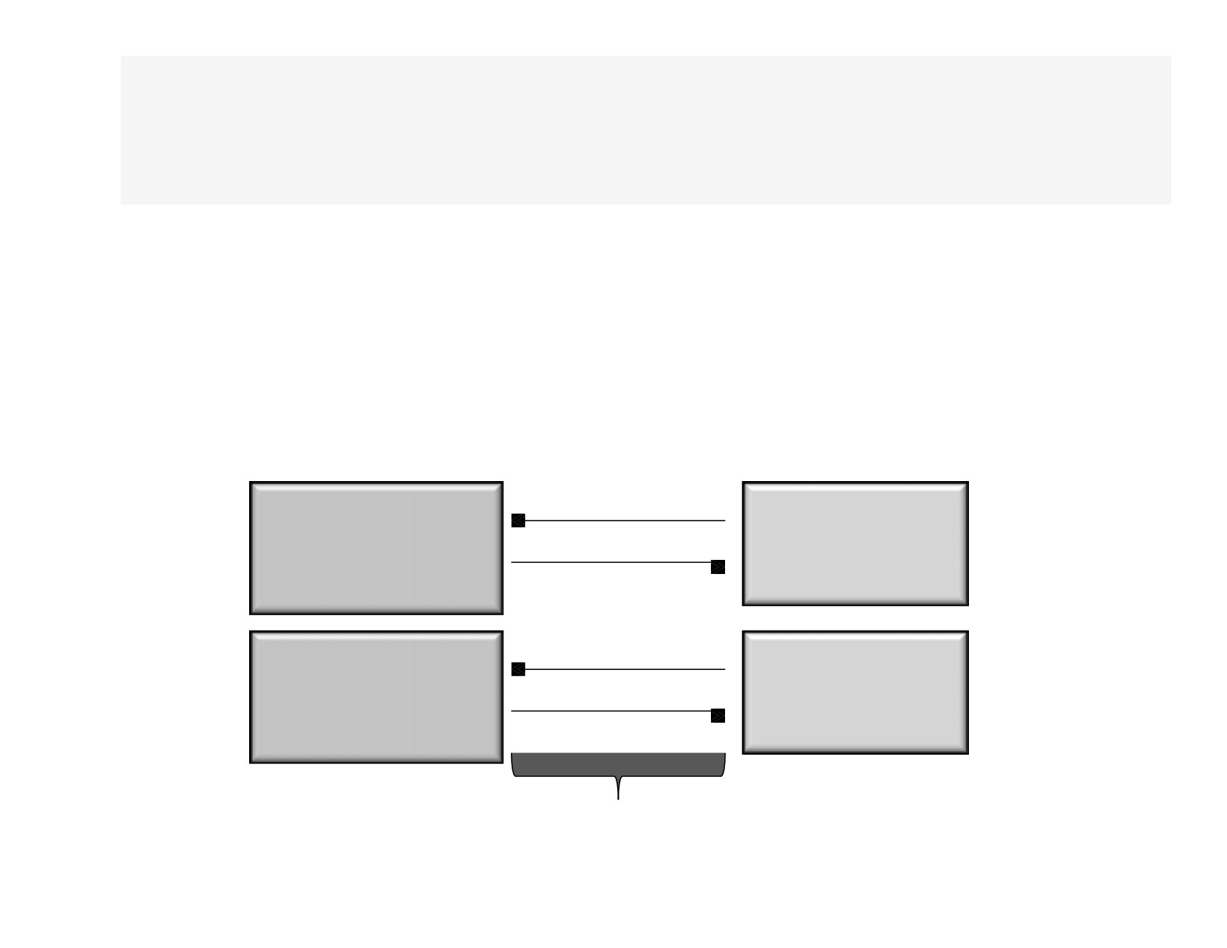
Data to Code = Not fit for Big Data
• Traditionally Data Processing Architectures divided systems into process and data nodes
- Risks network bottleneck
Processing Node
Load Data
Storage
Save Results
Node
Processing
Load Data
Storage
Node
Save Results
Node
Risk Bottleneck
70

Slide 39
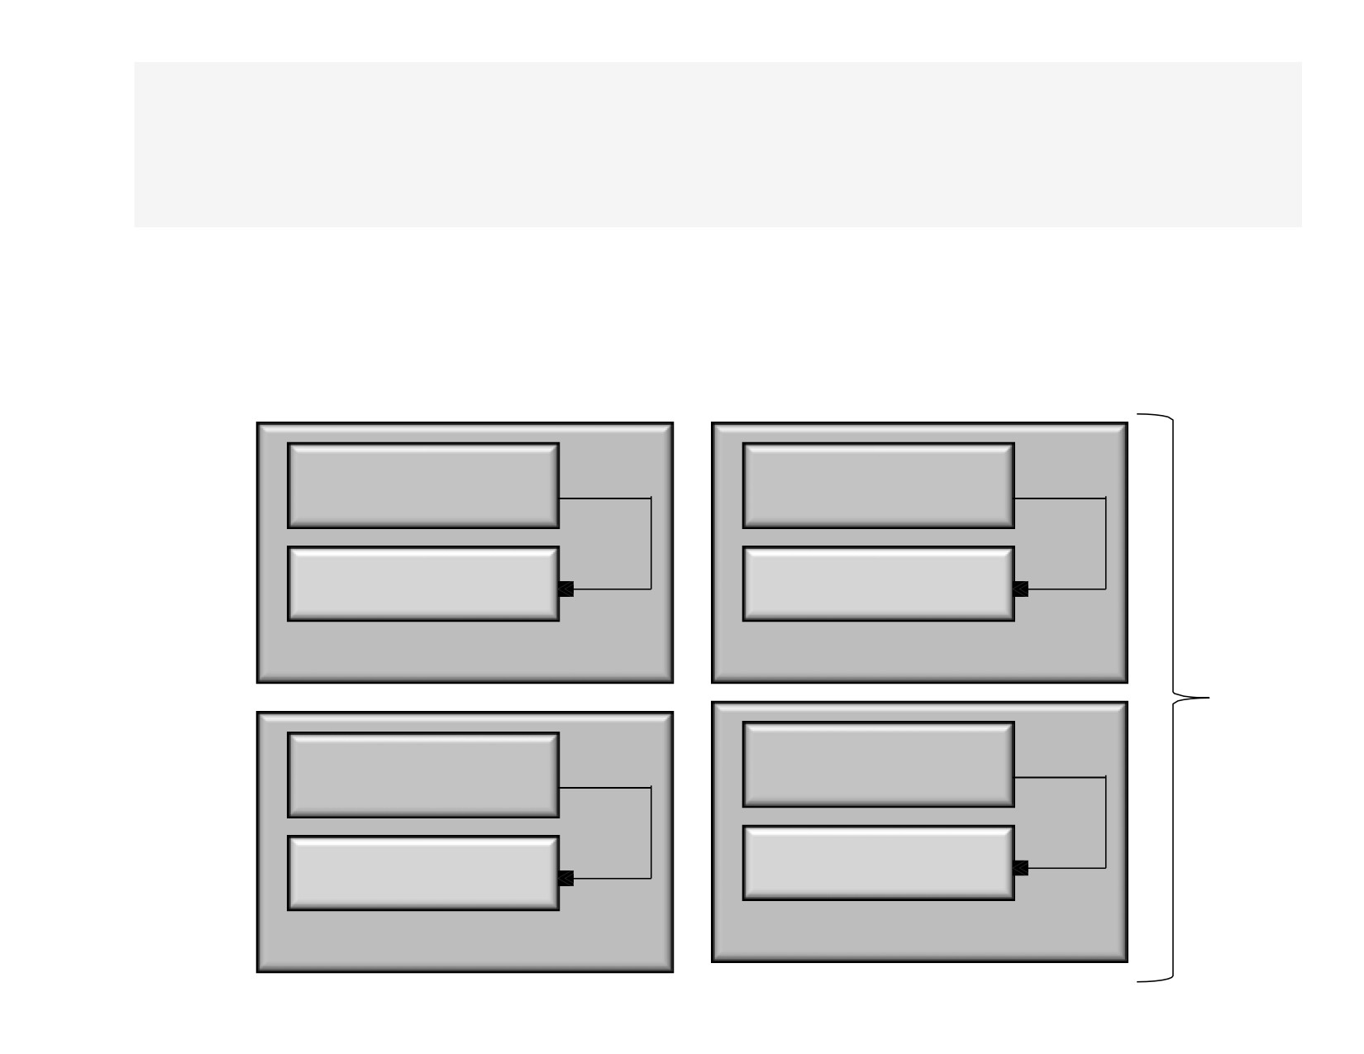
Code to Data
• Hadoop collocates processors and storage
- Code is moved to data (size is tiny, usually in KBs)
- Processors execute code and access underlying local storage
Processor
Processor
Storage
Storage
Hadoop Node
Hadoop Node
Processor
Processor
Storage Hadoop Node
Storage
Hadoop Node
71

Slide 40
Deal With Failures
• Given a large number machines, failures are common
- Large warehouses see machine failures weekly or even daily
- Example
• If you have hardware whose MTTF (Mean Time to Failure is once in 3 years), if you have a 1000 machines, you will see a
machine fail daily
• Hadoop is designed to cope with node failures
- Data is replicated
- Tasks are retried
72

Slide 41
Abstract Complexity
• Abstracts complexities in developing
distributed and concurrent applications
- Defines small number of components
- Provides simple and well defined interfaces of interactions between these components
• Frees developer from worrying about system- level challenges
- race conditions, data starvation, processing pipelines, data partitioning, code distribution, etc...
• Allows developers to focus on application development and business logic
73

Slide 43
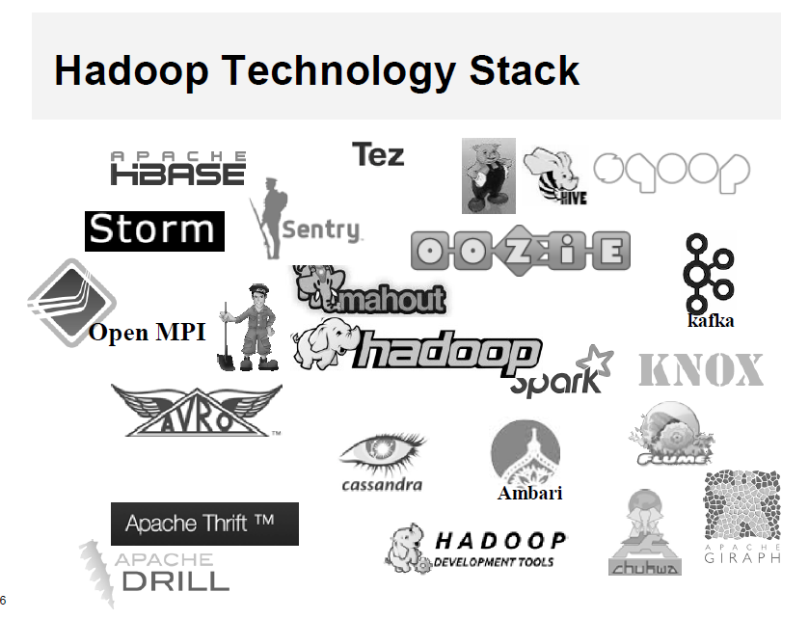
Hadoop Technology Stack
Open MPI
kafka
Ambari
66

Slide 44
Categorizing Hadoop Tech Stack
• Data Integration
• Management
- SQOOP, Flume, Chukwa, Kafka
- Ambari
• Data Serialization
• Orchestration
- Avro, Thrift
- Zookeeper, Oozie
• Data Storage (NOSQL)
• Data Intelligence
- HBase, Cassandra
- Mahout
• Data Access/Analytics
• Security
- Pig, Hive
- Knox, Sentry
• Data Access/Analytics +
• Hadoop Dev Tools
- Giraph, Storm, Drill, Tez,, Spark.
- HDT
67

Slide 45
Hadoop Distributions
•
Offered second commercial
distribution
• Offered first commercial distribution
• 100% open source Hadoop with a
- Cloudera:Hadoop Redhat:Linux
twist
• 100% open source Hadoop with a twist
- Proprietary C++ based filesystem
- Proprietary admin/management console
- Proprietary admin/management
• Cloudera Hadoop Distribution is called CDH
console
- CDH = Cloudera Distribution for Hadoop
• MapR Hadoop Distribution is
called Mseries - M3, M5, M7
•
Third commercial distribution
- Founded for ex-Yahoo Hadoop experts
- Spin-off Yahoo
•
100% open source Hadoop without any twist
- 100% open source when it comes to Hadoop software
– 100% open source admin/management tool calledAmbari
•
Hotonworks Hadoop Distribution is called HDP
- HDP = Hortonworks Data Platform
77

Slide 46
Cloud Hadoop
78

Slide 47
Summary
• Data being generated at a tremendous rate
• Emerging field of Big data analytics and data science
• Businesses using both traditional data analytics and data science
• Traditional data processing not suitable for “Big Data” Processing
• Hadoop has become founding technology for Big data processing, Analytics, and Data Science!
79

Slide 48
80

Slide 49
Tugas
Carilah 1 Contoh Kasus penggunaan Hadoop pada bisnis tertentu:
Jelaskan Langkah-Langkah Proses analisis big datanya?
Apa kelebihan dan kelemahan Hadoop pada bisnis tersebut
Jelaskan cakupan data yang dapat diproses pada kasus tersebut!
Bagaimana model bisnisnya pada penggunaan Hadoop tersebut!

