Slide 1
Algoritma dalam manajemen Big Data dan kompleksitasnya
Yudy Yunardy S.E., M.M.

Slide 2
What is Algorithm
Notes:
Algoritma adalah prosedur langkah demi langkah untuk pemrosesan, yang iteratif

Slide 5
Who is Algorithm

Slide 14
Selection Sort
Recursive algorithm

Slide 33
Merge Sort
Divide & conquer algorithm

Slide 34
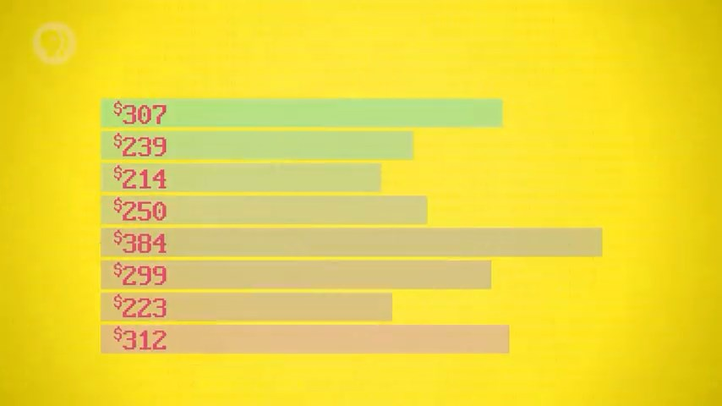

Slide 57
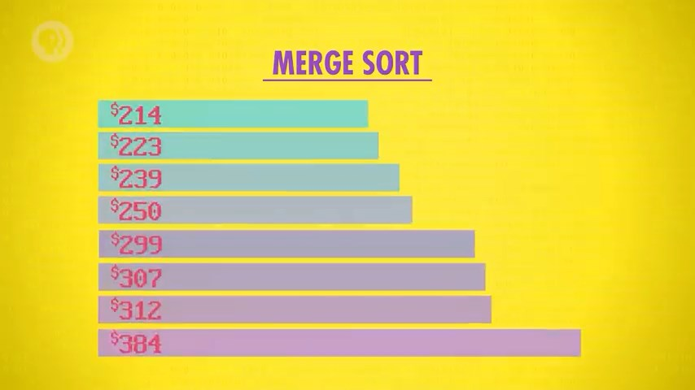

Slide 58
Complexity Theory
Big O rules

Slide 59
Selection Sort

Slide 60
Selection Sort
8²=64
n²
80²=6400

Slide 61
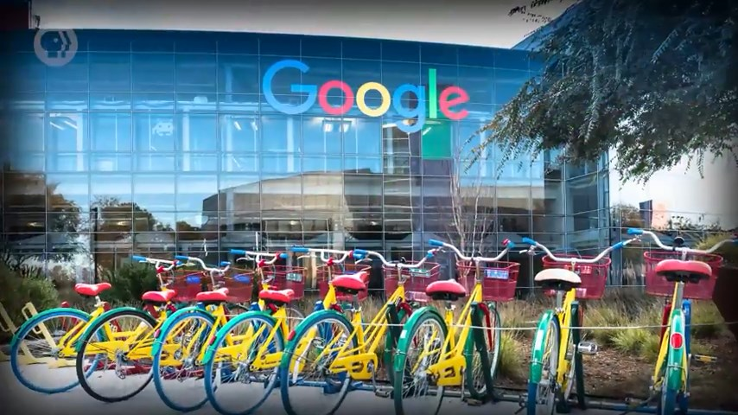

Slide 62
Merge Sort
nlog n
Log₂ 8 = 3
Log₂ 16 = 4
Log₂ 80 ~ 6.3

Slide 64
Effective = Selection and Merge sort
Efficient = Merge sort more efficient

Slide 65
Trade Off

Slide 66
Trade Off

Slide 67
Big Data Reduction Methods
Network Theory
Compression
Data deduplication
Data Preprocessing
Dimension Reduction
Data Mining and Machine Learning

Slide 68
00:00:00
TERIMA KASIH
Jangan lupa mengikuti kuis karena sekaligus merupakan absensi

