Slide 1
Konsep social network
Yudy Yunardy S.E., M.M.

Slide 2
WHAT

Slide 3
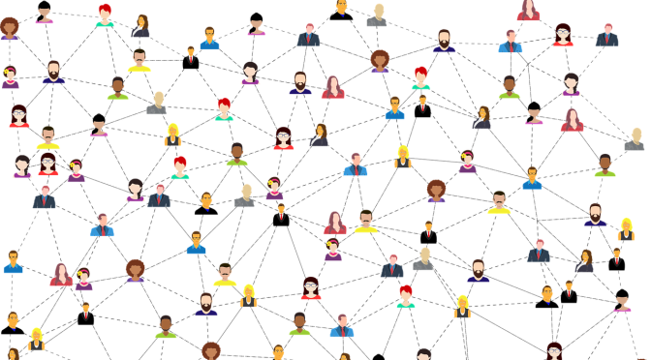
What is Social Network Analysis
Network of people, computer, communication, economy, experts, supply, knowledge
Network means objects and their relations (biological, cooperation, membership)
SNA focuses on people and their relations

Slide 4
Basic Research Issues in SNA
Community Detection
Link Prediction
Opinion Formation and Opinion Dynamics
Influence Propagation
Stability of the network

Slide 5
WHY

Slide 6
Primary kinds of Data
Linkage-based and Structural Analysis
Adding Content-based Analysis

Slide 7
Linkage-based and Structural Analysis
In linkage-based and structural analysis, we construct an analysis of the linkage behavior of the network in order to determine important nodes, communities, links, and evolving regions of the network. To provide a good overview of the global evolution behavior of the underlying network.

Slide 8
Adding Content-based Analysis
Many social networks such as Flickr, Message Networks, and Youtube contain a tremendous amount of content which can be leveraged in order to improve the quality of the analysis.

Slide 9
Social Network
Graph connection
Network Measures
Network Models

Slide 10
Graph Connection
Graph Basics
Graph Representation
Types of Graphs
Connectivity in Graphs
Special Graphs
Graph Algorithms

Slide 11
Graph Basics
Nodes
Edges
Degree and Degree Distribution

Slide 12
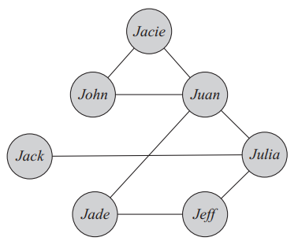
edge
node

Slide 13
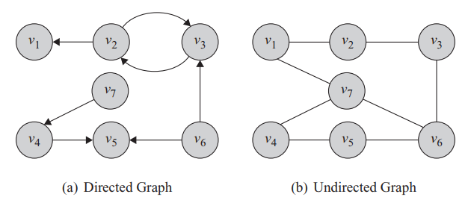
Out-degree
degree
In-degree
Pada directed graph jumlah in-degrees = out-degrees
Jumlah degree pada undirected graph adalah 2x jumlah edges

Slide 14
Graph Representation
Adjacency Matrix
Adjacency List
Edge List

Slide 15
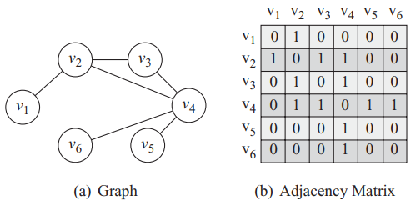
Adjacency Matrix

Slide 16
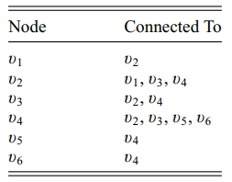
Adjacency List

Slide 17
Edge List

Slide 18
Types of Graphs
Null Graph (no node / edge)
Empty Graph (no edge)
Directed/Undirected/Mixed Graphs
Simple Graphs and Multigraphs
Weighted Graphs

Slide 19
Multigraph
Single graph

Slide 20
Weighted graph
3
5
2
1
4
1
6
9

Slide 21
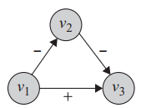
Weighted/signed graph

Slide 22
Connectivity in Graphs
Adjacent Nodes and Incident Edges
Traversing an Edge
Walk, Path, Trail, Tour and Cycle
Connectivity
Components
Shortest Path
Diameter

Slide 23
Adjacent nodes
Incident edges
Adjacent nodes
Two edges are incident when they connected via a node
In directed graph, two edges are incident if the ending of one is the beginning of other
Two nodes are adjacent when they connected via an edge

Slide 24
3
5
2
1
4
1
6
9
v1 to v2 is called traversing edge
v2 to v1 is also called traversing edge
v2 to v3 is called traversing edge
v3 to v2 is NOT traversing edge

Slide 25
3
5
2
1
4
1
6
9
v1 to v2 to v3 is called open walk
v1 to v2 to v3 to v6 to v7 to v1 is called closed walk
v1 to v7 to v6 to v7 to v1 is also called closed walk

Slide 26
3
5
2
1
4
1
6
9
v1 to v2 to v3 is called trail (no edge traversed more than once)
v1 to v2 to v3 to v6 to v7 to v1 is called closed trail (or a circuit)

Slide 27
3
5
2
1
4
1
6
9
3 – 5 – 1 is called path (nodes and edges are distinct)
3 – 5 – 1 – 4 – 2 is called closed path (or a cycle)

Slide 28
Connectivity

Slide 29
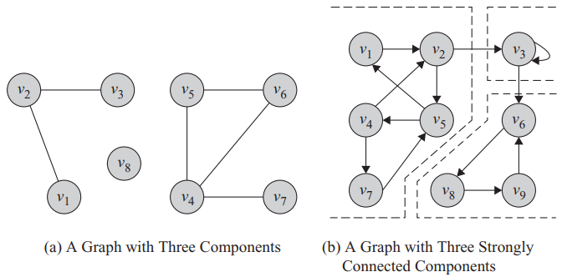
Components in Undirected and Directed Graphs

Slide 30
Shortest Path
3
5
2
1
4
1
6
9

Slide 31
Diameter
v1,v3 = 2
v1,v6 = 2
v1,v7 = 1
v1,v5 = 3
v1,v4 = 2
length of the longest shortest path between any pair of nodes in the graph

Slide 32
V4
V4
V5
V3
V5
V3
V2
V1
V2
V1
V7
V6
V7
V6
V8
V8
V9
V9
V0
V0

Slide 33
Special Graphs
Trees and Forests
Special Subgraphs
Complete Graphs
Planar Graphs
Bipartite Graphs
Regular Graphs
Bridges

Slide 34
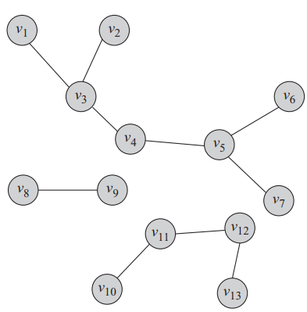
Forest containing 3 trees

Slide 35
Spanning Tree
Spanning tree from v1 to v5 is shown by the blue arrows OR read arrows
3
5
2
1
4
1
Minimum spanning tree from v1 to v5 is the blue arrows (2+1+6) because it’s smaller than red arrows (2+4+9)
6
9

Slide 36
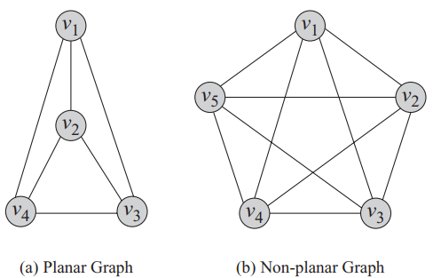

Slide 37
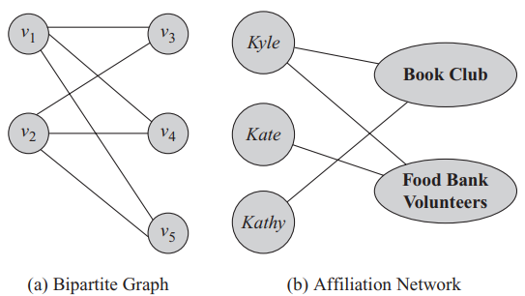

Slide 38
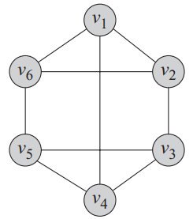
Regular graphs is when all nodes have the same degre
This is the 3-regular graphs (all nodes have 3 degrees/edges attached)

Slide 39
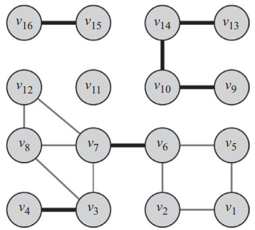
Bridges adalah edge yang jika dihilangkan maka connected graph akan menjadi disconnected graph.
Dalam contoh disamping, garis tebal adalah bridges

Slide 40
Graph Algorithms
Graph/Tree Traversal
Shortest Path Algorithms
Minimum Spanning Trees
Network Flow Algorithms
Maximum Bipartite Matching
Bridge Detection

Slide 41
Network Measures
Centrality
Transitivity and Reciprocity
Balance and Status
Similarity

Slide 42
Centrality
Degree Centrality
Eigenvector Centrality
Katz Centrality
PageRank
Betweenness Centrality
Closeness Centrality
Group Centrality

Slide 43
Transitivity and Reciprocity
Transitivity
Reciprocity

Slide 44
Balance and Status
Social Balance Theory
Social Status Theory

Slide 45
Similarity
Structural Equivalence
Regular Equivalence

Slide 46
Network Models
Real-World Networks
Random Graphs
Small-World Model
Preferential Attachment Model

Slide 47
Real-World Network
Degree Distribution
Clustering Coefficient
Average Path Length

Slide 48
Random Graph
Evolution of Random Graphs
Properties of Random Graphs
Modeling Real-World Network with Random Graphs

Slide 49
Small-World Model
Properties of the Small-World Model
Modeling Real-World Networks with the Small-World Model

Slide 50
Preferential Attachment Model
Properties of the Preferential Attachment Model
Modeling Real-World Networks with the Preferential Attachment Model

Slide 51
Kelompok A
Kelompok B
Mengolah data, pivot, drilldown, visualisasi
Data nasabah bank beserta saldo yg dimilikinya.
Hindsight : apakah ada korelasi antara job - balance ; marital - balance ; education - default ;
Insight : Apa hubungan job - marital - education - default - balance - housing - loan
Foresight : siapakah segmen pasar yg paling profitable, siapakah segmen pasar yg dapat digarap, promotional marketing seperti apakah yg dpt dilakukan
Mengolah data, pivot, drilldown, visualisasi
Data keuangan dan penjualan produk
Hindsight : apakah ada korelasi antara segment - profit ; product - profit ; discount - profit
Insight : Produk apakah yg paling menguntungkan, produk apa yg paling laku di tiap negara, segmen apa yg paling menguntungkan
Foresight : bagaimana meningkatkan penjualan produk yg tidak laku ; bagaimana meningkatkan penjualan produk yg laku ; bagaimana meningkatkan profit secara keseluruhan
Acquire
Prepare
Analyze
Report
Act
Kelompok C
Kelompok D
Mengolah data, pivot, drilldown, visualisasi
Data safety, injury dan cost
Hindsight : apakah ada korelasi antara gender - incident type ; age group - incident type ; injury location - incident type - incident cost
Insight : Incident type apa yg biaya nya paling tinggi, injury location apa, gender apa, age group apa
Foresight : bagaimana mencegah terjadinya insiden dimasa depan, bagaimana menurunkan incident cost
Mengolah data, pivot, drilldown, visualisasi
Data kematian covid-19 dan sebab lainnya
Hindsight : apakah ada korelasi antara jurisdiction occurrence dan covid-19 multiple cause ; apakah ada korelasi antar jurisdiction occurrence dan covid-19 underlying cause ; apakah ada korelasi kematian covid-19 dg kematian sebab lainnya
Insight : daerah mana yg tingkat kematian covid-19 paling tinggi
Foresight : bagaimana menurunkan tingkat kematian covid-19 di tiap jurisdiction, bagaimana mencegah penyebaran covid-19 antar jurisdiction
TUGAS
Kelompok

Slide 52
00:00:00
TERIMA KASIH
Jangan lupa mengikuti kuis karena sekaligus merupakan absensi

