Slide 1
Data Model and Data Mining
Yudy Yunardy S.E., M.M.

Slide 2

Machine Learning

Slide 3
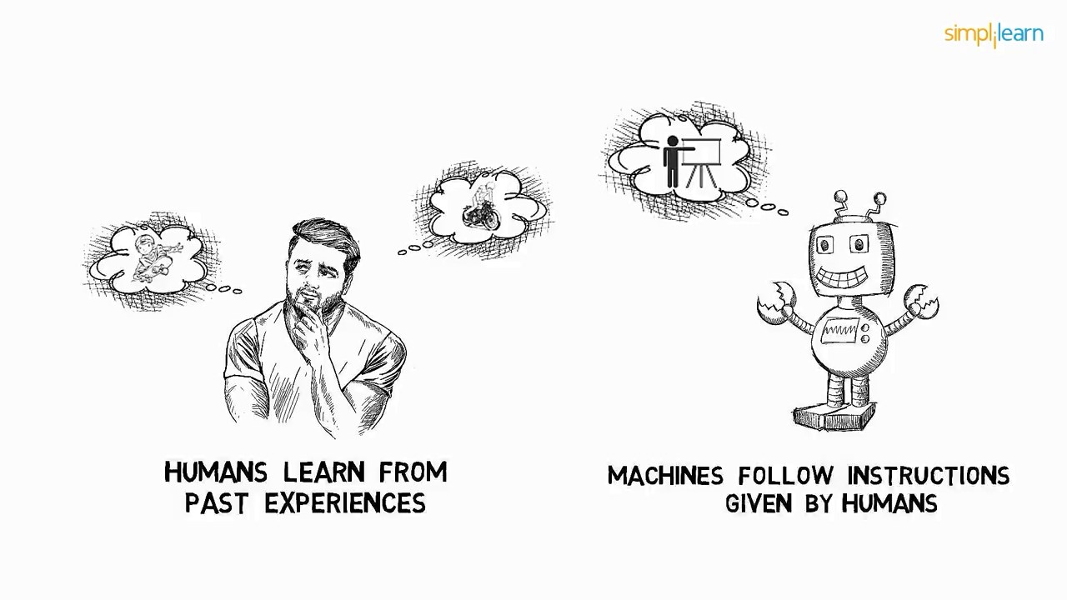

Slide 4
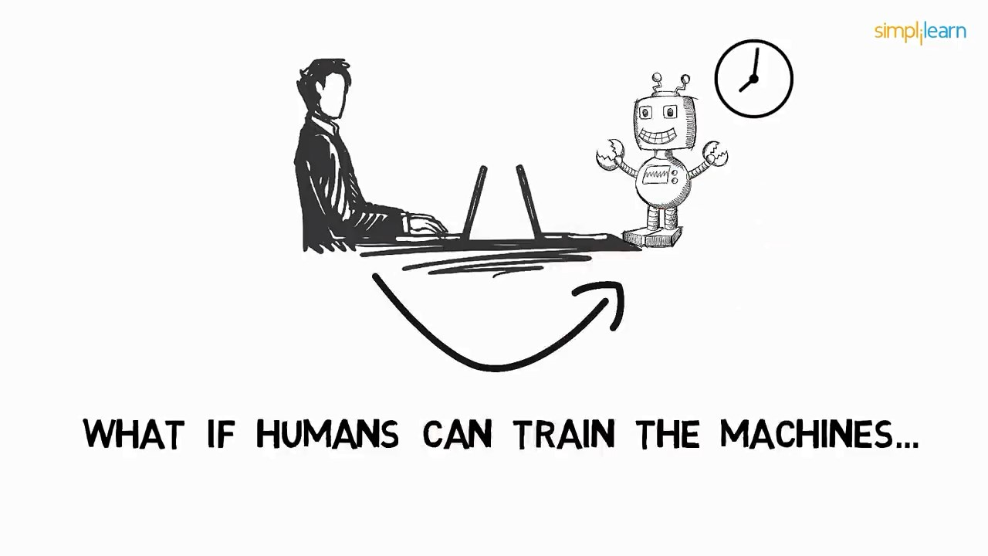

Slide 5
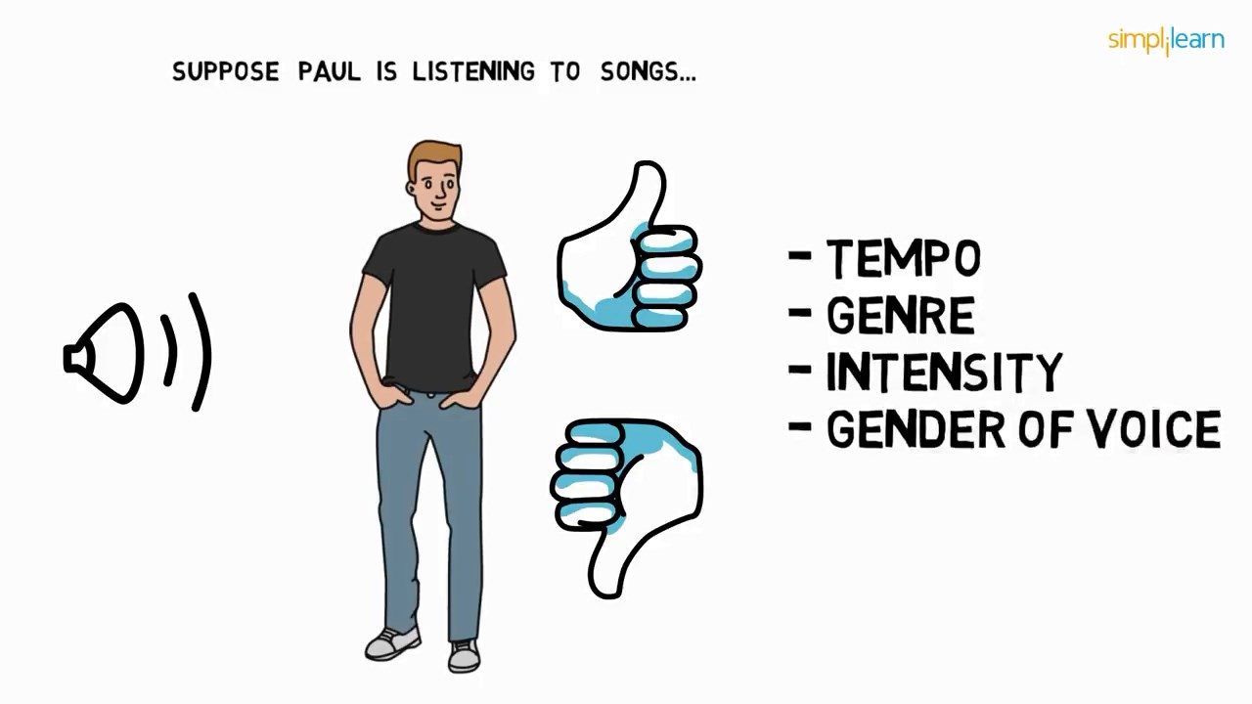

Slide 6
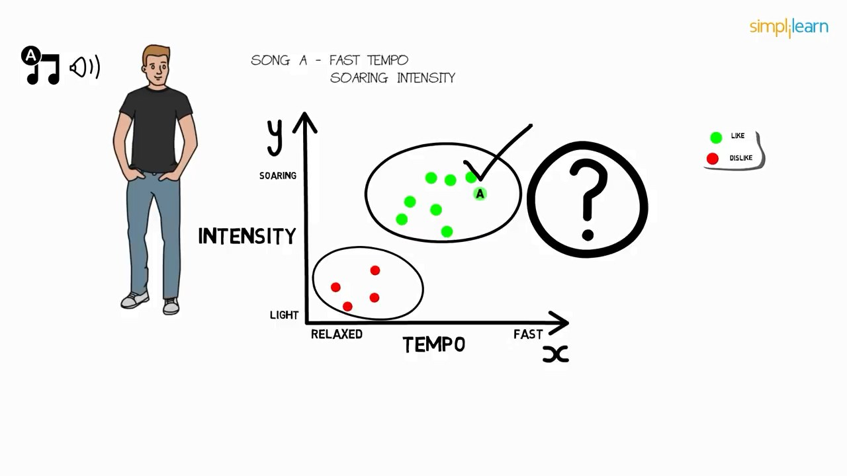

Slide 7
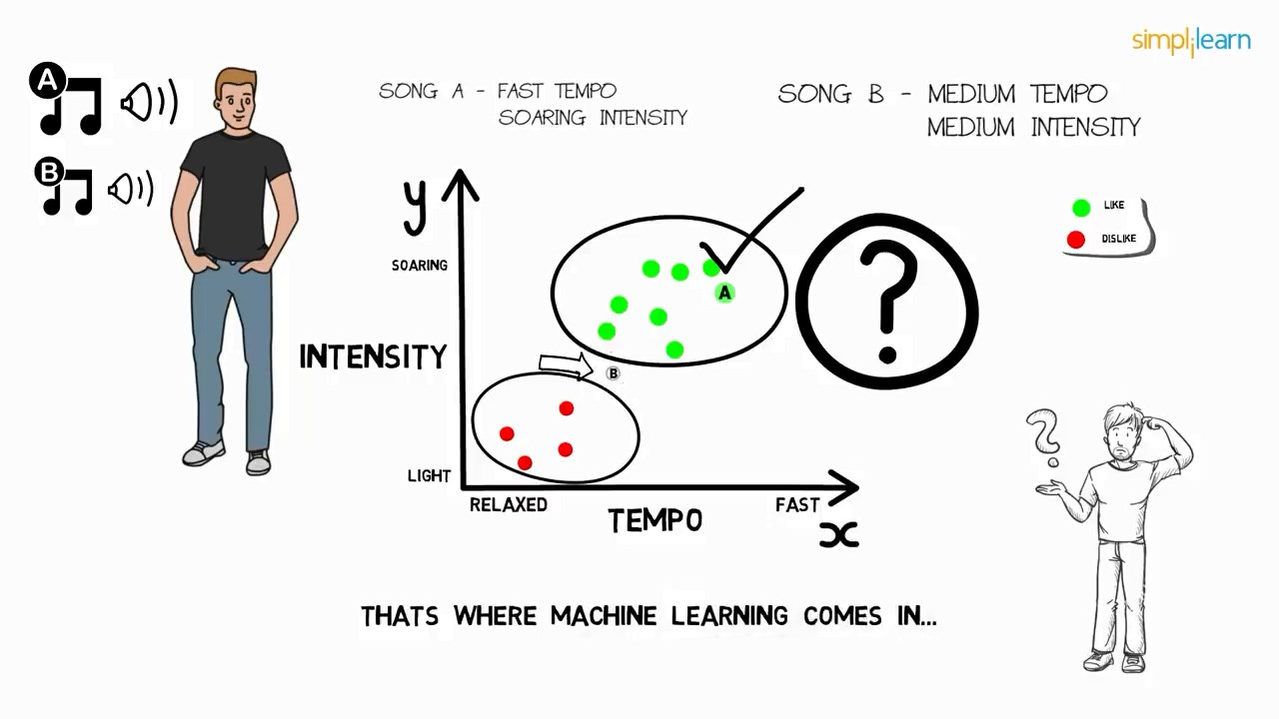

Slide 8
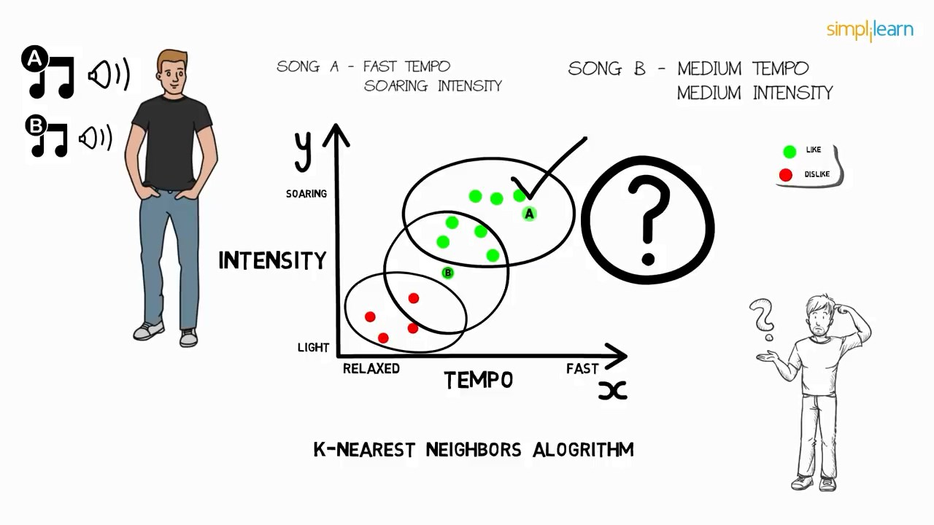

Slide 9
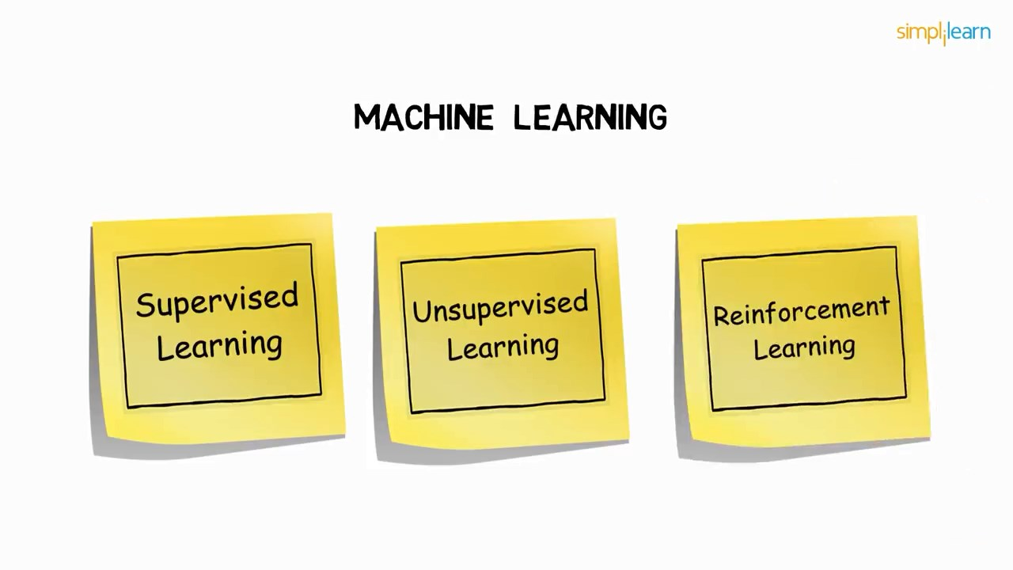

Slide 10
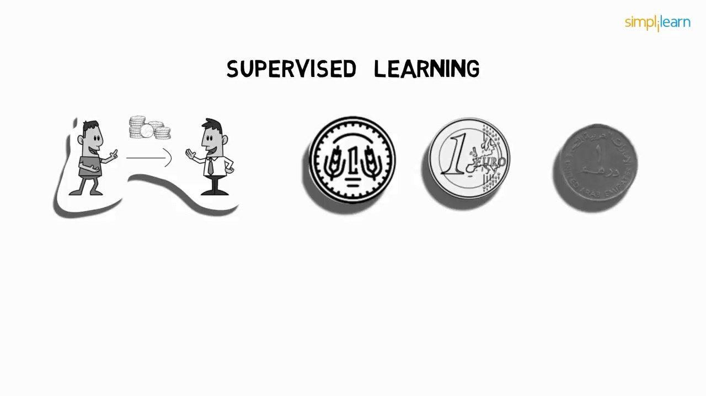

Slide 11
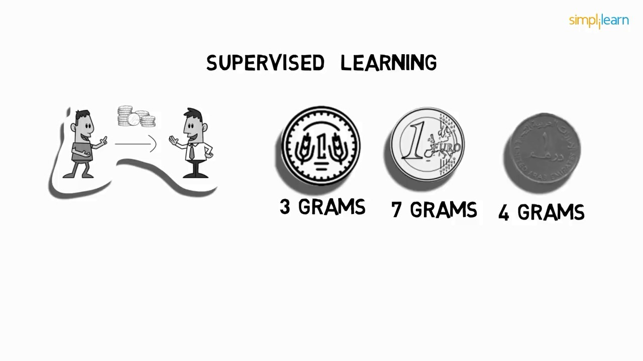

Slide 12
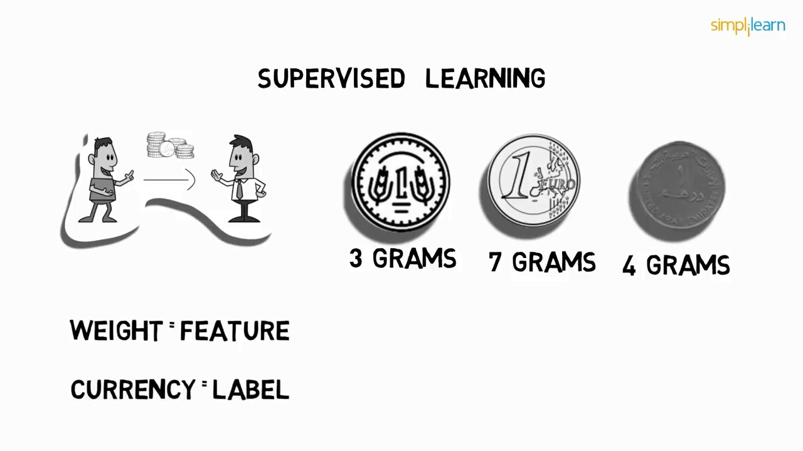

Slide 13
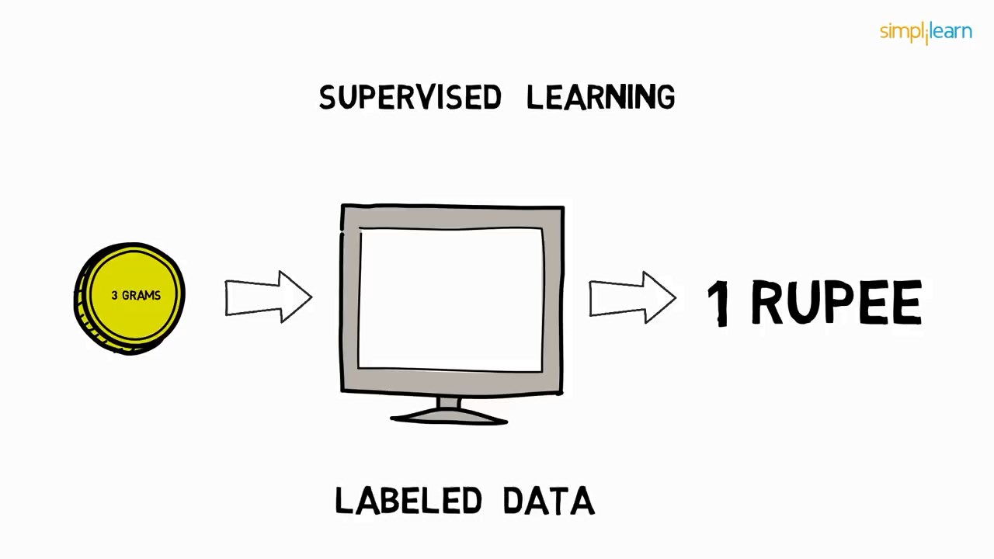

Slide 14
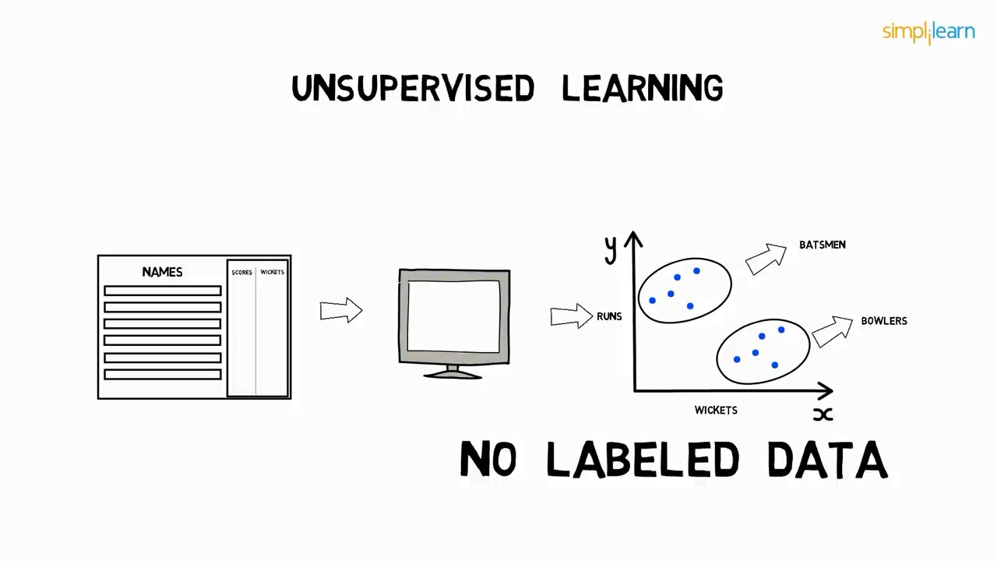

Slide 15
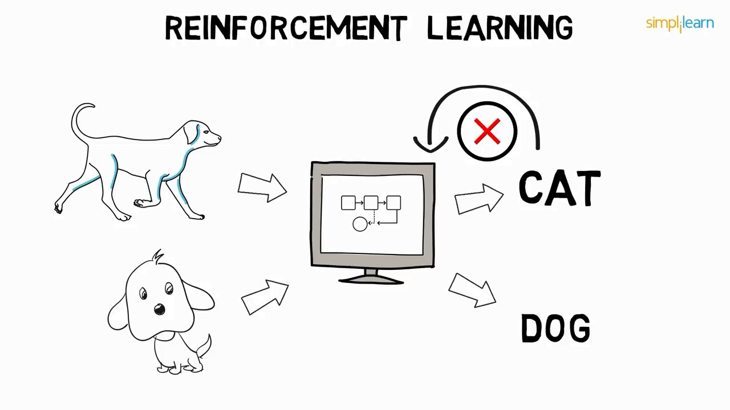

Slide 16
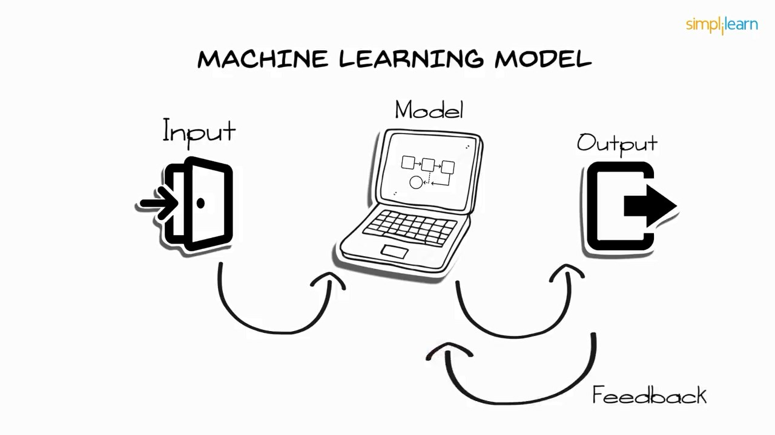

Slide 17

Data Modeling

Slide 18
Pemodelan Data (Data Modeling)
Data modeling – suatu teknik untuk mengorganisasi dan mendokumentasi data sistem. Disebut juga database modeling
Entity relationship diagram (ERD) – suatu model data yang menggunakan beberapa notasi untuk menggambarkan data dalam bentuk entitas dan relasi
Notes:
No additional notes

Slide 19
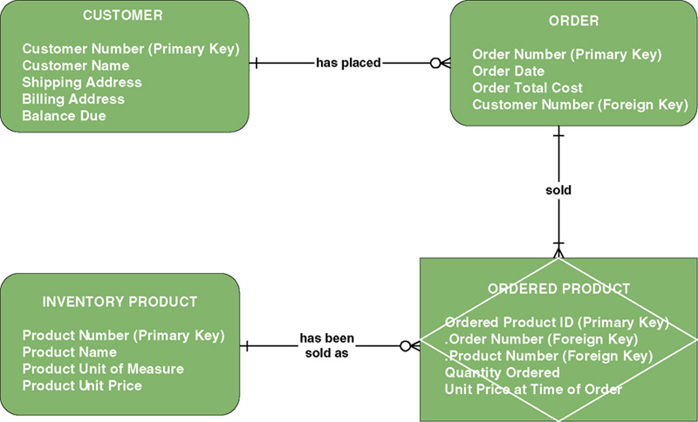
Contoh Entity Relationship Diagram (ERD)
Notes:
Teaching Notes
Be sure to explain that this is merely an example – there are numerous data modeling notations. While they may differ in appearance (symbology) the knowledge that data models are intended to convey the same.

Slide 20
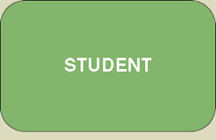
Entitas
suatu objek yang dapat diidentifikasi dalam lingkungan pemakai, sesuatu yang penting bagi pemakai dalam konteks sistem yang akan dibuat
Notes:
Teaching Notes:
Prompt the students for additional examples. Have them classify their example(s).
Obtain a data model from a source other than the textbook. Ask the students to classify the entities.

Slide 21
Entitas
Entity instance
entity
Student ID | Last Name | First Name
2144 | Arnold | Betty
3122 | Taylor | John
3843 | Simmons | Lisa
9844 | Macy | Bill
2837 | Leath | Heather
2293 | Wrench | Tim
instances
Notes:
Teaching Notes
Substitute the name(s) of one or more of your students.
Be sure to explain that these are “instances” and that instances do NOT appear in the names of entity symbols.

Slide 22
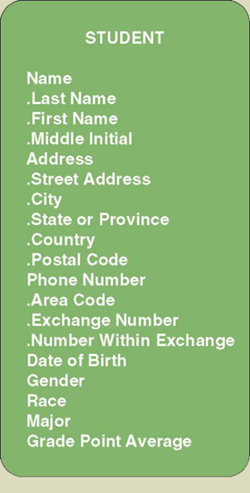
Data Modeling Concepts: Attributes
Atribut mendekripsikan karakteristik (properti) dari suatu entitas
Contoh atribut :
Integer : hanya boleh angka tanpa desimal
Float : hanya boleh angka, dengan decimal
Character : hanya boleh huruf dan tanda baca
Numeric : hanya boleh angka (int + float)
Alphanumeric : character + numeric
Date : hanya boleh angka dlm format tanggal
Time : hanya boleh angka dlm format waktu
Memo : text dengan ukuran tidak terbatas
Yes/No : biner, hanya memiliki dua kemungkinan
Notes:
Teaching Notes:
Go back to the slide showing the sample ERD (Figure 8-1). Pick an entity and ask the students to list attributes that they feel describe those entities.
Show the students a form. Ask the students to identify the attributes. Be sure that the students recognize what items appearing on the form are truly attributes and those that are simply headings or preprinted items. Also, often students accidentally identify attribute values as attributes. For example, they may say that an item that appears as a check box is an attribute when in fact it may be the value of an attribute (ie. Male and female are values, whereas GENDER is the real attribute).

Slide 23
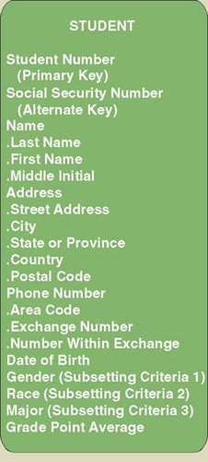
Key
Key – satu atau lebih atribut mempunyai nilai yang unik. Nama lain identifier.
Notes:
Teaching Notes
Students can generally relate to the following example. Suppose you are working for an hourly wage. The employer has some method of tracking the hours you work. Whether that involves a time clock, an identification badge that it scanned, or a log book, the system records a certain number of hours and some employee identifier that says those hours are yours. Without that identifier, come pay day the employer would not know whose hours were whose. The employer might pay someone else for the hours you worked. That’s how important a primary key or identifier is.

Slide 24

Relasi
Menunjukkan hubungan yang terjadi diantara sejumlah entitas yang berasal dari himpunan entitas yang berbeda
Notes:
Teaching Notes
Explain that there may be more than one relationship between two entities. You may reinforce this by adding additional relationships to the example (such as “transferred from” (to reflect a relationship where students changed from one curriculum to another).

Slide 25
Foreign Key
Primary Key
Student ID | Last Name | First Name | Dorm
2144 | Arnold | Betty | Smith
3122 | Taylor | John | Jones
3843 | Simmons | Lisa | Smith
9844 | Macy | Bill
2837 | Leath | Heather | Smith
2293 | Wrench | Tim | Jones
Foreign key – atribut yang merupakan atribut primary key pada entitas yang lain
Primary Key
Foreign Key
Duplicated from primary key of Dorm entity
(not unique in Student entity)
Dorm | Residence Director
Smith | Andrea Fernandez
Jones | Daniel Abidjan
Notes:
Teaching Notes
Foreign keys are what make a relational database relational.

Slide 26
Join Table Query
Student ID | Last Name | First Name | Dorm | Residence Director
2144 | Arnold | Betty | Smith | Andrea Fernandez
3122 | Taylor | John | Jones | Daniel Abidjan
3843 | Simmons | Lisa | Smith | Andrea Fernandez
9844 | Macy | Bill
2837 | Leath | Heather | Smith | Andrea Fernandez
2293 | Wrench | Tim | Jones | Daniel Abidjan
Dorm | Residence Director
Smith | Andrea Fernandez
Jones | Daniel Abidjan
Notes:
Teaching Notes
Foreign keys are what make a relational database relational.

Slide 27
Relational Schema – no duplicate
Student ID | Last Name | First Name | Dorm
2144 | Arnold | Betty | Smith
3122 | Taylor | John | Jones
3843 | Simmons | Lisa | Smith
9844 | Macy | Bill
2837 | Leath | Heather | Smith
2293 | Wrench | Tim | Jones
2293 | Wrench | Tim | Jones
duplicate
Notes:
Teaching Notes
Foreign keys are what make a relational database relational.

Slide 28
Relational Schema – no dissimilar
Student ID | Last Name | First Name | Dorm
2144 | Arnold | Betty | Smith
3122 | Taylor | John | Jones
3843 | Simmons | Lisa | Smith
9844 | Macy | Bill
2837 | Leath | Heather | Smith
2293 | Wrench | Tim | Jones
Tim | Wrench | 2293 | Jones
Not according to structure
Notes:
Teaching Notes
Foreign keys are what make a relational database relational.

Slide 29
Spesialisasi - pemisahan
Spesialisasi : pengelompokkan suatu entitas menjadi entitas-entitas baru (proses top-down)
Notes:
Teaching Notes:
If students have already studied object-oriented modeling, they will be familiar with generalization from that.
Ask the students to identify a generalization example. What are some common attributes? What are some unique attributes associated with the subtype(s)?
One common example is EMPLOYEE (supertype) with HOURLY EMPLOYEE (subtype) and SALARY EMPLOYEE (subtype).

Slide 30
Generalisasi - penggabungan
Generalisasi : entitas-entitas yang mula-mula terpisah kemudian disatukan menjadi satu entitas (proses bottom-up)
Notes:
Teaching Notes:
If students have already studied object-oriented modeling, they will be familiar with generalization from that.
Ask the students to identify a generalization example. What are some common attributes? What are some unique attributes associated with the subtype(s)?
One common example is EMPLOYEE (supertype) with HOURLY EMPLOYEE (subtype) and SALARY EMPLOYEE (subtype).

Slide 31
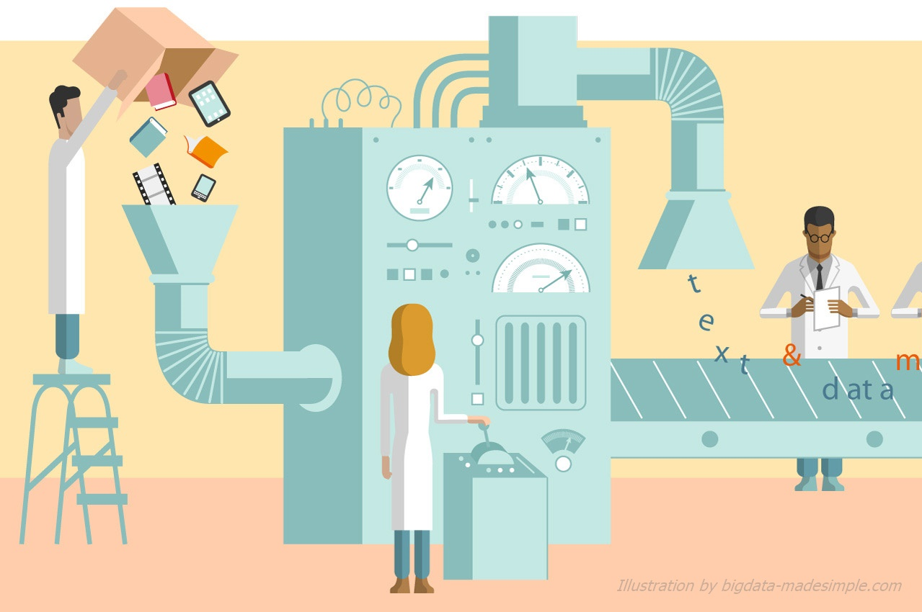
Data Mining

Slide 32
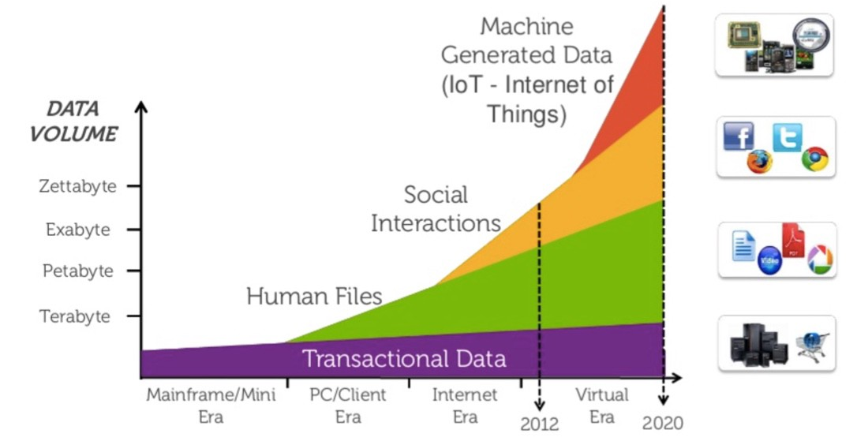
Why Data Mining? Explosion of Data

Slide 33
What Is Data Mining?
Data mining (knowledge discovery from data)
  Extraction of interesting (non-trivial, implicit, previously unknown and potentially useful) patterns or knowledge from huge amount of data
Alternative names
  Knowledge discovery (mining) in databases (KDD), knowledge
  extraction, data/pattern analysis, data archeology, data dredging, information harvesting, business intelligence, etc.

Slide 34
Potential Applications
Data analysis and decision support
  Market analysis and management
    Target marketing, customer relationship management (CRM),
    market basket analysis, cross selling, market segmentation
  Risk analysis and management
    Forecasting, customer retention, improved underwriting, quality
    control, competitive analysis
  Fraud detection and detection of unusual patterns (outliers)
Other Applications
  Text mining (news group, email, documents) and Web mining
  Stream data mining
  Bioinformatics and bio-data analysis

Slide 35
Ex.: Market Analysis and Management
Where does the data come from?—Credit card transactions, loyalty cards,
discount coupons, customer complaint calls, surveys …
Target marketing
  Find clusters of “model” customers who share the same characteristics: interest,
  income level, spending habits, etc.,
    E.g. Most customers with income level 60k – 80k with food expenses $600 - $800 a month live in that area
  Determine customer purchasing patterns over time
    E.g. Customers who are between 20 and 29 years old, with income of 20k – 29k usually buy this type of CD player
Cross-market analysis—Find associations/co-relations between product sales, & predict based on such association
  E.g. Customers who buy computer A usually buy software B

Slide 36
Ex.: Market Analysis and Management (2)
Customer requirement analysis
  Identify the best products for different customers
  Predict what factors will attract new customers
Provision of summary information
  Multidimensional summary reports
    E.g. Summarize all transactions of the first quarter from three different branches
    Summarize all transactions of last year from a particular branch
    Summarize all transactions of a particular product
  Statistical summary information
    E.g. What is the average age for customers who buy product A?
Fraud detection
  Find outliers of unusual transactions
Financial planning
  Summarize and compare the resources and spending

Slide 37
A typical DM System Architecture
Database, data warehouse, WWW or other information
repository (store data)
Database or data warehouse server (fetch and
combine data)
Knowledge base (turn data into meaningful groups
according to domain knowledge)
Data mining engine (perform mining tasks)
Pattern evaluation module (find interesting patterns)
User interface (interact with the user)

Slide 38
On What Kinds of Data?
Database-oriented data sets and applications
  Relational database, data warehouse, transactional database
Advanced data sets and advanced applications
  Object-Relational Databases
  Temporal Databases, Sequence Databases, Time-Series databases
  Spatial Databases and Spatiotemporal Databases
  Text databases and Multimedia databases
  Heterogeneous Databases and Legacy Databases
  Data Streams
  The World-Wide Web

Slide 39
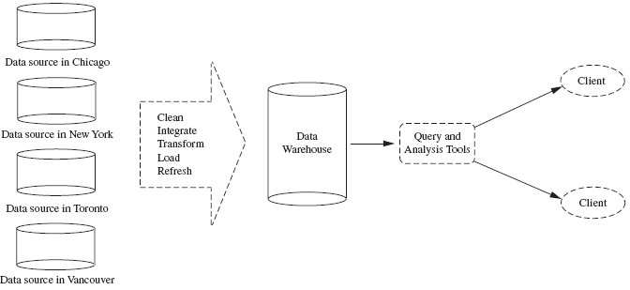
Data Warehouses
A repository of information collected from multiple sources, stored
under a unified schema, and that usually resides at a single site.
Constructed via a process of data cleaning, data integration, data
transformation, data loading and periodic data refreshing.

Slide 40
Data Mining Functionalities
- What kinds of patterns can be mined?
Concept/Class Description: Characterization and Discrimination
  Data can be associated with classes or concepts.
    E.g. classes of items – computers, printers, …
    concepts of customers – bigSpenders, budgetSpenders, …
    How to describe these items or concepts?
  Descriptions can be derived via
    Data characterization – summarizing the general characteristics of a
    target class of data.
      E.g. summarizing the characteristics of customers who spend more than $1,000 a year
      at AllElectronics. Result can be a general profile of the customers, such as 40 – 50 years old, employed, have excellent credit ratings.

Slide 41
Data Mining Functionalities
- What kinds of patterns can be mined?
    Data discrimination – comparing the target class with one or a set of
    comparative classes
      E.g. Compare the general features of software products whole sales increase by 10% in the last year with those whose sales decrease by 30% during the same period
    Or both of the above
Mining Frequent Patterns, Associations and
Correlations
  Frequent itemset: a set of items that frequently appear
  together in a transactional data set (e.g. milk and bread)
  Frequent subsequence: a pattern that customers tend to purchase product A, followed by a purchase of product B

Slide 42
Data Mining Functionalities
- What kinds of patterns can be mined?
  Association Analysis: find frequent patterns
    E.g. a sample analysis result – an association rule:
    buys(X, “computer”) => buys(X, “software”) [support = 1%, confidence = 50%]
    (if a customer buys a computer, there is a 50% chance that she will buy software. 1% of all of the transactions under analysis showed that computer and software
    are purchased together. )
    Associations rules are discarded as uninteresting if they do not satisfy both a minimum support threshold and a minimum confidence threshold.
  Correlation Analysis: additional analysis to find statistical correlations between associated pairs

Slide 43
Data Mining Functionalities
- What kinds of patterns can be mined?
Classification and Prediction
  Classification
    The process of finding a model that describes and distinguishes the data classes or concepts, for the purpose of being able to use the model to predict the class of
    objects whose class label is unknown.
    The derived model is based on the analysis of a set of training data (data objects whose class label is known).
    The model can be represented in classification (IF-THEN) rules, decision trees,
    neural networks, etc.
  Prediction
    Predict missing or unavailable numerical data values

Slide 44
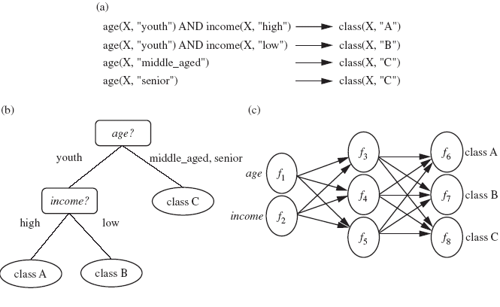
Data Mining Functionalities
- What kinds of patterns can be mined?

Slide 45
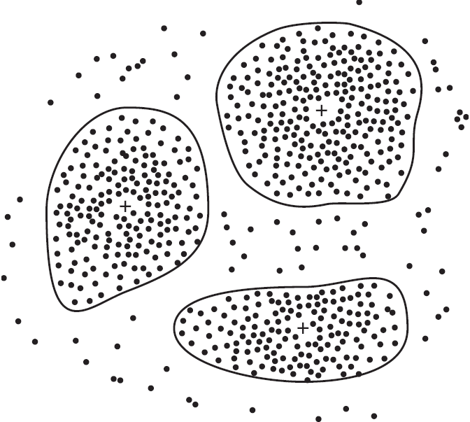
Data Mining Functionalities (2)
Cluster Analysis
  Class label is unknown: group data to form new classes
  Clusters of objects are formed based on the principle of maximizing intra-class similarity & minimizing interclass similarity
    E.g. Identify homogeneous subpopulations of customers. These clusters may
    represent individual target groups for marketing.

Slide 46
Data Mining Functionalities (2)
Outlier Analysis
  Data that do no comply with the general behavior or model.
  Outliers are usually discarded as noise or exceptions.
  Useful for fraud detection.
    E.g. Detect purchases of extremely large amounts
Evolution Analysis
  Describes and models regularities or trends for objects whose
  behavior changes over time.
    E.g. Identify stock evolution regularities for overall stocks and for the stocks of
    particular companies.

Slide 47
Monte Carlo Simulation/Prediction
1
2

Slide 48
Monte Carlo Simulation/Prediction
3
5
4

Slide 49
Are All of the Patterns Interesting?
Objective measures
  Based on statistics and structures of patterns, e.g., support, confidence, etc. (Rules that do not satisfy a threshold are considered uninteresting.)
Subjective measures
  Reflect the needs and interests of a particular user.
    E.g. A marketing manager is only interested in characteristics of customers who shop
    frequently.
  Based on user’s belief in the data.
    e.g., Patterns are interesting if they are unexpected, or can be used for strategic planning, etc
Objective and subjective measures need to be combined.

Slide 50
Are All of the Patterns Interesting?
Find all the interesting patterns: Completeness
  Unrealistic and inefficient
  User-provided constraints and interestingness measures should be used
Search for only interesting patterns: An optimization problem
  Highly desirable
  No need to search through the generated patterns to identify truly
  interesting ones.
  Measures can be used to rank the discovered patterns according their
  interestingness.

Slide 51
Classification of data mining systems
Database
  Relational, data warehouse, transactional, stream, object-oriented/relational, active, spatial, time-series, text, multi-media, heterogeneous, legacy, WWW
Knowledge
  Characterization, discrimination, association, classification, clustering, trend/deviation, outlier analysis, etc.
  Multiple/integrated functions and mining at multiple levels
Techniques utilized
  Database-oriented, data warehouse (OLAP – OnLine Analytical Processing), machine learning, statistics, visualization, etc.
Applications adapted
  Retail, telecommunication, banking, fraud analysis, bio-data mining, stock
  market analysis, text mining, Web mining, etc.

Slide 52
How Data Analysis In Sports Is Changing The Game
Helping Teams Win
Driving Customer Engagement
Benefiting The Broader Ecosystem
Improving Back-Office Intelligence
Expanding Partnerships

Slide 53
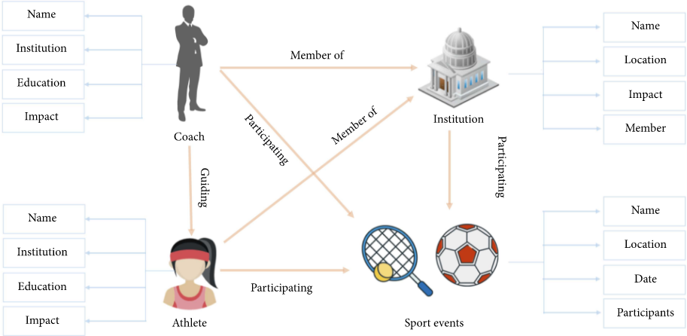
Entities and their relationships associated in sports big data

Slide 54
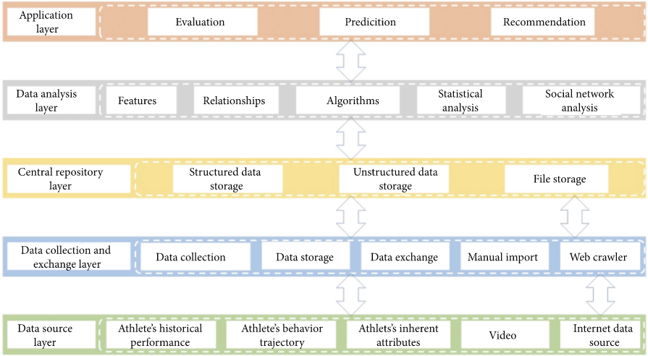
A framework of sports big data platform

Slide 55
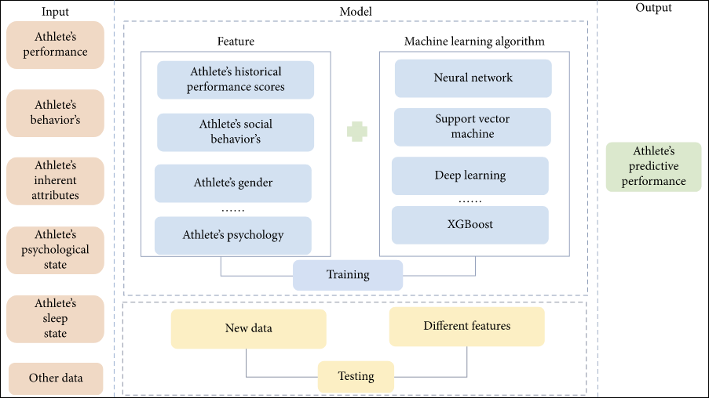
A model for predicting athlete’s performance

Slide 56
00:00:00
TERIMA KASIH
Jangan lupa mengikuti kuis karena sekaligus merupakan absensi

