Slide 1
Machine Learning dan Artificial Intelligence

Slide 2
Materi
AGENDA
• Tren otomatisasi
•Lanskap
• Komponen Machine Learning
• Dasar Machine Learning
• The Electronic Brain • Takeaway

Slide 3
Tren otomatisasi
Manual vs otomatisasi
Peningkatan Beban Biaya Tenaga Kerja
Kondisi Kerja Buruk
foxconn
Berulang dan berbahaya
Efisiensi 60k pekerjaan
Perampingan lini produksi
Brand-value meningkat
Barang elektronik
1,2 juta pegawai
Peningkatan otomatisasi
Perbaikan kondisi kerja
Otomatisasi berhasil meningkatkan value perusahaan

Slide 4
Tren otomatisasi
OECD rata-rata 57%
Thailand 72%
Nigeria 65%
Argentina 65%
Kamboja 77%
India 69%
Cina 77%
Malaysia 67%

Slide 5
Tren otomatisasi
• Pendanaan venture capital maupun korporasi mencapai USD 1 MM @ 2016
JEPANG 556 9 Co.
EROPA 115 2 Co.
USA 158 2 Co.
KOREA 75 2 Co.
Jumlah hak paten terkait kecerdasan buatan
Powerful Computers
Algoritma Cerdas
Sistem AI terdedikasi
Kecukupan data
Fast Decision Making
Correct Decision Made

Slide 6
LANSKAP KECERDASAN BUATAN
Kecerdasan Buatan (Artificial Intelligence)
Machine Learning
Natural Language Processing
Expert Systems
Speech
Vision
Planning
Robotics
Machine Learning
→ Memberi kemampuan kepada mesin untuk secara mandiri belajar berdasarkan pengalaman (data)
Data
Algoritma
Prediksi

Slide 7
KOMPONEN MACHINE LEARNING
7. https://www.linkedin.com/pulse/20140822073217-180198720-6-components-of-a-machine-learning-algorithm ✓ Informasi yang dapat mengidentifik asi data Pengambilan Fitur ✓ Pemilihan subset fitur yang relevan untuk dipakai dari keseluruhan fitur yang dapat diukur Pemilihan Fitur ✓ Pemilihan algoritma decision making yang akan digunakan (naïve bayes, support vector machines, decision tree, K-means clustering, dsb) Algoritma ✓ Melakukan tuning terhadap algoritma menggunakan data yang sudah diketahui sebelumnya Pelatihan ✓ Presisi ✓ Recall ✓ Sensitivitas ✓ Rasio error Evaluasi Hasil Pelatihan ✓ Menguji akurasi algoritma yang sudah dipilih Pengujian

Slide 8
Tren otomatisasi
8. DASAR MACHINE LEARNING 0,5 M 1 M 1,5 M 2 M HARGA LUAS200 m2 500 m2 1000 m2 ?? 1,5 M0,5 M Luis Serrano – A Friendly Introduction to Machine Learning Luis Serrana - A friendly introduction to Deep Learning and Neural Networks

Slide 9
Tren otomatisasi
9. DASAR MACHINE LEARNING A B C D A + B + C + D = Error Luis Serrano – A Friendly Introduction to Machine Learning Luis Serrana - A friendly introduction to Deep Learning and Neural Networks

Slide 10
Tren otomatisasi
10. DASAR MACHINE LEARNING A B C D A + B + C + D = Nilai error terkecil Goal function Error function Luis Serrano – A Friendly Introduction to Machine Learning Luis Serrana - A friendly introduction to Deep Learning and Neural Networks

Slide 11
Tren otomatisasi
11. THE ELECTRONIC BRAIN Error = + + + + + +True blue True red True blue True red 0,9 0,7 0,6 0,1 0,7 0,7 0,9 P = 0,7x 0,9 x 0,6 x 0,1 x 0,7 x 0,9 x 0,7 = 0.0166698 F(Err) = -ln(0,7)-ln(0,9)-ln(0,6)-ln(0,1) -ln(0,7)-ln(0,9)-ln(0,7) = 4,1 True blue True red 0,9 0,7 0,6 0,6 0,7 0,7 0,9 P = 0,7x 0,9 x 0,6 x 0,6 x 0,7 x 0,9 x 0,7 = 0.1000188 F(Err) = -ln(0,7)-ln(0,9)-ln(0,6)-ln(0,6) -ln(0,7)-ln(0,9)-ln(0,7) = 2,3 Luis Serrano – A Friendly Introduction to Machine Learning Luis Serrana - A friendly introduction to Deep Learning and Neural Networks

Slide 12
Tren otomatisasi
12. THE ELECTRONIC BRAIN True blue True red(3,1) (10,7) 6x – 7y = 25 X Y 25 6 7 Neuron Luis Serrano – A Friendly Introduction to Machine Learning Luis Serrana - A friendly introduction to Deep Learning and Neural Networks

Slide 13
Tren otomatisasi
13. THE ELECTRONIC BRAIN 6x – 2y = -5 7x – 3y = 1 X Y -5 6 2 X Y 1 7 3 A B Luis Serrano – A Friendly Introduction to Machine Learning Luis Serrana - A friendly introduction to Deep Learning and Neural Networks

Slide 14
Tren otomatisasi
14. A + B 7 5 -2 x x’ y 7x+5x’-2 = y -2 7 5 THE ELECTRONIC BRAIN Luis Serrano – A Friendly Introduction to Machine Learning Luis Serrana - A friendly introduction to Deep Learning and Neural Networks

Slide 15
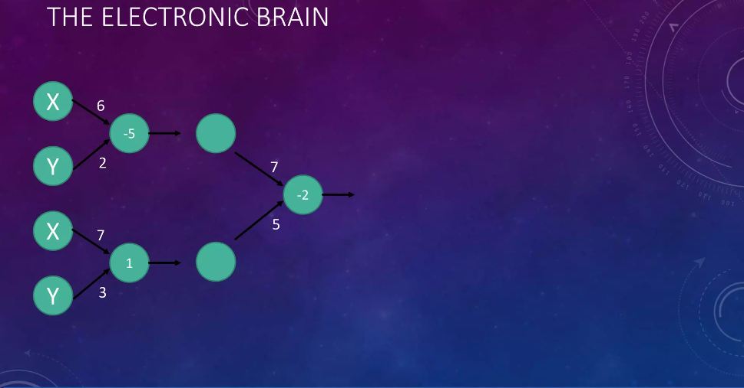
Tren otomatisasi
15. THE ELECTRONIC BRAIN X Y -5 6 2 X Y 1 7 3 -2 7 5 Luis Serrano – A Friendly Introduction to Machine Learning Luis Serrana - A friendly introduction to Deep Learning and Neural Networks

Slide 16
Tren otomatisasi
16. -2 7 5 X -5 6 2 Y 1 7 3 THE ELECTRONIC BRAIN Neural Network → electronic brain Luis Serrano – A Friendly Introduction to Machine Learning Luis Serrana - A friendly introduction to Deep Learning and Neural Networks

Slide 17
Tren otomatisasi
17. THE ELECTRONIC BRAIN Luis Serrano – A Friendly Introduction to Machine Learning Luis Serrana - A friendly introduction to Deep Learning and Neural Networks Deepmind Self-driving Car AlphaGo vs Fan Hui (Eur) (October 2015) : 5 games to 0 for AlphaGo AlphaGo vs Lee Sedol (Kor) (9-15 March 2016) : 4 games to 1 for AlphaGo

Slide 18
Tren otomatisasi
18. TAKEAWAY • Machine learning → disruptor → pemrograman • kompleksitas neural network • code debugability dan kontrol pemrogram • Without oversight AI could be an existential threat: “We are summoning the Demon” https://www.pri.org/stories/2016-05-19/advancement-ai-has-potential-fundamentally-change-how-we-solve-problems https://www.vanityfair.com/news/2017/03/elon-musk-billion-dollar-crusade-to-stop-ai-space-x Jason Tanz – The End of Code and Future of AI Elon Musk -Elon Musk at the Vanity Fair Summit: Artificial Intelligence Could Wipe Out Humanity

Slide 19
Tugas
Jawablah pertanyaan di bawah ini:
Apa yang dimaksud Machine Learning dan Artificial Intelligence ?
Apa saja komponen dari Machine Learning ?
Bagaimana pemanfaatan Machine Learning pada industry fintech ?
Apa saja kelebihan dan kekurangan dari Machine Learning !
Bagaimana perkembangan Machine Learning di Indonesia!

Slide 20
TERIMAKSIH

