Slide 1

Operations and Productivity
1
PowerPoint presentation to accompany
Heizer, Render, Munson
Operations Management, Twelfth Edition, Global Edition
Principles of Operations Management, Tenth Edition, Global Edition
PowerPoint slides by Jeff Heyl

Slide 2
Outline
Global Company Profile: Hard Rock Cafe
What Is Operations Management?
Organizing to Produce Goods and Services
The Supply Chain
Why Study OM?
What Operations Managers Do

Slide 3
Outline - Continued
The Heritage of Operations Management
Operations for Goods and Services
The Productivity Challenge
Current Challenges in Operations Management
Ethics, Social Responsibility, and Sustainability

Slide 4

Operations Management at Hard Rock Cafe
First opened in 1971
  Now – 150 restaurants in over 53 countries
Rock music memorabilia
Creates value in the form of good food and entertainment
3,500+ custom meals per day in Orlando
How does an item get on the menu?
Role of the Operations Manager

Slide 5
Learning Objectives
When you complete this chapter you should be able to:
1.1 Define operations management
1.2 Explain the distinction between goods and services
1.3 Explain the difference between production and productivity

Slide 6
Learning Objectives
When you complete this chapter you should be able to:
1.4 Compute single-factor productivity
1.5 Compute multifactor productivity
1.6 Identify the critical variables in enhancing productivity

Slide 7
What Is Operations Management?
Production is the creation of goods and services
Operations management (OM) is the set of activities that create value in the form of goods and services by transforming inputs into outputs

Slide 8
Organizing to Produce Goods and Services
Essential functions:
  1. Marketing – generates demand
  2. Production/operations – creates the product
  3. Finance/accounting – tracks how well the organization is doing, pays bills, collects the money

Slide 9
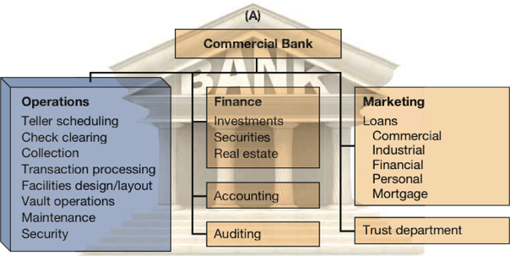
Organizational Charts
Figure 1.1

Slide 10
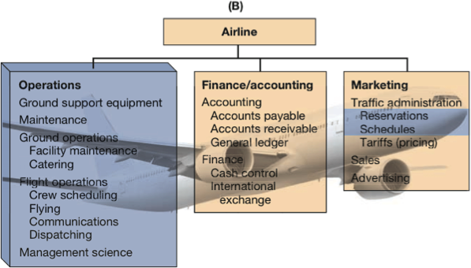
Organizational Charts
Figure 1.1

Slide 11
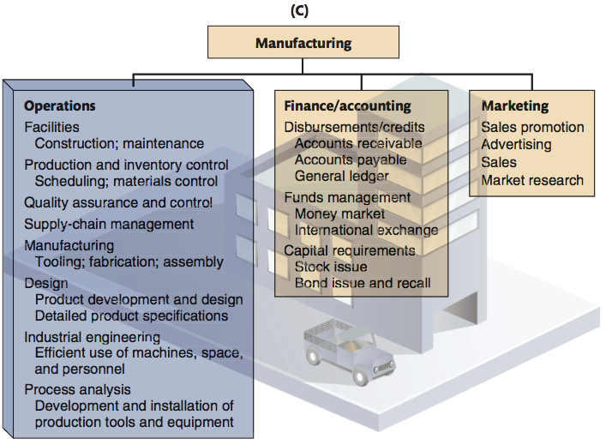
Organizational Charts
Figure 1.1

Slide 12





The Supply Chain
A global network of organizations and activities that supply a firm with goods and services
Members of the supply chain collaborate to achieve high levels of customer satisfaction, efficiency and competitive advantage
Figure 1.2
Farmer Syrup Bottler Distributor Retailer
producer

Slide 13
Why Study OM?
OM is one of three major functions of any organization; we want to study how people organize themselves for productive enterprise
We want (and need) to know how goods and services are produced
We want to understand what operations managers do
OM is such a costly part of an organization

Slide 14
Options for Increasing Contribution
TABLE 1.1
 |  |  |  |  | MARKETING OPTION |  |  | FINANCE/ ACCOUNTING OPTION |  |  | OM OPTION
 |  | CURRENT |  |  | INCREASE SALES REVENUE 50% |  |  | REDUCE FINANCE COSTS 50% |  |  | REDUCE PRODUCTION COSTS 20%
Sales |  |  | $100,000 |  |  | $150,000 |  |  | $100,000 |  |  | $100,000
Cost of goods |  |  | –80,000 |  |  | –120,000 |  |  | –80,000 |  |  | –64,000
Gross margin |  |  | 20,000 |  |  | 30,000 |  |  | 20,000 |  |  | 36,000
Finance costs |  |  | –6,000 |  |  | –6,000 |  |  | –3,000 |  |  | –6,000
Subtotal |  |  | 14,000 |  |  | 24,000 |  |  | 17,000 |  |  | 30,000
Taxes at 25% |  |  | –3,500 |  |  | –6,000 |  |  | –4,200 |  |  | –7,500
Contribution |  |  | $ 10,500 |  |  | $ 18,000 |  |  | $ 12,750 |  |  | $ 22,500

Slide 15

What Operations
Managers Do
Basic Management Functions
Planning
Organizing
Staffing
Leading
Controlling

Slide 16
Ten Strategic Decisions
TABLE 1.2
DECISION |  | CHAPTER(S)
1. Design of goods and services |  | 5, Supplement 5
2. Managing quality |  | 6, Supplement 6
3. Process and capacity strategy |  | 7, Supplement 7
4. Location strategy |  | 8
5. Layout strategy |  | 9
6. Human resources and job design |  | 10
7. Supply-chain management |  | 11, Supplement 11
8. Inventory management |  | 12, 14, 16
9. Scheduling |  | 13, 15
10. Maintenance |  | 17

Slide 17
The Strategic Decisions
Design of goods and services
  Defines what is required of operations
  Product design determines quality, sustainability and human resources
Managing quality
  Determine the customer’s quality expectations
  Establish policies and procedures to identify and achieve that quality
Table 1.2 (cont.)

Slide 18
The Strategic Decisions
Process and capacity design
  How is a good or service produced?
  Commits management to specific technology, quality, resources, and investment
Location strategy
  Nearness to customers, suppliers, and talent
  Considering costs, infrastructure, logistics, and government
Table 1.2 (cont.)

Slide 19
The Strategic Decisions
Layout strategy
  Integrate capacity needs, personnel levels, technology, and inventory
  Determine the efficient flow of materials, people, and information
Human resources and job design
  Recruit, motivate, and retain personnel with the required talent and skills
  Integral and expensive part of the total system design
Table 1.2 (cont.)
Notes:
Using this and subsequent slides, you might go through in more detail the decisions of Operations Management. While greater detail is provided by these slides than the earlier one, you may still decide to have the students contribute examples from their own experience.

Slide 20
The Strategic Decisions
Supply chain management
  Integrate supply chain into the firm’s strategy
  Determine what is to be purchased, from whom, and under what conditions
Inventory management
  Inventory ordering and holding decisions
  Optimize considering customer satisfaction, supplier capability, and production schedules
Table 1.2 (cont.)

Slide 21
The Strategic Decisions
Scheduling
  Determine and implement intermediate- and short-term schedules
  Utilize personnel and facilities while meeting customer demands
Maintenance
  Consider facility capacity, production demands, and personnel
  Maintain a reliable and stable process
Table 1.2 (cont.)

Slide 22
Where are the OM Jobs?
Technology/methods
Facilities/space utilization
Strategic issues
Response time
People/team development
Customer service
Quality
Cost reduction
Inventory reduction
Productivity improvement

Slide 23
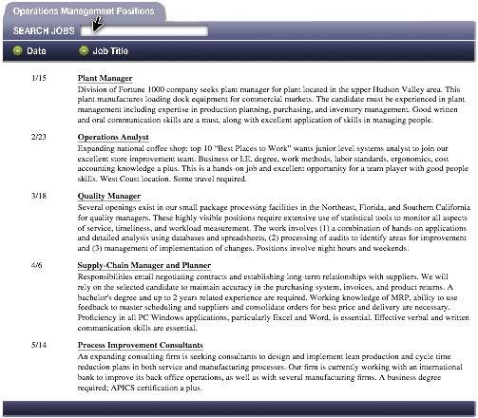
Opportunities
Figure 1.3

Slide 24
Certifications
APICS, the Association for Operations Management
American Society for Quality (ASQ)
Institute for Supply Management (ISM)
Project Management Institute (PMI)
Council of Supply Chain Management Professionals
Charter Institute of Procurement and Supply (CIPS)

Slide 25
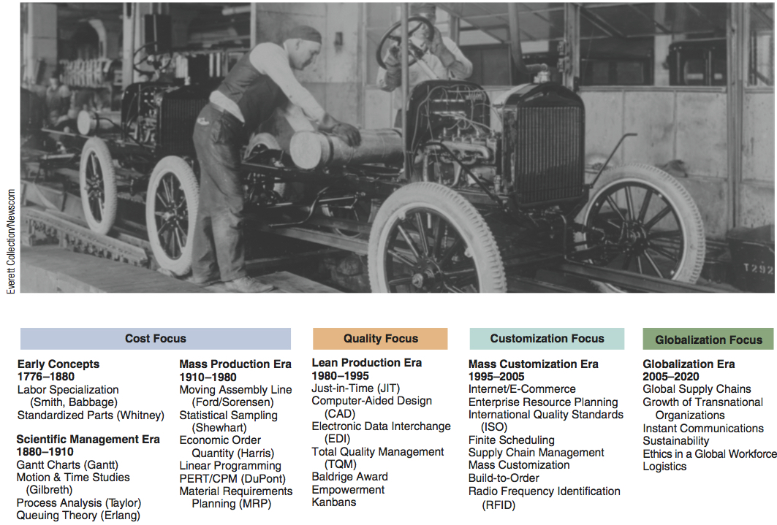
Significant Events in OM
Figure 1.4

Slide 26
The Heritage of OM
Division of labor (Adam Smith 1776; Charles Babbage 1852)
Standardized parts (Whitney 1800)
Scientific Management (Taylor 1881)
Coordinated assembly line (Ford/ Sorenson 1913)
Gantt charts (Gantt 1916)
Motion study (Frank and Lillian Gilbreth 1922)
Quality control (Shewhart 1924; Deming 1950)

Slide 27
The Heritage of OM
Computer (Atanasoff 1938)
CPM/PERT (DuPont 1957, Navy 1958)
Material requirements planning (Orlicky 1960)
Computer aided design (CAD 1970)
Flexible manufacturing system (FMS 1975)
Baldrige Quality Awards (1980)
Computer integrated manufacturing (1990)
Globalization (1992)
Internet (1995)

Slide 28
Eli Whitney
Born 1765; died 1825
In 1798, received government contract to make 10,000 muskets
Showed that machine tools could make standardized parts to exact specifications
  Musket parts could be used in any musket

Slide 29
Frederick W. Taylor
Born 1856; died 1915
Known as ‘father of scientific management’
In 1881, as chief engineer for Midvale Steel, studied how tasks were done
  Began first motion and time studies
Created efficiency principles

Slide 30
Taylor’s Principles
Management Should Take More Responsibility for:
Matching employees to right job
Providing the proper training
Providing proper work methods and tools
Establishing legitimate incentives for work to be accomplished

Slide 31
Frank and Lillian Gilbreth
Frank (1868-1924); Lillian (1878-1972)
Husband and wife engineering team
Further developed work measurement methods
Applied efficiency methods to their home and 12 children!
Book and Movie: “Cheaper by the Dozen,” “Bells on Their Toes”

Slide 32
Henry Ford
Born 1863; died 1947
In 1903, created Ford Motor Company
In 1913, first used moving assembly line to make Model T
  Unfinished product moved by conveyor past work station
Paid workers very well for 1911
($5/day!)

Slide 33
W. Edwards Deming
Born 1900; died 1993
Engineer and physicist
Credited with teaching Japan quality control methods in post-WW2
Used statistics to analyze process
His methods involve workers in decisions

Slide 34
Contributions From
Industrial engineering
Statistics
Management
Economics
Physical sciences
Information technology

Slide 35
Operations for
Goods and Services
Services – Economic activities that typically produce an intangible product (such as education, entertainment, lodging, government, financial, and health services)

Slide 36
Operations for
Goods and Services
Manufacturers produce tangible product, services often intangible
Operations activities often very similar
Distinction not always clear
Few pure services

Slide 37
Differences Between Goods and Services
TABLE 1.3
CHARACTERISTICS OF SERVICES |  | CHARACTERISTICS OF GOODS
Intangible: Ride in an airline seat |  | Tangible: The seat itself
Produced and consumed simultaneously: Beauty salon produces a haircut that is consumed as it is produced |  | Product can usually be kept in inventory (beauty care products)
Unique: Your investments and medical care are unique |  | Similar products produced (iPods)
High customer interaction: Often what the customer is paying for (consulting, education) |  | Limited customer involvement in production
Inconsistent product definition: Auto Insurance changes with age and type of car |  | Product standardized (iPhone)
Often knowledge based: Legal, education, and medical services are hard to automate |  | Standard tangible product tends to make automation feasible
Services dispersed: Service may occur at retail store, local office, house call, or via internet. |  | Product typically produced at a fixed facility
Quality may be hard to evaluate: Consulting, education, and medical services |  | Many aspects of quality for tangible products are easy to evaluate (strength of a bolt)
Reselling is unusual: Musical concert or medical care |  | Product often has some residual value

Slide 38
U.S. Agriculture, Manufacturing, and Service Employment
100 -
80 –
60 –
40 –
20 –
0 .
Figure 1.5
Percent of Workforce
|
|
|
|
|
|
|
|
|
1825
1875
1925
1975
2025 (est.)
1800
1850
1900
1950
2000
Agriculture Services Manufacturing

Slide 39
Organizations in Each Sector
TABLE 1.4
SECTOR |  | EXAMPLE | PERCENT OF ALL JOBS
Service Sector
Education, Medical, Other Trade (retail, wholesale), Transportation Information, Publishers, Broadcast Professional, Legal, Business Services, Associations Finance, Insurance, Real Estate Food, Lodging, Entertainment Public Administration |  | San Diego State University, Arnold Palmer Hospital Walgreen's, Walmart, Nordstrom, Alaska Airlines IBM, Bloomberg, Pearson, ESPN Snelling and Snelling, Waste Management, Inc., American Medical Association, Ernst & Young Citicorp, American Express, Prudential, Aetna Olive Garden, Motel 6, Walt Disney U.S., State of Alabama, Cook County | 15.3 15.8 1.9 13.6 9.6 10.4 15.6 |  | 85.2
Manufacturing Sector |  | General Electric, Ford, U.S. Steel, Intel |  |  | 8.6
Construction Sector |  | Bechtel, McDermott |  |  | 4.3
Agriculture |  | King Ranch |  |  | 1.4
Mining Sector |  | Homestake Mining |  |  | .5
Grand Total |  |  |  |  | 100.0

Slide 40
Service Pay
Perception that services are low-paying
42% of service workers receive above average wages
14 of 33 service industries pay below average
Retail trade pays only 61% of national average
Overall average wage is 96% of the average

Slide 41
Productivity Challenge
Productivity is the ratio of outputs (goods and services) divided by the inputs (resources such as labor and capital)
The objective is to improve productivity!
Important Note!
Production is a measure of output only and not a measure of efficiency

Slide 42
The Economic System
Inputs
Transformation
Outputs
Labor,
capital,
management
The U.S. economic system transforms inputs to outputs at about an annual 2.5% increase in productivity per year. The productivity increase is the result of a mix of capital (38% of 2.5%), labor (10% of 2.5%), and management (52% of 2.5%).
Goods and
services
Feedback loop
Figure 1.6

Slide 43
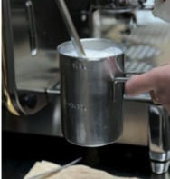
Improving Productivity at Starbucks
A team of 10 analysts continually look for ways to shave time. Some improvements:
Stop requiring signatures on credit card purchases under $25 |  | Saved 8 seconds per transaction
Change the size of the ice scoop |  | Saved 14 seconds per drink
New espresso machines |  | Saved 12 seconds per shot

Slide 44
Improving Productivity at Starbucks
A team of 10 analysts continually look for ways to shave time. Some improvements:
Operations improvements have helped Starbucks increase yearly revenue per outlet by $250,000 to $1,000,000.
Productivity has improved by 27%, or about 4.5% per year.
Stop requiring signatures on credit card purchases under $25 |  | Saved 8 seconds per transaction
Change the size of the ice scoop |  | Saved 14 seconds per drink
New espresso machines |  | Saved 12 seconds per shot

Slide 45
Productivity
Units produced
Input used
Productivity =
Measure of process improvement
Represents output relative to input
Only through productivity increases can our standard of living improve

Slide 46
Productivity Calculations
Labor Productivity
Units produced
Labor-hours used
Productivity =
1,000
250
= = 4 units/labor-hour
One resource input ⇨ single-factor productivity

Slide 47
Multi-Factor Productivity
Output
Labor + Material + Energy + Capital + Miscellaneous
Multifactor =
Also known as total factor productivity
Output and inputs are often expressed in dollars
Multiple resource inputs ⇨ multi-factor productivity

Slide 48
Collins Title Productivity
Old System:
Staff of 4 works 8 hrs/day 8 titles/day
Payroll cost = $640/day Overhead = $400/day
8 titles/day
32 labor-hrs
Old labor productivity
=
= .25 titles/labor-hr

Slide 49
Collins Title Productivity
Old System:
Staff of 4 works 8 hrs/day 8 titles/day
Payroll cost = $640/day Overhead = $400/day
New System:
14 titles/day Overhead = $800/day
8 titles/day
32 labor-hrs
Old labor productivity
=
= .25 titles/labor-hr
14 titles/day
32 labor-hrs
New labor productivity
=
= .4375 titles/labor-hr

Slide 50
Collins Title Productivity
Old System:
Staff of 4 works 8 hrs/day 8 titles/day
Payroll cost = $640/day Overhead = $400/day
New System:
14 titles/day Overhead = $800/day
8 titles/day
$640 + 400
Old multifactor productivity
=
= .0077 titles/dollar

Slide 51
Collins Title Productivity
Old System:
Staff of 4 works 8 hrs/day 8 titles/day
Payroll cost = $640/day Overhead = $400/day
New System:
14 titles/day Overhead = $800/day
8 titles/day
$640 + 400
Old multifactor productivity
=
= .0077 titles/dollar
14 titles/day
$640 + 800
New multifactor productivity
=
= .0097 titles/dollar

Slide 52
Measurement Problems
1. Quality may change while the quantity of inputs and outputs remains constant
2. External elements may cause an increase or decrease in productivity
3. Precise units of measure may be lacking

Slide 53
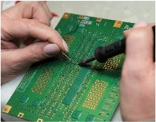
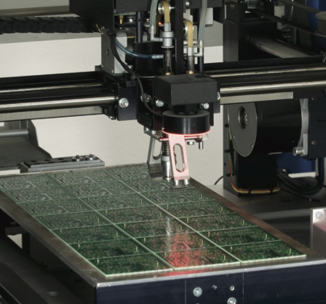
Productivity Variables
1. Labor - contributes about 10% of the annual increase
2. Capital - contributes about 38% of the annual increase
3. Management - contributes about 52% of the annual increase

Slide 54
Key Variables for Improved Labor Productivity
Basic education appropriate for the labor force
Diet of the labor force
Social overhead that makes labor available
Challenge is in maintaining and enhancing skills in the midst of rapidly changing technology and knowledge

Slide 55
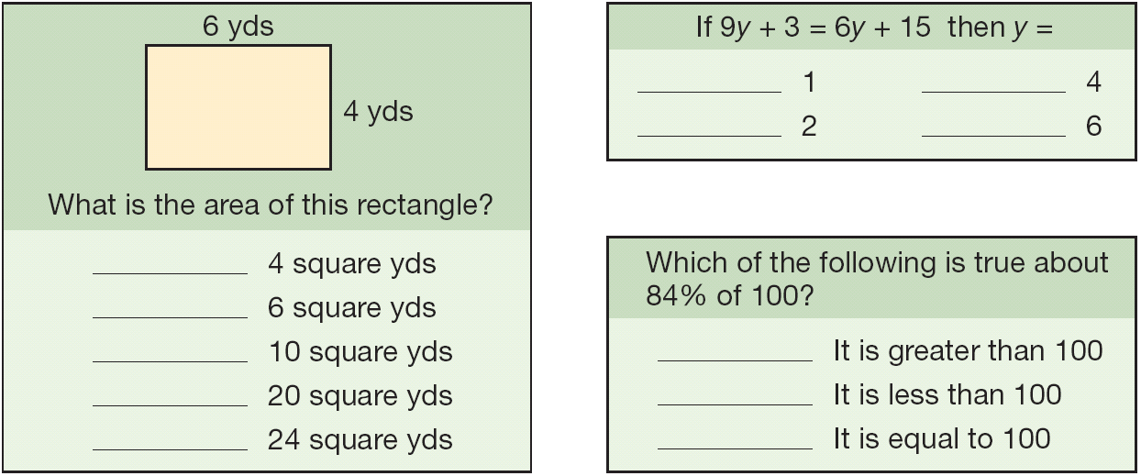
Labor Skills
About half of the 17-year-olds in the U.S. cannot correctly answer questions of this type
Figure 1.7

Slide 56

Capital
10
8
6
4
2
0
Percent increase in productivity
10 15 20 25 30 35
Percentage investment

Slide 57
Management
Ensures labor and capital are effectively used to increase productivity
  Use of knowledge
  Application of technologies
Knowledge societies
  Labor has migrated from manual work to technical and information-processing tasks
More effective use of technology, knowledge, and capital

Slide 58
Productivity in the Service Sector
Productivity improvement in services is difficult because:
Typically labor intensive
Frequently focused on unique individual attributes or desires
Often an intellectual task performed by professionals
Often difficult to mechanize and automate
Often difficult to evaluate for quality

Slide 59

Technology Innovation by Uber
Innovation:
Smartphone application
Peer-to-peer technology
Concept of mobility as a
service
Putting cab seekers directly in touch with nearby cab providers

Slide 60
Productivity at Taco Bell
Results:
Daily car trips reduced by 3% in Stockholm
Number of active cars reduced by 5%
Reduced CO₂ emissions
Reduced emissions expected to generate economic value of up to $22 million
3,000 jobs created in the short-run
Total value of $100 million per year created for the society
Improvements:

Slide 61
Current Challenges in OM
Globalization
Supply-chain partnering
Sustainability
Rapid product development
Mass customization
Lean operations

Slide 62
Ethics, Social Responsibility, and Sustainability
Challenges facing operations managers:
Develop and produce safe, high-quality green products
Train, retrain, and motivate employees in a safe workplace
Honor stakeholder commitments

Slide 63
Ethics, Social Responsibility, and Sustainability
Stakeholders
Those with a vested interest in an organization, including customers, distributors, suppliers, owners, lenders, employees, and community members.
Challenges facing operations managers:
Develop and produce safe, high-quality green products
Train, retrain, and motivate employees in a safe workplace
Honor stakeholder commitments

Slide 64
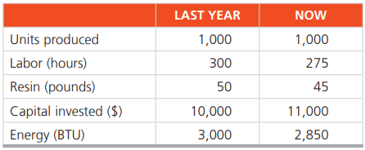
TUGAS
George Kyparisis membuat bola bowling di Miami. Dengan kenaikan biaya baru-baru ini, ia memiliki penemuan baru dalam efisiensi. George tertarik untuk menentukan produktivitas organisasinya. Dia ingin tahu apakah organisasinya dapat mempertahankan peningkatan rata-rata produktivitas 3% per tahun? Dia memiliki data berikut dalam 2 tahun terakhir:
Berapa persen produktivitas dari masing-masing komponen tersebut?
Berapa produktivitas multyfactor kasus tersebut?
Berapa yang harus diproduksi untuk meningkatkan capital invested 40% dari tahun kemarin?

