Slide 1
Aggregate Planning and S&OP
13
PowerPoint presentation to accompany
Heizer, Render, Munson
Operations Management, Twelfth Edition, Global Edition
Principles of Operations Management, Tenth Edition, Global Edition
PowerPoint slides by Jeff Heyl

Slide 2
Learning Objectives
When you complete this chapter you should be able to:
13.1 Define sales and operations planning
13.2 Define aggregate planning
13.3 Identify optional strategies for developing an aggregate plan

Slide 3
Learning Objectives
When you complete this chapter you should be able to:
13.4 Prepare a graphical aggregate plan
13.5 Solve an aggregate plan via the transportation method
13.6 Understand and solve a revenue management problem

Slide 4
The Planning Process
Figure 13.1
Long-range plans (over one year)
Capacity decisions critical to long range plans
Issues:
Research and Development
New product plans
Capital investments
Facility location/expansion
Top executives
Intermediate-range plans (3 to 18 months)
Issues:
Sales and operations planning
Production planning and budgeting
Setting employment, inventory,
subcontracting levels
Analyzing operating plans
Operations managers with sales and operations planning team
Short-range plans (up to 3 months)
Scheduling techniques
Issues:
Job assignments
Ordering
Job scheduling
Dispatching
Overtime
Part-time help
Operations managers, supervisors, foremen
Responsibility
Planning tasks and time horizons

Slide 5
Sales and Operations Planning
Coordination of demand forecasts with functional areas and the supply chain
Typically done by cross-functional teams
Determine which plans are feasible
Limitations must be reflected
Provides warning when resources do not match expectations
Output is an aggregate plan

Slide 6
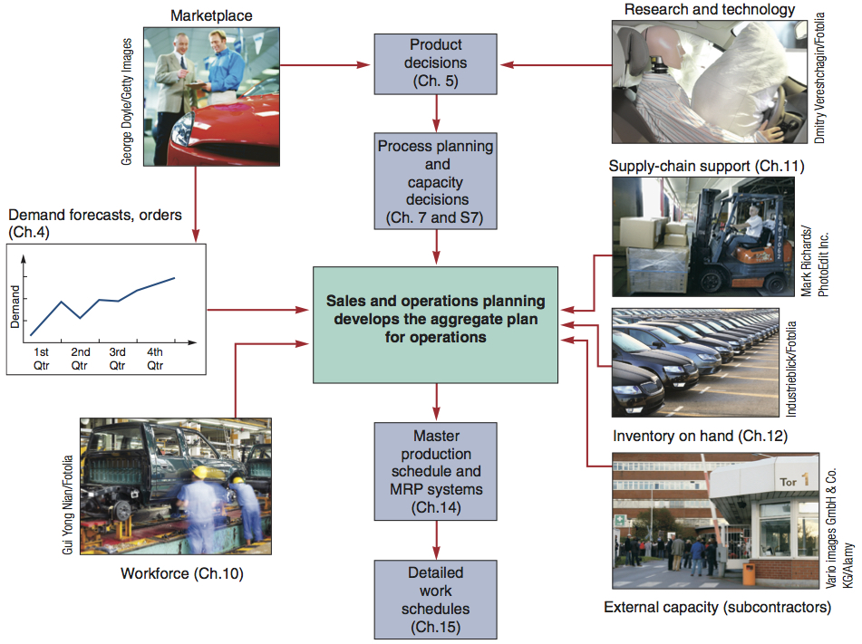
S&OP and the Aggregate Plan
Figure 13.2

Slide 7
Sales and Operations Planning
Decisions must be tied to strategic planning and integrated with all areas of the firm over all planning horizons
S&OP is aimed at
The coordination and integration of the internal and external resources necessary for a successful aggregate plan
Communication of the plan to those charged with its execution

Slide 8
Sales and Operations Planning
Requires
A logical unit for measuring sales and output
A forecast of demand for a reasonable intermediate planning period in aggregate terms
A method to determine the relevant costs
A model that combines forecasts and costs so scheduling decisions can be made for the planning period

Slide 9
Aggregate Planning
The objective of aggregate planning is usually to meet forecast demand while minimizing cost over the planning period

Slide 10
Aggregate Planning
QUARTER 1
Jan. | Feb. | March
150,000 | 120,000 | 110,000
QUARTER 2
April | May | June
100,000 | 130,000 | 150,000
QUARTER 3
July | Aug. | Sept.
180,000 | 150,000 | 140,000

Slide 11
Aggregate Planning
Combines appropriate resources into general terms
Part of a larger production planning system
Disaggregation breaks the plan down into greater detail
Disaggregation results in a master production schedule

Slide 12
Aggregate Planning Strategies
Should inventories be used to absorb changes in demand?
Should changes be accommodated by varying the size of the workforce?
Should part-timers be used, or should overtime or idle time absorb fluctuations?
Should subcontractors be used and maintain a stable workforce?
Should prices or other factors be changed to influence demand?

Slide 13
Capacity Options
Changing inventory levels
Increase inventory in low demand periods to meet high demand in the future
Increases costs associated with storage, insurance, handling, obsolescence, pilferage, and capital investment
Shortages may mean lost sales due to long lead times and poor customer service

Slide 14
Capacity Options
Varying workforce size by hiring or layoffs
Match production rate to demand
Training and separation costs for hiring and laying off workers
New workers may have lower productivity
Laying off workers may lower morale and productivity

Slide 15
Capacity Options
Varying production rates through overtime or idle time
Allows constant workforce
May be difficult to meet large increases in demand
Overtime can be costly and may drive down productivity
Absorbing idle time may be difficult

Slide 16
Capacity Options
Subcontracting
Temporary measure during periods of peak demand
May be costly
Assuring quality and timely delivery may be difficult
Exposes your customers to a possible competitor

Slide 17
Capacity Options
Using part-time workers
Useful for filling unskilled or low skilled positions, especially in services

Slide 18
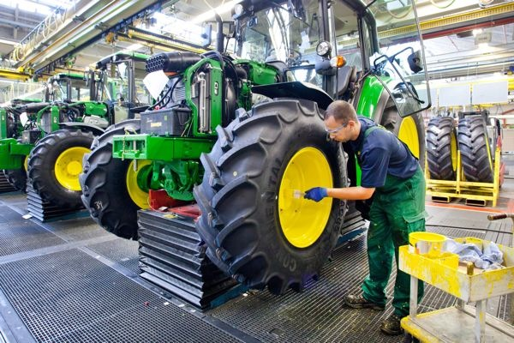
Demand Options
Influencing demand
Use advertising or promotion to increase demand in low periods
Attempt to shift demand to slow periods
May not be sufficient to balance demand and capacity

Slide 19
Demand Options
Back ordering during high-demand periods
Requires customers to wait for an order without loss of goodwill or the order
Most effective when there are few if any substitutes for the product or service
Often results in lost sales

Slide 20
Demand Options
Counterseasonal product and service mixing
Develop a product mix of counterseasonal items
May lead to products or services outside the company’s areas of expertise

Slide 21
Aggregate Planning Options
TABLE 13.1 | Aggregate Planning Options
OPTION | ADVANTAGES | DISADVANTAGES | COMMENTS
Changing inventory levels | Changes in human resources are gradual or none; no abrupt production changes. | Inventory holding cost may increase. Shortages may result in lost sales. | Applies mainly to production, not service, operations.
Varying workforce size by hiring or layoffs | Avoids the costs of other alternatives. | Hiring, layoff, and training costs may be significant. | Used where size of labor pool is large.

Slide 22
Aggregate Planning Options
TABLE 13.1 | Aggregate Planning Options
OPTION | ADVANTAGES | DISADVANTAGES | COMMENTS
Varying production rates through overtime or idle time | Matches seasonal fluctuations without hiring/ training costs. | Overtime premiums; tired workers; may not meet demand. | Allows flexibility within the aggregate plan.
Sub-contracting | Permits flexibility and smoothing of the firm’s output. | Loss of quality control; reduced profits; loss of future business. | Applies mainly in production settings.

Slide 23
Aggregate Planning Options
TABLE 13.1 | Aggregate Planning Options
OPTION | ADVANTAGES | DISADVANTAGES | COMMENTS
Using part-time workers | Is less costly and more flexible than full-time workers. | High turnover/ training costs; quality suffers; scheduling difficult. | Good for unskilled jobs in areas with large temporary labor pools.
Influencing demand | Tries to use excess capacity. Discounts draw new customers. | Uncertainty in demand. Hard to match demand to supply exactly. | Creates marketing ideas. Overbooking used in some businesses.

Slide 24
Aggregate Planning Options
TABLE 13.1 | Aggregate Planning Options
OPTION | ADVANTAGES | DISADVANTAGES | COMMENTS
Back ordering during high-demand periods | May avoid overtime. Keeps capacity constant. | Customer must be willing to wait, but goodwill is lost. | Many companies back order.
Counter-seasonal product and service mixing | Fully utilizes resources; allows stable workforce. | May require skills or equipment outside the firm’s areas of expertise. | Risky finding products or services with opposite demand patterns.

Slide 25
Mixing Options to Develop a Plan
A mixed strategy may be the best way to achieve minimum costs
There are many possible mixed strategies
Finding the optimal plan is not always possible

Slide 26
Mixing Options to Develop a Plan
Chase strategy
Match output rates to demand forecast for each period
Vary workforce levels or vary production rate
Favored by many service organizations

Slide 27
Mixing Options to Develop a Plan
Level strategy
Daily production is uniform
Use inventory or idle time as buffer
Stable production leads to better quality and productivity
Some combination of capacity options, a mixed strategy, might be the best solution

Slide 28
Methods for Aggregate Planning
Graphical Methods
Popular techniques
Easy to understand and use
Trial-and-error approaches that do not guarantee an optimal solution
Require only limited computations

Slide 29
Graphical Methods
Determine the demand for each period
Determine the capacity for regular time, overtime, and subcontracting each period
Find labor costs, hiring and layoff costs, and inventory holding costs
Consider company policy on workers and stock levels
Develop alternative plans and examine their total cost

Slide 30
Roofing Supplier Example 1
TABLE 13.2 |  | Monthly Forecasts
MONTH | EXPECTED DEMAND |  | PRODUCTION DAYS | DEMAND PER DAY (COMPUTED)
Jan | 900 |  | 22 | 41
Feb | 700 |  | 18 | 39
Mar | 800 |  | 21 | 38
Apr | 1,200 |  | 21 | 57
May | 1,500 |  | 22 | 68
June | 1,100 |  | 20 | 55
 | 6,200 |  | 124
Total expected demand
Number of production days
Average requirement
=
6,200
124
= = 50 units per day

Slide 31
Roofing Supplier Example 1
Forecast demand
Figure 13.3
70 –
60 –
50 –
40 –
30 –
0 –
Level production using average monthly forecast demand
Production rate per working day
Jan Feb Mar Apr May June = Month
⬇ ⬇ ⬇ ⬇ ⬇ ⬇
22 18 21 21 22 20 = Number of
working days

Slide 32
Roofing Supplier Example 2
TABLE 13.3 | Cost Information
Inventory carrying cost |  | $ 5 per unit per month
Subcontracting cost per unit |  | $20 per unit
Average pay rate |  | $10 per hour ($80 per day)
Overtime pay rate |  | $17 per hour (above 8 hours per day)
Labor-hours to produce a unit |  | 1.6 hours per unit
Cost of increasing daily production rate (hiring and training) |  | $300 per unit
Cost of decreasing daily production rate (layoffs) |  | $600 per unit
Plan 1 – constant workforce

Slide 33
Roofing Supplier Example 2
MONTH | PRODUCTION DAYS | PRODUCTION AT 50 UNITS PER DAY | DEMAND FORECAST | MONTHLY INVENTORY CHANGE | ENDING INVENTORY
Jan | 22 | 1,100 | 900 | +200 |  | 200
Feb | 18 | 900 | 700 | +200 |  | 400
Mar | 21 | 1,050 | 800 | +250 |  | 650
Apr | 21 | 1,050 | 1,200 | –150 |  | 500
May | 22 | 1,100 | 1,500 | –400 |  | 100
June | 20 | 1,000 | 1,100 | –100 |  | 0
 |  |  |  |  |  | 1,850
Total units of inventory carried over from one
month to the next = 1,850 units
Workforce required to produce 50 units per day = 10 workers

Slide 34
Roofing Supplier Example 2
COST |  |  |  | CALCULATIONS
Inventory carrying |  | $ 9,250 |  | (= 1,850 units carried x $5 per unit)
Regular-time labor |  | 99,200 |  | (= 10 workers x $80 per day x 124 days)
Other costs (overtime, hiring, layoffs, subcontracting) |  | 0
Total cost |  | $108,450
MONTH | PRODUCTION DAYS | PRODUCTION AT 50 UNITS PER DAY | DEMAND FORECAST | MONTHLY INVENTORY CHANGE | ENDING INVENTORY
Jan | 22 | 1,100 | 900 | +200 |  | 200
Feb | 18 | 900 | 700 | +200 |  | 400
Mar | 21 | 1,050 | 800 | +250 |  | 650
Apr | 21 | 1,050 | 1,200 | –150 |  | 500
May | 22 | 1,100 | 1,500 | –400 |  | 100
June | 20 | 1,000 | 1,100 | –100 |  | 0
 |  |  |  |  |  | 1,850
Total units of inventory carried over from one
month to the next = 1,850 units
Workforce required to produce 50 units per day = 10 workers

Slide 35
Roofing Supplier Example 2
7,000 –
6,000 –
5,000 –
4,000 –
3,000 –
2,000 –
1,000 –
6,200 units
Figure 13.4
Reduction of inventory
Cumulative level of production, using average monthly forecast requirements
Cumulative demand units
Cumulative forecast requirements
Excess inventory
|
Jan
|
Feb
|
Mar
|
Apr
|
May
|
June
Month

Slide 36
Roofing Supplier Example 3
In-house production = 38 units per day x 124 days
= 4,712 units
Subcontract units = 6,200 – 4,712
= 1,488 units
COST |  |  |  | CALCULATIONS
Regular-time labor |  | $ 75,392 |  | (= 7.6 workers x $80 per day x 124 days)
Subcontracting |  | 29,760 |  | (= 1,488 units x $20 per unit)
Total cost |  | $105,152

Slide 37
Roofing Supplier Example 3
Forecast demand
70 –
60 –
50 –
40 –
30 –
0 –
Level production using lowest monthly forecast demand
Production rate per working day
Jan Feb Mar Apr May June = Month
⬇ ⬇ ⬇ ⬇ ⬇ ⬇
22 18 21 21 22 20 = Number of
working days

Slide 38
Roofing Supplier Example 4
TABLE 13.4 |  | Cost Computations for Plan 3
MONTH | FORECAST (UNITS) |  | DAILY PROD RATE | BASIC PRODUCTION COST (DEMAND X 1.6 HRS/UNIT X $10/HR) |  |  | EXTRA COST OF INCREASING PRODUCTION (HIRING COST) |  |  | EXTRA COST OF DECREASING PRODUCTION (LAYOFF COST) |  |  | TOTAL COST
Jan | 900 |  | 41 |  | $ 14,400 |  |  | — |  |  | — |  | $ 14,400
Feb | 700 |  | 39 |  | 11,200 |  |  | — |  |  | $1,200 (= 2 x $600) |  | 12,400
Mar | 800 |  | 38 |  | 12,800 |  |  | — |  |  | $600 (= 1 x $600) |  | 13,400
Apr | 1,200 |  | 57 |  | 19,200 |  |  | $5,700 (= 19 x $300) |  |  | — |  | 24,900
May | 1,500 |  | 68 |  | 24,000 |  |  | $3,300 (= 11 x $300) |  |  | — |  | 24,300
June | 1,100 |  | 55 |  | 17,600 |  |  | — |  |  | $7,800 (= 13 x $600) |  | 25,400
 |  |  |  |  | $99,200 |  |  | $9,000 |  |  | $9,600 |  | $117,800

Slide 39
Roofing Supplier Example 4
Forecast demand and monthly production
70 –
60 –
50 –
40 –
30 –
0 –
Production rate per working day
Jan Feb Mar Apr May June = Month
⬇ ⬇ ⬇ ⬇ ⬇ ⬇
22 18 21 21 22 20 = Number of
working days

Slide 40
Comparison of Three Plans
TABLE 13.5 | Comparison of the Three Plans
COST |  | PLAN 1 |  |  | PLAN 2 |  |  | PLAN 3
Inventory carrying |  |  | $ 9,250 |  |  | $ 0 |  |  | $ 0
Regular labor |  |  | 99,200 |  |  | 75,392 |  |  | 99,200
Overtime labor |  |  | 0 |  |  | 0 |  |  | 0
Hiring |  |  | 0 |  |  | 0 |  |  | 9,000
Layoffs |  |  | 0 |  |  | 0 |  |  | 9,600
Subcontracting |  |  | 0 |  |  | 29,760 |  |  | 0
Total cost |  |  | $108,450 |  |  | $105,152 |  |  | $117,800
Plan 2 is the lowest cost option

Slide 41
Mathematical Approaches
Useful for generating strategies
Transportation Method of Linear Programming
Produces an optimal plan
Works well for inventories, overtime, subcontracting
Does not work when nonlinear or negative factors are introduced
Other Models
General form of linear programming
Simulation

Slide 42
Transportation Method
TABLE 13.6 | Farnsworth’ s Production, Demand, Capacity, and Cost Data
 |  | SALES PERIOD
 |  | MAR. |  | APR. | MAY
Demand |  | 800 |  | 1,000 | 750
Capacity:
Regular |  | 700 |  | 700 | 700
Overtime |  | 50 |  | 50 | 50
Subcontracting |  | 150 |  | 150 | 130
Beginning inventory |  | 100 | tires
COSTS
Regular time | $40 per tire
Overtime | $50 per tire
Subcontracting | $70 per tire
Carrying cost | $ 2 per tire per month

Slide 43
Transportation Example
Important points
Carrying costs are $2/tire/month. If goods are made in one period and held over to the next, holding costs are incurred.
Supply must equal demand, so a dummy column called “unused capacity” is added.
Because back ordering is not viable in this example, cells that might be used to satisfy earlier demand are not available.

Slide 44
Transportation Example
Quantities in each column designate the levels of inventory needed to meet demand requirements.
In general, production should be allocated to the lowest cost cell available without exceeding unused capacity in the row or demand in the column.

Slide 45
Transportation Example
SUPPLY FROM |  | DEMAND FOR |  |  |  |  |  |  |  | TOTAL CAPACITY AVAILABLE (supply)
 |  | Period 1 (Mar) |  | Period 2 (Apr) |  | Period 3 (May) |  | Unused Capacity (dummy)
Beginning inventory |  |  | 0 |  | 2 |  | 4 |  | 0 | 100
 |  | 100
Period 1 | Regular time |  | 40 |  | 42 |  | 44 |  | 0 | 700
 |  | 700
 | Overtime |  | 50 |  | 52 |  | 54 |  | 0 | 50
 |  |  |  | 50
 | Subcontract |  | 70 |  | 72 |  | 74 |  | 0 | 150
 |  |  |  | 150
Period 2 | Regular time |  |  |  | 40 |  | 42 |  | 0 | 700
 |  | X
 | Overtime |  |  |  | 50 |  | 52 |  | 0 | 50
 |  | X
 | Subcontract |  |  |  | 70 |  | 72 |  | 0 | 150
 |  | X
Period 3 | Regular time |  |  |  |  |  | 40 |  | 0 | 700
 |  | X |  | X
 | Overtime |  |  |  |  |  | 50 |  | 0 | 50
 |  | X |  | X
 | Subcontract |  |  |  |  |  | 70 |  | 0 | 130
 |  | X |  | X
TOTAL DEMAND |  | 800 |  | 1,000 |  | 750 |  | 230 |  | 2,780
 |  |  |  | 700
 |  |  |  | 50
 |  |  |  | 50 |  |  |  | 100
 |  |  |  |  |  | 700
 |  |  |  |  |  | 50
 |  |  |  |  |  |  |  | 130
Table 13.7

