Slide 1

Material Requirements Planning (MRP)
and ERP
14
PowerPoint presentation to accompany
Heizer, Render, Munson
Operations Management, Twelfth Edition, Global Edition
Principles of Operations Management, Tenth Edition, Global Edition
PowerPoint slides by Jeff Heyl

Slide 2
Learning Objectives
When you complete this chapter you should be able to:
14.1 Develop a product structure
14.2 Build a gross requirements plan
14.3 Build a net requirements plan
14.4 Determine lot sizes for lot-for-lot, EOQ, and POQ

Slide 3
Dependent Demand
For any product for which a schedule can be established, dependent demand techniques should be used

Slide 4
Dependent Demand
Benefits of MRP
  Better response to customer orders
  Faster response to market changes
  Improved utilization of facilities and labor
  Reduced inventory levels

Slide 5
Dependent Demand
The demand for one item is related to the demand for another item
Given a quantity for the end item, the demand for all parts and components can be calculated
In general, used whenever a schedule can be established for an item
MRP is the common technique

Slide 6
Dependent Inventory Model Requirements
Effective use of dependent demand inventory models requires the following
  Master production schedule
  Specifications or bill of material
  Inventory availability
  Purchase orders outstanding
  Lead times

Slide 7
Master Production Schedule (MPS)
Specifies what is to be made and when
Must be in accordance with the aggregate production plan
Inputs from financial plans, customer demand, engineering, labor availability, inventory fluctuations, supplier performance
As the process moves from planning to execution, each step must be tested for feasibility

Slide 8
Master Production Schedule (MPS)
MPS is established in terms of specific products, it disaggregates the aggregate plan
Schedule must be followed for a reasonable length of time
The MPS is quite often fixed or frozen in the near-term part of the plan
The MPS is a rolling schedule
The MPS is a statement of what is to be produced, not a forecast of demand

Slide 9
The Planning Process
Figure 14.1

Slide 10
The Planning Process
Production
Capacity
Inventory
Marketing
Customer
demand
Finance
Cash flow
Supply Chain
Procurement
Supplier
performance
Sales & Operations Planning
Generates an aggregate plan
Human Resources
Staff planning
Master production schedule
Figure 14.1

Slide 11
The Planning Process
Master production schedule
Change master production schedule?
Material requirements plan
Schedule and execute plan
Figure 14.1

Slide 12
Aggregate
Production Plan
Figure 14.2
Months January February
Aggregate Plan 1,500 1,200
(Shows the total
quantity of amplifiers)
Weeks 1 2 3 4 5 6 7 8
Master Production Schedule
(Shows the specific type and
quantity of amplifier to be
produced)
240-watt amplifier 100 100 100 100
150-watt amplifier 500 500 450 450
75-watt amplifier 300 100

Slide 13
Master Production Schedule (MPS)
Can be expressed in any of the following terms:
A customer order in a job shop (make-to-order) company
Modules in a repetitive (assemble-to-order or forecast) company
An end item in a continuous (stock-to-forecast) company

Slide 14
MPS Example
TABLE 14.1 |  | Master Production Schedule for Chef John's Buffalo Chicken Mac & Cheese
GROSS REQUIREMENTS FOR CHEF JOHN'S BUFFALO MAC & CHEESE
Day | 6 | 7 | 8 | 9 | 10 | 11 | 12 | 13 | 14 | And so on
Quantity | 450 |  | 200 | 350 | 525 |  | 235 | 375

Slide 15
Bills of Material
List of components, ingredients, and materials needed to make product
Provides product structure
  Items above given level are called parents
  Items below given level are called components or children

Slide 16

BOM Example
Level
Product structure for “Awesome” (A)
0
A
1
B₍₂₎
C₍₃₎
2
E₍₂₎
E₍₂₎
F₍₂₎
3
D₍₂₎
G₍₁₎
D₍₂₎

Slide 17
BOM Example
For an order of 50 Awesome speaker kits
Level
Product structure for “Awesome” (A)
Part B: 2 x number of As = (2)(50) = 100
Part C: 3 x number of As = (3)(50) = 150
Part D: 2 x number of Bs
+ 2 x number of Fs = (2)(100) + (2)(300) = 800
Part E: 2 x number of Bs
+ 2 x number of Cs = (2)(100) + (2)(150) = 500
Part F: 2 x number of Cs = (2)(150) = 300
Part G: 1 x number of Fs = (1)(300) = 300
0
A
1
B₍₂₎
C₍₃₎
2
E₍₂₎
E₍₂₎
F₍₂₎
3
D₍₂₎
G₍₁₎
D₍₂₎

Slide 18
Bills of Material
Modular Bills
  Modules are not final products but components that can be assembled into multiple end items
  Can significantly simplify planning and scheduling

Slide 19
Bills of Material
Planning Bills
  Also called “pseudo” or super bills
  Created to assign an artificial parent to the BOM
    Used to group subassemblies to reduce the number of items planned and scheduled
    Used to create standard “kits” for production

Slide 20
Bills of Material
Phantom Bills
  Describe subassemblies that exist only temporarily
  Are part of another assembly and never go into inventory
Low-Level Coding
  Item is coded at the lowest level at which it occurs
  BOMs are processed one level at a time

Slide 21
Accurate Inventory Records
Accurate inventory records are absolutely required for MRP (or any dependent demand system) to operate correctly
MRP systems require more than 99% accuracy

Slide 22
Purchase Orders Outstanding
A by-product of well-managed purchasing and inventory control department
Outstanding purchase orders must accurately reflect quantities and scheduled receipts

Slide 23
Lead Times for Components
The time required to purchase, produce, or assemble an item
  For production – the sum
  of the move, setup, and
  assembly or run times
  For purchased items –
  the time between the
  recognition of a need
  and when it's available
  for production
TABLE 14.2
Lead Times for Awesome Speaker Kits (As)
COMPONENT |  | LEAD TIME
A |  | 1 week
B |  | 2 weeks
C |  | 1 week
D |  | 1 week
E |  | 2 weeks
F |  | 3 weeks
G |  | 2 weeks

Slide 24
Time-Phased Product Structure
Figure 14.3
Start production of D
Must have D and E completed here so production can begin on B
1 week
2 weeks to produce
D
B
2 weeks
E
A
2 weeks
1 week
E
2 weeks
1 week
G
C
3 weeks
F
1 week
D
| | | | | | | |
1 2 3 4 5 6 7 8
Time in weeks

Slide 25
MRP Structure
Figure 14.4
Data Files
Output Reports
BOM
MRP by period report
Master
production schedule
MRP by date report
Lead times
(Item master file)
Planned order report
Inventory data
Material requirement planning programs (computer and software)
Purchase advice
Purchasing data
Exception reports
Order early or late or not needed
Order quantity too small or too large

Slide 26
Determining Gross Requirements
Starts with a production schedule for the end item – 50 units of Item A in week 8
Using the lead time for the item, determine the week in which the order should be released – a 1-week lead time means the order for 50 units should be released in week 7
This step is often called "lead time offset" or "time phasing"

Slide 27
Determining Gross Requirements
From the BOM, every Item A requires 2 Item Bs – 100 Item Bs are required in week 7 to satisfy the order release for Item A
The lead time for the Item B is 2 weeks – release an order for 100 units of Item B in week 5
The timing and quantity for component requirements are determined by the order release of the parent(s)

Slide 28
Determining Gross Requirements
The process continues through the entire BOM one level at a time – often called "explosion"
By processing the BOM by level, items with multiple parents are only processed once, saving time and resources and reducing confusion
Low-level coding ensures that each item appears at only one level in the BOM

Slide 29
Gross Requirements Plan
TABLE 14.3 | Gross Material Requirements Plan for 50 Awesome Speaker Kits (As) with Order Release Dates Also Shown
 |  | WEEK |  |  |  |  |  |  |  | LEAD TIME
 |  | 1 | 2 | 3 | 4 | 5 | 6 | 7 | 8
A. Required date |  |  |  |  |  |  |  |  | 50 | 1 week
Order release date |  |  |  |  |  |  |  | 50
B. Required date |  |  |  |  |  |  |  | 100 |  | 2 weeks
Order release date |  |  |  |  |  | 100
C. Required date |  |  |  |  |  |  |  | 150 |  | 1 week
Order release date |  |  |  |  |  |  | 150
E. Required date |  |  |  |  |  | 200 | 300 |  |  | 2 weeks
Order release date |  |  |  | 200 | 300
F. Required date |  |  |  |  |  |  | 300 |  |  | 3 weeks
Order release date |  |  |  | 300
D. Required date |  |  |  | 600 |  | 200 |  |  |  | 1 week
Order release date |  |  | 600 |  | 200
G. Required date |  |  |  | 300 |  |  |  |  |  | 2 weeks
Order release date |  | 300

Slide 30
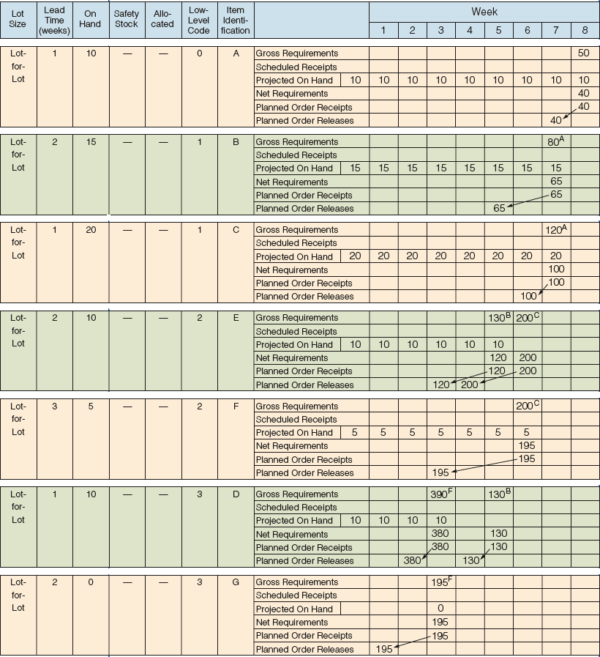
Net Requirements Plan
ITEM | ON HAND | ITEM | ON HAND
A | 10 | E | 10
B | 15 | F | 5
C | 20 | G | 0
D | 10
2 × number of As = 80
3 × number of As = 120

Slide 31
Net Requirements Plan
2 × number of Bs = 130
2 × number of Cs = 200
2 × number of Cs = 200
2 × number of Bs = 130
2 × number of Fs = 390
1 × number of Fs = 195

Slide 32
Determining Net Requirements
Starts with a production schedule for the end item – 50 units of Item A in week 8
Because there are 10 Item As on hand, only 40 are actually required – (net requirement) = (gross requirement – on-hand inventory)
The planned order receipt for Item A in week 8 is 40 units – 40 = 50 – 10

Slide 33
Determining Net Requirements
Following the lead time offset procedure, the planned order release for Item A is now 40 units in week 7
The gross requirement for Item B is now 80 units in week 7
There are 15 units of Item B on hand, so the net requirement is 65 units in week 7
A planned order receipt of 65 units in week 7 generates a planned order release of 65 units in week 5

Slide 34
Determining Net Requirements
The on-hand inventory record for Item B is updated to reflect the use of the 15 items in inventory and shows no on-hand inventory in week 8
This is referred to as the Gross-to-Net calculation and is the third basic function of the MRP process

Slide 35
Lot-Sizing Techniques
Lot-for-lot technique orders just what is required for production based on net requirements
  May not always be feasible
  If setup costs are high, lot-for-lot can be expensive
Economic order quantity (EOQ)
  EOQ expects a known constant demand and MRP systems often deal with unknown and variable demand

Slide 36
Lot-Sizing Techniques
Periodic order quantity (POQ) orders quantity needed for a predetermined time period
  Interval = EOQ / average demand per period
  Order quantity set to cover the interval
  Order quantity recalculated at the time of the order release
  No extra inventory

Slide 37
Lot-Sizing Techniques
Dynamic lot sizing techniques
  Balance lot size and setup costs
  Part period balancing (least total cost)
  Least unit cost
  Least period cost (Silver-Meal)
Dynamic programming approach
  Wagner-Whitin

Slide 38
Lot-for-Lot Example
WEEK |  | 1 | 2 | 3 | 4 | 5 | 6 | 7 | 8 | 9 | 10
Gross requirements |  | 35 | 30 | 40 | 0 | 10 | 40 | 30 | 0 | 30 | 55
Scheduled receipts
Projected on hand | 35 | 35 | 0 | 0 | 0 | 0 | 0 | 0 | 0 | 0 | 0
Net requirements |  | 0 | 30 | 40 | 0 | 10 | 40 | 30 | 0 | 30 | 55
Planned order receipts |  |  | 30 | 40 |  | 10 | 40 | 30 |  | 30 | 55
Planned order releases |  | 30 | 40 |  | 10 | 40 | 30 |  | 30 | 55
Holding cost = $1/week; Setup cost = $100; Lead time = 1 week

Slide 39
Lot-for-Lot Example
No on-hand inventory is carried through the system
Total holding cost = $0
There are seven setups for this item in this plan
Total ordering cost = 7 x $100 = $700
WEEK |  | 1 | 2 | 3 | 4 | 5 | 6 | 7 | 8 | 9 | 10
Gross requirements |  | 35 | 30 | 40 | 0 | 10 | 40 | 30 | 0 | 30 | 55
Scheduled receipts
Projected on hand | 35 | 35 | 0 | 0 | 0 | 0 | 0 | 0 | 0 | 0 | 0
Net requirements |  | 0 | 30 | 40 | 0 | 10 | 40 | 30 | 0 | 30 | 55
Planned order receipts |  |  | 30 | 40 |  | 10 | 40 | 30 |  | 30 | 55
Planned order releases |  | 30 | 40 |  | 10 | 40 | 30 |  | 30 | 55
Holding cost = $1/week; Setup cost = $100; Lead time = 1 week

Slide 40
EOQ Lot Size Example
WEEK |  | 1 | 2 | 3 | 4 | 5 | 6 | 7 | 8 | 9 | 10
Gross requirements |  | 35 | 30 | 40 | 0 | 10 | 40 | 30 | 0 | 30 | 55
Scheduled receipts
Projected on hand | 35 | 35 | 0 | 43 | 3 | 3 | 66 | 26 | 69 | 69 | 39
Net requirements |  | 0 | 30 | 0 | 0 | 7 | 0 | 4 | 0 | 0 | 16
Planned order receipts |  |  | 73 |  |  | 73 |  | 73 |  |  | 73
Planned order releases |  | 73 |  |  | 73 |  | 73 |  |  | 73
Holding cost = $1/week; Setup cost = $100; Lead time = 1 week
Average weekly gross requirements = 27; EOQ = 73 units

Slide 41
EOQ Lot Size Example
Annual demand D = 1,404
Holding cost = 375 units x $1 (including 57 units on hand at end of week 10)
Ordering cost = 4 x $100 = $400
Total cost = $375 + $400 = $775
WEEK |  | 1 | 2 | 3 | 4 | 5 | 6 | 7 | 8 | 9 | 10
Gross requirements |  | 35 | 30 | 40 | 0 | 10 | 40 | 30 | 0 | 30 | 55
Scheduled receipts
Projected on hand | 35 | 35 | 0 | 43 | 3 | 3 | 66 | 26 | 69 | 69 | 39
Net requirements |  | 0 | 30 | 0 | 0 | 7 | 0 | 4 | 0 | 0 | 16
Planned order receipts |  |  | 73 |  |  | 73 |  | 73 |  |  | 73
Planned order releases |  | 73 |  |  | 73 |  | 73 |  |  | 73
Holding cost = $1/week; Setup cost = $100; Lead time = 1 week
Average weekly gross requirements = 27; EOQ = 73 units

Slide 42
POQ Lot Size Example
WEEK |  | 1 | 2 | 3 | 4 | 5 | 6 | 7 | 8 | 9 | 10
Gross requirements |  | 35 | 30 | 40 | 0 | 10 | 40 | 30 | 0 | 30 | 55
Scheduled receipts
Projected on hand | 35 | 35 | 0 | 40 | 0 | 0 | 70 | 30 | 0 | 0 | 55
Net requirements |  | 0 | 30 | 0 | 0 | 10 | 0 | 0 | 0 | 55 | 0
Planned order receipts |  |  | 70 |  |  | 80 |  | 0 |  | 85 | 0
Planned order releases |  | 70 |  |  | 80 |  |  |  | 85
EOQ = 73 units; Average weekly gross requirements = 27;
POQ interval = 73/27 ≅ 3 weeks

Slide 43
POQ Lot Size Example
Setups = 3 x $100 = $300
Holding cost = (40 + 70 + 30 + 55) units x $1 = $195
Total cost = $300 + $195 = $495
WEEK |  | 1 | 2 | 3 | 4 | 5 | 6 | 7 | 8 | 9 | 10
Gross requirements |  | 35 | 30 | 40 | 0 | 10 | 40 | 30 | 0 | 30 | 55
Scheduled receipts
Projected on hand | 35 | 35 | 0 | 40 | 0 | 0 | 70 | 30 | 0 | 0 | 55
Net requirements |  | 0 | 30 | 0 | 0 | 10 | 0 |  | 0 | 55 | 0
Planned order receipts |  |  | 70 |  |  | 80 |  | 0 |  | 85 | 0
Planned order releases |  | 70 |  |  | 80 |  |  |  | 85
EOQ = 73 units; Average weekly gross requirements = 27;
POQ interval = 73/27 ≅ 3 weeks

Slide 44
Lot-Sizing Summary
For these three examples
 | COSTS
 | SETUP | HOLDING | TOTAL
Lot-for-lot | $700 | $0 | $700
EOQ | $400 | $375 | $775
POQ | $300 | $195 | $495
Wagner-Whitin would have yielded a plan with a total cost of $455

Slide 45

Lot-Sizing Summary
In theory, lot sizes should be recomputed whenever there is a lot size or order quantity change
In practice, this results in system nervousness and
instability
Lot-for-lot should
be used when
low-cost setups can
be achieved

Slide 46
Lot-Sizing Summary
Lot sizes can be modified to allow for scrap, process constraints, and purchase lots
Use lot-sizing with care as it can cause considerable distortion of requirements at lower levels of the BOM
When setup costs are significant and demand is reasonably smooth, POQ or EOQ should give reasonable results

