Slide 1

Design of Goods and Services
5
PowerPoint presentation to accompany
Heizer, Render, Munson
Operations Management, Twelfth Edition, Global Edition
Principles of Operations Management, Tenth Edition, Global Edition
PowerPoint slides by Jeff Heyl

Slide 2
Learning Objectives
When you complete this chapter you should be able to :
5.1 Define product life cycle
5.2 Describe a product development system
5.3 Build a house of quality
5.4 Explain how time-based competition is implemented by OM
5.5 Apply decision trees to product issues

Slide 3
Product Decision
The objective of the product decision is to develop and implement a product strategy that meets the demands of the marketplace with a competitive advantage

Slide 4
Product Strategy Options
Differentiation
  Shouldice Hospital
Low cost
  Taco Bell
Rapid response
  Toyota

Slide 5
Product Life Cycles
May be any length from a few days to decades
The operations function must be able to introduce new products successfully

Slide 6
Product Life Cycle
Cost of development and production
$
Sales revenue
Loss
Profit
Loss
Introduction Growth Maturity Decline
Figure 5.2

Slide 7
Life Cycle and Strategy
Introductory Phase
Fine tuning may warrant unusual expenses for
  Research
  Product development
  Process modification and enhancement
  Supplier development

Slide 8
Product Life Cycle
Growth Phase
Product design begins to stabilize
Effective forecasting of capacity becomes necessary
Adding or enhancing capacity may be necessary

Slide 9
Product Life Cycle
Maturity Phase
Competitors now established
High volume, innovative production may be needed
Improved cost control, reduction in options, paring down of product line

Slide 10
Product Life Cycle
Decline Phase
Unless product makes a special contribution to the organization, must plan to terminate offering

Slide 11
Product Life Cycle Costs
100 –
80 –
60 –
40 –
20 –
0 –
Costs committed
Costs incurred
Percent of total cost
Ease of change
Concept Detailed Manufacturing Distribution,
design design service,
prototype and disposal

Slide 12
Product-by-Value Analysis
Lists products in descending order of their individual dollar contribution to the firm
Lists the total annual dollar contribution of the product
Helps management evaluate alternative strategies

Slide 13
Generating New Products
Understanding the customer
Economic change
Sociological and demographic change
Technological change
Political and legal change
Market practice, professional standards, suppliers, distributors

Slide 14
Product Development Stages
Concept
Feasibility
Figure 5.3
Customer Requirements
Functional Specifications
Product Specifications
Scope for design and engineering teams
Scope of product development team
Design Review
Test Market
Introduction
Evaluation

Slide 15
Quality Function Deployment
Quality function deployment (QFD)
  Determine what will satisfy the customer
  Translate those customer desires into the target design
House of quality
  Utilize a planning matrix to relate customer wants to how the firm is going to meet those wants

Slide 16
Quality Function Deployment
Identify customer wants
Identify how the good/service will satisfy customer wants
Relate customer wants to product hows
Identify relationships between the firm’s hows
Develop our importance ratings
Evaluate competing products
Compare performance to desirable technical attributes

Slide 17
QFD House of Quality
Interrelationships
Customer importance ratings
How to satisfy
customer wants
What the customer
wants
Relationship
matrix
Competitive assessment
Target values
Weighted rating
Technical
evaluation
Notes:
1

Slide 18
House of Quality Example
Your team has been charged with designing a new camera for Great Cameras, Inc.
The first action is
to construct a
House of Quality

Slide 19
House of Quality Example
Interrelationships
How to Satisfy
Customer Wants
What the Customer
Wants
Relationship
Matrix
Analysis of
Competitors
Technical
Attributes and
Evaluation
What the customer wants
Customer
importance
rating
(5 = highest)
Lightweight 3
Easy to use 4
Reliable 5
Easy to hold steady 2
High resolution 1

Slide 20
House of Quality Example
Interrelationships
How to Satisfy
Customer Wants
What the Customer
Wants
Relationship
Matrix
Analysis of
Competitors
Technical
Attributes and
Evaluation
Low electricity requirements
Aluminum components
Auto focus
Auto exposure
High number of pixels
Ergonomic design
How to Satisfy
Customer Wants

Slide 21
House of Quality Example
Interrelationships
How to Satisfy
Customer Wants
What the Customer
Wants
Relationship
Matrix
Analysis of
Competitors
High relationship
Medium relationship
Low relationship
Technical
Attributes and
Evaluation
Lightweight 3
Easy to use 4
Reliable 5
Easy to hold steady 2
High resolution 1
Relationship matrix

Slide 22
House of Quality Example
Interrelationships
How to Satisfy
Customer Wants
What the Customer
Wants
Relationship
Matrix
Analysis of
Competitors
Technical
Attributes and
Evaluation
Low electricity requirements
Aluminum components
Auto focus
Auto exposure
High number of pixels
Ergonomic design
Relationships between the things we can do

Slide 23
House of Quality Example
Interrelationships
How to Satisfy
Customer Wants
What the Customer
Wants
Relationship
Matrix
Analysis of
Competitors
Technical
Attributes and
Evaluation
Lightweight 3
Easy to use 4
Reliable 5
Easy to hold steady 2
High resolution 1
Our importance ratings 22 9 27 27 32 25
Weighted rating

Slide 24
House of Quality Example
Interrelationships
How to Satisfy
Customer Wants
What the Customer
Wants
Relationship
Matrix
Analysis of
Competitors
Technical
Attributes and
Evaluation
Company A
Company B
How well do competing products meet customer wants
Lightweight 3
Easy to use 4
Reliable 5
Easy to hold steady 2
High resolution 1
G P
G P
F G
G P
P P
Our importance ratings 22 5

Slide 25
House of Quality Example
Interrelationships
How to Satisfy
Customer Wants
What the Customer
Wants
Relationship
Matrix
Analysis of
Competitors
Technical
Attributes and
Evaluation
2 circuits
Failure 1 per 10,000
Panel ranking
Target values
(Technical attributes)
75%
2’ to ∞
0.5 A
Company A 0.7 60% yes 1 ok G
Company B 0.6 50% yes 2 ok F
Us 0.5 75% yes 2 ok G
Technical evaluation

Slide 26
House of Quality Example
Low electricity requirements
Aluminum components
Auto focus
Auto exposure
High number of pixels
Ergonomic design
Company A
Company B
Completed House of Quality
Lightweight 3
Easy to use 4
Reliable 5
Easy to hold steady 2
High resolution 1
Our importance ratings
G P
G P
F G
G P
P P
22 9 27 27 32 25
0.5 A
75%
2’ to ∞
2 circuits
Failure 1 per 10,000
Panel ranking
Target values
(Technical attributes)
Company A 0.7 60% yes 1 ok G
Company B 0.6 50% yes 2 ok F
Us 0.5 75% yes 2 ok G
Technical evaluation

Slide 27
House of Quality Sequence
Deploying resources through the organization in response to customer requirements
Quality plan
Production process
Specific components
Production process
House 4
Design characteristics
Specific components
House 3
Design characteristics
House 2
Customer requirements
House 1
Figure 5.4

Slide 28
Organizing for Product Development
Traditionally – distinct departments
  Duties and responsibilities are defined
  Difficult to foster forward thinking
A Champion
  Product manager drives the product through the product development system and related organizations

Slide 29
Organizing for Product Development
Team approach
  Cross functional – representatives from all disciplines or functions
  Product development teams, design for manufacturability teams, value engineering teams
Japanese “whole organization” approach
  No organizational divisions

Slide 30
Organizing for Product Development
Product development teams
  Market requirements to product success
  Cross functional teams often involving vendors
  Open, highly participative environment
Concurrent engineering
  Simultaneous performance of product development stages

Slide 31
Manufacturability and
Value Engineering
Benefits:
  Reduced complexity of the product
  Reduction of environmental impact
  Additional standardization of components
  Improvement of functional aspects of the product
  Improved job design and job safety
  Improved maintainability (serviceability) of the product
  Robust design

Slide 32
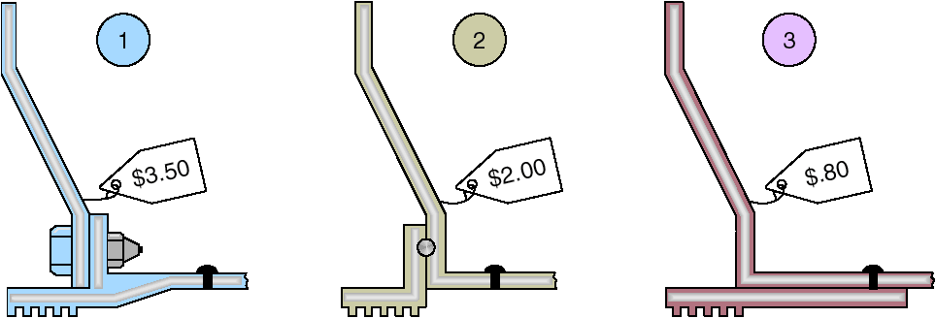
Cost Reduction of a Bracket via Value Engineering
Figure 5.5

Slide 33
Issues for Product Design
Robust design
Modular design
Computer-aided design (CAD)
Computer-aided manufacturing (CAM)
Virtual reality technology
Value analysis
Sustainability and Life Cycle Assessment (LCA)

Slide 34
Robust Design
Product is designed so that small variations in production or assembly do not adversely affect the product
Typically results in lower cost and higher quality

Slide 35
Modular Design
Products designed in easily segmented components
Adds flexibility to both production and marketing
Improved ability to satisfy customer requirements

Slide 36
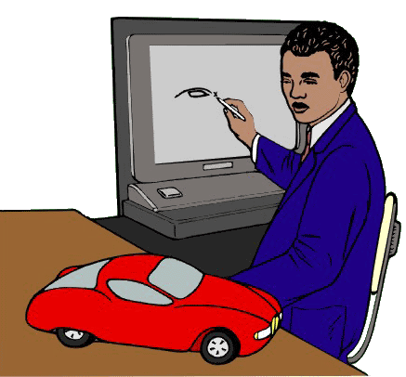
Computer Aided Design (CAD)
Using computers to design products and prepare engineering documentation
Shorter development cycles, improved accuracy, lower cost
Information and designs can be deployed worldwide

Slide 37
Extensions of CAD
3-D Object Modeling
  Small prototype development
Design for Manufacturing and Assembly (DFMA)
  Solve manufacturing problems during the design stage
CAD through the internet
International data exchange through STEP
3-D printing

Slide 38
Computer-Aided Manufacturing (CAM)
Utilizing specialized computers and program to control manufacturing equipment
Often driven by the CAD system (CAD/CAM)

Slide 39
Benefits of CAD/CAM
Product quality
Shorter design time
Production cost reductions
Database availability
New range of capabilities

Slide 40
Virtual Reality Technology
Computer technology used to develop an interactive, 3-D model of a product from the basic CAD data
Allows people to ‘see’ the finished design before a physical model is built
Very effective in large-scale designs such as plant layout

Slide 41
Value Analysis
Focuses on design improvement during production
Seeks improvements leading either to a better product or a product which can be produced more economically with less environmental impact

Slide 42
Sustainability and Life Cycle Assessment (LCA)
Sustainability means meeting the needs of the present without compromising the ability of future generations to meet their needs
LCA is a formal evaluation of the environmental impact of a product

Slide 43
Defining a Product
First definition is in terms of functions
Rigorous specifications are developed during the design phase
Manufactured products will have an engineering drawing
Bill of material (BOM) lists the components of a product

Slide 44
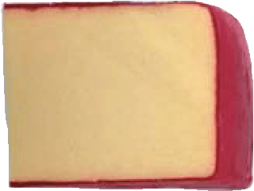
Monterey Jack Cheese
(a) U.S. grade AA. Monterey cheese shall conform to the following requirements:
(1) Flavor. Is fine and highly pleasing, free from undesirable flavors and odors. May possess a very slight acid or feed flavor.
(2) Body and texture. A plug drawn from the cheese shall be reasonably firm. It shall have numerous small mechanical openings evenly distributed throughout the plug. It shall not possess sweet holes, yeast holes, or other gas holes.
(3) Color. Shall have a natural, uniform, bright and attractive appearance.
(4) Finish and appearance—bandaged and
paraffin-dipped. The rind shall be sound,
firm, and smooth providing a good
protection to the cheese.
Code of Federal Regulation, Parts 53 to 109, General Service Administration

Slide 45
Product Documents
Engineering drawing
  Shows dimensions, tolerances, and materials
  Shows codes for Group Technology
Bill of Material
  Lists components, quantities and where used
  Shows product structure

Slide 46
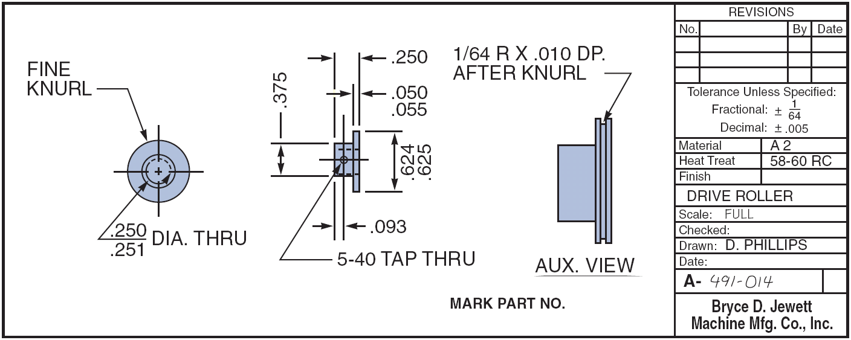
Engineering Drawings
Figure 5.8

Slide 47
Bills of Material
BOM for a Panel Weldment
NUMBER DESCRIPTION QTY
A 60-71 PANEL WELDM’T 1
A 60-7 LOWER ROLLER ASSM. 1
R 60-17 ROLLER 1
R 60-428 PIN 1
P 60-2 LOCKNUT 1
A 60-72 GUIDE ASSM. REAR 1
R 60-57-1 SUPPORT ANGLE 1
A 60-4 ROLLER ASSM. 1
02-50-1150 BOLT 1
A 60-73 GUIDE ASSM. FRONT 1
A 60-74 SUPPORT WELDM’T 1
R 60-99 WEAR PLATE 1
02-50-1150 BOLT 1
Figure 5.9 (a)

Slide 48
Bills of Material
Hard Rock Cafe’s Hickory BBQ Bacon Cheeseburger
DESCRIPTION QTY
Bun 1
Hamburger patty 8 oz.
Cheddar cheese 2 slices
Bacon 2 strips
BBQ onions 1/2 cup
Hickory BBQ sauce 1 oz.
Burger set
Lettuce 1 leaf
Tomato 1 slice
Red onion 4 rings
Pickle 1 slice
French fries 5 oz.
Seasoned salt 1 tsp.
11-inch plate 1
HRC flag 1
Figure 5.9 (b)

Slide 49
Make-or-Buy Decisions
Produce components themselves or buy from an outside source
Variations in
  Quality
  Cost
  Delivery schedules
Critical to product definition

Slide 50
Application of Decision Trees to Product Design
Particularly useful when there are a series of decisions and outcomes that lead to other decisions and outcomes

Slide 51
Application of Decision Trees to Product Design
Procedure
Include all possible alternatives and states of nature – including “doing nothing”
Enter payoffs at end of branch
Determine the expected value of each branch and “prune” the tree to find the alternative with the best expected value

Slide 52
Application of Decision Trees to Product Design
Example:
DECISION TREE APPLIED TO PRODUCT DESIGN
Silicon, Inc., a semiconductor manufacturer, is investigating the possibility of producing and marketing a microprocessor. Undertaking this project will require either purchasing a sophisticated CAD system or hiring and training several additional engineers. The market for the product could be either favorable or unfavorable. Silicon, Inc., of course, has the option of not developing the new product at all.
With favorable acceptance by the market, sales would be 25,000 processors selling for $100 each. With unfavorable acceptance, sales would be only 8,000 processors selling for $100 each. The cost of CAD equipment is $500,000, but that of hiring and training three new engineers is only $375,000. However, manufacturing costs should drop from $50 each when manufacturing without CAD to $40 each when manufacturing with CAD. The probability of favorable acceptance of the new microprocessor is .40; the probability of unfavorable acceptance is .60.
APPROACH :
Use of a decision tree seems appropriate as Silicon, Inc., has the basic ingredients: a choice of decisions, probabilities, and payoffs.
SOLUTION :
we draw a decision tree with a branch for each of the three decisions, assign the respective probabilities and payoff for each branch, and then compute the respective EMVs. The expected monetary values (EMVs) have been circled at each step of the decision tree. For the top branch

Slide 53
Decision Tree Example
(.4)
High sales
Purchase CAD
(.6) Low sales
Hire and train engineers
(.4)
High sales
(.6)
Low sales
Do nothing
Figure 5.13

Slide 54
Decision Tree Example
(.4)
High sales
$2,500,000 Revenue
– 1,000,000 Mfg cost ($40 x 25,000)
– 500,000 CAD cost
$1,000,000 Net
Purchase CAD
(.6) Low sales
$800,000 Revenue
– 320,000 Mfg cost ($40 x 8,000)
– 500,000 CAD cost
– $20,000 Net loss
Hire and train engineers
(.4)
High sales
EMV (purchase CAD system) = (.4)($1,000,000) + (.6)(– $20,000)
(.6)
Low sales
Do nothing
Figure 5.13

Slide 55
Decision Tree Example
(.4)
High sales
$2,500,000 Revenue
– 1,000,000 Mfg cost ($40 x 25,000)
– 500,000 CAD cost
$1,000,000 Net
Purchase CAD
$388,000
(.6) Low sales
$800,000 Revenue
– 320,000 Mfg cost ($40 x 8,000)
– 500,000 CAD cost
– $20,000 Net loss
Hire and train engineers
(.4)
High sales
EMV (purchase CAD system) = (.4)($1,000,000) + (.6)(– $20,000)
= $388,000
(.6)
Low sales
Do nothing
Figure 5.13

Slide 56
Decision Tree Example
(.4)
High sales
$2,500,000 Revenue
– 1,000,000 Mfg cost ($40 x 25,000)
– 500,000 CAD cost
$1,000,000 Net
Purchase CAD
$388,000
(.6) Low sales
$800,000 Revenue
– 320,000 Mfg cost ($40 x 8,000)
– 500,000 CAD cost
– $20,000 Net loss
Hire and train engineers
$365,000
(.4)
High sales
$2,500,000 Revenue
– 1,250,000 Mfg cost ($50 x 25,000)
– 375,000 Hire and train cost
$875,000 Net
(.6)
Low sales
$800,000 Revenue
– 400,000 Mfg cost ($50 x 8,000)
– 375,000 Hire and train cost
$25,000 Net
Do nothing $0
$0 Net
Figure 5.13

Slide 57
Application of Decision Trees to Product Design
Example:
DECISION TREE APPLIED TO PRODUCT DESIGN
EMV (Purchase CAD system) = (.4)(+1,000,000) + (.6)(9+20,000) = +388,000
This figure represents the results that will occur if Silicon, Inc., purchases CAD.
The expected value of hiring and training engineers is the second series of branches:
EMV (Hire>train engineers) = (.4)($875,000) + (.6)($25,000) = $365,000

