Slide 1
Location Strategies
8
PowerPoint presentation to accompany
Heizer, Render, Munson
Operations Management, Twelfth Edition, Global Edition
Principles of Operations Management, Tenth Edition, Global Edition
PowerPoint slides by Jeff Heyl

Slide 2
Learning Objectives
When you complete this chapter you should be able to:
8.1 Identify and explain seven major factors that effect location decisions
8.2 Compute labor productivity
8.3 Apply the factor-rating method
8.4 Complete a locational break-even analysis graphically and mathematically

Slide 3
Learning Objectives
When you complete this chapter you should be able to:
8.5 Use the center-of-gravity method
8.6 Understand the differences between service- and industrial-sector location analysis

Slide 4
The Strategic Importance of Location
One of the most important decisions a firm makes
Increasingly global in nature
Significant impact on fixed and variable costs
Decisions made relatively infrequently

Slide 5
The Strategic Importance of Location
Long-term decisions
Once committed to a location, many resource and cost issues are difficult to change

Slide 6
The Strategic Importance of Location
The objective of location strategy is to maximize the benefit of location to the firm
Options include
Expanding existing facilities
Maintain existing and add sites
Closing existing and relocating

Slide 7
Location and Costs
Location decisions require careful consideration
Once in place, location-related costs are fixed in place and difficult to reduce
Effort spent determining optimal facility location is a good investment

Slide 8
Factors That Affect Location Decisions
Globalization adds to complexity
Drivers of globalization
Market economics
Communication
Rapid, reliable transportation
Ease of capital flow
Differing labor costs
Identify key success factors (KSFs)

Slide 9
Location Decisions
Country Decision
Key Success Factors
Political risks, government rules, attitudes, incentives
Cultural and economic issues
Location of markets
Labor talent, attitudes, productivity, costs
Availability of supplies, communications, energy
Exchange rates and currency risks
Figure 8.1

Slide 10
Location Decisions
Region/ Community Decision
Key Success Factors
Corporate desires
Attractiveness of region
Labor availability and costs
Costs and availability of utilities
Environmental regulations
Government incentives and fiscal policies
Proximity to raw materials and customers
Land/construction costs
MN
WI
MI
IL
IN
OH
Figure 8.1

Slide 11
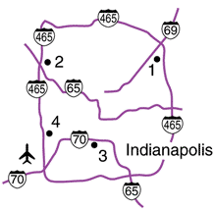
Location Decisions
Site Decision
Key Success Factors
Site size and cost
Air, rail, highway, and waterway systems
Zoning restrictions
Proximity of services/ supplies needed
Environmental impact issues
Customer density and demographics
Figure 8.1

Slide 12
Global Competitiveness Index of Countries
TABLE 8.1
Competitiveness of 144 Selected Countries
COUNTRY |  | 2015 RANKING
Switzerland |  | 1
Singapore |  | 2
U.S. |  | 3
Finland |  | 4
Germany |  | 5
Japan |  | 6
Canada |  | 15
Israel |  | 27
China |  | 28
Russia |  | 53
Mexico |  | 61
Vietnam |  | 68
Haiti |  | 137
Chad |  | 143
Guinea |  | 144

Slide 13
Factors That Affect Location Decisions
Labor productivity
Wage rates are not the only cost
Lower productivity may increase total cost
Labor cost per day
Productivity (units per day)
= Labor cost per unit
South Carolina
Mexico
$70
60 units
$25
20 units
= $1.17 per unit
= $1.25 per unit

Slide 14
Factors That Affect Location Decisions
Exchange rates and currency risks
Can have a significant impact on costs
Rates change over time
Costs
Tangible – easily measured costs such as utilities, labor, materials, taxes
Intangible – not as easy to quantify and include education, public transportation, community, quality-of-life

Slide 15
Factors That Affect Location Decisions
Exchange rates and currency risks
Can have a significant impact on costs
Rates change over time
Costs
Tangible – easily measured costs such as utilities, labor, materials, taxes
Intangible – not as easy to quantify and include education, public transportation, community, quality-of-life
Location decisions based on costs alone can create difficult ethical situations

Slide 16
Factors That Affect Location Decisions
Political risk, values, and culture
National, state, local governments' attitudes toward private and intellectual property, zoning, pollution, employment stability may be in flux
Worker attitudes toward turnover, unions, absenteeism
Globally cultures have different attitudes toward punctuality, legal, and ethical issues

Slide 17
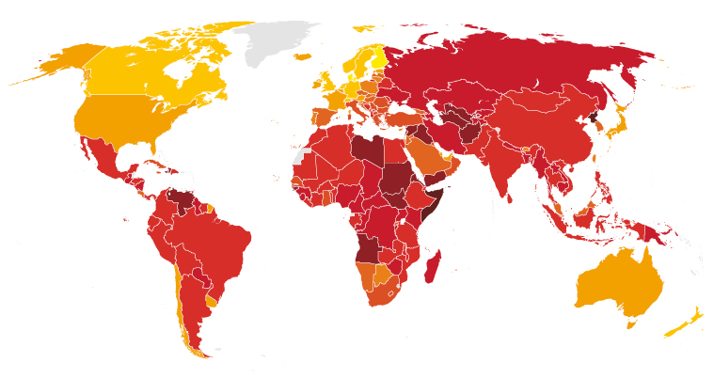
Ranking Corruption
Rank Country 2015 CPI Score (out of 100)
1 Demark 91
2 Finland 90
3 Sweden 89
4 New Zealand 88
5 Netherlands, Norway, 87
7 Switzerland 86
8 Singapore 85
9 Canada 83
10 Germany, UK 81
16 USA 76
18 Japan 75
17 USA 74
30 Taiwan 62
37 South Korea 56
83 China 37
119 Russia 29
Least Corrupt
Most Corrupt

Slide 18
Factors That Affect Location Decisions
Proximity to markets
Very important to services
JIT systems or high transportation costs may make it important to manufacturers
Proximity to suppliers
Perishable goods, high transportation costs, bulky products

Slide 19
Factors That Affect Location Decisions
Proximity to competitors (clustering)
Often driven by resources such as natural, information, capital, talent
Found in both manufacturing and service industries

Slide 20
Clustering of Companies
TABLE 8.3 | Clustering of Companies
INDUSTRY |  | LOCATIONS | REASON FOR CLUSTERING
Wine making |  | Napa Valley (U.S.) Bordeaux region (France) | Natural resources of land and climate
Software firms |  | Silicon Valley, Boston, Bangalore, Israel | Talent resources of bright graduates in scientific/technical areas, venture capitalists nearby
Clean energy |  | Colorado | Critical mass of talent and information, with 1,000 companies

Slide 21
Clustering of Companies
TABLE 8.3 | Clustering of Companies
INDUSTRY |  | LOCATIONS | REASON FOR CLUSTERING
Theme parks (Disney World, Universal Studios, and Sea World) |  | Orlando, Florida | A hot spot for entertainment, warm weather, tourists, and inexpensive labor
Electronics firms (Sony, IBM, HP, Motorola, and Panasonic) |  | Northern Mexico | NAFTA, duty free export to U.S.
Computer hardware manufacturers |  | Singapore, Taiwan | High technological penetration rate and per capita GDP, skilled/educated workforce with large pool of engineers

Slide 22
Clustering of Companies
TABLE 8.3 | Clustering of Companies
INDUSTRY |  | LOCATIONS | REASON FOR CLUSTERING
Fast food chains (Wendy’s, McDonald’s, Burger King, Pizza Hut) |  | Sites within 1 mile of each other | Stimulate food sales, high traffic flows
General aviation aircraft (Cessna, Learjet, Boeing, Raytheon) |  | Wichita, Kansas | Mass of aviation skills
Athletic footwear, outdoor wear |  | Portland, Oregon | 300 companies, many owned by Nike, deep talent pool and outdoor culture

Slide 23
Factor-Rating Method
Popular because a wide variety of factors can be included in the analysis
Six steps in the method
Develop a list of relevant factors called key success factors
Assign a weight to each factor
Develop a scale for each factor
Score each location for each factor
Multiply score by weights for each factor and total the score for each location
Make a recommendation based on the highest point score

Slide 24
Factor-Rating Example
TABLE 8.4 | Weights, Scores, and Solution
 |  |  |  |  | SCORES (OUT OF 100) |  | WEIGHTED SCORES
KEY SUCCESS FACTOR |  | WEIGHT |  |  | FRANCE | DENMARK | FRANCE |  |  | DENMARK
Labor availability and attitude |  |  | .25 |  | 70 | 60 | (.25)(70) = 17.5 |  |  | (.25)(60) = 15.0
People-to-car ratio |  |  | .05 |  | 50 | 60 | (.05)(50) = 2.5 |  |  | (.05)(60) = 3.0
Per capita income |  |  | .10 |  | 85 | 80 | (.10)(85) = 8.5 |  |  | (.10)(80) = 8.0
Tax structure |  |  | .39 |  | 75 | 70 | (.39)(75) = 29.3 |  |  | (.39)(70) = 27.3
Education and health |  |  | .21 |  | 60 | 70 | (.21)(60) = 12.6 |  |  | (.21)(70) = 14.7
Totals |  |  | 1.00 |  |  |  |  | 70.4 |  |  | 68.0

Slide 25
Locational Cost-Volume Analysis
An economic comparison of location alternatives
Three steps in the method
Determine fixed and variable costs for each location
Plot the cost for each location
Select location with lowest total cost for expected production volume

Slide 26
Locational Cost-Volume Analysis Example
Three locations:
Selling price = $120
Expected volume = 2,000 units
Fixed Variable Total
City Cost Cost Cost
Athens $30,000 $75 $180,000
Brussels $60,000 $45 $150,000
Lisbon $110,000 $25 $160,000
Total Cost = Fixed Cost + (Variable Cost x Volume)

Slide 27
Locational Cost-Volume Analysis Example
Crossover point – Athens/Brussels
30,000 + 75(x) = 60,000 + 45(x)
30(x) = 30,000
x = 1,000
Crossover point – Brussels/Lisbon
60,000 + 45(x) = 110,000 + 25(x)
20(x) = 50,000
x = 2,500

Slide 28
Locational Cost-Volume Analysis Example
Figure 8.2
–
$180,000 –
–
$160,000 –
$150,000 –
–
$130,000 –
–
$110,000 –
–
–
$80,000 –
–
$60,000 –
–
–
$30,000 –
–
$10,000 –
–
Lisbon cost curve
Annual cost
Brussels
cost curve
Athens
cost curve
Athens lowest cost
Brussels
lowest cost
Lisbon lowest
cost
| | | | | | |
0 500 1,000 1,500 2,000 2,500 3,000
Volume

Slide 29
Center-of-Gravity Method
Finds location of distribution center that minimizes distribution costs
Considers
Location of markets
Volume of goods shipped to those markets
Shipping cost (or distance)

Slide 30
Center-of-Gravity Method
Place existing locations on a coordinate grid
Grid origin and scale are arbitrary
Maintain relative distances
Calculate x and y coordinates for 'center of gravity'
Assumes cost is directly proportional to distance and volume shipped

Slide 31
Center-of-Gravity Method
x-coordinate of the center of gravity
y-coordinate of the center of gravity
where x_{i} = x-coordinate of location i
y_{i} = y-coordinate of location i
Q_{i} = Quantity of goods moved to or from location i

Slide 32
Center-of-Gravity Method
TABLE 8.5 | Demand for Quain's Discount Department Stores
STORE LOCATION |  | NUMBER OF CONTAINERS SHIPPED PER MONTH
Chicago |  | 2,000
Pittsburgh |  | 1,000
New York |  | 1,000
Atlanta |  | 2,000

Slide 33
Center-of-Gravity Method
North-South
Figure 8.3
New York (130, 130)
120 –
90 –
60 –
30 –
–
Chicago (30, 120)
Pittsburgh (90, 110)
x₁ = 30
y₁ = 120
Q₁ = 2,000
Atlanta (60, 40)
| | | | | |
30 60 90 120 150
East-West
Arbitrary origin

Slide 34
Center-of-Gravity Method
(30)(2000) + (90)(1000) + (130)(1000) + (60)(2000)
2000 + 1000 + 1000 + 2000
x-coordinate =
= 66.7
(120)(2000) + (110)(1000) + (130)(1000) + (40)(2000)
2000 + 1000 + 1000 + 2000
y-coordinate =
= 93.3

Slide 35
Center-of-Gravity Method
North-South
Figure 8.3
New York (130, 130)
120 –
90 –
60 –
30 –
–
Chicago (30, 120)
Pittsburgh (90, 110)
+
Center of gravity (66.7, 93.3)
Atlanta (60, 40)
| | | | | |
30 60 90 120 150
East-West
Arbitrary origin

Slide 36
Service Location Strategy
Purchasing power of customer-drawing area
Service and image compatibility with demographics of the customer-drawing area
Competition in the area
Quality of the competition
Uniqueness of the firm’s and competitors’ locations
Physical qualities of facilities and neighboring businesses
Operating policies of the firm
Quality of management

Slide 37
How Hotel Chains Select Sites
Location is a strategically important decision in the hospitality industry
La Quinta started with 35 independent variables and worked to refine a regression model to predict profitability
The final model had only four variables
Price of the inn
Median income levels
State population per inn
Location of nearby colleges

Slide 38
How Hotel Chains Select Sites
Location is a strategically important decision in the hospitality industry
La Quinta started with 35 independent variables and worked to refine a regression model to predict profitability
The final model had only four variables
Price of the inn
Median income levels
State population per inn
Location of nearby colleges
R² = .51
51% of the
profitability is
predicted by
just these
four variables!

Slide 39
Geographic Information Systems (GIS)
Important tool to help in location analysis
Enables more complex demographic analysis
Available data bases include
Detailed census data
Detailed maps
Utilities
Geographic features
Locations of major services

Slide 40
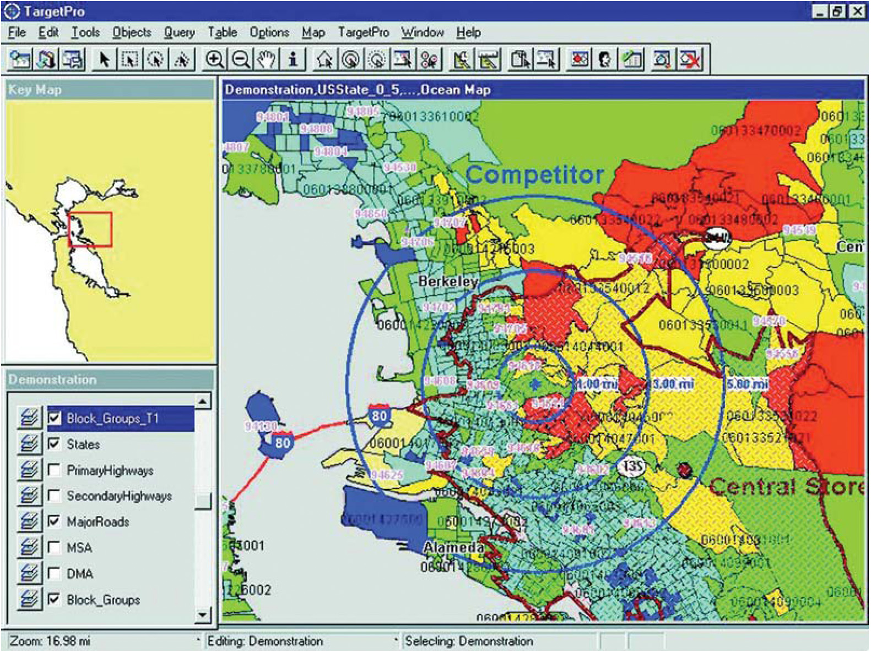
Geographic Information Systems (GIS)

