Slide 1
Layout Strategies
9
PowerPoint presentation to accompany
Heizer, Render, Munson
Operations Management, Twelfth Edition, Global Edition
Principles of Operations Management, Tenth Edition, Global Edition
PowerPoint slides by Jeff Heyl

Slide 2
Learning Objectives
When you complete this chapter you should be able to:
9.1 Discuss important issues in office layout
9.2 Define the objectives of retail layout
9.3 Discuss modern warehouse management and terms such as ASRS, cross-docking, and random stocking
9.4 Identify when fixed-position layouts are appropriate

Slide 3
Learning Objectives
When you complete this chapter you should be able to:
9.5 Explain how to achieve a good process-oriented facility layout
9.6 Define work cell and the requirements of a work cell
9.7 Define product-oriented layout
9.8 Explain how to balance production flow in a repetitive or product-oriented facility

Slide 4
Strategic Importance of Layout Decisions
The objective of layout strategy is to develop an effective and efficient layout that will meet the firm’s competitive requirements

Slide 5
Layout Design Considerations
Higher utilization of space, equipment, and people
Improved flow of information, materials, or people
Improved employee morale and safer working conditions
Improved customer/client interaction
Flexibility

Slide 6
Types of Layout
Office layout
Retail layout
Warehouse layout
Fixed-position layout
Process-oriented layout
Work-cell layout
Product-oriented layout

Slide 7
Types of Layout
Office layout: Positions workers, their equipment, and spaces/offices to provide for movement of information
Retail layout: Allocates display space and responds to customer behavior
Warehouse layout: Addresses trade-offs between space and material handling

Slide 8
Types of Layout
Fixed-position layout: Addresses the layout requirements of large, bulky projects such as ships and buildings
Process-oriented layout: Deals with low-volume, high-variety production (also called job shop or intermittent production)

Slide 9
Types of Layout
Work cell layout: Arranges machinery and equipment to focus on production of a single product or group of related products
Product-oriented layout: Seeks the best personnel and machine utilizations in repetitive or continuous production

Slide 10
Layout Strategies
TABLE 9.1 | Layout Strategies
 |  | OBJECTIVES | EXAMPLES
Office |  | Locate workers requiring frequent contact close to one another | Allstate Insurance Microsoft Corp.
Retail |  | Expose customer to high-margin items | Kroger’s Supermarket Walgreen’s Bloomingdale’s
Warehouse (storage) |  | Balance low-cost storage with low-cost material handling | Federal-Mogul’s warehouse The Gap’s distribution center
Project (fixed position) |  | Move material to the limited storage areas around the site | Ingall Ship Building Corp. Trump Plaza Pittsburgh Airport

Slide 11
Layout Strategies
TABLE 9.1 | Layout Strategies
 |  | OBJECTIVES | EXAMPLES
Job Shop (process oriented) |  | Manage varied material flow for each product | Arnold Palmer Hospital Hard Rock Cafe Olive Garden
Work Cell (product families) |  | Identify a product family, build teams, cross-train team members | Hallmark Cards Wheeled Coach Ambulances
Repetitive/ Continuous (product oriented) |  | Equalize the task time at each workstation | Sony’s TV assembly line Toyota Scion

Slide 12
Good Layouts Consider
Material handling equipment
Capacity and space requirements
Environment and aesthetics
Flows of information
Cost of moving between various work areas

Slide 13
Office Layout
Grouping of workers, their equipment, and spaces to provide comfort, safety, and movement of information
Movement of information is main distinction
Typically in state of flux due to frequent technological changes

Slide 14
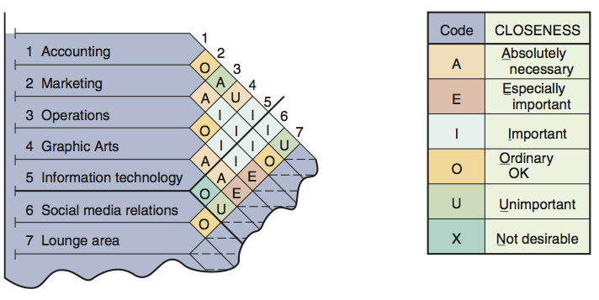
Relationship Chart
Figure 9.1

Slide 15
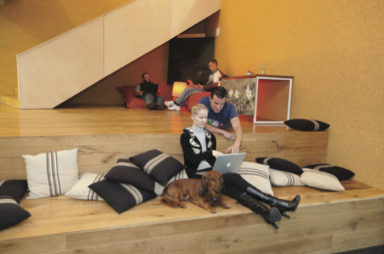
Office Layout
Three physical and social aspects
Proximity
Privacy
Permission
Two major trends
Information technology
Dynamic needs for space and services

Slide 16
Retail Layout
Objective is to maximize profitability per square foot of floor space
Sales and profitability vary directly with customer exposure

Slide 17
Five Helpful Ideas for Supermarket Layout
Locate high-draw items around the periphery of the store
Use prominent locations for high-impulse and high-margin items
Distribute power items to both sides of an aisle and disperse them to increase viewing of other items
Use end-aisle locations
Convey mission of store through careful positioning of lead-off department

Slide 18
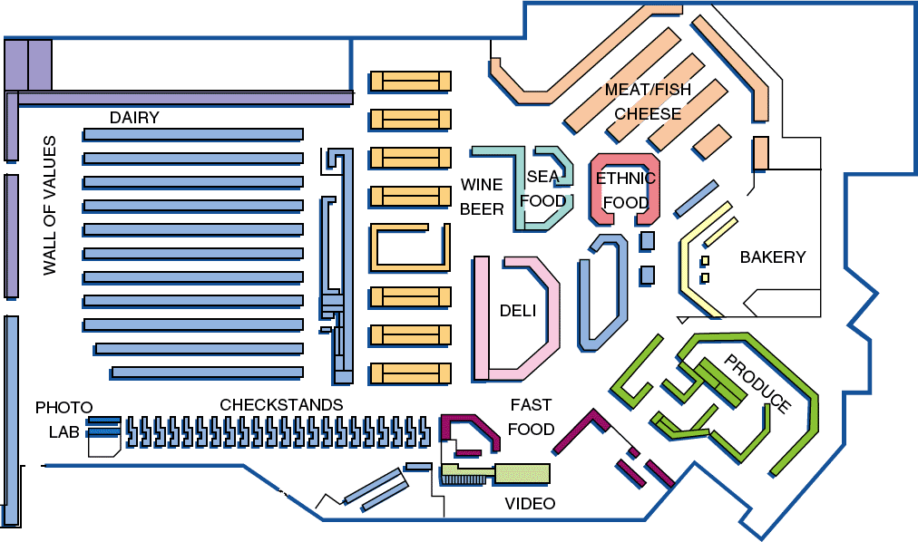
Store Layout
Figure 9.2

Slide 19
Slotting
Manufacturers pay slotting fees to retailers to get the retailers to display (slot) their product
Contributing factors
Limited shelf space
An increasing number of new products
Better information about sales through POS data collection
Closer control of inventory

Slide 20
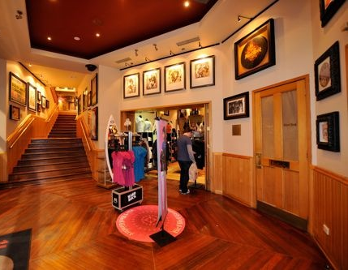
Servicescapes
Ambient conditions - background characteristics such as lighting, sound, smell, and temperature
Spatial layout and functionality - which involve customer circulation path planning, aisle characteristics, and product grouping
Signs, symbols, and artifacts - characteristics of building design that carry social significance

Slide 21
Warehouse and Storage Layouts
Objective is to find the optimum trade-offs between handling costs and costs associated with warehouse space
Maximize the total "cube" of the warehouse – utilize its full volume while maintaining low material handling costs

Slide 22
Warehousing and Storage Layouts
Material Handling Costs
All costs associated with the transaction
Incoming transport
Storage
Finding and moving material
Outgoing transport
Equipment, people, material, supervision, insurance, depreciation
Minimize damage and spoilage

Slide 23
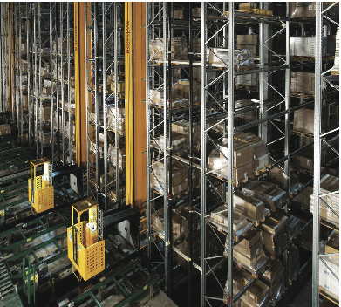
Warehousing and Storage Layouts
Warehouse density tends to vary inversely with the number of different items stored
Automated Storage and Retrieval Systems (ASRSs) can significantly improve warehouse productivity
Dock location is a key design element

Slide 24
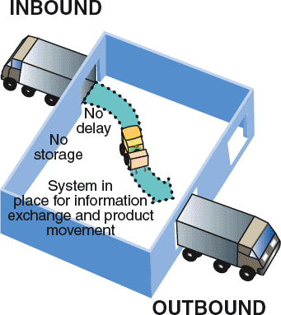
Cross-Docking
Materials are moved directly from receiving to shipping and are not placed in storage in the warehouse
Requires tight scheduling and accurate shipments, bar code or RFID identification used for advanced shipment notification as materials are unloaded

Slide 25
Random Stocking
Typically requires automatic identification systems (AISs) and effective information systems
Allows more efficient use of space
Key tasks
Maintain list of “open” locations
Maintain accurate records
Sequence items to minimize travel, “pick” time
Combine picking orders
Assign classes of items to particular areas

Slide 26
Customizing
Value-added activities performed at the warehouse
Enable low cost and rapid response strategies
Assembly of components
Loading software
Repairs
Customized labeling and packaging

Slide 27
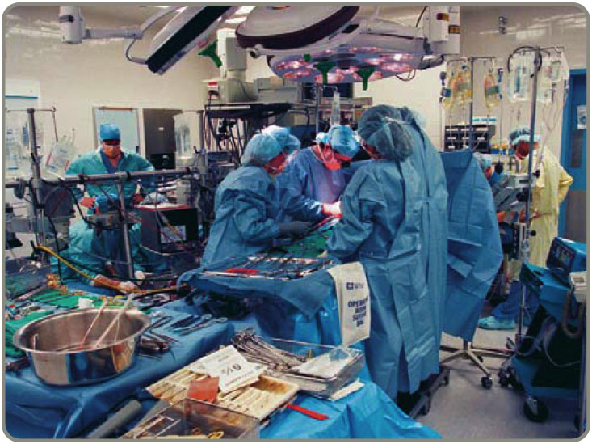
Fixed-Position Layout
Product remains in one place
Workers and equipment come to site
Complicating factors
Limited space at site
Different materials required at different stages of the project
Volume of materials needed is dynamic

Slide 28
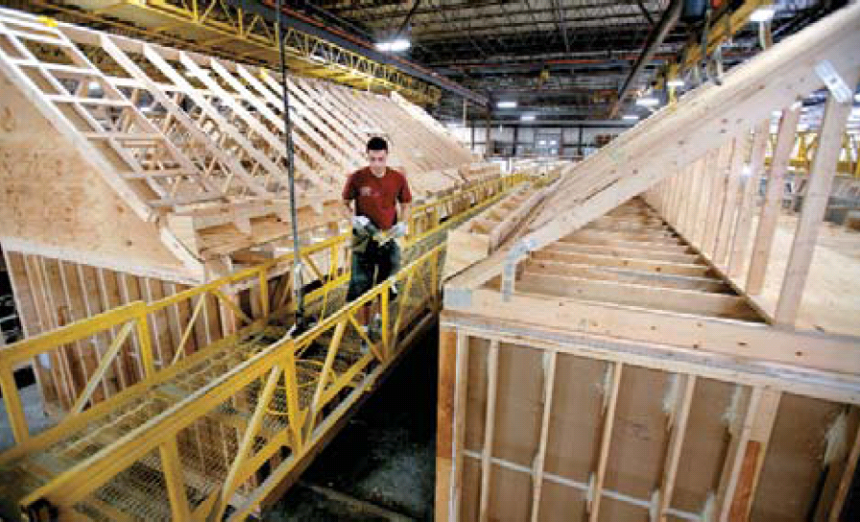
Alternative Strategy
As much of the project as possible is completed off-site in a product-oriented facility
This can significantly improve efficiency but is only possible when multiple similar units need to be created

Slide 29
Process-Oriented Layout
Like machines and equipment are grouped together
Flexible and capable of handling a wide variety of products or services
Scheduling can be difficult and setup, material handling, and labor costs can be high

Slide 30
Process-Oriented Layout
Surgery
ER triage room
Emergency room admissions
Patient A - broken leg
Patient B - erratic heart pacemaker
Laboratories
Radiology
ER Beds
Pharmacy
Billing/exit
Figure 9.3

Slide 31
Process-Oriented Layout
Arrange work centers so as to minimize the costs of material handling
Basic cost elements are
Number of loads (or people) moving between centers
Distance loads (or people) move between centers

Slide 32
Process-Oriented Layout
where n = total number of work centers or departments
i, j = individual departments
X_{ij} = number of loads moved from department i to department j
C_{ij} = cost to move a load between department i and department j

Slide 33
Process Layout Example
Arrange six departments in a factory to minimize the material handling costs. Each department is 20 x 20 feet and the building is 60 feet long and 40 feet wide.
Construct a "from-to matrix"
Determine the space requirements
Develop an initial schematic diagram
Determine the cost of this layout
Try to improve the layout
Prepare a detailed plan

Slide 34
Process Layout Example
Figure 9.4
Number of loads per week
Department Assembly Painting Machine Receiving Shipping Testing
(1) (2) Shop (3) (4) (5) (6)
Assembly (1)
Painting (2)
Machine Shop (3)
Receiving (4)
Shipping (5)
Testing (6)
50 100 0 0 20
30 50 10 0
20 0 100
50 0
0

Slide 35
Process Layout Example
Figure 9.5
Area A Area B Area C
Area D Area E Area F
Assembly Painting Machine Shop
Department Department Department
(1) (2) (3)
40'
Receiving Shipping Testing
Department Department Department
(4) (5) (6)
60'

Slide 36
Process Layout Example
Interdepartmental Flow Graph
Figure 9.6
100
Assembly
(1)
50
Painting
(2)
30
Machine Shop (3)
20
20
10
50
100
Receiving
(4)
Shipping
(5)
Testing
(6)
50

Slide 37
Process Layout Example
Cost = $50 + $200 + $40 (1 and 2) (1 and 3) (1 and 6)
+ $30 + $50 + $10 (2 and 3) (2 and 4) (2 and 5)
+ $40 + $100 + $50 (3 and 4) (3 and 6) (4 and 5)
= $570

Slide 38
Process Layout Example
Revised Interdepartmental Flow Graph
30
Figure 9.7
Painting
(2)
50
Assembly
(1)
100
Machine Shop (3)
10
20
50
20
100
Receiving
(4)
Shipping
(5)
Testing
(6)
50

Slide 39
Process Layout Example
Cost = $50 + $100 + $20 (1 and 2) (1 and 3) (1 and 6)
+ $60 + $50 + $10 (2 and 3) (2 and 4) (2 and 5)
+ $40 + $100 + $50 (3 and 4) (3 and 6) (4 and 5)
= $480

Slide 40
Process Layout Example
Figure 9.8
Area A Area B Area C
Area D Area E Area F
Painting Assembly Machine Shop
Department Department Department
(2) (1) (3)
40'
Receiving Shipping Testing
Department Department Department
(4) (5) (6)
60'

Slide 41
Work Cells
Reorganizes people and machines into groups to focus on single products or product groups
Group technology identifies products that have similar characteristics for particular cells
Volume must justify cells
Cells can be reconfigured as designs or volume changes

Slide 42
Advantages of Work Cells
Reduced work-in-process inventory
Less floor space required
Reduced raw material and finished goods inventories
Reduced direct labor cost
Heightened sense of employee participation
Increased equipment and machinery utilization
Reduced investment in machinery and equipment

Slide 43
Requirements of Work Cells
Identification of families of products
A high level of training, flexibility and empowerment of employees
Being self-contained, with its own equipment and resources
Test (poka-yoke) at each station in the cell

Slide 44
Improving Layouts Using Work Cells
Figure 9.9 (a)
Material
Current layout - workers in small closed areas.
Improved layout - cross-trained workers can assist each other. May be able to add a third worker as additional output is needed.

Slide 45
Improving Layouts Using Work Cells
Figure 9.9 (b)
Current layout - straight lines make it hard to balance tasks because work may not be divided evenly
Improved layout - in U shape, workers have better access. Four cross-trained workers were reduced to three.
U-shaped line may reduce employee movement and space requirements while enhancing communication, reducing the number of workers, and facilitating inspection

Slide 46
Staffing and Balancing Work Cells
Determine the takt time
Total work time available
Takt time =
Units required to satisfy customer demand
Determine the number of operators required
Total operation time required
Takt time
Workers required =

Slide 47
Staffing Work Cells Example
600 mirrors per day required
Mirror production scheduled for 8 hours per day
From a work balance chart total operation time = 140 seconds
60
50
40
30
20
10
0
Standard time required
Figure 9.10
Assemble
Paint
Test
Label
Pack for
shipment
Operations

Slide 48
Staffing Work Cells Example
600 mirrors per day required
Mirror production scheduled for 8 hours per day
From a work balance chart total operation time = 140 seconds
Takt time = (8 hrs x 60 mins) / 600 units
= .8 min = 48 seconds
Total operation time required
Takt time
Workers required =
= 140 / 48 = 2.92

Slide 49
Work Balance Charts
Used for evaluating operation times in work cells
Can help identify bottleneck operations
Flexible, cross-trained employees can help address labor bottlenecks
Machine bottlenecks may require other approaches

Slide 50
Focused Work Center and Focused Factory
Focused Work Center
Identify a large family of similar products that have a large and stable demand
Moves production from a general-purpose, process-oriented facility to a large work cell
Focused Factory
A focused work cell in a separate facility
May be focused by product line, layout, quality, new product introduction, flexibility, or other requirements

Slide 51
Repetitive and Product-Oriented Layout
Organized around products or families of similar high-volume, low-variety products
Volume is adequate for high equipment utilization
Product demand is stable enough to justify high investment in specialized equipment
Product is standardized or approaching a phase of life cycle that justifies investment
Supplies of raw materials and components are adequate and of uniform quality

Slide 52
Product-Oriented Layouts
Fabrication line
Builds components on a series of machines
Machine-paced
Require mechanical or engineering changes to balance
Assembly line
Puts fabricated parts together at a series of workstations
Paced by work tasks
Balanced by moving tasks

Slide 53
Product-Oriented Layouts
Fabrication line
Builds components on a series of machines
Machine-paced
Require mechanical or engineering changes to balance
Assembly line
Puts fabricated parts together at a series of workstations
Paced by work tasks
Balanced by moving tasks
Both types of lines must be balanced so that the time to perform the work at each station is the same

Slide 54
Product-Oriented Layouts
Advantages
Low variable cost per unit
Low material handling costs
Reduced work-in-process inventories
Easier training and supervision
Rapid throughput
Disadvantages
High volume is required
Work stoppage at any point ties up the whole operation
Lack of flexibility in product or production rates

Slide 55
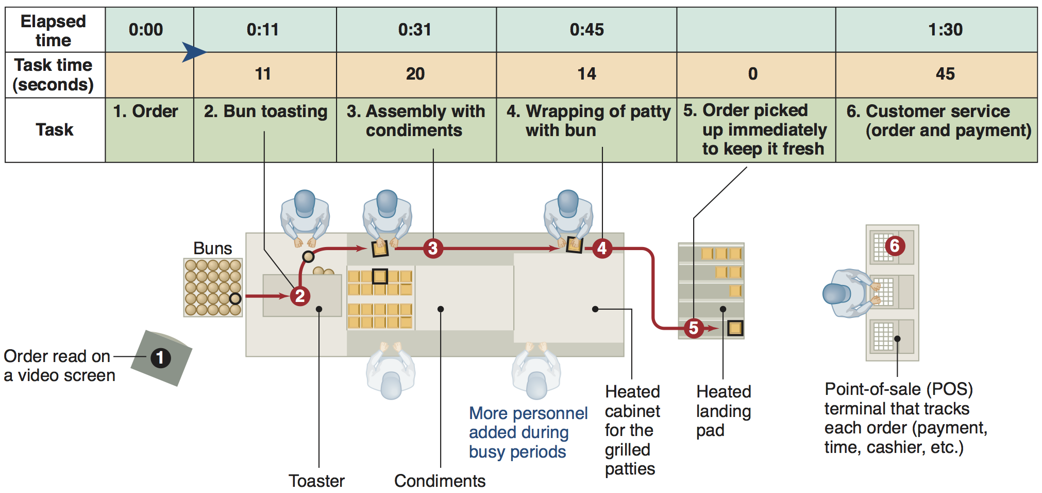
McDonald's Assembly Line
Figure 9.11

Slide 56
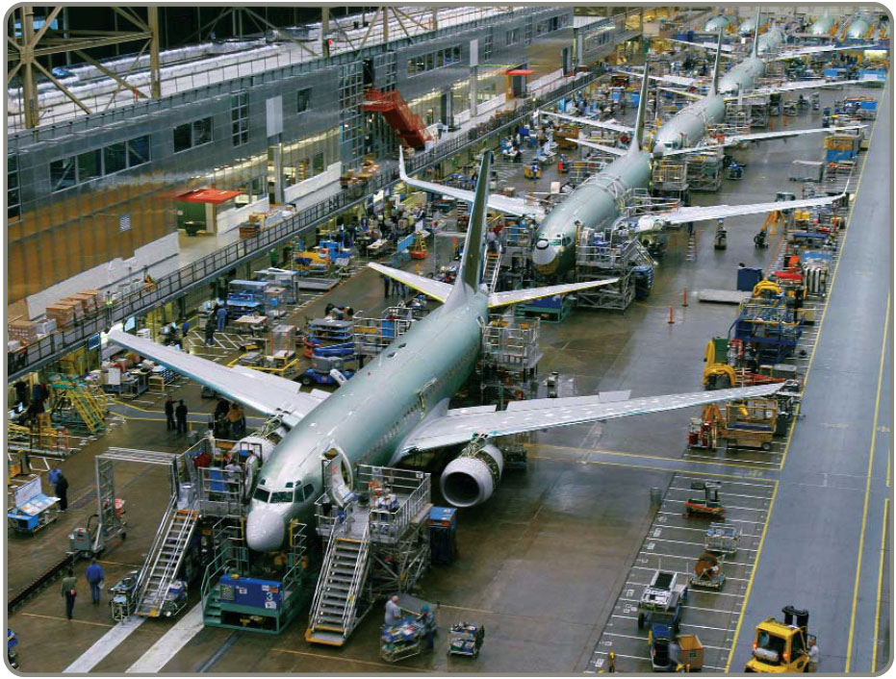
Assembly-Line Balancing
Objective is to minimize the imbalance between machines or personnel while meeting required output
Starts with the precedence relationships
Determine cycle time
Calculate theoretical minimum number of workstations
Balance the line by assigning specific tasks to workstations

Slide 57
Wing Component Example
TABLE 9.2 |  | Precedence Data for Wing Component
TASK | ASSEMBLY TIME (MINUTES) |  |  |  | TASK MUST FOLLOW TASK LISTED BELOW
A |  |  | 10 |  | –
B |  |  | 11 |  | A
C |  |  | 5 |  | B
D |  |  | 4 |  | B
E |  |  | 11 |  | A
F |  |  | 3 |  | C, D
G |  |  | 7 |  | F
H |  |  | 11 |  | E
I |  |  | 3 |  | G, H
Total time |  |  | 65
This means that tasks B and E cannot be done until task A has been completed

Slide 58
Wing Component Example
TABLE 9.2 |  | Precedence Data for Wing Component
TASK | ASSEMBLY TIME (MINUTES) |  |  |  | TASK MUST FOLLOW TASK LISTED BELOW
A |  |  | 10 |  | –
B |  |  | 11 |  | A
C |  |  | 5 |  | B
D |  |  | 4 |  | B
E |  |  | 11 |  | A
F |  |  | 3 |  | C, D
G |  |  | 7 |  | F
H |  |  | 11 |  | E
I |  |  | 3 |  | G, H
Total time |  |  | 65
480 available mins per day
40 units required
Figure 9.12
5
C
10
11
3
7
A
B
F
G
4
3
11
D
11
I
E
H

Slide 59
Wing Component Example
TABLE 9.2 |  | Precedence Data for Wing Component
TASK | ASSEMBLY TIME (MINUTES) |  |  |  | TASK MUST FOLLOW TASK LISTED BELOW
A |  |  | 10 |  | –
B |  |  | 11 |  | A
C |  |  | 5 |  | B
D |  |  | 4 |  | B
E |  |  | 11 |  | A
F |  |  | 3 |  | C, D
G |  |  | 7 |  | F
H |  |  | 11 |  | E
I |  |  | 3 |  | G, H
Total time |  |  | 65
480 available mins per day
40 units required
Production time available per day
Units required per day
Cycle time =
= 480 / 40
= 12 minutes per unit
Figure 9.12
5
C
10
11
3
7
A
B
F
G
Minimum number of workstations
4
3
11
D
11
I
= 65 / 12
= 5.42, or 6 stations
E
H

Slide 60
Wing Component Example
TABLE 9.3 | Layout Heuristics That May Be Used to Assign Tasks to Workstations in Assembly-Line Balancing
1. Longest task time |  | From the available tasks, choose the task with the largest (longest) task time
2. Most following tasks |  | From the available tasks, choose the task with the largest number of following tasks
3. Ranked positional weight |  | From the available tasks, choose the task for which the sum of following task times is the longest
4. Shortest task time |  | From the available tasks, choose the task with the shortest task time
5. Least number of following tasks |  | From the available tasks, choose the task with the least number of subsequent tasks

Slide 61
Wing Component Example
480 available mins per day
40 units required
Figure 9.13
Cycle time = 12 mins
Minimum workstations
= 5.42 or 6
Station 2
5
C
10
11
3
7
A
B
F
G
4
3
D
Station 3
I
Station 4
11
11
Station 6
Station 1
E
H
Station 6
Station 3
Station 5

Slide 62
Wing Component Example
TABLE 9.2 |  | Precedence Data for Wing Component
TASK | ASSEMBLY TIME (MINUTES) |  |  |  | TASK MUST FOLLOW TASK LISTED BELOW
A |  |  | 10 |  | –
B |  |  | 11 |  | A
C |  |  | 5 |  | B
D |  |  | 4 |  | B
E |  |  | 11 |  | A
F |  |  | 3 |  | C, D
G |  |  | 7 |  | F
H |  |  | 11 |  | E
I |  |  | 3 |  | G, H
Total time |  |  | 65
480 available mins per day
40 units required
Cycle time = 12 mins
Minimum workstations
= 5.42 or 6
Figure 9.12
5
∑ Task times
(Actual number of workstations) x (Largest cycle time)
Efficiency =
C
10
11
3
7
A
B
F
G
= 65 minutes / ((6 stations) x (12 minutes))
= 90.3%
4
3
11
D
11
I
E
H
Idle Time = ((6 stations) × (12 minutes)) – 65 minutes = 7 minutes

