Slide 1
Supply Chain Management
11
PowerPoint presentation to accompany
Heizer, Render, Munson
Operations Management, Twelfth Edition, Global Edition
Principles of Operations Management, Tenth Edition, Global Edition
PowerPoint slides by Jeff Heyl

Slide 2
Learning Objectives
When you complete this chapter you should be able to:
11.1 Explain the strategic importance of the supply chain
11.2 Identify six sourcing strategies
11.3 Explain issues and opportunities in the supply chain
11.4 Describe the steps in supplier selection

Slide 3
Learning Objectives
When you complete this chapter you should be able to:
11.5 Explain major issues in logistics management
11.6 Compute percentage of assets committed to inventory and inventory turnover

Slide 4
Supply-Chain Management
The objective of supply chain management is to structure the supply chain to maximize its competitive advantage and benefits to the ultimate consumer

Slide 5
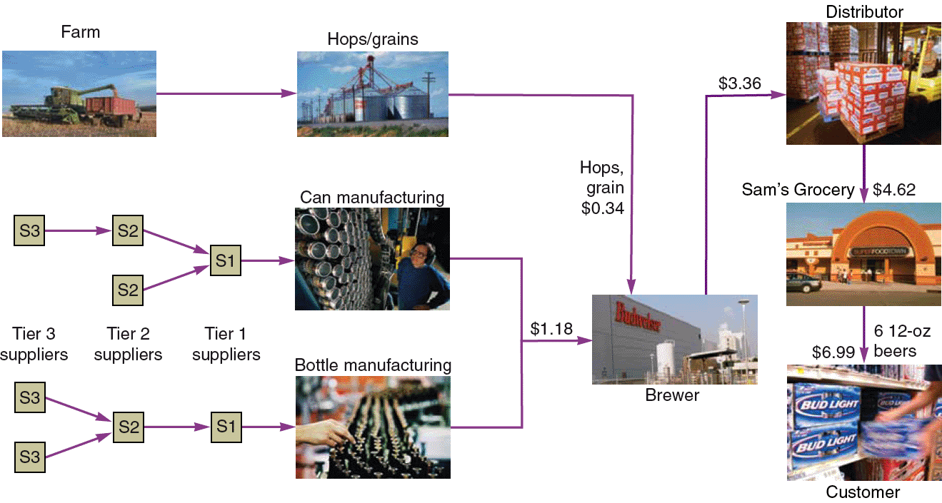
A Supply Chain for Beer
Figure 11.1

Slide 6
The Supply Chain’s Strategic Importance
The coordination of all supply chain activities, starting with raw materials and ending with a satisfied customer
Includes suppliers, manufacturers and/or service providers, distributors, wholesalers, retailers, and final customers

Slide 7
The Supply Chain’s Strategic Importance
Large portion of sales dollars spent on purchases
Supplier relationships increasingly integrated and long term
Improve innovation, speed design, reduce costs
Managing supplier relationships has added emphasis

Slide 8
Sourcing Issues
Make-or-buy decisions
Choosing between obtaining products and services externally as opposed to producing them internally
Outsourcing
Transfer traditional internal activities and resources to outside vendors
Efficiency in specialization
Focus on core competencies

Slide 9
Six Sourcing Strategies
Many suppliers
Few suppliers
Vertical integration
Joint ventures
Keiretsu networks
Virtual companies

Slide 10
Many Suppliers
Commonly used for commodity products
Purchasing is typically based on price
Suppliers compete with one another
Supplier is responsible for technology, expertise, forecasting, cost, quality, and delivery

Slide 11
Few Suppliers
Buyer forms longer term relationships with fewer suppliers
Create value through economies of scale and learning curve improvements
Suppliers more willing to participate in JIT programs and contribute design and technological expertise
Cost of changing suppliers is huge
Trade secrets and other alliances may be at risk

Slide 12
Vertical Integration
Vertical Integration Examples of Vertical Integration
Raw material (suppliers) |  |  | Tree Harvesting
Backward integration |  | Chipmakers | Pulpmaking
Current transformation | Pepsi | Apple | International Paper
Forward integration | Bottling | Retail stores | End-User Paper Conversion
Finished goods (customers)
Figure 11.2

Slide 13
Vertical Integration
Developing the ability to produce goods or services previously purchased
Integration may be forward, towards the customer, or backward, towards suppliers
Can improve cost, quality, delivery, and inventory but requires capital, managerial skills, and demand
Risky in industries with rapid technological change

Slide 14
Joint Ventures
Formal collaboration
Enhance skills
Secure supply
Reduce costs
The challenge is to cooperation without diluting brand or conceding competitive advantage

Slide 15
Keiretsu Networks
A middle ground between few suppliers and vertical integration
Supplier becomes part of the company coalition
Often provide financial support for suppliers through ownership or loans
Members expect long-term relationships and provide technical expertise and stable deliveries
May extend through several levels of the supply chain

Slide 16
Virtual Companies
Rely on a variety of supplier relationships to provide services on demand
Fluid organizational boundaries that allow the creation of unique enterprises to meet changing market demands
Relationships may be short- or long-term
Exceptionally lean performance, low capital investment, flexibility, and speed

Slide 17
Managing the Integrated Supply Chain
Issues
Local optimization can magnify fluctuations
Incentives push merchandise into the supply chain for sales that have not occurred
Large lots reduce shipping and production costs but increase inventory holding and do not reflect actual sales

Slide 18
Managing the Integrated Supply Chain
Opportunities
Accurate “pull” data, shared information
Lot size reduction, shipping, discounts, reduced ordering costs
Single stage control of replenishment
Single supply chain member responsible for ordering
Vendor managed inventory (VMI)

Slide 19
Managing the Integrated Supply Chain
Opportunities
Collaborative planning, forecasting, and replenishment (CPFR) throughout the supply chain
Blanket orders against which actual orders are released
Standardization

Slide 20
Managing the Integrated Supply Chain
Opportunities
Postponement withholds modification as long as possible
Electronic ordering and funds transfer speed transactions and reduce paperwork
Drop shipping and special packaging bypasses the seller and reduces costs

Slide 21
Building the Supply Base
Supplier evaluation
Finding potential suppliers
Determine likelihood of their becoming good suppliers
Supplier certification
Qualification
Education
Certification

Slide 22
Building the Supply Base
Supplier development
Integrate the supplier into the system
Quality requirements
Product specifications
Schedules and delivery
Procurement policies
Training
Engineering and production help
Information transfer procedures

Slide 23
Building the Supply Base
Negotiation
A significant element in purchasing
Highly valued skills
Cost-based price model
Supplier opens books
Market-based price model
Based on published, auction, or indexed prices
Competitive bidding
Common policy for many purchases
Does not generally foster long-term relationships

Slide 24
Building the Supply Base
Contracting
Share risks, benefits, create incentives
Centralized purchasing
Leverage volume
Develop specialized staff
Develop supplier relationships
Maintain professional control
Devote resources to selection and negotiation
Reduce duplication of tasks
Promote standardization

Slide 25
Building the Supply Base
E-Procurement
Speeds purchasing, reduces costs, integrates supply chain
Online catalogs and exchanges
Standard items or industry-specific web sites
Online auctions
Low barriers to entry
Reverse auctions for buyers
Price not always the most important factor

Slide 26
Shipping Systems
Airfreight
Fast and flexible for light loads
May be expensive
Waterways
Typically used for bulky, low-value cargo
Used when shipping cost is more important than speed

Slide 27
Shipping Systems
Pipelines
Used for transporting oil, gas, and other chemical products
Multimodal
Combines shipping methods
Common, especially in international shipments
Aided by standardized containers

Slide 28
Supplier Selection Analysis
Many factors play a role
Choosing lowest bid is becoming rare
Factor-weighting technique considers multiple criteria
Each factor is assigned a weight and a score
Choose the supplier with the best weighted score

Slide 29
Factor Weighting Approach
 |  |  |  | FABER PAINT |  |  |  | SMITH DYE
CRITERION | WEIGHT |  |  | SCORE (1-5) (5 HIGHEST) | WEIGHT x SCORE |  |  | SCORE (1-5) (5 HIGHEST) | WEIGHT x SCORE
Engineering/ innovation skills |  | .20 |  | 5 |  | 1.0 |  | 5 |  | 1.0
Production process capability |  | .15 |  | 4 |  | 0.6 |  | 5 |  | 0.75
Distribution capability |  | .05 |  | 4 |  | 0.2 |  | 3 |  | 0.15
Quality performance |  | .10 |  | 2 |  | 0.2 |  | 3 |  | 0.3
Facilities/location |  | .05 |  | 2 |  | 0.1 |  | 3 |  | 0.15
Financial strength |  | .15 |  | 4 |  | 0.6 |  | 5 |  | 0.75
Information systems |  | .10 |  | 2 |  | 0.2 |  | 5 |  | 0.5
Integrity |  | .20 |  | 5 |  | 1.0 |  | 3 |  | 0.6
Total |  | 1.00 |  |  |  | 3.9 |  |  |  | 4.2

