Slide 1

Human Resources, Job Design, and Work Measurement
10
PowerPoint presentation to accompany
Heizer, Render, Munson
Operations Management, Twelfth Edition, Global Edition
Principles of Operations Management, Tenth Edition, Global Edition
PowerPoint slides by Jeff Heyl

Slide 2
Learning Objectives
When you complete this chapter you should be able to:
10.1 Describe labor-planning policies
10.2 Identify the major issues in job design
10.3 Identify major ergonomic and work environment issues
10.4 Use the tools of methods analysis

Slide 3
Learning Objectives
When you complete this chapter you should be able to:
10.5 Identify four ways of establishing labor standards
10.6 Compute the normal and standard times in a time study
10.7 Find the proper sample size for a time study

Slide 4
Human Resource Strategy
The objective of a human resource strategy is to manage labor and design jobs so people are effectively and efficiently utilized

Slide 5
Human Resource Strategy
Ensure that people:
Are efficiently utilized within the constraints of other operations management decisions
Have a reasonable quality of work life in an atmosphere of mutual commitment and trust

Slide 6
Constraints on Human Resource Strategy
Product strategy
Skills needed
Talents needed
Materials used
Safety
Process strategy
Technology
Machinery and equipment used
Safety
What
Procedure
Schedules
Time of day
Time of year
(seasonal)
Stability of schedules
Individual differences
Strength and fatigue
Information processing and response
When
HUMAN RESOURCE STRATEGY
Who
Location strategy
Climate
Temperature
Noise
Light
Air quality
Layout strategy
Fixed position
Process
Assembly line
Work cell
Product
Where
How
Figure 10.1

Slide 7
Labor Planning
Employment-Stability Policies
Follow demand exactly
  Matches direct labor costs to production
  Incurs costs in hiring and termination, unemployment insurance, and premium wages
  Labor is treated as a variable cost

Slide 8
Labor Planning
Employment-Stability Policies
Hold employment constant
  Maintains trained workforce
  Minimizes hiring, layoff, and unemployment costs
  Employees may be underutilized during slack periods or overworked during busy periods
  Labor is treated as a fixed cost

Slide 9
Work Schedules
Standard work schedule
  Five eight-hour days
Flextime
  Allows employees, within limits, to determine their own schedules
Flexible work week/compressed workweek
  Fewer but longer days
Part-time status
  Fewer, possibly irregular, hours

Slide 10
Job Classification and
Work Rules
Specify who can do what
Specify when they can do it
Specify under what conditions they can do it
Often result of union contracts
Restricts flexibility in assignments and consequently efficiency of production

Slide 11
Job Design
Specifying the tasks that constitute a job for an individual or a group
  Job specialization
  Job expansion
  Psychological components
  Self-directed teams
  Motivation and incentive systems

Slide 12
Labor Specialization
The division of labor into unique tasks
First suggested by Adam Smith in 1776
  Development of dexterity
  Less loss of time
  Development of specialized tools
Later Charles Babbage (1832) added another consideration
  Paying exactly the wage needed for the particular skill required

Slide 13
Job Expansion
Adding more variety to jobs
Intended to reduce boredom associated with labor specialization
  Job enlargement
  Job rotation
  Job enrichment
  Employee empowerment

Slide 14
Job Enlargement
Figure 10.2
Enriched job
Planning
(Participate in a cross-function quality improvement team)
Enlarged job
Task #3
(Lock printed circuit board into fixture for next operation)
Present job
(Manually insert and solder six resistors)
Task #2
(Adhere labels to printed circuit board)
Control
(Test circuits after assembly)

Slide 15


Psychological Components of Job Design
Human resource strategy requires consideration of the psychological components of job design

Slide 16
Core Job Characteristics
Jobs should include the following characteristics
Skill variety
Job identity
Job significance
Autonomy
Feedback

Slide 17
Self-Directed Teams
Group of empowered individuals working together to reach a common goal
May be organized for long-term or
short-term objectives
Effective because
  Provide employee empowerment
  Ensure core job characteristics
  Meet individual psychological needs

Slide 18
Self-Directed Teams
To maximize effectiveness, managers should
Ensure those who have legitimate contributions are on the team
Provide management support
Ensure the necessary training
Endorse clear objectives and goals
Employ financial and non-financial rewards
Reduce supervisory control

Slide 19
Job Design Continuum
Self-directed teams
Figure 10.3
Empowerment
Enrichment
Self-direction
Enlargement
Specialization
Job expansion

Slide 20
Benefits of Teams and
Expanded Job Designs
Improved quality of work life
Improved job satisfaction
Increased motivation
Allows employees to accept more responsibility
Improved productivity and quality
Reduced turnover and absenteeism

Slide 21
Limitations of Job Expansion
Higher capital cost
Individual differences
Higher wage rates
Smaller labor pool
Higher training costs

Slide 22
Limitations of Job Expansion
Higher capital cost
Individual differences
Higher wage rates
Smaller labor pool
Higher training costs
Average Annual Training Hours/ Employee
U.S. 7
Sweden 170
Japan 200

Slide 23
Motivation and Incentive Systems
Bonuses – cash or stock options
Profit-sharing – profits for distribution to employees
Gain sharing – rewards for improvements
Incentive systems – typically based on production rates
Knowledge-based systems – reward for knowledge or skills

Slide 24
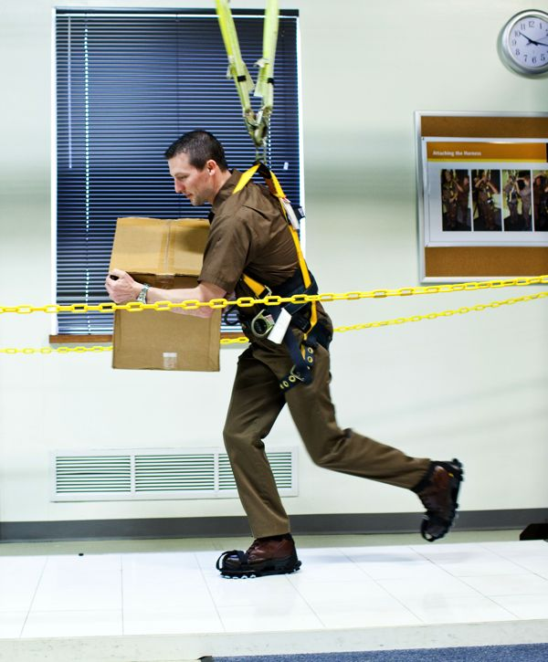
Ergonomics and the Work Environment
Ergonomics is the study of the human interface with the environment and machines
  Often called
  human factors
Operator input
to machines needs
to be carefully
evaluated

Slide 25

Ergonomics and Work Methods
Feedback to operators
The work environment
  Illumination
  Noise
  Temperature
  Humidity

Slide 26
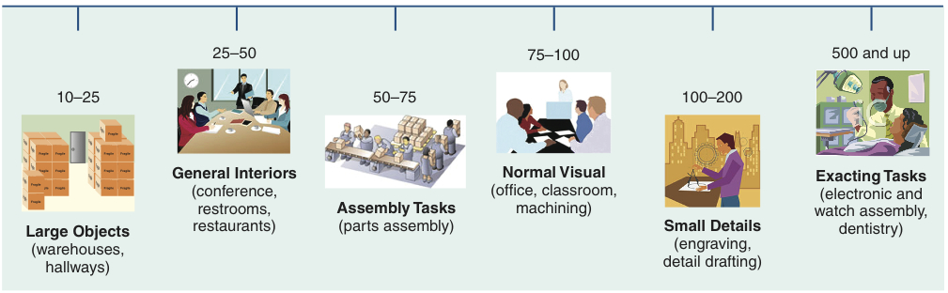
Recommended Levels of Illumination
Figure 10.4a

Slide 27
Levels of Illumination
TASK CONDITION | TYPE OF TASK OR AREA | ILLUMINATION LEVEL | TYPE OF ILLUMINATION
Small detail, extreme accuracy | Sewing, inspecting dark materials | 100 | Overhead ceiling lights and desk lamp
Normal detail, prolonged periods | Reading, parts assembly, general office work | 20-50 | Overhead ceiling lights
Good contrast, fairly large objects | Recreational facilities | 5-10 | Overhead ceiling lights
Large objects | Restaurants, stairways, warehouses | 2-5 | Overhead ceiling lights

Slide 28
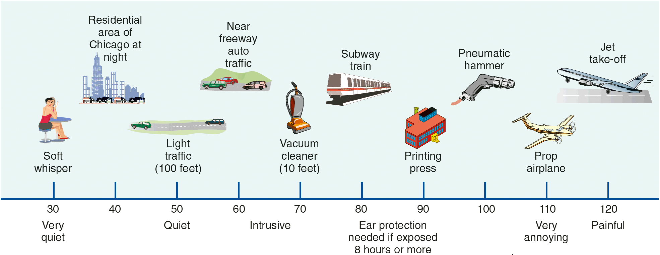
Decibel Levels
Table 10.4b

Slide 29
Methods Analysis
Focuses on how task is performed
Used to analyze
  Movement of individuals or material
    Flow diagrams and process charts
  Activities of human and machine and crew activity
    Activity charts
  Body movement
    Operations charts

Slide 30
Flow Diagram
Welding
From
press mach.
Storage bins
Paint shop
Mach. 3
Mach. 4
Machine 1
Mach. 2
Figure 10.5 (a)

Slide 31
Flow Diagram
Machine 4
Welding
Machine 3
Machine 2
Paint shop
Machine 1
From press mach.
Storage bins
Figure 10.5 (b)

Slide 32
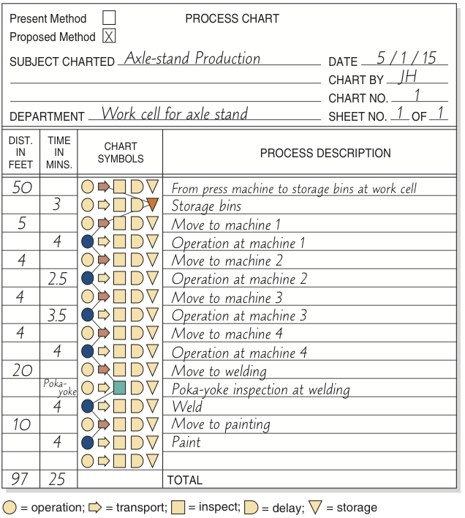
Process Chart
Figure 10.5 (c)

Slide 33
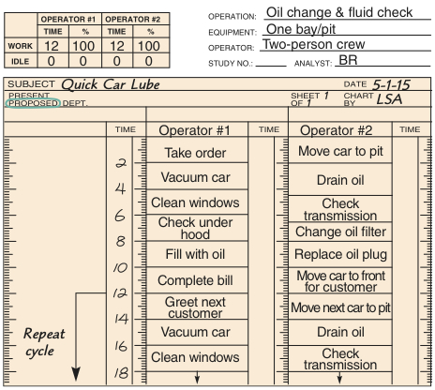
Activity Chart
Figure 10.6

Slide 34
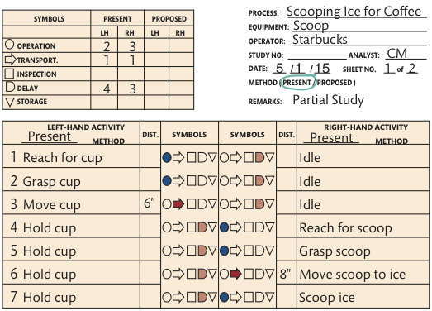
Operations Chart
Figure 10.7

Slide 35
The Visual Workplace
Use low-cost visual devices to share information quickly and accurately
Displays and graphs replace printouts and paperwork
Able to provide timely information in a dynamic environment
System should focus on improvement

Slide 36
The Visual Workplace
Visual signals can take many forms and serve many functions
Present the big picture
Performance
Housekeeping

Slide 37
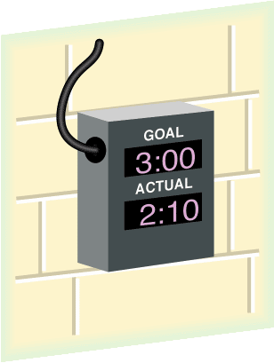

The Visual Workplace
Visual utensil holder encourages housekeeping
A "3-minute service" clock reminds employees of the goal
Figure 10.8

Slide 38

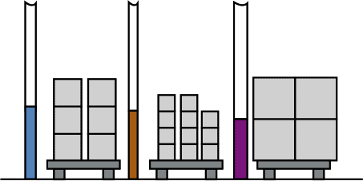
The Visual Workplace
Visual signals at the machine notify support personnel
Visual kanbans reduce inventory and foster JIT
Reorder point
Line/machine stoppage
Parts/ maintenance needed
All systems go
Part A Part B Part C
Andon
Figure 10.8

Slide 39

The Visual Workplace
Quantities in bins indicate ongoing daily requirements, and clipboards provide information on schedule changes
Company data, process specifications, and operating procedures are posted in each work area
Figure 10.8

Slide 40
Labor Standards
Effective manpower planning is dependent on a knowledge of the labor required
Labor standards are the amount of time required to perform a job or part of a job
Accurate labor standards help determine labor requirements, costs, and fair work

Slide 41
Labor Standards
Started early in the 20th century
Important to both manufacturing and service organizations
Necessary for determining staffing requirements
Important to labor incentive systems

Slide 42
Meaningful Standards Help Determine
Labor content of items produced
Staffing needs
Cost and time estimates
Crew size and work balance
Expected production
Basis of wage-incentive plans
Efficiency of employees
Notes:
This slide can be used to frame a discussion of capacity.
Points to be made might include:
- capacity definition and measurement is necessary if we are to develop a production schedule
- while a process may have “maximum” capacity, many factors prevent us from achieving that capacity on a continuous basis.
Students should be asked to suggest factors which might prevent one from achieving maximum capacity.

Slide 43
Labor Standards
May be set in four ways:
Historical experience
Time studies
Predetermined time standards
Work sampling

Slide 44
Historical Experience
How the task was performed last time
Easy and inexpensive
Data available from production records or time cards
Data is not objective and may be inaccurate
Not recommended

Slide 45
Time Studies
Involves timing a sample of a worker's performance and using it to set a standard
Requires trained and experienced observers
Cannot be set before the work is performed

Slide 46
Time Studies
Define the task to be studied
Divide the task into precise elements
Decide how many times to measure the task
Time and record element times and rating of performance

Slide 47
Time Studies
Compute average observed time
Sum of the times recorded to perform each element
Number of observations
Average observed
time
=
Determine performance rating and normal time
Average
observed
time
Performance
rating factor
Normal time = x

Slide 48
Time Studies
Add the normal times for each element to develop the total normal time for the task
Compute the standard time
Total normal time
1 - Allowance factor
Standard time =

Slide 49
Time Study Example 1
Average observed time = 4.0 minutes
Worker rating = 85%
Allowance factor = 13%
Normal time = (Average observed time) x (Rating factor)
= (4.0)(.85)
= 3.4 minutes
Normal time
1 – Allowance factor
3.4
1 – .13
3.4
.87
Standard time = = =
= 3.9 minutes
Notes:
It might be useful at this point to discuss typical equipment utilization rates for different process strategies if you have not done so before.

Slide 50
Time Study Example 2
Allowance factor = 15%
 | OBSERVATIONS (MIN) |  |  |  |  | PERFORMANCE RATING
JOB ELEMENT | 1 | 2 | 3 | 4 | 5
(A) Compose and type letter | 8 | 10 | 9 | 21* | 11 | 120%
(B) Type envelope address | 2 | 3 | 2 | 1 | 3 | 105%
(C) Stuff, stamp, seal, and sort envelopes | 2 | 1 | 5* | 2 | 1 | 110%
Delete unusual or nonrecurring observations (marked with *)
Compute average time for each element
Average time for A = (8 + 10 + 9 + 11)/4 = 9.5 minutes
Average time for B = (2 + 3 + 2 + 1 + 3)/5 = 2.2 minutes
Average time for C = (2 + 1 + 2 + 1)/4 = 1.5 minutes

Slide 51
Time Study Example 2
Compute the normal time for each element
Normal time = (Average observed time) x (Rating)
Normal time for A = (9.5)(1.2) = 11.4 minutes
Normal time for B = (2.2)(1.05) = 2.31 minutes
Normal time for C = (1.5)(1.10) = 1.65 minutes
Add the normal times to find the total normal time
Total normal time = 11.40 + 2.31 + 1.65
= 15.36 minutes

Slide 52
Time Study Example 2
Compute the standard time for the job
Total normal time
1 – Allowance factor
Standard time =
15.36
1 – .15
= = 18.07 minutes

Slide 53
Determine Sample Size
How accurate we want to be
The desired level of confidence
How much variation exists within the job elements

Slide 54
Determine Sample Size
Required sample size =
where h = accuracy level (acceptable error) desired in percent of the job element expressed as a decimal
z = number of standard deviations required for the desired level of confidence
s = standard deviation of the initial sample
= mean of the initial sample
n = required sample size

Slide 55
Determine Sample Size
TABLE 10.2
Common z-Values
DESIRED CONFIDENCE (%) |  | z-VALUE (STANDARD DEVIATION REQUIRED FOR DESIRED LEVEL OF CONFIDENCE)
90.0 |  | 1.65
95.0 |  | 1.95
95.45 |  | 2.00
99.0 |  | 2.58
99.73 |  | 3.00
Required sample size =
where h = accuracy level (acceptable error) desired in percent of the job element expressed as a decimal
z = number of standard deviations required for the desired level of confidence
s = standard deviation of the initial sample
= mean of the initial sample
n = required sample size

Slide 56
Time Study Example 3
Desired accuracy with 5%
Confidence level = 95%
Sample standard deviation = 1.0
Sample mean = 3.00
h = .05 = 3.00 s = 1.0
z = 1.96 (from Table S10.2 or Appendix I)

Slide 57
Time Study Example 3
Variations
If desired accuracy h is expressed as an absolute amount, substitute e for , where e is the absolute amount of acceptable error

Slide 58
Time Study Example 3
Variations
When the standard deviation s is not provided, it must be computed
where

Slide 59
Work Sampling
Estimates percent of time a worker spends on various tasks
Requires random observations to record worker activity
Determines how employees allocate their time
Can be used to set staffing levels, reassign duties, estimate costs, and set delay allowances

Slide 60
Work Sampling
Take a preliminary sample to obtain estimates of parameter values
Compute the sample size required
Prepare a schedule for random observations at appropriate times
Observe and record worker activities
Determine how workers spend their time

Slide 61
Work Sampling
Determining the sample size
where n = required sample size
z = standard normal deviate for desired confidence level
p = estimated value of sample proportion
h = acceptable error level in percent (as a decimal)

Slide 62
Work Sampling Example
Estimates employees idle 25% of the time
Sample should be accurate within ± 3%
Wants to have 95.45% confidence in the results
where n = required sample size
z = 2 for a 95.45% confidence level
p = estimate of idle proportion = 25% = .25
h = acceptable error of 3% = .03

