Slide 1
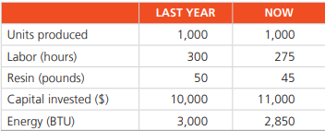
Tasks
George Kyparisis makes bowling balls in his Miami plant. With recent increases in his costs, he has a newfound interest in efficiency. George is interested in determining the productivity of his organization. He would like to know if his organization is maintaining the manufacturing average of 3% increase in productivity per year? He has the following data representing a month from last year and an equivalent month this year:
Show the productivity percentage change for each category and then determine the improvement for labor-hours, the typical standard for comparison.
Lillian Fok is president of Lakefront Manufacturing, a producer of bicycle tires. Fok makes 1,000 tires per day with the following resources:
What is the labor productivity per labor-hour for these tires at Lakefront Manufacturing?
What is the multifactor productivity for these tires at Lakefront Manufacturing?
What is the percent change in multifactor productivity if Fok can reduce the energy bill by $1,000 per day without cutting production or changing any other inputs?

