Slide 1
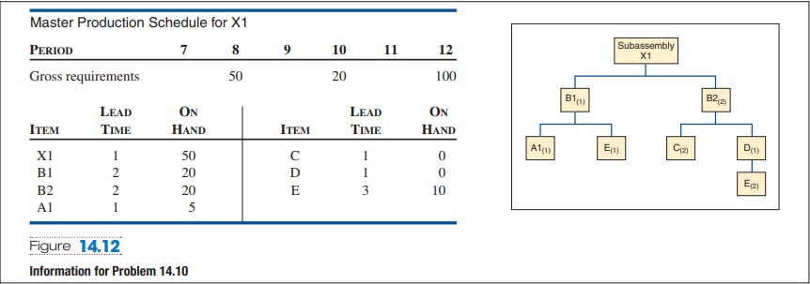
Task
Given the product structure and master production schedule ( Figure 14.12 below), develop a gross requirements plan for all items.
Given the preceding product structure, master production schedule, and inventory status ( Figure 14.12 ), develop a net materials requirements (planned order release) for all items

