Slide 1
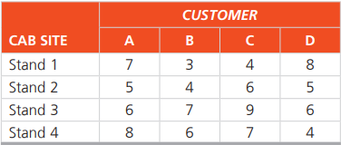
Task
The Green Cab Company has a taxi waiting at each of four cabstands in Evanston, Illinois. Four customers have called and requested service. The distances, in miles, from the waiting taxis to the customers are given in the following table.
Find the optimal assignment of taxis to customers so as to minimize total driving distances to the customers

Slide 2
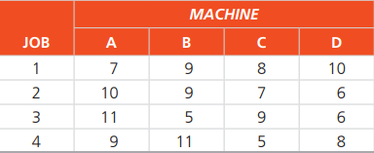
Task
J.C. Howard’s medical testing company in Kansas wishes to assign a set of jobs to a set of machines. The following table provides the production data of each machine when performing the specific job:
Determine the assignment of jobs to machines that will maximize total production.
What is the total production of your assignments?

Slide 3
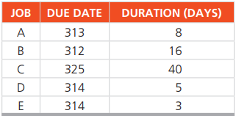
Task
The following jobs are waiting to be processed at the same machine center. Jobs are logged as they arrive:
In what sequence would the jobs be ranked according to the following decision rules:
FCFS,
EDD,
SPT
LPT?
All dates are specified as manufacturing planning calendar days. Assume that all jobs arrive on day 275. Which decision is best and why?

Slide 4
Task
Daniel’s Barber Shop at Newark Airport is open 7 days a week but has fluctuating demand. Daniel Ball is interested in treating his barbers as well as he can with steady work and preferably 5 days of work with two consecutive days off. His analysis of his staffing needs resulted in the following plan.
Schedule Daniel’s staff with the minimum number of barbers.

