Slide 1
Task
The results of a time study to perform a quality control test are shown in the following table. On the basis of these observations, determine the normal and standard time for thetest, assuming a 23% allowance factor.

Slide 2
Task
M. P. VanOyen Manufacturing has gone out on bid for a regulator component. Expected demand is 700 units per month. The item can be purchased from either Allen Manufacturing or Baker Manufacturing. Their price lists are shown in the table. Ordering cost is $50, and annual holding cost per unit is $5.
What is the economic order quantity?
Which supplier should be used? Why?
What is the optimal order quantity and total annual cost of ordering, purchasing, and holding the component?

Slide 3
Task
Fairview Industries is preparing its aggregate plan for the second half of the year. The table below contains monthly demand estimates and working days per month. Complete the table by computing total demand, demand per day (for each month), and the average requirement (in units per day) over the six-month planning horizon. Prepare a graph of forecast demand and level production, by months, for the planning period. Label your graph carefully
Calculate for plan1, plan2, and plan3?
What is the better plan?
Month | demand | Production Days
Jan | 850 | 20
Feb | 700 | 18
Mar | 900 | 21
Apr | 880 | 20
Mei | 950 | 21
Juni | 1210 | 22
Costs
Inventory cost | : | $ 10 | Per unit per month
Subcontracing cost | : | $ 30 | Per unit
Average pay rate | : | $ 10 | /hour
Over time | : | $ 17
Hiring cost | : | $400 | Per unit
Layoffs cost | : | $800 | Per unit
Labor-hours to produce a unit | : | 1.6 | Hours/unit
Hours per day | : | 8 | Hours

Slide 4
Task
Given the product structure and master production schedule Figure below, develop a gross requirements plan for all items. Given the preceding product structure, master production schedule, and inventory status, develop a net materials requirements (planned order release) for all items
Item | Lead Time | On Hand
A | 2 | 10
B | 2 | 10
C | 2 | 15
D | 3 | 20
E | 2 | 10
F | 3 | 10
G | 2 | 20
A
B(2)A
C(3)A
D(2)
E(2)A
F(2)A
G(1)
E(2)
G(2)

Slide 5
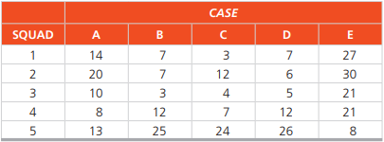
Task
The Baton Rouge Police Department has five detective squads available for assignment to five open crime cases. The chief of detectives, Jose Noguera, wishes to assign the squads so that the total time to conclude the cases is minimized. The average number of days, based on past performance, for each squad to complete each case is as follows:
Each squad is composed of different types of specialists, and whereas one squad may be very effective in certain types of cases, it may be almost useless in others. Solve the problem by using the assignment method

Slide 6
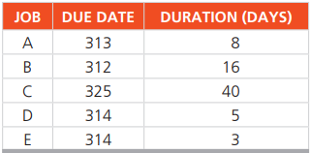
Task
An Alabama lumberyard has four jobs on order, as shown in the following table. Today is day 205 on the yard’s schedule
In what sequence would the jobs be ranked according to the following decision rules:
FCFS,
EDD,
SPT
LPT?
Which is best and why? Which has the minimum lateness?

