Slide 1
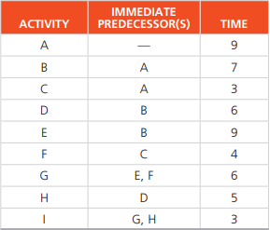
Tasks-2
The activities described by the following table are given for the Howard Corporation in Kansas:
Draw the appropriate AON PERT diagram for J.C. Howard’s management team.
Find the critical path.
What is the project completion time?

Slide 2
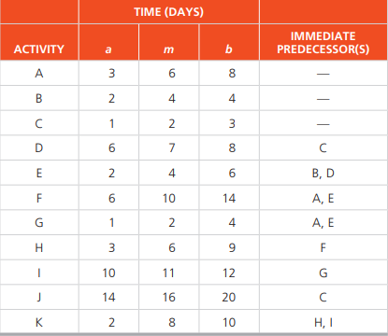
Tasks-2
Kelle Carpet and Trim installs carpet in commercial offices. Peter Kelle has been very concerned with the amount of time it took to complete several recent jobs. Some of his workers are very unreliable. A list of activities and their optimistic completion time, the most likely completion time, and the pessimistic completion time (all in days) for a new contract are given in the following table:
Determine the expected completion time and variance for each activity.
Determine the total project completion time and the critical path for the project.
Determine ES, EF, LS, LF, and slack for each activity.
What is the probability that Kelle Carpet and Trim will finish the project in 40 days or less?

