Slide 1
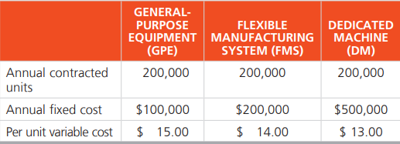
Task
Borges Machine Shop, Inc., has a 1-year contract for the production of 200,000 gear housings for a new off-road vehicle. Owner Luis Borges hopes the contract will be extended and the volume increased next year. Borges has developed costs for three alternatives. They are general-purpose equipment (GPE), flexible manufacturing system (FMS), and expensive, but efficient, dedicated machine (DM). The cost data follow:
Which process is best for this contract?

