Slide 1
Tasks
Hyundai Motors is considering three sites—A, B, and C—at which to locate a factory to build its new-model automobile, the Hyundai Sport C150. The goal is to locate at a minimumcost site, where cost is measured by the annual fixed plus variable costs of production. Hyundai Motors has gathered the following data:
The firm knows it will produce between 0 and 60,000 Sport C150s at the new plant each year, but, thus far, that is the extent of its knowledge about production plans
For what values of volume, V, of production, if any, is site C a recommended site?
What volume indicates site A is optimal?
Over what range of volume is site B optimal?

Slide 2
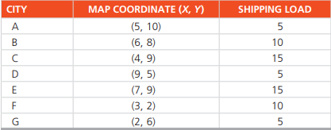
Tasks
The following table gives the map coordinates and the shipping loads for a set of cities that we wish to connect through a central hub.
The firm knows it will produce between 0 and 60,000 Sport C150s at the new plant each year, but, thus far, that is the extent of its knowledge about production plans
Near which map coordinates should the hub be located?
If the shipments from city A triple, how does this change the coordinates?

