Slide 1
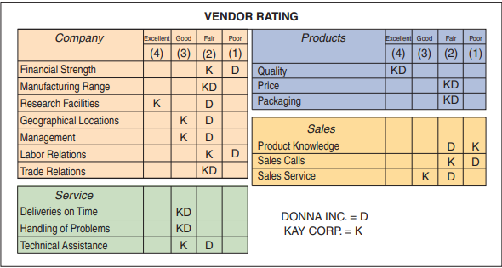
Task
As purchasing agent for Eynan Enterprises in Richmond, Virginia, you ask your buyer to provide you with a ranking of “excellent,” “good,” “fair,” or “poor” for a variety of characteristics for two potential vendors. You suggest that the “Products” total be weighted 40% and the other three categories totals be weighted 20% each. The buyer has returned the rankings shown in Table
Which of the two vendors would you select?
Using the data in Problem S11.10, assume that both Donna, Inc. and Kay Corp. are able to move all their “poor” ratings to “fair.” How would you then rank the two firms?

