Slide 1
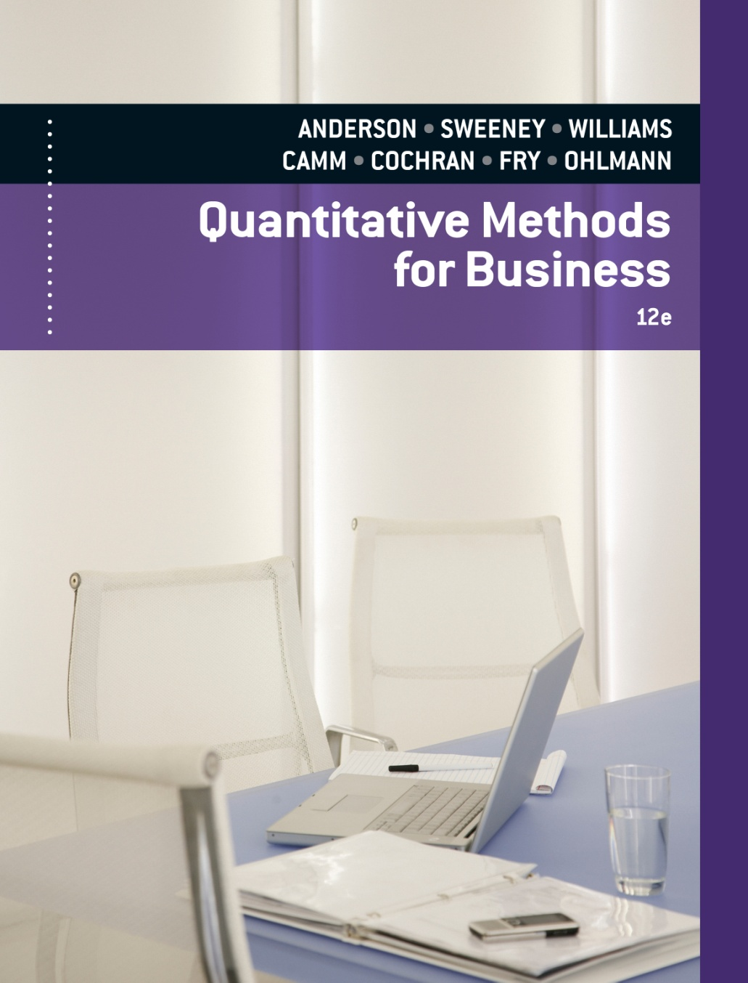
Slides by
.
.
.
.
.
.
.
.
.
.
.
.
John Loucks
St. Edward’s Univ.

Slide 2
Chapter 14, Part A
Inventory Models with Deterministic Demand
Economic Order Quantity (EOQ) Model
Economic Production Lot Size Model
Inventory Model with Planned Shortages
Quantity Discounts for the EOQ Model

Slide 3
Inventory Models
The study of inventory models is concerned with two basic questions:
  How much should be ordered each time
  When should the reordering occur
The objective is to minimize total variable cost over a specified time period (assumed to be annual in the following review).

Slide 4
Inventory Costs
Ordering cost -- salaries and expenses of processing an order, regardless of the order quantity
Holding cost -- usually a percentage of the value of the item assessed for keeping an item in inventory (including cost of capital, insurance, security costs, taxes, warehouse overhead, and other related variable expenses)
Backorder cost -- costs associated with being out of stock when an item is demanded (including lost goodwill)
Purchase cost -- the actual price of the items
Other costs

Slide 5
Deterministic Models
The simplest inventory models assume demand and the other parameters of the problem to be deterministic and constant.
The deterministic models covered in this chapter are:
  Economic order quantity (EOQ)
  Economic production lot size
  EOQ with planned shortages
  EOQ with quantity discounts

Slide 6
Economic Order Quantity (EOQ)
The most basic of the deterministic inventory models is the economic order quantity (EOQ).
The variable costs in this model are annual holding cost and annual ordering cost.
For the EOQ, annual holding and ordering costs are equal.

Slide 7
Economic Order Quantity
Assumptions
  Demand D is known and occurs at a constant rate.
  The order quantity Q is the same for each order.
  The cost per order, $C_{o}, is constant and does not depend on the order quantity.
  The purchase cost per unit, C, is constant and does not depend on the quantity ordered.
  The inventory holding cost per unit per time period, $C_{h}, is constant.
  Shortages such as stock-outs or backorders are not permitted.
  The lead time for an order is constant.
  The inventory position is reviewed continuously.

Slide 8
Economic Order Quantity
Formulas
  Optimal order quantity: Q * = 2DC_{o}/C_{h}
  Number of orders per year: D/Q *
  Time between orders (cycle time): Q */D years
  Total annual cost: [C_{h}(Q*/2)] + [C_{o}(D/Q *)]
(holding + ordering)

Slide 9
Example: Bart’s Barometer Business
Economic Order Quantity Model
Bart's Barometer Business is a retail outlet that
deals exclusively with weather equipment. Bart is
trying to decide on an inventory and reorder policy
for home barometers.
Barometers cost Bart $50 each and demand is
about 500 per year distributed fairly evenly
throughout the year.

Slide 10
Example: Bart’s Barometer Business
Economic Order Quantity Model
Reordering costs are $80 per order and holding
costs are figured at 20% of the cost of the item. Bart's
Barometer Business is open 300 days a year (6 days a
week and closed two weeks in August). Lead time is
60 working days.

Slide 11
Example: Bart’s Barometer Business
Total Variable Cost Model
Total Costs = (Holding Cost) + (Ordering Cost)
TC = [C_{h}(Q/2)] + [C_{o}(D/Q)]
= [.2(50)(Q/2)] + [80(500/Q)]
= 5Q + (40,000/Q)

Slide 12
Example: Bart’s Barometer Business
Optimal Reorder Quantity
Q * = 2DC_{o} /C_{h} = 2(500)(80)/10 = 89.44 ≈ 90
Optimal Reorder Point
Lead time is m = 60 days and daily demand is d = 500/300 or 1.667.
Thus the reorder point r = dm = (1.667)(60) = 100 Bart should reorder 90 barometers when his inventory position reaches 100 (that is 10 on hand and one outstanding order).

Slide 13
Example: Bart’s Barometer Business
Number of Orders Per Year
Number of reorder times per year = (500/90) = 5.56 or once every (300/5.56) = 54 working days (about every 9 weeks).
Total Annual Variable Cost
TC = 5(90) + (40,000/90) = 450 + 444 = $894

Slide 14
Sensitivity Analysis for the EOQ Model
Optimal Order Quantities for Several Costs
Possible | Possible | Optimal | Projected Total
Inventory | Cost Per | Order | Annual Cost
Holding Cost | Order | Qnty. (Q*) | Using Q* | Using Q = 90
18% | $75 | 91 units | $822 | $822
18 | 85 | 97 | 875 | 877
22 | 75 | 83 | 908 | 912
22 | 85 | 88 | 967 | 967

Slide 15
Example: Bart’s Barometer Business
We’ll now use a spreadsheet to implement
the Economic Order Quantity model. We’ll confirm
our earlier calculations for Bart’s problem and
perform some sensitivity analysis.
This spreadsheet can be modified to accommodate
other inventory models presented in this chapter.

Slide 16
Example: Bart’s Barometer Business
Partial Spreadsheet with Input Data

Slide 17
Example: Bart’s Barometer Business
Partial Spreadsheet Showing Formulas

Slide 18
Example: Bart’s Barometer Business
Partial Spreadsheet Showing Output

Slide 19
Example: Bart’s Barometer Business
Summary of Spreadsheet Results
  A 16.15% negative deviation from the EOQ resulted in only a 1.55% increase in the Total Annual Cost.
  Annual Holding Cost and Annual Ordering Cost are no longer equal.
  The Reorder Point is not affected, in this model, by a change in the Order Quantity.

Slide 20
Economic Production Lot Size
The economic production lot size model is a variation of the basic EOQ model.
A replenishment order is not received in one lump sum as it is in the basic EOQ model.
Inventory is replenished gradually as the order is produced (which requires the production rate to be greater than the demand rate).
This model's variable costs are annual holding cost and annual set-up cost (equivalent to ordering cost).
For the optimal lot size, annual holding and set-up costs are equal.

Slide 21
Economic Production Lot Size
Assumptions
  Demand occurs at a constant rate of D items per year or d items per day.
  Production rate is P items per year or p items per day (and P > D, p > d ).
  Set-up cost: $C_{o} per run.
  Holding cost: $C_{h} per item in inventory per year.
  Purchase cost per unit is constant (no quantity discount).
  Set-up time (lead time) is constant.
  Planned shortages are not permitted.

Slide 22
Economic Production Lot Size
Formulas
  Optimal production lot-size:
  Q* = 2DC_{o} /[(1-D/P )C_{h}]
  Number of production runs per year: D/Q *
  Time between set-ups (cycle time): Q*/D years
  Total annual cost: [C_{h}(Q*/2)(1-D/P )] + [C_{o}/(D/Q*)]
(holding + ordering)
  Length of the production run: t = Q*/p

Slide 23
Example: Beauty Bar Soap
Economic Production Lot Size Model
Beauty Bar Soap is produced on a production line that has an annual capacity of 60,000 cases. The annual demand is estimated at 26,000 cases, with the demand rate essentially constant throughout the year.
The cleaning, preparation, and setup of the production line cost approximately $135. The manufacturing cost per case is $4.50, and the annual holding cost is figured at a 24% rate.
Other relevant data include a five-day lead time to schedule and set up a production run and 250 working days per year.

Slide 24
Example: Beauty Bar Soap
Total Annual Variable Cost Model
This is an economic production lot size problem with
D = 26,000, P = 60,000, C_{h} = 1.08, C_{o} = 135
TC = (Holding Costs) + (Set-Up Costs)
= [C_{h}(Q/2)(1 - D/P )] + [C_{o}(D/Q)]
= [1.08(Q/2)(1 – 26,000/60,000)] + [135(26,000/Q)]
= .306Q + 3,510,000/Q

Slide 25
Example: Beauty Bar Soap
Optimal Production Lot Size
Q * = 2DC_{o}/[(1 -D/P )C_{h}]
= 2(26,000)(135) /[(1 – 26,000/60,000))1.08)]
= 3,387
Number of Production Runs (Cycles) Per Year
D/Q * = 26,000/3,387
= 7.6764 times per year

Slide 26
Example: Beauty Bar Soap
Total Annual Variable Cost
Optimal TC = .306(3,387) + 3,510,000/3,387
= 1,036.42 + 1,036.32
= $2,073

Slide 27
Example: Beauty Bar Soap
Idle Time Between Production Runs
There are 7.6764 cycles per year.
Thus, each cycle lasts (250/7.6764) = 32.567 days.
The time to produce 3,387 per run:
3387/240 = 14.1125 days.
Thus, the production line is idle for:
32.567 – 14.1125 = 18.4545 days between runs.
The production line is utilized:
14.1125/32.567(100) = 43.33%

Slide 28
Example: Beauty Bar Soap
Maximum Inventory
Maximum inventory = (1-D/P )Q *
= (1-26,000/60,000)3,387 ≈ 1,919.3
Machine Utilization
Machine is producing D/P = 26,000/60,000
= .4333 of the time.

Slide 29
EOQ with Planned Shortages
With the EOQ with planned shortages model, a replenishment order does not arrive at or before the inventory position drops to zero.
Shortages occur until a predetermined backorder quantity is reached, at which time the replenishment order arrives.
The variable costs in this model are annual holding, backorder, and ordering.
For the optimal order and backorder quantity combination, the sum of the annual holding and backordering costs equals the annual ordering cost.

Slide 30
EOQ with Planned Shortages
Assumptions
  Demand occurs at a constant rate of D items/year.
  Ordering cost: $C_{o} per order.
  Holding cost: $C_{h} per item in inventory per year.
  Backorder cost: $C_{b} per item backordered per year.
  Purchase cost per unit is constant (no qnty. discount).
  Set-up time (lead time) is constant.
  Planned shortages are permitted (backordered demand units are withdrawn from a replenishment order when it is delivered).

Slide 31
EOQ with Planned Shortages
Formulas
  Optimal order quantity:
  Q * = 2DC_{o}/C_{h} (C_{h}+C_{b} )/C_{b}
  Maximum number of backorders:
  S * = Q *(C_{h}/(C_{h}+C_{b}))
  Number of orders per year: D/Q *
  Time between orders (cycle time): Q */D years
  Total annual cost:
  [C_{h}(Q *-S *)²/2Q *] + [C_{o}(D/Q *)] + [S *2C_{b}/2Q *]
(holding + ordering + backordering)

Slide 32
Example: Higley Radio Components Co.
EOQ with Planned Shortages Model
Higley has a product for which the assumptions
of the inventory model with shortages are valid.
Demand for the product is 2,000 units per year. The
inventory holding cost rate is 20% per year. The
product costs Higley $50 to purchase. The ordering
cost is $25 per order. The annual shortage cost is
estimated to be $30 per unit per year. Higley
operates 250 days per year.

Slide 33
Example: Higley Radio Components Co.
Optimal Order Policy
D = 2,000; C_{o} = $25; C_{h} = .20(50) = $10; C_{b} = $30
Q * = 2DC_{o}/C_{h} (C_{h} + C_{b})/C_{b}
= 2(2000)(25)/10 x (10+30)/30
= 115.47
S * = Q *(C_{h}/(C_{h}+C_{b}))
= 115.47(10/(10+30)) = 28.87

Slide 34
Example: Higley Radio Components Co.
Maximum Inventory
Q – S = 115.47 – 28.87 = 86.6 units
Cycle Time
T = Q/D(250) = 115.47/2000(250) = 14.43 working days

Slide 35
Example: Higley Radio Components Co.
Total Annual Cost
Holding Cost:
C_{h}(Q –S)²/(2Q) = 10(115.47 – 28.87)²/(2(115.47))
= $324.74
Ordering Cost:
C_{o}(D/Q) = 25(2000/115.47) = $433.01
Backorder Cost:
C_{b}(S²/(2Q) = 30(28.87)²/(2(115.47)) = $108.27
Total Cost:
324.74 + 433.01 + 108.27 = $866.02

Slide 36
Example: Higley Radio Components Co.
Stockout: When and How Long
Question:
How many days after receiving an order does
Higley run out of inventory? How long is Higley
without inventory per cycle?

Slide 37
Example: Higley Radio Components Co.
Stockout: When and How Long
Answer:
Inventory exists for C_{b}/(C_{b}+C_{h}) = 30/(30+10) = .75
of the order cycle. (Note, (Q *-S *)/Q * = .75 also,
before Q * and S * are rounded.)
An order cycle is Q */D = .057735 years = 14.434
days. Thus, Higley runs out of inventory .75(14.434)
= 10.823 days after receiving an order
Higley is out of stock for approximately 14.434 –
10.823 = 3.611 days per order cycle

Slide 38
Example: Higley Radio Components Co.
Reorder Point
Question:
At what inventory or backorder level should Higley place an inventory replenishment order?

Slide 39
Example: Higley Radio Components Co.
Reorder Point
Answer:
Higley is out of stock for approximately 3.611 working days per order cycle. Reorder lead time is 7 working days. Hence, Higley should reorder when it has inventory on hand to cover just 7 – 3.611 = 3.389 days of demand.
Demand per day is 2000/250 = 8 units. Hence, 3.389 days of inventory is 3.389 x 8 = 27.112 units.
Higley should place an order for 115 units when its
inventory drops to 27.112 units

Slide 40
Example: Higley Radio Components Co.
EOQs with and without Planned Shortages
 | With Shortages | Without Shortages
EOQ (units) | 115.47 | 100
Max. Inventory (units) | 86.60 | 100
Max. Shortages (units) | 28.87 | 0
Reorder Point (units) | 27.112 | 56
Cycle Time (days) | 14.43 | 12.50
Shortage Time/Cycle (days) | 3.611 | 0
Shortage Time/Cycle (%) | 25 | 0

Slide 41
Example: Higley Radio Components Co.
EOQs with and without Planned Shortages
Annual Costs | With Shortages | Without Shortages
Holding | $324.74 | $500.00
Ordering | 433.01 | 500.00
Backordering | 108.27 | 0
Total | $866.02 | $1000.00

Slide 42
EOQ with Quantity Discounts
The EOQ with quantity discounts model is applicable where a supplier offers a lower purchase cost when an item is ordered in larger quantities.
This model's variable costs are annual holding, ordering and purchase costs.
For the optimal order quantity, the annual holding and ordering costs are not necessarily equal.

Slide 43
EOQ with Quantity Discounts
Assumptions
  Demand occurs at a constant rate of D items/year.
  Ordering Cost is $C_{o} per order.
  Holding Cost is $C_{h} = $C_{i}I per item in inventory per year (note holding cost is based on the cost of the item, C_{i}).
  Purchase Cost is $C₁ per item if the quantity ordered is between 0 and x₁, $C₂ if the order quantity is between x₁ and x₂ , etc.
  Delivery time (lead time) is constant.
  Planned shortages are not permitted.

Slide 44
EOQ with Quantity Discounts
Formulas
  Optimal order quantity: the procedure for determining Q* will be demonstrated
  Number of orders per year: D/Q*
  Time between orders (cycle time): Q*/D years
  Total annual cost: [C_{h}(Q*/2)] + [C_{o}(D/Q*)] + DC
(holding + ordering + purchase)

Slide 45
Example: Nick's Camera Shop
EOQ with Quantity Discounts Model
Nick's Camera Shop carries Zodiac instant print
film. The film normally costs Nick $3.20 per roll, and
he sells it for $5.25. Zodiac film has a shelf life of 18
months. Nick's average sales are 21 rolls per week.
His annual inventory holding cost rate is 25% and it
costs Nick $20 to place an order with Zodiac.

Slide 46
Example: Nick's Camera Shop
EOQ with Quantity Discounts Model
If Zodiac offers a 7% discount on orders of 400
rolls or more, a 10% discount for 900 rolls or more,
and a 15% discount for 2000 rolls or more, determine
Nick's optimal order quantity.
--------------------
D = 21(52) = 1092; C_{h} = .25(C_{i}); C_{o} = 20

Slide 47
Example: Nick's Camera Shop
Unit-Prices’ Economical Order Quantities
  For C₄ = .85(3.20) = $2.72
To receive a 15% discount Nick must order
at least 2,000 rolls. Unfortunately, the film's shelf
life is 18 months. The demand in 18 months (78
weeks) is 78 x 21 = 1638 rolls of film.
If he ordered 2,000 rolls he would have to
scrap 372 of them. This would cost more than the
15% discount would save.

Slide 48
Example: Nick's Camera Shop
Unit-Prices’ Economical Order Quantities
  For C₃ = .90(3.20) = $2.88
Q₃* = 2DC_{o}/C_{h} = 2(1092)(20)/[.25(2.88)] = 246.31 (not feasible)
The most economical, feasible quantity for C₃ is 900.
  For C₂ = .93(3.20) = $2.976
Q₂* = 2DC_{o}/C_{h} = 2(1092)(20)/[.25(2.976)] = 242.30
(not feasible)
The most economical, feasible quantity for C₂ is 400.

Slide 49
Example: Nick's Camera Shop
Unit-Prices’ Economical Order Quantities
  For C₁ = 1.00(3.20) = $3.20
Q₁* = 2DC_{o}/C_{h} = 2(1092)(20)/.25(3.20) = 233.67 (feasible)
When we reach a computed Q that is feasible we stop computing Q's. (In this problem we have no more to compute anyway.)

Slide 50
Example: Nick's Camera Shop
Total Cost Comparison
Compute the total cost for the most economical, feasible order quantity in each price category for which
a Q * was computed.
TC_{i} = (C_{h})(Q_{i}*/2) + (C_{o})(D/Q_{i}*) + DC_{i}
TC₃ = (.72)(900/2) + (20)(1092/900) + (1092)(2.88) = 3,493
TC₂ = (.744)(400/2) + (20)(1092/400) + (1092)(2.976) = 3,453
TC₁ = (.80)(234/2) + (20)(1092/234) + (1092)(3.20) = 3,681
Comparing the total costs for order quantities of 234, 400 and 900, the lowest total annual cost is $3,453. Nick should order 400 rolls at a time.

Slide 51
End of Chapter 14, Part A

