Slide 1
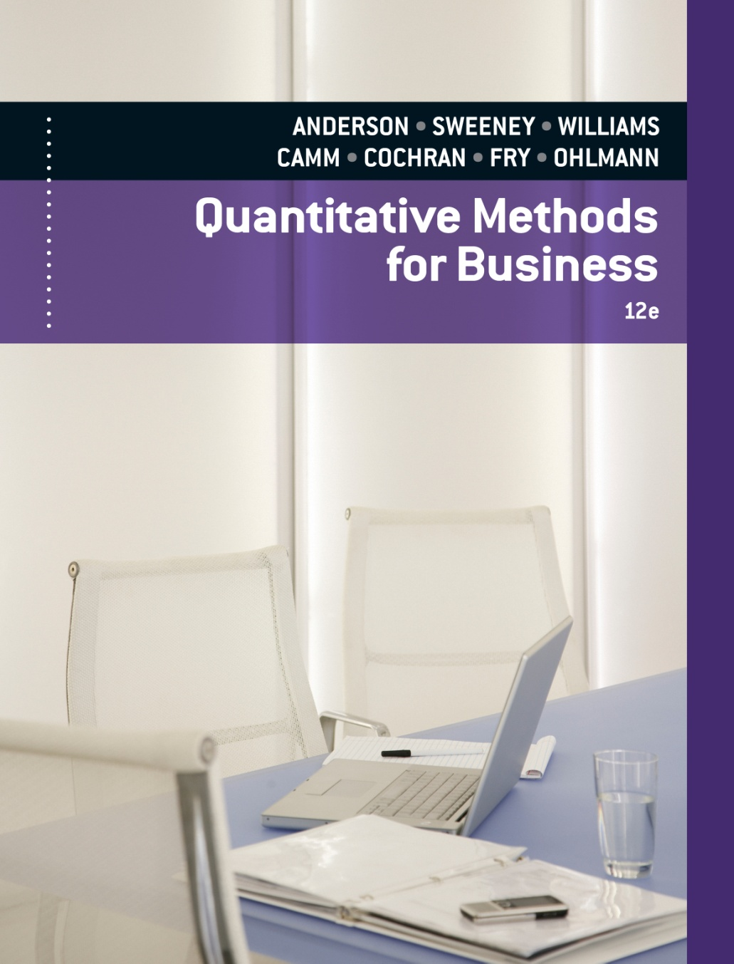
Slides by
.
.
.
.
.
.
.
.
.
.
.
.
John Loucks
St. Edward’s Univ.

Slide 2
Chapter 15, Part A
Waiting Line Models
Structure of a Waiting Line System
Queuing Systems
Queuing System Input Characteristics
Queuing System Operating Characteristics
Analytical Formulas
Single-Server Waiting Line Model with Poisson Arrivals and Exponential Service Times
Multiple-Server Waiting Line Model with Poisson Arrivals and Exponential Service Times
Economic Analysis of Waiting Lines

Slide 3
Structure of a Waiting Line System
Queuing theory is the study of waiting lines.
Four characteristics of a queuing system are:
  the manner in which customers arrive
  the time required for service
  the priority determining the order of service
  the number and configuration of servers in the system.

Slide 4
Structure of a Waiting Line System
Distribution of Arrivals
  Generally, the arrival of customers into the system is a random event.
  Frequently the arrival pattern is modeled as a Poisson process.
Distribution of Service Times
  Service time is also usually a random variable.
  A distribution commonly used to describe service time is the exponential distribution.

Slide 5
Structure of a Waiting Line System
Queue Discipline
  Most common queue discipline is first come, first served (FCFS).
  An elevator is an example of last come, first served (LCFS) queue discipline.
  Other disciplines assign priorities to the waiting units and then serve the unit with the highest priority first.

Slide 6
Structure of a Waiting Line System
Single-Server
Multiple-Server
System
Customer
arrives
Waiting line
S₁
Customer
leaves
System
S₁
Customer
arrives
Waiting line
S₂
Customer
leaves
S₃

Slide 7
Queuing Systems
A three part code of the form A/B/k is used to describe various queuing systems.
A identifies the arrival distribution, B the service (departure) distribution, and k the number of servers for the system.

Slide 8
Queuing Systems
Symbols used for the arrival and service processes are: M - Markov distributions (Poisson/exponential), D - Deterministic (constant) and G - General distribution (with a known mean and variance).
For example, M/M/k refers to a system in which arrivals occur according to a Poisson distribution, service times follow an exponential distribution and there are k servers working at identical service rates.

Slide 9
Queuing System Input Characteristics
λ = the average arrival rate
1/λ = the average time between arrivals
µ = the average service rate for each server
1/µ = the average service time
σ = the standard deviation of the service time

Slide 10
Queuing System Operating Characteristics
P₀ = probability the service facility is idle
P_{n} = probability of n units in the system
P_{w} = probability an arriving unit must wait for service
L_{q} = average number of units in the queue awaiting service
L = average number of units in the system
W_{q} = average time a unit spends in the queue awaiting service
W = average time a unit spends in the system

Slide 11
Steady-State Operation
When a business like a restaurant opens in the morning, no customers are in the restaurant.
Gradually, activity builds up to a normal or steady state.
The beginning or start-up period is referred to as the transient period.
The transient period ends when the system reaches the normal or steady-state operation.
Waiting line models describe the steady-state operating characteristics of a waiting line.

Slide 12
Analytical Formulas
When the queue discipline is FCFS, analytical formulas have been derived for several different queuing models including the following:
  M/M/1
  M/M/k
  M/G/1
  M/G/k with blocked customers cleared
  M/M/1 with a finite calling population
Analytical formulas are not available for all possible queuing systems. In this event, insights may be gained through a simulation of the system.

Slide 13
Single-Server Waiting Line Model with
Poisson Arrivals and Exponential Service Times
M/M/1 queuing system
Single server
Poisson arrival-rate distribution
Exponential service-time distribution
Unlimited maximum queue length
Infinite calling population
Examples:
  Single-window theatre ticket sales booth
  Single-scanner airport security station

Slide 14
Example: SJJT, Inc. (A)
M/M/1 Queuing System
Joe Ferris is a stock trader on the floor of the New
York Stock Exchange for the firm of Smith, Jones,
Johnson, and Thomas, Inc. Stock transactions arrive
at a mean rate of 20 per hour. Each order received by
Joe requires an average of two minutes to process.
Orders arrive at a mean rate of 20 per hour or one
order every 3 minutes. Therefore, in a 15 minute
interval the average number of orders arriving will be
λ = 15/3 = 5.

Slide 15
Example: SJJT, Inc. (A)
Arrival Rate Distribution
Question
What is the probability that no orders are received within a 15-minute period?
Answer
P (x = 0) = (5⁰e ⁻⁵)/0! = e ⁻⁵ = .0067

Slide 16
Example: SJJT, Inc. (A)
Arrival Rate Distribution
Question
What is the probability that exactly 3 orders are received within a 15-minute period?
Answer
P (x = 3) = (5³e ⁻⁵)/3! = 125(.0067)/6 = .1396

Slide 17
Example: SJJT, Inc. (A)
Arrival Rate Distribution
Question
What is the probability that more than 6 orders arrive within a 15-minute period?
Answer
P (x > 6) = 1 - P (x = 0) - P (x = 1) - P (x = 2)
- P (x = 3) - P (x = 4) - P (x = 5)
- P (x = 6)
= 1 - .762 = .238

Slide 18
Example: SJJT, Inc. (A)
Service Rate Distribution
Question
What is the mean service rate per hour?
Answer
Since Joe Ferris can process an order in an average time of 2 minutes (= 2/60 hr.), then the mean service rate, µ, is µ = 1/(mean service time), or 60/2.
μ = 30/hr.

Slide 19
Example: SJJT, Inc. (A)
Service Time Distribution
Question
What percentage of the orders will take less than one minute to process?
Answer
Since the units are expressed in hours,
P (T < 1 minute) = P (T < 1/60 hour).
Using the exponential distribution, P (T < t ) = 1 - e^{-µt}.
Hence, P (T < 1/60) = 1 - e^{-30(1/60)}
= 1 - .6065 = .3935 = 39.35%

Slide 20
Example: SJJT, Inc. (A)
Service Time Distribution
Question
What percentage of the orders will be processed in exactly 3 minutes?
Answer
Since the exponential distribution is a continuous distribution, the probability a service time exactly equals any specific value is 0.

Slide 21
Example: SJJT, Inc. (A)
Service Time Distribution
Question
What percentage of the orders will require more than 3 minutes to process?
Answer
The percentage of orders requiring more than 3 minutes to process is:
P (T > 3/60) = e^{-30(3/60)} = e ^{-1.5} = .2231 = 22.31%

Slide 22
Example: SJJT, Inc. (A)
Average Time in the System
Question
What is the average time an order must wait from the time Joe receives the order until it is finished being processed (i.e. its turnaround time)?
Answer
This is an M/M/1 queue with λ = 20 per hour and μ = 30 per hour. The average time an order waits in the system is: W = 1/(µ - λ )
= 1/(30 - 20)
= 1/10 hour or 6 minutes

Slide 23
Example: SJJT, Inc. (A)
Average Length of Queue
Question
What is the average number of orders Joe has waiting to be processed?
Answer
Average number of orders waiting in the queue is:
L_{q} = λ²/[µ(µ - λ)]
= (20)²/[(30)(30-20)]
= 400/300
= 4/3

Slide 24
Example: SJJT, Inc. (A)
Utilization Factor
Question
What percentage of the time is Joe processing orders?
Answer
The percentage of time Joe is processing orders is equivalent to the utilization factor, λ/μ. Thus, the percentage of time he is processing orders is:
λ/μ = 20/30
= 2/3 or 66.67%

Slide 25
Example: SJJT, Inc. (A)
Formula Spreadsheet

Slide 26
Example: SJJT, Inc. (A)
Spreadsheet Solution

Slide 27
Improving the Waiting Line Operation
Waiting line models often indicate when improvements in operating characteristics are desirable.
To make improvements in the waiting line operation, analysts often focus on ways to improve the service rate by:
- Increasing the service rate by making a creative
design change or by using new technology.
- Adding one or more servers so that more customers
can be served simultaneously.

Slide 28
Multiple-Server Waiting Line Model with
Poisson Arrivals and Exponential Service Times
M/M/k queuing system
Multiple servers (with one central waiting line)
Poisson arrival-rate distribution
Exponential service-time distribution
Unlimited maximum queue length
Infinite calling population
Examples:
  Four-teller transaction counter in bank
  Two-clerk returns counter in retail store

Slide 29
M/M/k Example: SJJT, Inc. (B)
M/M/2 Queuing System
Smith, Jones, Johnson, and Thomas, Inc. has begun a major advertising campaign which it believes will increase its business 50%. To handle the increased volume, the company has hired an additional floor trader, Fred Hanson, who works at the same speed as Joe Ferris.
Note that the new arrival rate of orders, λ , is 50% higher than that of problem (A). Thus, λ = 1.5(20) = 30 per hour.

Slide 30
M/M/k Example: SJJT, Inc. (B)
Sufficient Service Rate
Question
Why will Joe Ferris alone not be able to handle the increase in orders?
Answer
Since Joe Ferris processes orders at a mean rate of µ = 30 per hour, then λ = µ = 30 and the utilization factor is 1.
This implies the queue of orders will grow infinitely large. Hence, Joe alone cannot handle this increase in demand.

Slide 31
M/M/k Example: SJJT, Inc. (B)
Probability of n Units in System
Question
What is the probability that neither Joe nor Fred will be working on an order at any point in time?

Slide 32
M/M/k Example: SJJT, Inc. (B)
Probability of n Units in System (continued)
Answer
Given that λ = 30, µ = 30, k = 2 and (λ /µ) = 1, the probability that neither Joe nor Fred will be working is:
= 1/[(1 + (1/1!)(30/30)1] + [(1/2!)(1)2][2(30)/(2(30)-30)]
= 1/(1 + 1 + 1) = 1/3 = .333

Slide 33
Example: SJJT, Inc. (B)
Average Time in System
Question
What is the average turnaround time for an order with both Joe and Fred working?

Slide 34
Example: SJJT, Inc. (B)
Average Time in System (continued)
Answer
The average turnaround time is the average waiting time in the system, W.
L = L_{q} + (λ /µ) = 1/3 + (30/30) = 4/3
W = L/λ = (4/3)/30 = 4/90 hr. = 2.67 min.

Slide 35
Example: SJJT, Inc. (B)
Average Length of Queue
Question
What is the average number of orders waiting to be filled with both Joe and Fred working?
Answer
The average number of orders waiting to be filled is L_{q}. This was calculated earlier as 1/3.

Slide 36
Some General Relationships
For Waiting Line Models
Little's flow equations are:
L = λW and L_{q} = λW_{q}
Little’s flow equations show how operating
characteristics L, L_{q}, W, and W_{q} are related in any
waiting line system. Arrivals and service times do
not have to follow specific probability distributions
for the flow equations to be applicable.

Slide 37
Example: SJJT, Inc. (C)
Economic Analysis of Queuing Systems
The advertising campaign of Smith, Jones, Johnson and Thomas, Inc. (see problems (A) and (B)) was so successful that business actually doubled. The mean rate of stock orders arriving at the exchange is now 40 per hour and the company must decide how many floor traders to employ. Each floor trader hired can process an order in an average time of 2 minutes.

Slide 38
Example: SJJT, Inc. (C)
Economic Analysis of Queuing Systems
Based on a number of factors the brokerage firm has determined the average waiting cost per minute for an order to be $.50. Floor traders hired will earn $20 per hour in wages and benefits. Using this information compare the total hourly cost of hiring 2 traders with that of hiring 3 traders.

Slide 39
Economic Analysis of Waiting Lines
The total cost model includes the cost of waiting and
the cost of service.
TC = c_{w}L + c_{s}k
where:
c_{w} = the waiting cost per time period for each unit
L = the average number of units in the system
c_{s} = the service cost per time period for each server
k = the number of servers
TC = the total cost per time period

Slide 40
Example: SJJT, Inc. (C)
Economic Analysis of Waiting Lines
Total Hourly Cost
= (Total hourly cost for orders in the system)
+ (Total salary cost per hour)
= ($30 waiting cost per hour)
x (Average number of orders in the system)
+ ($20 per trader per hour) x (Number of traders)
= 30L + 20k
Thus, L must be determined for k = 2 traders and for k = 3 traders with λ = 40/hr. and μ = 30/hr. (since the average service time is 2 minutes (1/30 hr.).

Slide 41
Example: SJJT, Inc. (C)
Cost of Two Servers
P₀ = 1 / [1+(1/1!)(40/30)]+[(1/2!)(40/30)2(60/(60-40))]
= 1 / [1 + (4/3) + (8/3)]
= 1/5

Slide 42
Example: SJJT, Inc. (C)
Cost of Two Servers (continued)
Thus,
L = L_{q} + (λ /µ) = 16/15 + 4/3 = 2.40
Total Cost = 30(2.40) + (20)(2) = $112.00 per hour

Slide 43
Example: SJJT, Inc. (C)
Cost of Three Servers
P₀ = 1/[[1+(1/1!)(40/30)+(1/2!)(40/30)2]+
[(1/3!)(40/30)3(90/(90-40))] ]
= 1 / [1 + 4/3 + 8/9 + 32/45]
= 15/59

Slide 44
Example: SJJT, Inc. (C)
Cost of Three Servers (continued)
Thus, L = .1446 + 40/30 = 1.4780
Total Cost = 30(1.4780) + (20)(3) = $104.35 per hour

Slide 45
Example: SJJT, Inc. (C)
System Cost Comparison
Waiting Wage Total
Cost/Hr Cost/Hr Cost/Hr
2 Traders $82.00 $40.00 $112.00
3 Traders 44.35 60.00 104.35
Thus, the cost of having 3 traders is less than that of 2 traders.

Slide 46
End of Chapter 15, Part A

