Slide 1
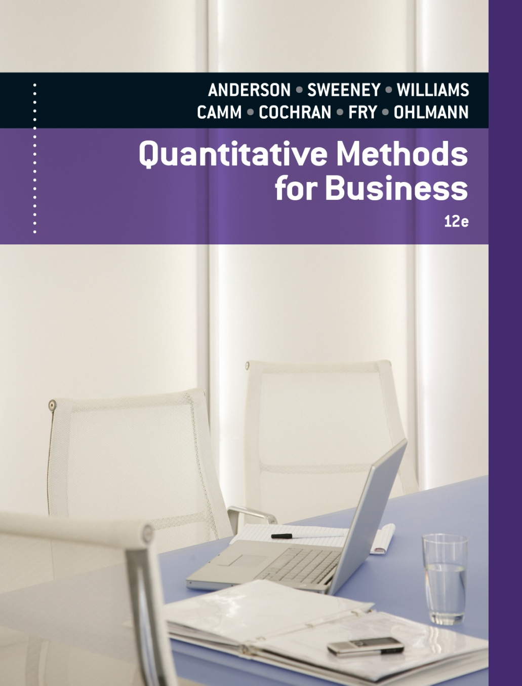
Slides by
.
.
.
.
.
.
.
.
.
.
.
.
John Loucks
St. Edward’s Univ.

Slide 2
Chapter 15, Part B Waiting Line Models
Single-Server Waiting Line Model with Poisson Arrivals and Constant Service Times
Single-Server Waiting Line Model with Poisson Arrivals and Arbitrary Service Times
Multiple-Server Waiting Line Model with Poisson Arrivals, Arbitrary Service Times, and No Waiting Line
Waiting Lines with Finite Calling Populations

Slide 3
Single-Server Waiting Line Model with
Poisson Arrivals and Constant Service Times
M/D/1 queuing system
Single server
Poisson arrival-rate distribution
Constant service time
Unlimited maximum queue length
Infinite calling population
Examples:
Single-booth automatic car wash
Coffee vending machine

Slide 4
Example: Ride ‘Em Cowboy!
M/D/1 Queuing System
The mechanical pony ride machine at the entrance
to a very popular J-Mart store provides 2 minutes of
riding for $.50. Children wanting to ride the pony
arrive (accompanied of course) according to a
Poisson distribution with a mean rate of 15 per hour.

Slide 5
Example: Ride ‘Em Cowboy!
What fraction of the time is the pony idle?
λ = 15 per hour
μ = 60/2 = 30 per hour
Utilization = λ/μ = 15/30 = .5
Idle fraction = 1 – Utilization = 1 - .5 = .5

Slide 6
Example: Ride ‘Em Cowboy!
What is the average number of children waiting to ride the pony?
What is the average time a child waits for a ride?
(or 1 minute)

Slide 7
Single-Server Waiting Line Model with
Poisson Arrivals and Arbitrary Service Times
M/G/1 queuing system
Single server
Poisson arrival-rate distribution
General or unspecified service time distribution
Unlimited maximum queue length
Infinite calling population

Slide 8
Single-Server Waiting Line Model with Poisson Arrivals and Arbitrary Service Times
The Cutler University Student Union has one
self-service copying machine. On the average, 12
customers per hour arrive to make copies. (The
arrival process follows a Poisson distribution.)
The time to copy documents follows
approximately a normal distribution with a mean of
2.5 minutes and a standard deviation of 30 seconds.

Slide 9
Single-Server Waiting Line Model with Poisson Arrivals and Arbitrary Service Times
The Union manager has received several
complaints from students regarding the long lines at
the copier. Based of this information, determine:
1) the average number of customers waiting or using
the copier.
2) the probability an arriving customer must wait in
line.
3) the proportion of time the copier is idle.
4) the average time a customer must wait in line
before using the copier.

Slide 10
Single-Server Waiting Line Model with Poisson Arrivals and Arbitrary Service Times
This situation can be modeled as an M/G/1
system with:
λ = 12 per hour = 12/60 = .2/minute
1/µ = 2.5 minutes
µ = 1/(2.5) = .4 per minute
σ = 30 seconds = .5 minutes

Slide 11
Single-Server Waiting Line Model with Poisson Arrivals and Arbitrary Service Times
Average number of customers waiting or using the copier
Substituting the appropriate values gives:
Thus L = .26 + (.2/.4) = .76 customers
where

Slide 12
Single-Channel Waiting Line Model with Poisson Arrivals and Arbitrary Service Times
Probability an arriving customer must wait in line
Proportion of time the copier is idle
Average time a customer must wait in line before using the copier

Slide 13
Multiple-Server Waiting Line Model with Poisson Arrivals, Arbitrary Service Times, and No Waiting Line
M/G/k Queuing system
Multiple servers
Poisson arrival-rate distribution
Arbitrary service times
No waiting line
Infinite calling population
Example:
Telephone system with k lines. (When all k lines are being used, additional callers get a busy signal.)

Slide 14
Multiple-Server Waiting Line Model with Poisson Arrivals, Arbitrary Service Times, and No Waiting Line
Several firms are over-the-counter (OTC) market
makers of MegaTech stock. A broker wishing to
trade this stock for a client will call on these firms to
execute the order. If the market maker's phone line is
busy, a broker will immediately try calling another
market maker to transact the order.

Slide 15
Multiple-Server Waiting Line Model with Poisson Arrivals, Arbitrary Service Times, and No Waiting Line
Richardson and Company is one such OTC
market maker. It estimates that on the average, a
broker will try to call to execute a stock transaction
every two minutes. The time required to complete
the transaction averages 75 seconds. The firm has
four traders staffing its phones. Assume calls arrive
according to a Poisson distribution.

Slide 16
Multiple-Server Waiting Line Model with Poisson Arrivals, Arbitrary Service Times, and No Waiting Line
What percentage of its potential business will be
lost by Richardson?
What percentage of its potential business would
be lost if only three traders staffed its phones?

Slide 17
Multiple-Server Waiting Line Model with Poisson Arrivals, Arbitrary Service Times, and No Waiting Line
This problem can be modeled as an M/G/k
system with block customers cleared with:
1/λ = 2 minutes = 2/60 hour
λ = 60/2 = 30 per hour
1/µ = 75 seconds = 75/60 minutes = 75/3600 hours
µ = 3600/75 = 48 per hour

Slide 18
Multiple-Server Waiting Line Model with Poisson Arrivals, Arbitrary Service Times, and No Waiting Line
Percentage of potential business that be lost when using 4 traders (k = 4)
The system will be blocked when there are four customers in the system. Hence, the answer is P₄.
continued

Slide 19
Multiple-Server Waiting Line Model with Poisson Arrivals, Arbitrary Service Times, and No Waiting Line
Percentage of potential business that be lost when using 4 traders (k = 4)
Now,
Thus, with four traders 0.3% of the potential
customers are lost.

Slide 20
Multiple-Server Waiting Line Model with Poisson Arrivals, Arbitrary Service Times, and No Waiting Line
Percentage of potential business that be lost when using 3 traders (k = 3)
The system will be blocked when there are three customers in the system. Hence, the answer is P₃.
Thus, with three traders 2.2% of the potential
customers are lost.

Slide 21
Waiting Lines with Finite Calling Populations
Biff Smith is in charge of maintenance for four of
the rides at the Rollerama Amusement Park. On the
average, each ride operates four hours before
needing maintenance. When maintenance is needed,
the average repair time is 10 minutes.
Assuming the time between machine maintenance
as well as the service times follow exponential
distributions, determine:
1) the proportion of time Biff is idle, and
2) the average time a ride is "down" for maintenance.

Slide 22
Waiting Lines with Finite Calling Populations
This problem can be modeled as an
M/M/1 queue with a finite calling population
of size N = 4 (rides).
λ = 1/(4 hours) = .25 per hour
µ = 60/(10 minutes) = 6 per hour
λ/μ = .25/6 = 1/24

Slide 23
Waiting Lines with Finite Calling Populations
Proportion of time Biff is idle
Hence, Biff is idle approximately 84% of the time.

Slide 24
Waiting Lines with Finite Calling Populations
Average time a ride is "down" for maintenance
where

Slide 25
Waiting Lines with Finite Calling Populations
Average time a ride is "down" for maintenance
Substituting the appropriate values gives:
L_{q} = 4 - ((.25+6)/.25)(1-.840825) = .020625
L = .020625 + (1-.840825) = .1798
W_{q} = .020625/((4-.1798).25) = .021596
W = .021596 + 1/6 = .18826 hours or 11.3 minutes

Slide 26
End of Chapter 15, Part B

