Slide 1

Slides by
.
.
.
.
.
.
.
.
.
.
.
.
John Loucks
St. Edward’s Univ.

Slide 2
Chapter 6, Part B
Time Series Analysis and Forecasting
Linear Trend Projection
Seasonality

Slide 3
Linear Trend Projection
If a time series exhibits a linear trend, the method of least squares may be used to determine a trend line (projection) for future forecasts.
Least squares, also used in regression analysis, determines the unique trend line forecast which minimizes the mean square error between the trend line forecasts and the actual observed values for the time series.
The independent variable is the time period and the dependent variable is the actual observed value in the time series.

Slide 4
Linear Trend Projection
Using the method of least squares, the formula for the trend projection is:
T_{t} = b₀ + b₁t
where: T_{t} = linear trend forecast in period t
b₀ = Y-intercept of the linear trend line
b₁ = slope of the linear trend line
t = the time period

Slide 5
Linear Trend Projection
For the trend projection equation T_{t} = b₀ + b₁t
where: Y_{t} = actual value of the time series in period t
n = number of periods in the time series
= average values of the time series
= mean value of t

Slide 6
Linear Trend Projection
Example: Auger’s Plumbing Service
The number of plumbing repair jobs performed by
Auger's Plumbing Service in the last nine months is
listed on the right.
Month Jobs
Month Jobs
Forecast the number of
repair jobs Auger's will
perform in December
using the least squares
method.
March 353
August 409
April 387
September 399
May 342
October 412
June 374
November 408
July 396

Slide 7
Linear Trend Projection
Example: Auger’s Plumbing Service
(month) t Y_{t}
(Mar.) 1 -4 16 353 -33.67 134.68
(Apr.) 2 -3 9 387 0.33 -0.99
(May) 3 -2 4 342 -44.67 89.34
(June) 4 -1 1 374 -12.67 12.67
(July) 5 0 0 396 9.33 0
(Aug.) 6 1 1 409 22.33 22.33
(Sep.) 7 2 4 399 12.33 24.66
(Oct.) 8 3 9 412 25.33 75.99
(Nov.) 9 4 16 408 21.33 85.32
Sum 45 60 3480 444.00

Slide 8
Linear Trend Projection
Example: Auger’s Plumbing Service
T₁₀ = 351.07 + (7.12)(10) = 422.27

Slide 9
Linear Trend Projection
Example: Auger’s Plumbing Service
Forecast for December (Month 10) using a
three-period (k = 3) weighted moving average with
weights of .6, .3, and .1
for the newest to oldest
data, respectively. Then,
compare this Month 10
weighted moving average
forecast with the Month 10
trend projection forecast.
Month Jobs
Month Jobs
March 353
August 409
April 387
Septem. 399
May 342
October 412
June 374
Novem. 408
July 396

Slide 10
Linear Trend Projection
Example: Auger’s Plumbing Service
Three-Month Weighted Moving Average
The forecast for December will be the weighted
average of the preceding three months: September,
October, and November.
F₁₀ = .1Y_{Sep.} + .3Y_{Oct.} + .6Y_{Nov.}
= .1(399) + .3(412) + .6(408)
= 408.3
Trend Projection
F₁₀ = 422.27 (from earlier slide)

Slide 11
Linear Trend Projection
Example: Auger’s Plumbing Service
Conclusion
Due to the positive trend component in the time series, the trend projection produced a forecast that is more in line with the trend that exists. The weighted moving average, even with heavy (.6) weight placed on the current period, produced a forecast that is lagging behind the changing data.

Slide 12
Seasonality without Trend
To the extent that seasonality exists, we need to incorporate it into our forecasting models to ensure accurate forecasts.
We will first look at the case of a seasonal time series with no trend and then discuss how to model seasonality with trend.

Slide 13
Seasonality without Trend
Example: Umbrella Sales
Year | Quarter 1 | Quarter 2 | Quarter 3 | Quarter 4
1 | 125 | 153 | 106 | 88
2 | 118 | 161 | 133 | 102
3 | 138 | 144 | 113 | 80
4 | 109 | 137 | 125 | 109
5 | 130 | 165 | 128 | 96
Sometimes it is difficult to identify patterns in a time series presented in a table.
Plotting the time series can be very informative.

Slide 14
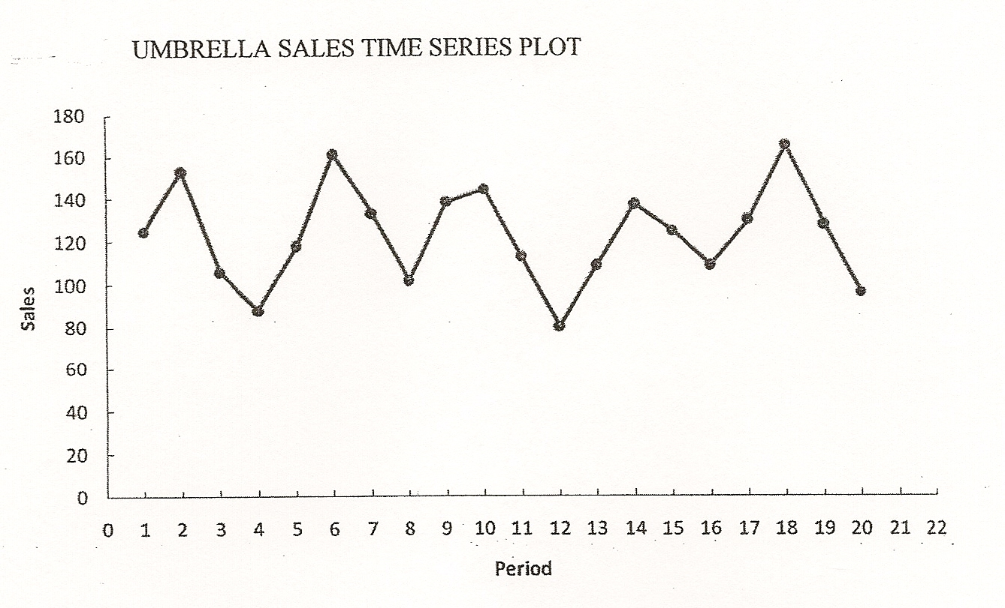
Seasonality without Trend
Example: Umbrella Sales
Time Series Plot

Slide 15
Seasonality without Trend
Example: Umbrella Sales
The time series plot does not indicate any long-term trend in sales.
However, close inspection of the plot does reveal a seasonal pattern.
  The first and third quarters have moderate sales,
  the second quarter the highest sales, and
  the fourth quarter tends to be the lowest quarter in terms of sales.

Slide 16
Seasonality without Trend
We will treat the season as a categorical variable.
Recall that when a categorical variable has k levels, k – 1 dummy variables are required.
If there are four seasons, we need three dummy variables.
  Qtr1 = 1 if Quarter 1, 0 otherwise
  Qtr2 = 1 if Quarter 2, 0 otherwise
  Qtr3 = 1 if Quarter 3, 0 otherwise

Slide 17
Seasonality without Trend
Example: Umbrella Sales
General Form of the Equation is:
Optimal Model is:
The forecasts of quarterly sales in year 6 are:
  Quarter 1: Sales = 95 + 29(1) + 57(0) + 26(0) = 124
  Quarter 2: Sales = 95 + 29(0) + 57(1) + 26(0) = 152
  Quarter 3: Sales = 95 + 29(0) + 57(0) + 26(1) = 121
  Quarter 4: Sales = 95 + 29(0) + 57(0) + 26(0) = 95

Slide 18
Seasonality without Trend
Example: Umbrella Sales
Year | Quarter 1 | Quarter 2 | Quarter 3 | Quarter 4
1 | 125 | 153 | 106 | 88
2 | 118 | 161 | 133 | 102
3 | 138 | 144 | 113 | 80
4 | 109 | 137 | 125 | 109
5 | 130 | 165 | 128 | 96
Average | 124 | 152 | 121 | 95
We could have obtained the quarterly forecasts for next year by simply computing the average number of umbrellas sold in each quarter.

Slide 19
Seasonality and Trend
We will now extend the curve-fitting approach to include situations where the time series contains both a seasonal effect and a linear trend.
We will introduce an additional variable to represent time.

Slide 20
Seasonality and Trend
Example: Terry’s Tie Shop
Business at Terry's Tie Shop can be viewed as
falling into three distinct seasons: (1) Christmas
(November and December); (2) Father's Day (late
May to mid June); and (3) all other times.
Average weekly sales ($) during each of the
three seasons during the past four years are shown on the next slide.

Slide 21
Seasonality and Trend
Example: Terry’s Tie Shop
Season
Year
1 2 3
1
2
3
4
1856 2012 985
1995 2168 1072
2241 2306 1105
2280 2408 1120
Determine a forecast for the average weekly
sales in year 5 for each of the three seasons.

Slide 22
Seasonality and Trend
Example: Terry’s Tie Shop
There are three seasons, so we will need two dummy variables.
  Seas1_{t} = 1 if Season 1 in time period t, 0 otherwise
  Seas2_{t} = 1 if Season 2 in time period t, 0 otherwise
General Form of the Equation is:
Optimal Model

Slide 23
Seasonality and Trend
Example: Terry’s Tie Shop
The forecasts of average weekly sales in the three seasons of year 5 (time periods 13, 14, and 15) are:
Seas. 1: Sales₁₃ = 797 + 1095.43(1) + 1189.47(0) + 36.47(13)
  = 2366.5
Seas. 2: Sales₁₄ = 797 + 1095.43(0) + 1189.47(1) + 36.47(14)
  = 2497.0
Seas. 3: Sales₁₅ = 797 + 1095.43(0) + 1189.47(0) + 36.47(15)
  = 1344.0

Slide 24
End of Chapter 6, Part B

