Slide 1
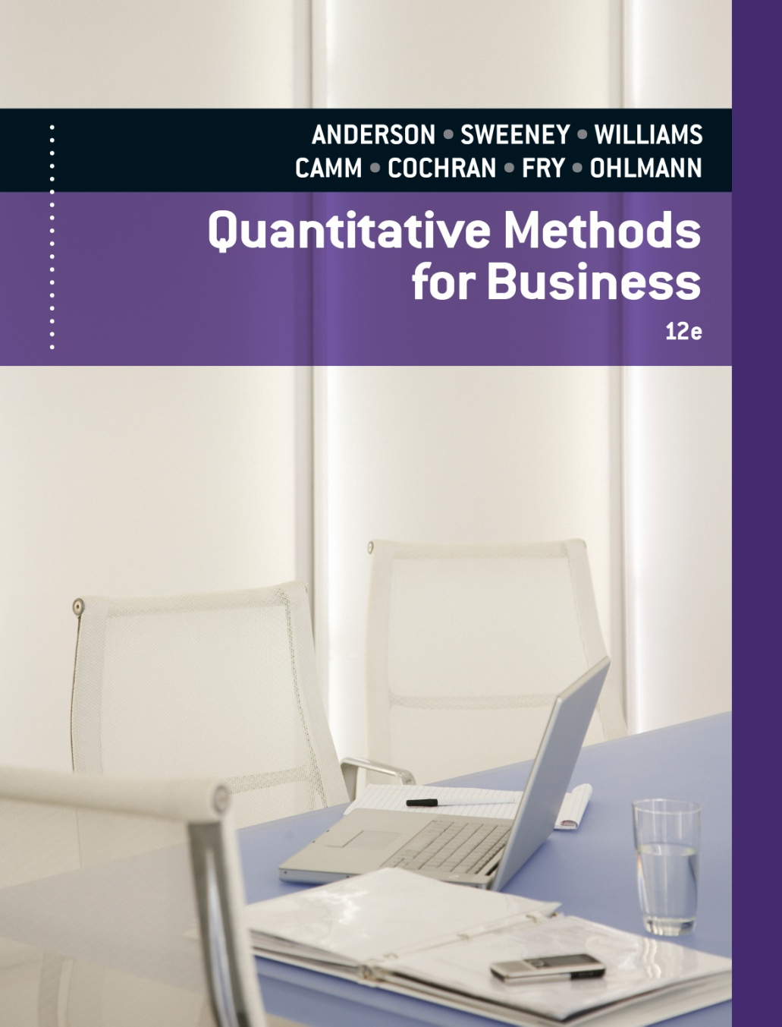
SLIDES BY
.
.
.
.
.
.
.
.
.
.
.
.
John Loucks
St. Edward’s Univ.

Slide 2
Chapter 14, Part A Inventory Models with Deterministic Demand
Inventory Model with Planned Shortages
Quantity Discounts for the EOQ Model

Slide 3
EOQ with Planned Shortages
With the EOQ with planned shortages model, a replenishment order does not arrive at or before the inventory position drops to zero.
Shortages occur until a predetermined backorder quantity is reached, at which time the replenishment order arrives.
The variable costs in this model are annual holding, backorder, and ordering.
For the optimal order and backorder quantity combination, the sum of the annual holding and backordering costs equals the annual ordering cost.

Slide 4
EOQ with Planned Shortages
Assumptions
Demand occurs at a constant rate of D items/year.
Ordering cost: $C_{o} per order.
Holding cost: $C_{h} per item in inventory per year.
Backorder cost: $C_{b} per item backordered per year.
Purchase cost per unit is constant (no qnty. discount).
Set-up time (lead time) is constant.
Planned shortages are permitted (backordered demand units are withdrawn from a replenishment order when it is delivered).

Slide 5
EOQ with Planned Shortages
Formulas
Optimal order quantity:
Q * = 2DC_{o}/C_{h} (C_{h}+C_{b} )/C_{b}
Maximum number of backorders:
S * = Q *(C_{h}/(C_{h}+C_{b}))
Number of orders per year: D/Q *
Time between orders (cycle time): Q */D years
Total annual cost:
[C_{h}(Q *-S *)²/2Q *] + [C_{o}(D/Q *)] + [S *2C_{b}/2Q *]
(holding + ordering + backordering)

Slide 6
Example: Higley Radio Components Co.
EOQ with Planned Shortages Model
Higley has a product for which the assumptions
of the inventory model with shortages are valid.
Demand for the product is 2,000 units per year. The
inventory holding cost rate is 20% per year. The
product costs Higley $50 to purchase. The ordering
cost is $25 per order. The annual shortage cost is
estimated to be $30 per unit per year. Higley
operates 250 days per year.

Slide 7
Example: Higley Radio Components Co.
Optimal Order Policy
D = 2,000; C_{o} = $25; C_{h} = .20(50) = $10; C_{b} = $30
Q * = 2DC_{o}/C_{h} (C_{h} + C_{b})/C_{b}
= 2(2000)(25)/10 x (10+30)/30
= 115.47
S * = Q *(C_{h}/(C_{h}+C_{b}))
= 115.47(10/(10+30)) = 28.87

Slide 8
Example: Higley Radio Components Co.
Maximum Inventory
Q – S = 115.47 – 28.87 = 86.6 units
Cycle Time
T = Q/D(250) = 115.47/2000(250) = 14.43 working days

Slide 9
Example: Higley Radio Components Co.
Total Annual Cost
Holding Cost:
C_{h}(Q –S)²/(2Q) = 10(115.47 – 28.87)²/(2(115.47))
= $324.74
Ordering Cost:
C_{o}(D/Q) = 25(2000/115.47) = $433.01
Backorder Cost:
C_{b}(S²/(2Q) = 30(28.87)²/(2(115.47)) = $108.27
Total Cost:
324.74 + 433.01 + 108.27 = $866.02

Slide 10
Example: Higley Radio Components Co.
Stockout: When and How Long
Question:
How many days after receiving an order does
Higley run out of inventory? How long is Higley
without inventory per cycle?

Slide 11
Example: Higley Radio Components Co.
Stockout: When and How Long
Answer:
Inventory exists for C_{b}/(C_{b}+C_{h}) = 30/(30+10) = .75
of the order cycle. (Note, (Q *-S *)/Q * = .75 also,
before Q * and S * are rounded.)
An order cycle is Q */D = .057735 years = 14.434
days. Thus, Higley runs out of inventory .75(14.434)
= 10.823 days after receiving an order
Higley is out of stock for approximately 14.434 –
10.823 = 3.611 days per order cycle

Slide 12
Example: Higley Radio Components Co.
Reorder Point
Question:
At what inventory or backorder level should Higley place an inventory replenishment order?

Slide 13
Example: Higley Radio Components Co.
Reorder Point
Answer:
Higley is out of stock for approximately 3.611 working days per order cycle. Reorder lead time is 7 working days. Hence, Higley should reorder when it has inventory on hand to cover just 7 – 3.611 = 3.389 days of demand.
Demand per day is 2000/250 = 8 units. Hence, 3.389 days of inventory is 3.389 x 8 = 27.112 units.
Higley should place an order for 115 units when its
inventory drops to 27.112 units

Slide 14
Example: Higley Radio Components Co.
EOQs with and without Planned Shortages
 | With Shortages | Without Shortages
EOQ (units) | 115.47 | 100
Max. Inventory (units) | 86.60 | 100
Max. Shortages (units) | 28.87 | 0
Reorder Point (units) | 27.112 | 56
Cycle Time (days) | 14.43 | 12.50
Shortage Time/Cycle (days) | 3.611 | 0
Shortage Time/Cycle (%) | 25 | 0

Slide 15
Example: Higley Radio Components Co.
EOQs with and without Planned Shortages
Annual Costs | With Shortages | Without Shortages
Holding | $324.74 | $500.00
Ordering | 433.01 | 500.00
Backordering | 108.27 | 0
Total | $866.02 | $1000.00

Slide 16
EOQ with Quantity Discounts
The EOQ with quantity discounts model is applicable where a supplier offers a lower purchase cost when an item is ordered in larger quantities.
This model's variable costs are annual holding, ordering and purchase costs.
For the optimal order quantity, the annual holding and ordering costs are not necessarily equal.

Slide 17
EOQ with Quantity Discounts
Assumptions
Demand occurs at a constant rate of D items/year.
Ordering Cost is $C_{o} per order.
Holding Cost is $C_{h} = $C_{i}I per item in inventory per year (note holding cost is based on the cost of the item, C_{i}).
Purchase Cost is $C₁ per item if the quantity ordered is between 0 and x₁, $C₂ if the order quantity is between x₁ and x₂ , etc.
Delivery time (lead time) is constant.
Planned shortages are not permitted.

Slide 18
EOQ with Quantity Discounts
Formulas
Optimal order quantity: the procedure for determining Q* will be demonstrated
Number of orders per year: D/Q*
Time between orders (cycle time): Q*/D years
Total annual cost: [C_{h}(Q*/2)] + [C_{o}(D/Q*)] + DC
(holding + ordering + purchase)

Slide 19
Example: Nick's Camera Shop
EOQ with Quantity Discounts Model
Nick's Camera Shop carries Zodiac instant print
film. The film normally costs Nick $3.20 per roll, and
he sells it for $5.25. Zodiac film has a shelf life of 18
months. Nick's average sales are 21 rolls per week.
His annual inventory holding cost rate is 25% and it
costs Nick $20 to place an order with Zodiac.

Slide 20
Example: Nick's Camera Shop
EOQ with Quantity Discounts Model
If Zodiac offers a 7% discount on orders of 400
rolls or more, a 10% discount for 900 rolls or more,
and a 15% discount for 2000 rolls or more, determine
Nick's optimal order quantity.
--------------------
D = 21(52) = 1092; C_{h} = .25(C_{i}); C_{o} = 20

Slide 21
Example: Nick's Camera Shop
Unit-Prices’ Economical Order Quantities
For C₄ = .85(3.20) = $2.72
To receive a 15% discount Nick must order
at least 2,000 rolls. Unfortunately, the film's shelf
life is 18 months. The demand in 18 months (78
weeks) is 78 x 21 = 1638 rolls of film.
If he ordered 2,000 rolls he would have to
scrap 372 of them. This would cost more than the
15% discount would save.

Slide 22
Example: Nick's Camera Shop
Unit-Prices’ Economical Order Quantities
For C₃ = .90(3.20) = $2.88
Q₃* = 2DC_{o}/C_{h} = 2(1092)(20)/[.25(2.88)] = 246.31 (not feasible)
The most economical, feasible quantity for C₃ is 900.
For C₂ = .93(3.20) = $2.976
Q₂* = 2DC_{o}/C_{h} = 2(1092)(20)/[.25(2.976)] = 242.30
(not feasible)
The most economical, feasible quantity for C₂ is 400.

Slide 23
Example: Nick's Camera Shop
Unit-Prices’ Economical Order Quantities
For C₁ = 1.00(3.20) = $3.20
Q₁* = 2DC_{o}/C_{h} = 2(1092)(20)/.25(3.20) = 233.67 (feasible)
When we reach a computed Q that is feasible we stop computing Q's. (In this problem we have no more to compute anyway.)

Slide 24
Example: Nick's Camera Shop
Total Cost Comparison
Compute the total cost for the most economical, feasible order quantity in each price category for which
a Q * was computed.
TC_{i} = (C_{h})(Q_{i}*/2) + (C_{o})(D/Q_{i}*) + DC_{i}
TC₃ = (.72)(900/2) + (20)(1092/900) + (1092)(2.88) = 3,493
TC₂ = (.744)(400/2) + (20)(1092/400) + (1092)(2.976) = 3,453
TC₁ = (.80)(234/2) + (20)(1092/234) + (1092)(3.20) = 3,681
Comparing the total costs for order quantities of 234, 400 and 900, the lowest total annual cost is $3,453. Nick should order 400 rolls at a time.

Slide 25
Tasks
Suppose that Westside Auto, with D 12,000 units per year, C_{h} (2.50)(0.20) $0.50, and Co $25, decided to operate with a backorder inventory policy. Backorder costs are estimated to be $5 per unit per year and 250 working day per year. Identify the following:
Minimum cost order quantity
Maximum number of backorders
Maximum inventory
Cycle time
Total annual cost
Assume that the following quantity discount schedule is appropriate. If annual demand is 120 units, ordering costs are $20 per order, and the annual holding cost rate is 25%, what order quantity would you recommend?
Order Size | Discount (%) | Harga per unit
0 - 49 | 0 | $30
50 – 99 | 5 | $28.50
100 lebih | 10 | $27

