Slide 1
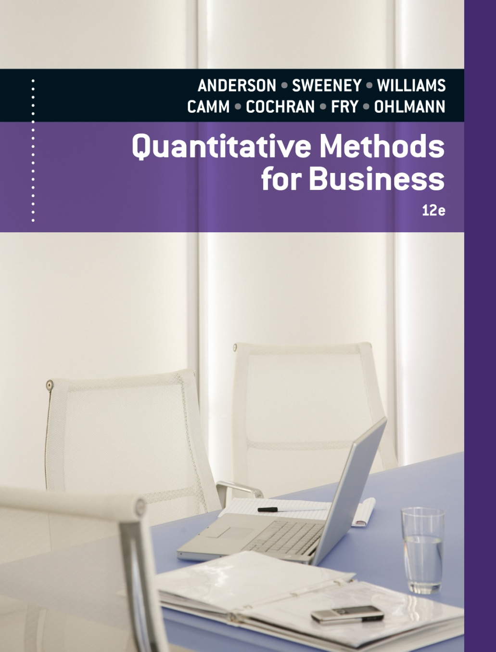
SLIDES BY
.
.
.
.
.
.
.
.
.
.
.
.
John Loucks
St. Edward’s Univ.

Slide 2
Chapter 15, Part A Waiting Line Models
Structure of a Waiting Line System
Queuing Systems
Queuing System Input Characteristics
Queuing System Operating Characteristics
Analytical Formulas
Single-Server Waiting Line Model with Poisson Arrivals and Exponential Service Times
Multiple-Server Waiting Line Model with Poisson Arrivals and Exponential Service Times

Slide 3
Structure of a Waiting Line System
Queuing theory is the study of waiting lines.
Four characteristics of a queuing system are:
the manner in which customers arrive
the time required for service
the priority determining the order of service
the number and configuration of servers in the system.

Slide 4
Structure of a Waiting Line System
Distribution of Arrivals
Generally, the arrival of customers into the system is a random event.
Frequently the arrival pattern is modeled as a Poisson process.
Distribution of Service Times
Service time is also usually a random variable.
A distribution commonly used to describe service time is the exponential distribution.

Slide 5
Structure of a Waiting Line System
Queue Discipline
Most common queue discipline is first come, first served (FCFS).
An elevator is an example of last come, first served (LCFS) queue discipline.

Slide 6
Structure of a Waiting Line System
Single-Server
Multiple-Server
System
Customer
arrives
Waiting line
S₁
Customer
leaves
System
S₁
Customer
arrives
Waiting line
S₂
Customer
leaves
S₃

Slide 7
Queuing System Input Characteristics
λ = the average arrival rate
1/λ = the average time between arrivals
µ = the average service rate for each server
1/µ = the average service time
σ = the standard deviation of the service time

Slide 8
Queuing System Operating Characteristics
P₀ = probability the service facility is idle
P_{n} = probability of n units in the system
P_{w} = probability an arriving unit must wait for service
L_{q} = average number of units in the queue awaiting service
L = average number of units in the system
W_{q} = average time a unit spends in the queue awaiting service
W = average time a unit spends in the system

Slide 9
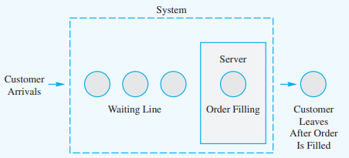
Single-Server Waiting Line Model
Operating Characteristics
λ = the mean number of arrivals per time period (the arrival rate)
μ = the mean number of services per time period (the service rate)

Slide 10
Operating Characteristics
The probability that no units are in the system:
2. The average number of units in the waiting line:
3. The average number of units in the system:

Slide 11
Operating Characteristics
4. The average time a unit spends in the waiting line:
5. The average time a unit spends in the system:
6. The probability that an arriving unit has to wait for service:

Slide 12
Operating Characteristics
7. The probability of n units in the system:

Slide 13
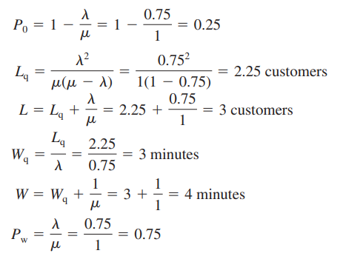
Example: Burger Dome
Recall that for the Burger Dome problem we had an arrival rate of 0.75 customers per minute and a service rate of 1 customer per minute. We can be used to provide operating characteristics for the Burger Dome single-server waiting line

Slide 14
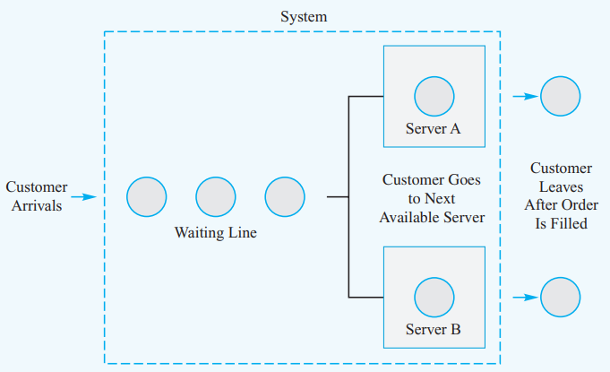
Multiple-Server Waiting Line Model
Operating Characteristics
λ = the mean number of arrivals per time period (the arrival rate)
μ = the mean number of services per time period (the service rate)
k = the number of servers

Slide 15
Operating Characteristics
1. The probability that no units are in the system:
2. The average number of units in the waiting line:
3. The average number of units in the system:

Slide 16
Operating Characteristics
4. The average time a unit spends in the waiting line:
5. The average time a unit spends in the system:
6. The probability that an arriving unit has to wait for service:

Slide 17
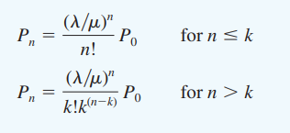
Operating Characteristics
7. The probability of n units in the system:

Slide 18
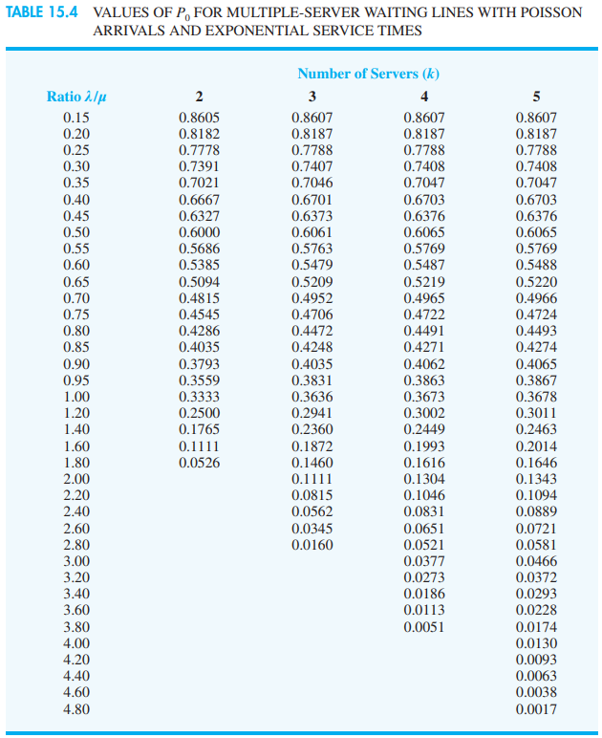
values of P₀ for selected values of and k.

Slide 19
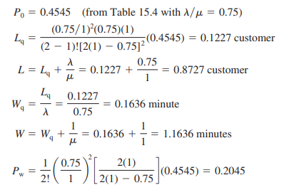
Example: Burger Dome
We use equations for the k 2-server system. For an arrival rate of 0.75 customers per minute and a service rate of 1 customer per minute for each server, we obtain the operating characteristics:

Slide 20
End of Chapter 15, Part A

Slide 21
Tasks
Willow Brook National Bank operates a drive-up teller window that allows customers to complete bank transactions without getting out of their cars. On weekday mornings, arrivals to the drive-up teller window occur at random, with an arrival rate of 24 customers per hour or 0.4 customers per minute. In the Willow Brook National Bank waiting line system (see Problem 1), assume that the service times for the drive-up teller follow an exponential probability distribution with a service rate of 36 customers per hour, or 0.6 customers per minute. Use the single-server drive-up bank teller operation referred to in Problems 1 and 2 to determine the following operating characteristics for the system
The probability that no customers are in the system
The average number of customers waiting
The average number of customers in the system
The average time a customer spends waiting
The average time a customer spends in the system
The probability that arriving customers will have to wait for service
The probability that arriving 3 customers will have to wait for service

Slide 22
Tasks
All airplane passengers at the Lake City Regional Airport must pass through a security screening area before proceeding to the boarding area. The airport has two screening stations available, and the facility manager must decide how many to have open at any particular time. The service rate for processing passengers at each screening station is 3 passengers per minute. On Monday morning the arrival rate is 5.4 passengers per minute. Assume that processing times at each screening station follow an exponential distribution and that arrivals follow a Poisson distribution.
The probability that no customers are in the system
The average number of customers waiting
The average number of customers in the system
The average time a customer spends waiting
The average time a customer spends in the system
The probability that arriving customers will have to wait for service
The probability that arriving 2 customers will have to wait for service

