Slide 1
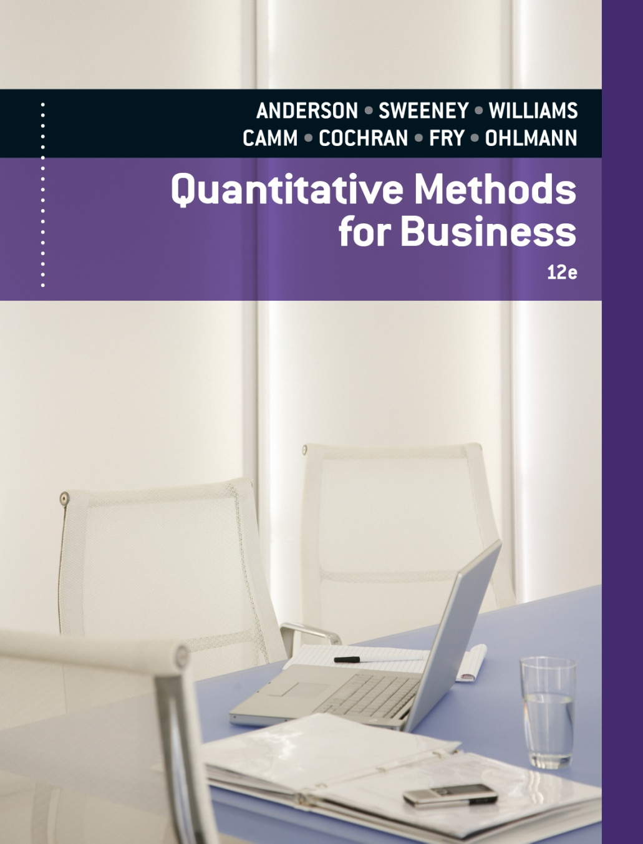
SLIDES BY
.
.
.
.
.
.
.
.
.
.
.
.
John Loucks
St. Edward’s Univ.

Slide 2
Chapter 15, Part B Waiting Line Models
Single-Server Waiting Line Model with Poisson Arrivals and Arbitrary Service Times
Multiple-Server Waiting Line Model with Poisson Arrivals, Arbitrary Service Times, and No Waiting Line
Waiting Lines with Finite Calling Populations

Slide 3
Single-Server Waiting Line Model with
Poisson Arrivals and Arbitrary Service Times
M/G/1 queuing system
Single server
Poisson arrival-rate distribution
General or unspecified service time distribution
Unlimited maximum queue length
Infinite calling population

Slide 4
Single-Server Waiting Line Model with Poisson Arrivals and Arbitrary Service Times
The Cutler University Student Union has one
self-service copying machine. On the average, 12
customers per hour arrive to make copies. (The
arrival process follows a Poisson distribution.)
The time to copy documents follows
approximately a normal distribution with a mean of
2.5 minutes and a standard deviation of 30 seconds.

Slide 5
Single-Server Waiting Line Model with Poisson Arrivals and Arbitrary Service Times
The Union manager has received several
complaints from students regarding the long lines at
the copier. Based of this information, determine:
1) the average number of customers waiting or using
the copier.
2) the probability an arriving customer must wait in
line.
3) the proportion of time the copier is idle.
4) the average time a customer must wait in line
before using the copier.

Slide 6
Operating Characteristics for the M/G/1 Model
λ = the arrival rate
μ = the service rate
σ = the standard deviation of the service time
1. The probability that no units are in the system:
2. The average number of units in the waiting line:

Slide 7
Operating Characteristics for the M/G/1 Model
3. The average number of units in the system:
4. The average time a unit spends in the waiting line:

Slide 8
Operating Characteristics for the M/G/1 Model
5. The average time a unit spends in the system:
6. The probability that an arriving unit has to wait for service:

Slide 9
Single-Server Waiting Line Model with Poisson Arrivals and Arbitrary Service Times
Example: This situation can be modeled as an M/G/1
system with:
λ = 12 per hour = 12/60 = .2/minute
1/µ = 2.5 minutes
µ = 1/(2.5) = .4 per minute
σ = 30 seconds = .5 minutes

Slide 10
Single-Server Waiting Line Model with Poisson Arrivals and Arbitrary Service Times
Average number of customers waiting or using the copier
Substituting the appropriate values gives:
Thus L = .26 + (.2/.4) = .76 customers
where

Slide 11
Single-Channel Waiting Line Model with Poisson Arrivals and Arbitrary Service Times
Probability an arriving customer must wait in line
Proportion of time the copier is idle
Average time a customer must wait in line before using the copier

Slide 12
Multiple-Server Waiting Line Model with Poisson Arrivals, Arbitrary Service Times, and No Waiting Line
M/G/k Queuing system
Multiple servers
Poisson arrival-rate distribution
Arbitrary service times
No waiting line
Infinite calling population

Slide 13
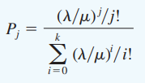
Operating Characteristics for the M/G/k Model with Blocked Customers Cleared
λ = the arrival rate
μ = the service rate
k = the number of servers
P_{j} = the arrival rate the service rate for each server the number of servers the probability that j of the k servers are busy
for j = 0, 1, 2, . . . , k

Slide 14
Operating Characteristics for the M/G/k Model with Blocked Customers Cleared
where L will certainly be less than k

Slide 15
Multiple-Server Waiting Line Model with Poisson Arrivals, Arbitrary Service Times, and No Waiting Line
Example:
Telephone system with k lines. (When all k lines are being used, additional callers get a busy signal.)
Several firms are over-the-counter (OTC) market
makers of MegaTech stock. A broker wishing to
trade this stock for a client will call on these firms to
execute the order. If the market maker's phone line is
busy, a broker will immediately try calling another
market maker to transact the order.

Slide 16
Multiple-Server Waiting Line Model with Poisson Arrivals, Arbitrary Service Times, and No Waiting Line
Richardson and Company is one such OTC
market maker. It estimates that on the average, a
broker will try to call to execute a stock transaction
every two minutes. The time required to complete
the transaction averages 75 seconds. The firm has
four traders staffing its phones. Assume calls arrive
according to a Poisson distribution.

Slide 17
Multiple-Server Waiting Line Model with Poisson Arrivals, Arbitrary Service Times, and No Waiting Line
What percentage of its potential business will be
lost by Richardson?
What percentage of its potential business would
be lost if only three traders staffed its phones?

Slide 18
Multiple-Server Waiting Line Model with Poisson Arrivals, Arbitrary Service Times, and No Waiting Line
This problem can be modeled as an M/G/k
system with block customers cleared with:
1/λ = 2 minutes = 2/60 hour
λ = 60/2 = 30 per hour
1/µ = 75 seconds = 75/60 minutes = 75/3600 hours
µ = 3600/75 = 48 per hour

Slide 19
Multiple-Server Waiting Line Model with Poisson Arrivals, Arbitrary Service Times, and No Waiting Line
Percentage of potential business that be lost when using 4 traders (k = 4)
The system will be blocked when there are four customers in the system. Hence, the answer is P₄.
continued

Slide 20
Multiple-Server Waiting Line Model with Poisson Arrivals, Arbitrary Service Times, and No Waiting Line
Percentage of potential business that be lost when using 4 traders (k = 4)
Now,
Thus, with four traders 0.3% of the potential
customers are lost.

Slide 21
Multiple-Server Waiting Line Model with Poisson Arrivals, Arbitrary Service Times, and No Waiting Line
Percentage of potential business that be lost when using 3 traders (k = 3)
The system will be blocked when there are three customers in the system. Hence, the answer is P₃.
Thus, with three traders 2.2% of the potential
customers are lost.

Slide 22
Waiting Lines with Finite Calling Populations
Biff Smith is in charge of maintenance for four of
the rides at the Rollerama Amusement Park. On the
average, each ride operates four hours before
needing maintenance. When maintenance is needed,
the average repair time is 10 minutes.
Assuming the time between machine maintenance
as well as the service times follow exponential
distributions, determine:
1) the proportion of time Biff is idle, and
2) the average time a ride is "down" for maintenance.

Slide 23
Operating Characteristics for the M/M/1 Model with a Finite Calling Population
λ = the arrival rate
μ = the service rate
N = the size of the population
1. The probability that no units are in the system:
2. The average number of units in the waiting line:

Slide 24
Operating Characteristics for the M/M/1 Model with a Finite Calling Population
3. The average number of units in the system:
4. The average time a unit spends in the waiting line:
5. The average time a unit spends in the system:

Slide 25
Operating Characteristics for the M/M/1 Model with a Finite Calling Population
6. The probability an arriving unit has to wait for service:
7. The probability of n units in the system:

Slide 26
Waiting Lines with Finite Calling Populations
Example: This problem can be modeled as an
M/M/1 queue with a finite calling population
of size N = 4 (rides).
λ = 1/(4 hours) = .25 per hour
µ = 60/(10 minutes) = 6 per hour
λ/μ = .25/6 = 1/24

Slide 27
Waiting Lines with Finite Calling Populations
Proportion of time Biff is idle
Hence, Biff is idle approximately 84% of the time.

Slide 28
Waiting Lines with Finite Calling Populations
Average time a ride is "down" for maintenance
where

Slide 29
Waiting Lines with Finite Calling Populations
Average time a ride is "down" for maintenance
Substituting the appropriate values gives:
L_{q} = 4 - ((.25+6)/.25)(1-.840825) = .020625
L = .020625 + (1-.840825) = .1798
W_{q} = .020625/((4-.1798).25) = .021596
W = .021596 + 1/6 = .18826 hours or 11.3 minutes

Slide 30
End of Chapter 15, Part B

Slide 31
Tasks
Jobs arrive randomly at a particular assembly plant; assume that the arrival rate is five jobs per hour. Service times (in minutes per job) do not follow the exponential probability distribution. Two proposed designs for the plant’s assembly operation are shown.
 | Service Time
Design | Mean | Standard Deviation
A | 6 | 3
B | 6,25 | 0,6
What is the service rate in jobs per hour for each design?
For the service rates in part (a), what design appears to provide the best or fastest service rate?
What are the standard deviations of the service times in hours?
Use the M/G/1 model to compute the operating characteristics for each design P₀, L_{q}, L, W_{q}, W, P_{w} !

Slide 32
Tasks
Five administrative assistants use an office copier. The average time between arrivals for each assistant is 40 minutes, which is equivalent to an arrival rate of 1 /4 = 0.025 arrivals per minute. The mean time each assistant spends at the copier is 5 minutes, which is equivalent to a service rate of 1 /5 = 0.20 per minute. Use the M/M/1 model with a finite calling population to determine the following:.
The probability that the copier is idle
The average number of administrative assistants in the waiting line
The average number of administrative assistants at the copier
The average time an assistant spends waiting for the copier
The average time an assistant spends at the copier

