Slide 1
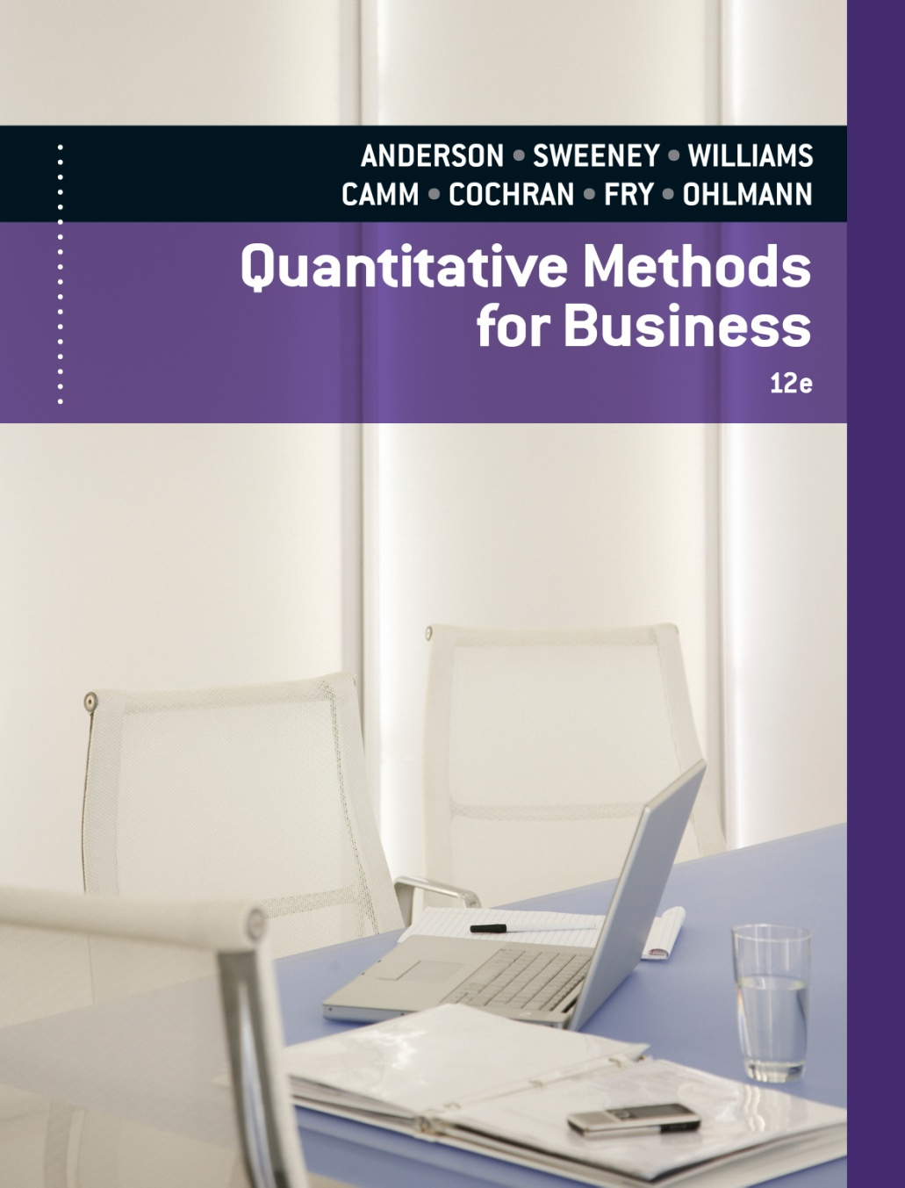
SLIDES BY
.
.
.
.
.
.
.
.
.
.
.
.
John Loucks
St. Edward’s Univ.

Slide 2
Chapter 17 Markov Processes
Market Share Analysis
Transition Probabilities
Steady-State Probabilities
Absorbing States
Transition Matrix with Submatrices
Fundamental Matrix

Slide 3
Markov Processes
Markov process models are useful in studying the evolution of systems over repeated trials or sequential time periods or stages.
the promotion of managers to various positions within an organization
the migration of people into and out of various regions of the country
the progression of students through the years of college, including eventually dropping out or graduating

Slide 4
Markov Processes
Markov processes have been used to describe the probability that:
a machine that is functioning in one period will function or break down in the next period.
a consumer purchasing brand A in one period will purchase brand B in the next period.

Slide 5
Example: Market Share Analysis
Suppose we are interested in analyzing the market share and customer loyalty for Murphy’s Foodliner and Ashley’s Supermarket, the only two grocery stores in a small town. We focus on the sequence of shopping trips of one customer and assume that the customer makes one shopping trip each week to either Murphy’s Foodliner or Ashley’s Supermarket, but not both.

Slide 6
Example: Market Share Analysis
We refer to the weekly periods or shopping trips as the trials of the process. Thus, at each trial, the customer will shop at either Murphy’s Foodliner or Ashley’s Supermarket. The particular store selected in a given week is referred to as the state of the system in that period. Because the customer has two shopping alternatives at each trial, we say the system has two states.
State 1. The customer shops at Murphy’s Foodliner.
State 2. The customer shops at Ashley’s Supermarket.

Slide 7
Example: Market Share Analysis
Suppose that, as part of a market research study, we collect data from 100 shoppers over a 10-week period. In reviewing the data, suppose that we find that of all customers who shopped at Murphy’s in a given week, 90% shopped at Murphy’s the following week while 10% switched to Ashley’s.
Suppose that similar data for the customers who shopped at Ashley’s in a given week show that 80% shopped at Ashley’s the following week while 20% switched to Murphy’s.

Slide 8
Transition Probabilities
Transition probabilities govern the manner in which the state of the system changes from one stage to the next. These are often represented in a transition matrix.

Slide 9
Transition Probabilities
A system has a finite Markov chain with stationary transition probabilities if:
there are a finite number of states,
the transition probabilities remain constant from stage to stage, and
the probability of the process being in a particular state at stage n+1 is completely determined by the state of the process at stage n (and not the state at stage n-1). This is referred to as the memory-less property.

Slide 10
Example: Market Share Analysis
Transition Probabilities
p_{ij} = probability of making a transition from state i
in a given period to state j in the next period
p₁₁ p₁₂ 0.9 0.1
P = =
p₂₁ p₂₂ 0.2 0.8

Slide 11
Example: Market Share Analysis
State Probabilities
Murphy’s
.9
P = .9(.9) = .81
Murphy’s
Ashley’s
.9
Murphy’s
.1
P = .9(.1) = .09
Murphy’s
P = .1(.2) = .02
Ashley’s
.2
.1
Ashley’s
P = .1(.8) = .08
.8

Slide 12
Example: Market Share Analysis
State Probabilities for Future Periods
Beginning Initially with a Murphy’s Customer
State Probabilities for Future Periods
Beginning Initially with an Ashley’s Customer

Slide 13
Steady-State Probabilities
The state probabilities at any stage of the process can be recursively calculated by multiplying the initial state probabilities by the state of the process at stage n.
The probability of the system being in a particular state after a large number of stages is called a steady-state probability.

Slide 14
Steady-State Probabilities
Steady state probabilities can be found by solving the system of equations ΠP = Π together with the condition for probabilities that Σπ_{i} = 1.
Matrix P is the transition probability matrix
Vector Π is the vector of steady state probabilities.

Slide 15
Example: Market Share Analysis
Steady-State Probabilities
Let π₁ = long run proportion of Murphy’s visits
π₂ = long run proportion of Ashley’s visits
Then,
.9 .1
[π₁ π₂] = [π₁ π₂]
.2 .8
continued . . .

Slide 16
Example: Market Share Analysis
Steady-State Probabilities
.9π₁ + .2π₂ = π₁ (1)
.1π₁ + .8π₂ = π₂ (2)
π₁ + π₂ = 1 (3)
Substitute π₂ = 1 - π₁ into (1) to give:
π₁ = .9π₁ + .2(1 - π₁) = 2/3 = .667
Substituting back into (3) gives:
π₂ = 1/3 = .333.

Slide 17
Example: Market Share Analysis
Steady-State Probabilities
Thus, if we have 1000 customers in the system, the Markov process model tells us that in the long run, with steady-state probabilities π₁ = .667 and π₂ = .333, 667 customers will be Murphy’s and 333 customers will be Ashley’s.

Slide 18
Example: Market Share Analysis
Suppose Ashley’s Supermarket is contemplating an advertising campaign to attract more of Murphy’s customers to its store. Let us suppose further that Ashley’s believes this promotional strategy will increase the probability of a Murphy’s customer switching to Ashley’s from 0.10 to 0.15.

Slide 19
Example: Market Share Analysis
Revised Transition Probabilities

Slide 20
Example: Market Share Analysis
Revised Steady-State Probabilities
.85π₁ + .20π₂ = π₁ (1)
.15π₁ + .80π₂ = π₂ (2)
π₁ + π₂ = 1 (3)
Substitute π₂ = 1 - π₁ into (1) to give:
π₁ = .85π₁ + .20(1 - π₁) = .57
Substituting back into (3) gives:
π₂ = .43.

Slide 21
Example: Market Share Analysis
Suppose that the total market consists of 6000 customers per week. The new promotional strategy will increase the number of customers doing their weekly shopping at Ashley’s from 2000 to 2580.
If the average weekly profit per customer is $10, the proposed promotional strategy can be expected to increase Ashley’s profits by $5800 per week. If the cost of the promotional campaign is less than $5800 per week, Ashley should consider implementing the strategy.

Slide 22
Example: North’s Hardware
Henry, a persistent salesman, calls North's
Hardware Store once a week hoping to speak with
the store's buying agent, Shirley. If Shirley does not
accept Henry's call this week, the probability she
will do the same next week is .35. On the other
hand, if she accepts Henry's call this week, the
probability she will not do so next week is .20.

Slide 23
Example: North’s Hardware
Transition Matrix
Next Week's Call
Refuses Accepts
This Refuses .35 .65
Week's
Call Accepts .20 .80

Slide 24
Example: North’s Hardware
Steady-State Probabilities
Question
How many times per year can Henry expect to talk to Shirley?
Answer
To find the expected number of accepted calls per year, find the long-run proportion (probability) of a call being accepted and multiply it by 52 weeks.
continued . . .

Slide 25
Example: North’s Hardware
Steady-State Probabilities
Answer (continued)
Let π₁ = long run proportion of refused calls
π₂ = long run proportion of accepted calls
Then,
.35 .65
[π₁ π₂] = [π₁ π₂]
.20 .80
continued . . .

Slide 26
Example: North’s Hardware
Steady-State Probabilities
Answer (continued)
.35π₁ + .20π₂ = π₁ (1)
.65π₁ + .80π₂ = π₂ (2)
π₁ + π₂ = 1 (3)
Solve for π₁ and π₂.
continued . . .

Slide 27
Example: North’s Hardware
Steady-State Probabilities
Answer (continued)
Solving using equations (2) and (3). (Equation 1 is redundant.) Substitute π₁ = 1 - π₂ into (2) to give:
.65(1 - π₂) + .80π₂ = π₂
This gives π₂ = .76471. Substituting back into equation (3) gives π₁ = .23529.
Thus the expected number of accepted calls per year is:
(.76471)(52) = 39.76 or about 40

Slide 28
Example: North’s Hardware
State Probability
Question
What is the probability Shirley will accept Henry's next two calls if she does not accept his call this week?

Slide 29
Example: North’s Hardware
State Probability
Answer
Refuses
.35
P = .35(.35) = .1225
Refuses
Accepts
.35
Refuses
.65
P = .35(.65) = .2275
Refuses
P = .65(.20) = .1300
Accepts
.20
.65
Accepts
P = .65(.80) = .5200
.80

Slide 30
Example: North’s Hardware
State Probability
Question
What is the probability of Shirley accepting exactly one of Henry's next two calls if she accepts his call this week?

Slide 31
Example: North’s Hardware
State Probability
Answer
The probability of exactly one of the next two calls being accepted if this week's call is accepted can be found by adding the probabilities of (accept next week and refuse the following week) and (refuse next week and accept the following week) =
.13 + .16 = .29

Slide 32
Absorbing States
An absorbing state is one in which the probability that the process remains in that state once it enters the state is 1.
If there is more than one absorbing state, then a steady-state condition independent of initial state conditions does not exist.

Slide 33
Transition Matrix with Submatrices
If a Markov chain has both absorbing and nonabsorbing states, the states may be rearranged so that the transition matrix can be written as the following composition of four submatrices: I, 0, R, and Q:
I
0
R
Q

Slide 34
Transition Matrix with Submatrices
I = an identity matrix indicating one always remains in an absorbing state once it is reached
0 = a zero matrix representing 0 probability of
transitioning from the absorbing states to the
nonabsorbing states
R = the transition probabilities from the nonabsorbing states to the absorbing states
Q = the transition probabilities between the nonabsorbing states

Slide 35
Example: Jetair Aerospace
The vice president of personnel at Jetair Aerospace
has noticed that yearly shifts in personnel can be
modeled by a Markov process. The transition matrix is:
Next Year
Same Pos. Promotion Retire Quit Fired
Current Year
Same Position .55 .10 .05 .20 .10
Promotion .70 .20 0 .10 0
Retire 0 0 1 0 0
Quit 0 0 0 1 0
Fired 0 0 0 0 1

Slide 36
Example: Jetair Aerospace
Transition Matrix
Next Year
Retire Quit Fired Same Promotion
Current Year
Retire 1 0 0 0 0
Quit 0 1 0 0 0
Fired 0 0 1 0 0
Same .05 .20 .10 .55 .10
Promotion 0 .10 0 .70 .20

Slide 37
Fundamental Matrix
The fundamental matrix, N, is the inverse of the difference between the identity matrix and the Q matrix.
N = (I - Q )⁻¹

Slide 38
Example: Jetair Aerospace
Fundamental Matrix
-1 -1
1 0 .55 .10 .45 -.10
N = (I - Q ) ⁻¹ = − =
0 1 .70 .20 -.70 .80

Slide 39
Example: Jetair Aerospace
Fundamental Matrix
The determinant, d = a₁₁a₂₂ - a₂₁a₁₂
= (.45)(.80) - (-.70)(-.10) = .29
Thus,
.80/.29 .10/.29 2.76 .34
N = =
.70/.29 .45/.29 2.41 1.55

Slide 40
NR Matrix
The NR matrix is the product of the fundamental (N) matrix and the R matrix.
It gives the probabilities of eventually moving from each nonabsorbing state to each absorbing state.
Multiplying any vector of initial nonabsorbing state probabilities by NR gives the vector of probabilities for the process eventually reaching each of the absorbing states. Such computations enable economic analyses of systems and policies.

Slide 41
Example: Jetair Aerospace
NR Matrix
The probabilities of eventually moving to the absorbing states from the nonabsorbing states are given by:
2.76 .34 .05 .20 .10
NR = x
2.41 1.55 0 .10 0

Slide 42
Example: Jetair Aerospace
NR Matrix (continued)
Retire Quit Fired
Same .14 .59 .28
NR =
Promotion .12 .64 .24

Slide 43
Example: Jetair Aerospace
Absorbing States
Question
What is the probability of someone who was just promoted eventually retiring? . . . quitting? . . . being fired?

Slide 44
Example: Jetair Aerospace
Absorbing States (continued)
Answer
The answers are given by the bottom row of the NR matrix. The answers are therefore:
Eventually Retiring = .12
Eventually Quitting = .64
Eventually Being Fired = .24

Slide 45
End of Chapter 17

Slide 46
TASKS
Management of the New Fangled Softdrink Company believes that the probability of a customer purchasing Red Pop or the company’s major competition, Super Cola, is based on the customer’s most recent purchase. Suppose that the following transition probabilities are appropriate:
From | To
 | Red Pop | Super Cola
Red Pop | 0,9 | 0,1
Super Cola | 0,1 | 0,9
Show the three-period tree diagram for a customer who last purchased Red Pop. What is the probability that this customer purchases Red Pop on the third purchase?
Show the three-period tree diagram for a customer who last purchased Red Pop. What is the probability that this customer purchases Red Pop on the third purchase for beginning initially with Super Cola?
What is the steady-state probability of the case?

Slide 47
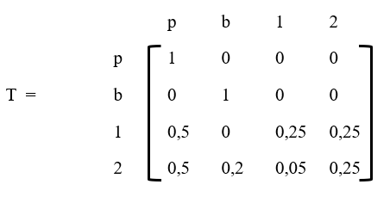
TASKS
A bank company located in the Jakarta area provides a loan to a customer which will be demonstrated using the following transition matrix, which describes the accounts receivable for its customers :
Shows matrix I, matrix 0, matrix R and matrix Q!
Show the fundamental matrix!
Show an N.R matrix!
Of these cases had receivables of $ 4,000 in month 1 and $ 5,000 in month 2. To determine how much of this was collectible and how much would be uncollectible?

