Slide 1
SLIDES BY
.
.
.
.
.
.
.
.
.
.
.
.
John Loucks
St. Edward’s Univ.

Slide 2
Chapter 3, Part A Probability Distributions
Random Variables
Discrete Probability Distributions
Binomial Probability Distribution
Poisson Probability Distribution
.40
.30
.20
.10
0 1 2 3 4

Slide 3
Random Variables
A random variable is a numerical description of the
outcome of an experiment.
A discrete random variable may assume either a
finite number of values or an infinite sequence of
values.
A continuous random variable may assume any
numerical value in an interval or collection of
intervals.

Slide 4
Random Variables
Examples of Random Variables
The first, second, and fourth variables above are discrete,
while the third one is continuous.

Slide 5
Random Variables
Examples of Random Variables
Question
Random Variable x
Type
Family
size
x = Number of dependents in
family reported on tax return
Discrete
Distance from
home to store
x = Distance in miles from
home to the store site
Continuous
Own dog
or cat
x = 1 if own no pet;
= 2 if own dog(s) only;
= 3 if own cat(s) only;
= 4 if own dog(s) and cat(s)
Discrete

Slide 6
Example: JSL Appliances
Discrete random variable with a finite number of values
Let x = number of TVs sold at the store in one day,
where x can take on 5 values (0, 1, 2, 3, 4)

Slide 7
Example: JSL Appliances
Discrete random variable with an infinite sequence of values
Let x = number of customers arriving in one day,
where x can take on the values 0, 1, 2, . . .
We can count the customers arriving, but there is no
finite upper limit on the number that might arrive.

Slide 8
Discrete Probability Distributions
The probability distribution for a random variable
describes how probabilities are distributed over
the values of the random variable.
We can describe a discrete probability distribution
with a table, graph, or equation.

Slide 9
Discrete Probability Distributions
The probability distribution is defined by a
probability function, denoted by f(x), which provides
the probability for each value of the random variable.
The required conditions for a discrete probability
function are:
f(x) > 0
Σf(x) = 1

Slide 10
Example: DiCarlo Motors, Inc.
Using past data on daily car sales, …
a tabular representation of the probability
distribution for car sales was developed.
Number
Units Sold of Days
0 54
1 117
2 72
3 42
4 12
5 3
300
x f(x)
0 .18
1 .39
2 .24
3 .14
4 .04
5 .01
1.00
.18 = 54/300

Slide 11
Example: DiCarlo Motors, Inc.
Graphical Representation of the Probability Distribution
.50
.40
.30
Probability
.20
.10
0 1 2 3 4 5
Values of Random Variable x (car sales)

Slide 12
Example: DiCarlo Motors, Inc.
The probability distribution provides the following information.
There is a 0.18 probability that no cars will be sold during a day.
The most probable sales volume is 1, with f(1) = 0.39.
There is a 0.05 probability of an outstanding sales day with four or five cars being sold.

Slide 13
Discrete Uniform Probability Distribution
The discrete uniform probability distribution is the
simplest example of a discrete probability
distribution given by a formula.
The discrete uniform probability function is
f(x) = 1/n
the values of the
random variable
are equally likely
where:
n = the number of values the random
variable may assume

Slide 14
Expected Value and Variance
The expected value, or mean, of a random variable
is a measure of its central location.
E(x) = μ = Σxf(x)
The variance summarizes the variability in the
values of a random variable.
Var(x) = σ ² = Σ(x - μ)²f(x)
The standard deviation, σ, is defined as the positive
square root of the variance.

Slide 15
Example: DiCarlo Motors, Inc.
Expected Value of a Discrete Random Variable
x f(x) xf(x)
0 .18 .00
1 .39 .39
2 .24 .48
3 .14 .42
4 .04 .16
5 .01 .05
E(x) = 1.50
expected number of cars sold in a day

Slide 16
Example: DiCarlo Motors, Inc.
Variance and Standard Deviation
of a Discrete Random Variable
x
x - μ
(x - μ)²
f(x)
(x - μ)²f(x)
0
1
2
3
4
5
-1.5
-0.5
0.5
1.5
2.5
3.5
2.25
0.25
0.25
2.25
6.25
12.25
.18
.39
.24
.14
.04
.01
.4050
.0975
.0600
.3150
.2500
.1225
cars
squared
Variance of daily sales = σ ² = 1.2500
Standard deviation of daily sales = 1.118 cars

Slide 17
Binomial Probability Distribution
Four Properties of a Binomial Experiment
1. The experiment consists of a sequence of n
identical trials.
2. Two outcomes, success and failure, are possible
on each trial.
3. The probability of a success, denoted by p, does
not change from trial to trial.
stationarity
assumption
4. The trials are independent.

Slide 18
Binomial Probability Distribution
Our interest is in the number of successes
occurring in the n trials.
We let x denote the number of successes
occurring in the n trials.

Slide 19
Binomial Probability Distribution
Binomial Probability Function
where:
f(x) = the probability of x successes in n trials
n = the number of trials
p = the probability of success on any one trial

Slide 20
Binomial Probability Distribution
Binomial Probability Function
Probability of a particular
sequence of trial outcomes
with x successes in n trials
Number of experimental
outcomes providing exactly
x successes in n trials

Slide 21
Example: Nastke Clothing Store
Binomial Probability Distribution
The store manager estimates that the probability of a customer making a purchase is 0.30. What is the probability that 2 of the next 3 customers entering the store make a purchase?
Let: p = .30, n = 3, x = 2

Slide 22
Example: Nastke Clothing Store
Tree Diagram
1st Customer
2nd Customer
3rd Customer
x
Prob.
Purchases
(.3)
P (.3)
3
.027
DNP (.7)
2
.063
Purchases
(.3)
P (.3)
2
.063
Does Not
Purchase (.7)
DNP (.7)
1
.147
Purchases
(.3)
P (.3)
2
.063
(.7)
Does Not
Purchase
DNP (.7)
1
.147
P (.3)
1
.147
Does Not
Purchase (.7)
DNP (.7)
0
.343

Slide 23
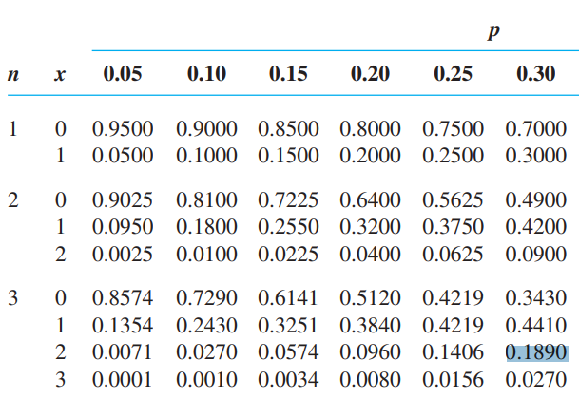
Example: Nastke Clothing Store
Binomial Table

Slide 24
Binomial Probability Distribution
Expected Value
Variance
Standard Deviation
E(x) = μ = np
Var(x) = σ ² = np(1 − p)

Slide 25
Example: Nastke Clothing Store
Binomial Probability Distribution
Expected Value
Variance
Standard Deviation
E(x) = μ = 3(.3) = .9 customers out of 3
Var(x) = σ ² = 3(.3)(.7) = .63

Slide 26
Poisson Probability Distribution
A Poisson distributed random variable is often
useful in estimating the number of occurrences
over a specified interval of time or space
It is a discrete random variable that may assume
an infinite sequence of values (x = 0, 1, 2, . . . ).

Slide 27
Poisson Probability Distribution
Examples of a Poisson distributed random variable:
the number of knotholes in 24 linear feet of
pine board
the number of vehicles arriving at a toll
booth in one hour

Slide 28
Poisson Probability Distribution
Two Properties of a Poisson Experiment
The probability of an occurrence is the same
for any two intervals of equal length.
The occurrence or nonoccurrence in any
interval is independent of the occurrence or
nonoccurrence in any other interval.

Slide 29
Poisson Probability Distribution
Poisson Probability Function
where:
f(x) = probability of x occurrences in an interval
λ = mean number of occurrences in an interval
e = 2.71828

Slide 30
Example: Drive-up Teller Window
Poisson Probability Function: Time Interval
Suppose that we are interested in the number of arrivals at the drive-up teller window of a bank during a 15-minute period on weekday mornings. If we assume that the probability of a car arriving is the same for any two time periods of equal length and that the arrival or non-arrival of a car in any time period is independent of the arrival or non-arrival in any other time period, the Poisson probability function is applicable.
Then if we assume that an analysis of historical data shows that the average number of cars arriving during a 15-minute interval of time is 10, the Poisson probability function with λ = 10 applies.

Slide 31
Example: Drive-up Teller Window
Poisson Probability Function: Time Interval
We wanted to know the probability of five arrivals
in 15 minutes.
λ = 10/15-minutes, x = 5

Slide 32
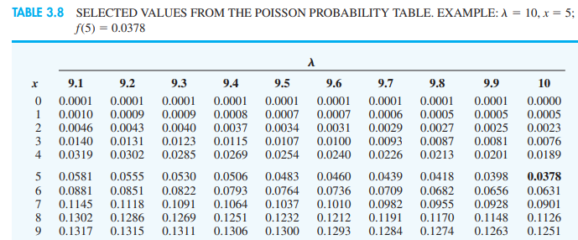
Example: Drive-up Teller Window
Poisson Probability Table

Slide 33
Example: Department of Transportation
Poisson Probability Function: Distance Interval
Suppose that we are concerned with the occurrence of major defects in a section of highway one month after resurfacing. We assume that the probability of a defect is the same for any two intervals of equal length and that the occurrence or nonoccurrence of a defect in any one interval is independent of the occurrence or nonoccurrence in any other interval. Thus, the Poisson probability distribution applies.
Suppose that major defects occur at the average rate of two per mile.

Slide 34
Example: Department of Transportation
Poisson Probability Function: Distance Interval
We want to find the probability that no major defects
will occur in a particular 3-mile section of the highway.
λ = 2/mile = 6/3-miles, x = 0

Slide 35
End of Chapter 3, Part A

Slide 36
Task
Using past data on daily car sales
Computte a probability distribution for the random variable x
Compute E(x), the expected value of x
Compute 2 , the variance of x
Compute , the standard deviation of x
Consider a binomial experiment with 2 trials and p 0.4.
Compute the probability of 1 success, f(1)
Compute f(0)
Compute f(2).
Find the probability of at least one success
Find the expected value, variance, and standard deviation
Telephone calls arrive at the rate of 48 per hour at the reservation desk for Regional Airways
Find the probability of receiving 3 calls in a 5-minute interval
Find the probability of receiving 10 calls in 15 minutes
Find the probability of receiving no calls in 5 minutes
Find the probability of at least 2 calls in 15 minutes
Number Units Sold of Days
0 8
1 68
2 82
3 36
4 6
200

