Slide 1
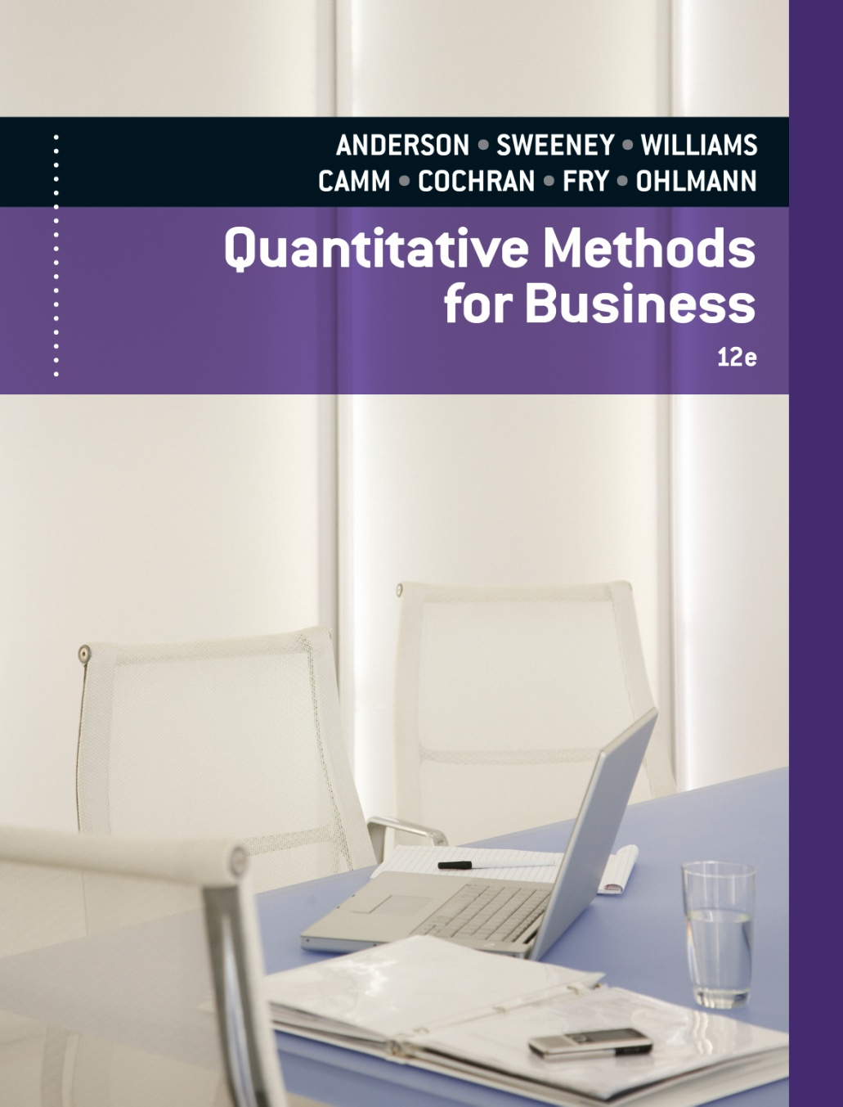
SLIDES BY
.
.
.
.
.
.
.
.
.
.
.
.
John Loucks
St. Edward’s Univ.

Slide 2
Chapter 4 Decision Analysis
Problem Formulation
Decision Making without Probabilities
Decision Making with Probabilities
Decision Analysis with Sample Information

Slide 3
Decision Analysis
Decision analysis can be used to develop an optimal strategy when a decision maker is faced with several decision alternatives and an uncertain or risk-filled pattern of future events.
Even when a careful decision analysis has been conducted, the uncertain future events make the final consequence uncertain.
The risk associated with any decision alternative is a direct result of the uncertainty associated with the final consequence.
Good decision analysis includes risk analysis that provides probability information about the favorable as well as the unfavorable consequences that may occur.

Slide 4
Problem Formulation
A decision problem is characterized by decision alternatives, states of nature, and resulting payoffs.
The decision alternatives are the different possible strategies the decision maker can employ.
The states of nature refer to future events, not under the control of the decision maker, which may occur. States of nature should be defined so that they are mutually exclusive and collectively exhaustive.

Slide 5
Example: Pittsburgh Development Corp.
Pittsburgh Development Corporation (PDC) purchased land that will be the site of a new luxury condominium complex. PDC commissioned preliminary architectural drawings for three different projects: one with 30, one with 60, and one with 90 condominiums.
The financial success of the project depends upon the size of the condominium complex and the chance event concerning the demand for the condominiums. The statement of the PDC decision problem is to select the size of the new complex that will lead to the largest profit given the uncertainty concerning the demand for the condominiums.

Slide 6
Influence Diagrams
An influence diagram is a graphical device showing the relationships among the decisions, the chance events, and the consequences.
Squares or rectangles depict decision nodes.
Circles or ovals depict chance nodes.
Diamonds depict consequence nodes.
Lines or arcs connecting the nodes show the direction of influence.

Slide 7
Influence Diagrams
Decision
Chance
Consequence
Demand for the
Condominiums
Complex
Size
Profit

Slide 8
Payoff Tables
The consequence resulting from a specific combination of a decision alternative and a state of nature is a payoff.
A table showing payoffs for all combinations of decision alternatives and states of nature is a payoff table.
Payoffs can be expressed in terms of profit, cost, time, distance or any other appropriate measure.

Slide 9
Example: Pittsburgh Development Corp.
Consider the following problem with three decision alternatives and two states of nature with the following payoff table representing profits:
States of Nature
Strong Demand Weak Demand
Decision Alternative s₁ s₂
Small complex, d₁ 8 7
Medium complex, d₂ 14 5
Large complex, d₃ 20 -9
PAYOFF TABLE

Slide 10
Decision Making without Probabilities
Three commonly used criteria for decision making when probability information regarding the likelihood of the states of nature is unavailable are:
the optimistic approach
the conservative approach
the minimax regret approach.

Slide 11
Optimistic Approach
The optimistic approach would be used by an optimistic decision maker.
The decision with the largest possible payoff is chosen.
If the payoff table was in terms of costs, the decision with the lowest cost would be chosen.

Slide 12
Example: Optimistic Approach
An optimistic decision maker would use the optimistic (maximax) approach. We choose the decision that has the largest single value in the payoff table.
Maximum
Decision Payoff
d₁ 8
d₂ 14
d₃ 20
Maximaxdecision
Maximax
payoff

Slide 13
Conservative Approach
The conservative approach would be used by a conservative decision maker.
For each decision the minimum payoff is listed and then the decision corresponding to the maximum of these minimum payoffs is selected. (Hence, the minimum possible payoff is maximized.)
If the payoff was in terms of costs, the maximum costs would be determined for each decision and then the decision corresponding to the minimum of these maximum costs is selected. (Hence, the maximum possible cost is minimized.)

Slide 14
Example: Conservative Approach
A conservative decision maker would use the conservative (maximin) approach. List the minimum payoff for each decision. Choose the decision with the maximum of these minimum payoffs.
Minimum
Decision Payoff
d₁ 7
d₂ 5
d₃ -9
Maximin
decision
Maximin
payoff

Slide 15
Minimax Regret Approach
The minimax regret approach requires the construction of a regret table or an opportunity loss table.
This is done by calculating for each state of nature the difference between each payoff and the largest payoff for that state of nature.
Then, using this regret table, the maximum regret for each possible decision is listed.
The decision chosen is the one corresponding to the minimum of the maximum regrets.

Slide 16
Example: Minimax Regret Approach
For the minimax regret approach, first compute a regret table by subtracting each payoff in a column from the largest payoff in that column. In this example, in the first column subtract 8, 14, and 20 from 20; etc.
States of Nature
Strong Demand Weak Demand
Decision Alternative s₁ s₂
Small complex, d₁ 12 0
Medium complex, d₂ 6 2
Large complex, d₃ 0 16
REGRET TABLE

Slide 17
Example: Minimax Regret Approach
For each decision list the maximum regret. Choose the decision with the minimum of these values.
Maximum
Decision Regret
d₁ 12
d₂ 6
d₃ 16
Minimax
decision
Minimax
regret

Slide 18
Decision Making with Probabilities
Expected Value Approach
If probabilistic information regarding the states of nature is available, one may use the expected value (EV) approach.
Here the expected return for each decision is calculated by summing the products of the payoff under each state of nature and the probability of the respective state of nature occurring.
The decision yielding the best expected return is chosen.

Slide 19
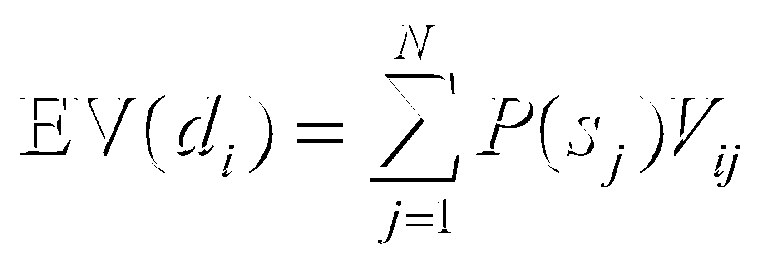
Expected Value of a Decision Alternative
The expected value of a decision alternative is the sum of weighted payoffs for the decision alternative.
The expected value (EV) of decision alternative d_{i} is defined as:
where: N = the number of states of nature
P(s_{j} ) = the probability of state of nature s_{j}
V_{ij} = the payoff corresponding to decision alternative d_{i} and state of nature s_{j}

Slide 20
Expected Value Approach
Calculate the expected value for each decision. The decision tree on the next slide can assist in this calculation. Here d₁, d₂, and d₃ represent the decision alternatives of building a small, medium, and large complex, while s₁ and s₂ represent the states of nature of strong demand and weak demand.

Slide 21
Decision Trees
A decision tree is a chronological representation of the decision problem.
Each decision tree has two types of nodes; round nodes correspond to the states of nature while square nodes correspond to the decision alternatives.
The branches leaving each round node represent the different states of nature while the branches leaving each square node represent the different decision alternatives.
At the end of each limb of a tree are the payoffs attained from the series of branches making up that limb.

Slide 22
Decision Tree
Payoffs
s₁
.8
$8 mil
2
s₂
.2
d₁
$7 mil
d₂
s₁
.8
$14 mil
1
3
s₂
.2
d₃
$5 mil
s₁
.8
$20 mil
4
s₂
.2
-$9 mil

Slide 23
Expected Value for Each Decision
EMV = .8(8 mil) + .2(7 mil) = $7.8 mil
Small
d₁
2
EMV = .8(14 mil) + .2(5 mil) = $12.2 mil
Medium
d₂
1
3
EMV = .8(20 mil) + .2(-9 mil) = $14.2 mil
Large
d₃
4
Choose the decision alternative with the largest EV. Build the large complex.

Slide 24
Expected Value of Perfect Information
Frequently information is available which can improve the probability estimates for the states of nature.
The expected value of perfect information (EVPI) is the increase in the expected profit that would result if one knew with certainty which state of nature would occur.
The EVPI provides an upper bound on the expected value of any sample or survey information.

Slide 25
Expected Value of Perfect Information
EVPI Calculation
Step 1:
Determine the optimal return corresponding to each state of nature.
Step 2:
Compute the expected value of these optimal returns.
Step 3:
Subtract the EV of the optimal decision from the amount determined in step (2).

Slide 26
Expected Value of Perfect Information
Expected Value with Perfect Information (EVwPI)
Expected Value without Perfect Information (EVwoPI)
Expected Value of Perfect Information (EVPI)
EVwPI = .8(20 mil) + .2(7 mil) = $17.4 mil
EVwoPI = .8(20 mil) + .2(-9 mil) = $14.2 mil
EVPI = |EVwPI – EVwoPI| = |17.4 – 14.2| = $3.2 mil

Slide 27
Decision Analysis with Sample Information
Frequently, decision makers have preliminary or prior probability assessments for the states of nature that are the best probability values available at that time.
To make the best possible decision, the decision maker may want to seek additional information about the states of nature.
This new information, often obtained through sampling, can be used to revise the prior probabilities so that the final decision is based on more accurate probabilities for the states of nature.
These revised probabilities are called posterior probabilities.

Slide 28
Example: Pittsburgh Development Corp.
Let us return to the PDC problem and assume that management is considering a 6-month market research study designed to learn more about potential market acceptance of the PDC condominium project. Management anticipates that the market research study will provide one of the following two results:
1. Favorable report: A significant number of the
individuals contacted express interest in
purchasing a PDC condominium.
2. Unfavorable report: Very few of the individuals
contacted express interest in purchasing a PDC
condominium.

Slide 29
Influence Diagram
Decision
Chance
Consequence
Market
Survey
Results
Demand
for the
Condominiums
Market
Survey
Complex
Size
Profit

Slide 30
Sample Information
PDC has developed the following branch probabilities.
If the market research study is undertaken:
P(Favorable report) = P(F) = .77
P(Unfavorable report) = P(U) = .23
If the market research report is favorable:
P(Strong demand | favorable report) = P(s₁|F) = .94
P(Weak demand | favorable report) = P(s₂|F) = .06

Slide 31
Sample Information
If the market research report is unfavorable:
P(Strong demand | unfavorable report) = P(s₁|U) = .35
P(Weak demand | unfavorable report) = P(s₂|U) = .65
If the market research study is not undertaken, the prior
probabilities are applicable:
P(Favorable report) = P(F) = .80
P(Unfavorable report) = P(U) = .20

Slide 32
Decision Tree
s₁
P(s₁) = .94
$ 8 mil
d₁
6
s₂
P(s₂) = .06
$ 7 mil
d₂
s₁
P(s₁) = .94
$14 mil
3
7
s₂
F
(.77)
P(s₂) = .06
$ 5 mil
d₃
s₁
8
s₂
P(s₁) = .94
$20 mil
Conduct
Market
Research
Study
P(s₂) = .06
-$ 9 mil
2
s₁
P(s₁) = .35
$ 8 mil
d₁
9
s₂
U
(.23)
P(s₂) = .65
$ 7 mil
d₂
s₁
10
s₂
P(s₁) = .35
$14 mil
4
P(s₂) = .65
d₃
s₁
$ 5 mil
1
P(s₁) = .35
$20 mil
11
s₂
s₁
P(s₂) = .65
-$ 9 mil
d₁
12
s₂
P(s₁) = .80
$ 8 mil
Do Not Conduct
Market Research
Study
s₁
P(s₂) = .20
$ 7 mil
d₂
5
13
s₂
P(s₁) = .80
$14 mil
d₃
s₁
P(s₂) = .20
$ 5 mil
14
s₂
P(s₁) = .80
$20 mil
P(s₂) = .20
-$ 9 mil

Slide 33
Decision Strategy
A decision strategy is a sequence of decisions and chance outcomes where the decisions chosen depend on the yet-to-be-determined outcomes of chance events.
The approach used to determine the optimal decision strategy is based on a backward pass through the decision tree using the following steps:
At chance nodes, compute the expected value by multiplying the payoff at the end of each branch by the corresponding branch probabilities.
At decision nodes, select the decision branch that leads to the best expected value. This expected value becomes the expected value at the decision node.

Slide 34
Decision Tree
EV =
$18.26 mil
d₁
6
EV = .94(8) + .06(7) = $7.94 mil
d₂
F
(.77)
3
7
EV = .94(14) + .06(5) = $13.46 mil
d₃
EV =
$15.93
mil
8
EV = .94(20) + .06(-9) = $18.26 mil
2
d₁
9
EV = .35(8) + .65(7) = $7.35 mil
U
(.23)
d₂
4
10
EV = .35(14) + .65(5) = $8.15 mil
d₃
1
EV =
$8.15 mil
11
EV = .35(20) + .65(-9) = $1.15 mil
EV =
$15.93
mil
d₁
12
EV = .8(8) + .2(7) = $7.80 mil
d₂
5
13
EV = .8(14) + .2(5) = $12.20 mil
d₃
EV = $14.20 mil
14
EV = .8(20) + .2(-9) = $14.20 mil

Slide 35
Decision Strategy
PDC’s optimal decision strategy is:
Conduct the market research study.
If the market research report is favorable, construct the large condominium complex.
If the market research report is unfavorable, construct the medium condominium complex.

Slide 36
Expected Value of Sample Information
The expected value of sample information (EVSI) is the additional expected profit possible through knowledge of the sample or survey information.
The expected value associated with the market research study is $15.93.
The best expected value if the market research study is not undertaken is $14.20.
We can conclude that the difference, $15.93 − $14.20 = $1.73, is the expected value of sample information.
Conducting the market research study adds $1.73 million to the PDC expected value.

Slide 37
End of Chapter 4

Slide 38
Tasks
Suppose that a decision maker faced with four decision alternatives and four states of nature develops the following profit payoff table:
If the decision maker knows nothing about the probabilities of the four states of nature, what is the recommended decision using the optimistic, conservative, and minimax regret approaches?

Slide 39
Tasks
Hale’s TV Productions is considering producing a pilot for a comedy series in the hope of selling it to a major television network. The network may decide to reject the series, but it may also decide to purchase the rights to the series for either one or two years. At this point in time, Hale may either produce the pilot and wait for the network’s decision or transfer the rights for the pilot and series to a competitor for $100,000. Hale’s decision alternatives and profits (in thousands of dollars) are as follows:
The probabilities for the states of nature are P(s₁) 0.20, P(s₂) 0.30, and P(s₃) 0.50. For a consulting fee of $5000, an agency will review the plans for the comedy series and indicate the overall chances of a favorable network reaction to the series. Assume that the agency review will result in a favorable (F) or an unfavorable (U) review and that the following probabilities are relevant:
Construct a decision tree for this problem
What is the recommended decision if the agency opinion is not used? What is the expected value?
What is the expected value of perfect information?
What is Hale’s optimal decision strategy assuming the agency’s information is used?
What is the expected value of the agency’s information?

