Slide 1
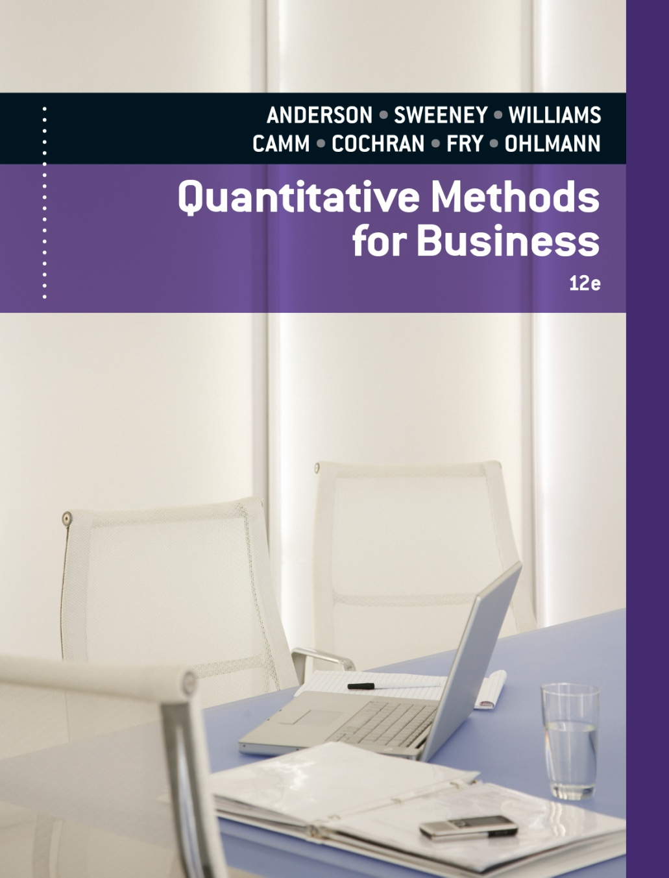
SLIDES BY
.
.
.
.
.
.
.
.
.
.
.
.
John Loucks
St. Edward’s Univ.

Slide 2
Chapter 13 Project Scheduling: PERT/CPM
Project Scheduling Based on
Expected Activity Times
Project Scheduling Considering
Uncertain Activity Times
Considering Time-Cost Trade-Offs

Slide 3
PERT/CPM
PERT
Program Evaluation and Review Technique
Developed by U.S. Navy for Polaris missile project
Developed to handle uncertain activity times
CPM
Critical Path Method
Developed by DuPont & Remington Rand
Developed for industrial projects for which activity times generally were known
Today’s project management software packages have combined the best features of both approaches.

Slide 4
PERT/CPM
PERT and CPM have been used to plan, schedule, and control a wide variety of projects:
R&D of new products and processes
Construction of buildings and highways
Maintenance of large and complex equipment
Design and installation of new systems

Slide 5
PERT/CPM
PERT/CPM is used to plan the scheduling of individual activities that make up a project.
Projects may have as many as several thousand activities.
A complicating factor in carrying out the activities is that some activities depend on the completion of other activities before they can be started.

Slide 6
PERT/CPM
Project managers rely on PERT/CPM to help them answer questions such as:
What is the total time to complete the project?
What are the scheduled start and finish dates for each specific activity?
Which activities are critical and must be completed exactly as scheduled to keep the project on schedule?
How long can noncritical activities be delayed before they cause an increase in the project completion time?

Slide 7
Project Network
A project network can be constructed to model the precedence of the activities.
The nodes of the network represent the activities.
The arcs of the network reflect the precedence relationships of the activities.
A critical path for the network is a path consisting of activities with zero slack.

Slide 8
Example: Frank’s Fine Floats
Frank’s Fine Floats is in the business of building
elaborate parade floats. Frank ‘s crew has a new float to
build and want to use PERT/CPM to help them manage
the project.
The table on the next slide shows the activities that
comprise the project as well as each activity’s estimated
completion time (in days) and immediate predecessors.
Frank wants to know the total time to complete the
project, which activities are critical, and the earliest and
latest start and finish dates for each activity.

Slide 9
Example: Frank’s Fine Floats
Immediate Completion
Activity Description Predecessors Time (days)
A Initial Paperwork --- 3
B Build Body A 3
C Build Frame A 2
D Finish Body B 3
E Finish Frame C 7
F Final Paperwork B,C 3
G Mount Body to Frame D,E 6
H Install Skirt on Frame C 2

Slide 10
Example: Frank’s Fine Floats
Project Network
B
D
3
3
G
F
6
A
3
Start
Finish
3
E
C
7
H
2
2

Slide 11
Earliest Start and Finish Times
Step 1: Make a forward pass through the network as follows: For each activity i beginning at the Start node, compute:
Earliest Start Time = the maximum of the earliest finish times of all activities immediately preceding activity i. (This is 0 for an activity with no predecessors.)
Earliest Finish Time = (Earliest Start Time) + (Time to complete activity i ).
The project completion time is the maximum of the Earliest Finish Times at the Finish node.

Slide 12
Example: Frank’s Fine Floats
Earliest Start and Finish Times
B
3 6
D
6 9
3
3
G
12 18
F
6 9
6
A
0 3
3
18 18
Start
Finish
3
E
5 12
0
C
3 5
7
H
5 7
2
2

Slide 13
Latest Start and Finish Times
Step 2: Make a backwards pass through the network as follows: Move sequentially backwards from the Finish node to the Start node. At a given node, j, consider all activities ending at node j. For each of these activities, i, compute:
Latest Finish Time = the minimum of the latest start times beginning at node j. (For node N, this is the project completion time.)
Latest Start Time = (Latest Finish Time) - (Time to complete activity i ).

Slide 14
Example: Frank’s Fine Floats
Latest Start and Finish Times
B
3 6
D
6 9
3
6 9
3
9 12
G
12 18
F
6 9
6
12 18
A
0 3
3
15 18
Start
Finish
18 18
3
0 3
E
5 12
0
18 18
C
3 5
7
5 12
H
5 7
2
3 5
2
16 18

Slide 15
Determining the Critical Path
Step 3: Calculate the slack time for each activity by:
Slack = (Latest Start) - (Earliest Start), or
= (Latest Finish) - (Earliest Finish).

Slide 16
Example: Frank’s Fine Floats
Activity Slack Time
Activity ES EF LS LF Slack
A 0 3 0 3 0 (critical)
B 3 6 6 9 3
C 3 5 3 5 0 (critical)
D 6 9 9 12 3
E 5 12 5 12 0 (critical)
F 6 9 15 18 9
G 12 18 12 18 0 (critical)
H 5 7 16 18 11

Slide 17
Example: Frank’s Fine Floats
Determining the Critical Path
A critical path is a path of activities, from the Start node to the Finish node, with 0 slack times.
Critical Path: A – C – E – G
The project completion time equals the maximum of the activities’ earliest finish times.
Project Completion Time: 18 days

Slide 18
Example: Frank’s Fine Floats
Critical Path
B
3 6
D
6 9
3
6 9
3
9 12
G
12 18
F
6 9
6
12 18
A
0 3
3
15 18
Start
Finish
3
0 3
E
5 12
C
3 5
7
5 12
H
5 7
2
3 5
2
16 18
Critical Path: Start – A – C – E – G – Finish

Slide 19
Critical Path Procedure
Step 1. Develop a list of the activities that make up the project.
Step 2. Determine the immediate predecessor(s) for each activity in the project.
Step 3. Estimate the completion time for each activity.
Step 4. Draw a project network depicting the activities and immediate predecessors listed in steps 1 and 2.

Slide 20
Critical Path Procedure
Step 5. Use the project network and the activity time estimates to determine the earliest start and the earliest finish time for each activity by making a forward pass through the network. The earliest finish time for the last activity in the project identifies the total time required to complete the project.
Step 6. Use the project completion time identified in step 5 as the latest finish time for the last activity and make a backward pass through the network to identify the latest start and latest finish time for each activity.

Slide 21
Critical Path Procedure
Step 7. Use the difference between the latest start time and the earliest start time for each activity to determine the slack for each activity.
Step 8. Find the activities with zero slack; these are the critical activities.
Step 9. Use the information from steps 5 and 6 to develop the activity schedule for the project.

Slide 22
Uncertain Activity Times
In the three-time estimate approach, the time to complete an activity is assumed to follow a Beta distribution.
An activity’s mean completion time is:
t = (a + 4m + b)/6
a = the optimistic completion time estimate
b = the pessimistic completion time estimate
m = the most likely completion time estimate

Slide 23
Uncertain Activity Times
An activity’s completion time variance is:
σ ² = ((b-a)/6)²
a = the optimistic completion time estimate
b = the pessimistic completion time estimate
m = the most likely completion time estimate

Slide 24
Uncertain Activity Times
In the three-time estimate approach, the critical path is determined as if the mean times for the activities were fixed times.
The overall project completion time is assumed to have a normal distribution with mean equal to the sum of the means along the critical path and variance equal to the sum of the variances along the critical path.

Slide 25
Example: ABC Associates
Consider the following project:
Immed. Optimistic Most Likely Pessimistic
Activity Predec. Time (Hr.) Time (Hr.) Time (Hr.)
A -- 4 6 8
B -- 1 4.5 5
C A 3 3 3
D A 4 5 6
E A 0.5 1 1.5
F B,C 3 4 5
G B,C 1 1.5 5
H E,F 5 6 7
I E,F 2 5 8
J D,H 2.5 2.75 4.5
K G,I 3 5 7

Slide 26
Example: ABC Associates
Project Network
5
3
6
6
1
5
3
4
5
4
2

Slide 27
Example: ABC Associates
Activity Expected Times and Variances
t = (a + 4m + b)/6 σ ² = ((b-a)/6)²
Activity Expected Time Variance
A 6 4/9
B 4 4/9
C 3 0
D 5 1/9
E 1 1/36
F 4 1/9
G 2 4/9
H 6 1/9
I 5 1
J 3 1/9
K 5 4/9

Slide 28
Example: ABC Associates
Earliest/Latest Times and Slack
Activity ES EF LS LF Slack
A 0 6 0 6 0 *
B 0 4 5 9 5
C 6 9 6 9 0 *
D 6 11 15 20 9
E 6 7 12 13 6
F 9 13 9 13 0 *
G 9 11 16 18 7
H 13 19 14 20 1
I 13 18 13 18 0 *
J 19 22 20 23 1
K 18 23 18 23 0 *

Slide 29
Example: ABC Associates
Determining the Critical Path
A critical path is a path of activities, from the Start node to the Finish node, with 0 slack times.
Critical Path: A – C – F – I – K
The project completion time equals the maximum of the activities’ earliest finish times.
Project Completion Time: 23 hours

Slide 30
Example: ABC Associates
Critical Path (A – C – F – I – K)
6 11
15 20
19 22
20 23
5
3
13 19
14 20
0 6
0 6
6 7
12 13
6
6
1
13 18
13 18
6 9
6 9
9 13
9 13
5
3
4
18 23
18 23
0 4
5 9
9 11
16 18
5
4
2

Slide 31
Example: ABC Associates
Probability the project will be completed within 24 hrs
σ ² = σ ²_{A} + σ ²_{C} + σ ²_{F} + σ ²_{H} + σ ²_{K}
= 4/9 + 0 + 1/9 + 1 + 4/9
= 2
σ = 1.414
z = (24 - 23)/σ = (24-23)/1.414 = .71
From the Standard Normal Distribution table:
P(z < .71) = .7612

Slide 32
End of Chapter 13

Slide 33
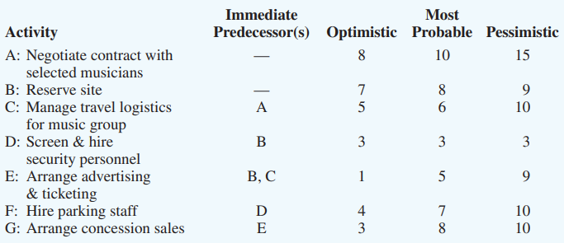
TASK
At a local university, the Student Commission on Programming and Entertainment (SCOPE) is preparing to host its first rock concert of the school year. To successfully produce this rock concert, SCOPE has listed the requisite activities and related information in the following table (duration estimates measured in days)
Draw the project network.
Compute the expected duration and variance of each activity.
Determine the critical path in the project network.
What is the expected duration and variance of the critical path?
What is the likelihood that the project will be completed within 30 days?

