Slide 1
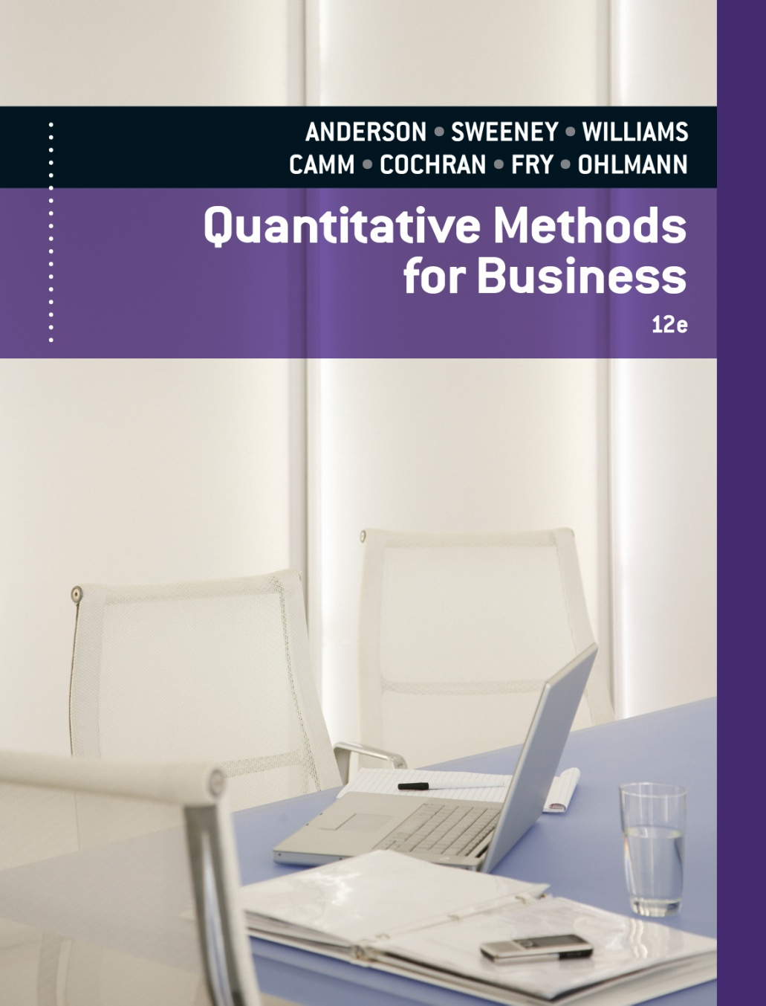
SLIDES BY
.
.
.
.
.
.
.
.
.
.
.
.
John Loucks
St. Edward’s Univ.

Slide 2
Chapter 14, Part A Inventory Models with Deterministic Demand
Economic Order Quantity (EOQ) Model
Economic Production Lot Size Model

Slide 3
Inventory Models
The study of inventory models is concerned with two basic questions:
How much should be ordered each time
When should the reordering occur
The objective is to minimize total variable cost over a specified time period (assumed to be annual in the following review).

Slide 4
Inventory Costs
Ordering cost -- salaries and expenses of processing an order, regardless of the order quantity
Holding cost -- usually a percentage of the value of the item assessed for keeping an item in inventory (including cost of capital, insurance, security costs, taxes, warehouse overhead, and other related variable expenses)
Backorder cost -- costs associated with being out of stock when an item is demanded (including lost goodwill)
Purchase cost -- the actual price of the items
Other costs

Slide 5
Deterministic Models
The simplest inventory models assume demand and the other parameters of the problem to be deterministic and constant.
The deterministic models covered in this chapter are:
Economic order quantity (EOQ)
Economic production lot size
EOQ with planned shortages
EOQ with quantity discounts

Slide 6
Economic Order Quantity (EOQ)
The most basic of the deterministic inventory models is the economic order quantity (EOQ).
The variable costs in this model are annual holding cost and annual ordering cost.
For the EOQ, annual holding and ordering costs are equal.

Slide 7
Economic Order Quantity
Assumptions
Demand D is known and occurs at a constant rate.
The order quantity Q is the same for each order.
The cost per order, $C_{o}, is constant and does not depend on the order quantity.
The purchase cost per unit, C, is constant and does not depend on the quantity ordered.
The inventory holding cost per unit per time period, $C_{h}, is constant.
Shortages such as stock-outs or backorders are not permitted.
The lead time for an order is constant.
The inventory position is reviewed continuously.

Slide 8
Economic Order Quantity
Formulas
Optimal order quantity: Q * = 2DC_{o}/C_{h}
Number of orders per year: D/Q *
Time between orders (cycle time): Q */D years
Total annual cost: [C_{h}(Q*/2)] + [C_{o}(D/Q *)]
(holding + ordering)

Slide 9
Example: Bart’s Barometer Business
Economic Order Quantity Model
Bart's Barometer Business is a retail outlet that
deals exclusively with weather equipment. Bart is
trying to decide on an inventory and reorder policy
for home barometers.
Barometers cost Bart $50 each and demand is
about 500 per year distributed fairly evenly
throughout the year.

Slide 10
Example: Bart’s Barometer Business
Economic Order Quantity Model
Reordering costs are $80 per order and holding
costs are figured at 20% of the cost of the item. Bart's
Barometer Business is open 300 days a year (6 days a
week and closed two weeks in August). Lead time is
60 working days.

Slide 11
Example: Bart’s Barometer Business
Total Variable Cost Model
Total Costs = (Holding Cost) + (Ordering Cost)
TC = [C_{h}(Q/2)] + [C_{o}(D/Q)]
= [.2(50)(Q/2)] + [80(500/Q)]
= 5Q + (40,000/Q)

Slide 12
Example: Bart’s Barometer Business
Optimal Reorder Quantity
Q * = 2DC_{o} /C_{h} = 2(500)(80)/10 = 89.44 ≈ 90
Optimal Reorder Point
Lead time is m = 60 days and daily demand is d = 500/300 or 1.667.
Thus the reorder point r = dm = (1.667)(60) = 100 Bart should reorder 90 barometers when his inventory position reaches 100 (that is 10 on hand and one outstanding order).

Slide 13
Example: Bart’s Barometer Business
Number of Orders Per Year
Number of reorder times per year = (500/90) = 5.56 or once every (300/5.56) = 54 working days (about every 9 weeks).
Total Annual Variable Cost
TC = 5(90) + (40,000/90) = 450 + 444 = $894

Slide 14
Economic Production Lot Size
The economic production lot size model is a variation of the basic EOQ model.
A replenishment order is not received in one lump sum as it is in the basic EOQ model.
Inventory is replenished gradually as the order is produced (which requires the production rate to be greater than the demand rate).
This model's variable costs are annual holding cost and annual set-up cost (equivalent to ordering cost).
For the optimal lot size, annual holding and set-up costs are equal.

Slide 15
Economic Production Lot Size
Assumptions
Demand occurs at a constant rate of D items per year or d items per day.
Production rate is P items per year or p items per day (and P > D, p > d ).
Set-up cost: $C_{o} per run.
Holding cost: $C_{h} per item in inventory per year.
Purchase cost per unit is constant (no quantity discount).
Set-up time (lead time) is constant.
Planned shortages are not permitted.

Slide 16
Economic Production Lot Size
Formulas
Optimal production lot-size:
Q* = 2DC_{o} /[(1-D/P )C_{h}]
Number of production runs per year: D/Q *
Time between set-ups (cycle time): Q*/D years
Total annual cost: [C_{h}(Q*/2)(1-D/P )] + [C_{o}/(D/Q*)]
(holding + ordering)
Length of the production run: t = Q*/p

Slide 17
Example: Beauty Bar Soap
Economic Production Lot Size Model
Beauty Bar Soap is produced on a production line that has an annual capacity of 60,000 cases. The annual demand is estimated at 26,000 cases, with the demand rate essentially constant throughout the year.
The cleaning, preparation, and setup of the production line cost approximately $135. The manufacturing cost per case is $4.50, and the annual holding cost is figured at a 24% rate.
Other relevant data include a five-day lead time to schedule and set up a production run and 250 working days per year.

Slide 18
Example: Beauty Bar Soap
Total Annual Variable Cost Model
This is an economic production lot size problem with
D = 26,000, P = 60,000, C_{h} = 1.08, C_{o} = 135
TC = (Holding Costs) + (Set-Up Costs)
= [C_{h}(Q/2)(1 - D/P )] + [C_{o}(D/Q)]
= [1.08(Q/2)(1 – 26,000/60,000)] + [135(26,000/Q)]
= .306Q + 3,510,000/Q

Slide 19
Example: Beauty Bar Soap
Optimal Production Lot Size
Q * = 2DC_{o}/[(1 -D/P )C_{h}]
= 2(26,000)(135) /[(1 – 26,000/60,000))1.08)]
= 3,387
Number of Production Runs (Cycles) Per Year
D/Q * = 26,000/3,387
= 7.6764 times per year

Slide 20
Example: Beauty Bar Soap
Total Annual Variable Cost
Optimal TC = .306(3,387) + 3,510,000/3,387
= 1,036.42 + 1,036.32
= $2,073

Slide 21
Example: Beauty Bar Soap
Idle Time Between Production Runs
There are 7.6764 cycles per year.
Thus, each cycle lasts (250/7.6764) = 32.567 days.
The time to produce 3,387 per run:
3387/240 = 14.1125 days.
Thus, the production line is idle for:
32.567 – 14.1125 = 18.4545 days between runs.
The production line is utilized:
14.1125/32.567(100) = 43.33%

Slide 22
Example: Beauty Bar Soap
Maximum Inventory
Maximum inventory = (1-D/P )Q *
= (1-26,000/60,000)3,387 ≈ 1,919.3
Machine Utilization
Machine is producing D/P = 26,000/60,000
= .4333 of the time.

Slide 23
End of Chapter 14, Part A

Slide 24
Tasks
Suppose that the R&B Beverage Company has a soft drink product that shows a constant annual demand rate of 3600 cases. A case of the soft drink costs R&B $3. Ordering costs are $20 per order and holding costs are 25% of the value of the inventory. R&B has 250 working days per year, and the lead time is 5 days. Identify the following aspects of the inventory policy::
Economic order quantit!
Reorder point ?
Cycle time ?
Total annual cost?
Wilson Publishing Company produces books for the retail market. Demand for a current book is expected to occur at a constant annual rate of 7200 copies. The cost of one copy of the book is $14.50. The holding cost is based on an 18% annual rate, and production setup costs are $150 per setup. The equipment on which the book is produced has an annual production volume of 25,000 copies. Wilson has 250 working days per year, and the lead time for a production run is 15 days. Use the production lot size model to compute the following values::
Minimum cost production lot size!
Number of production runs per year!
Cycle time!
Maximum inventory!
Reorder point!
Total annual cost !

