Slide 1
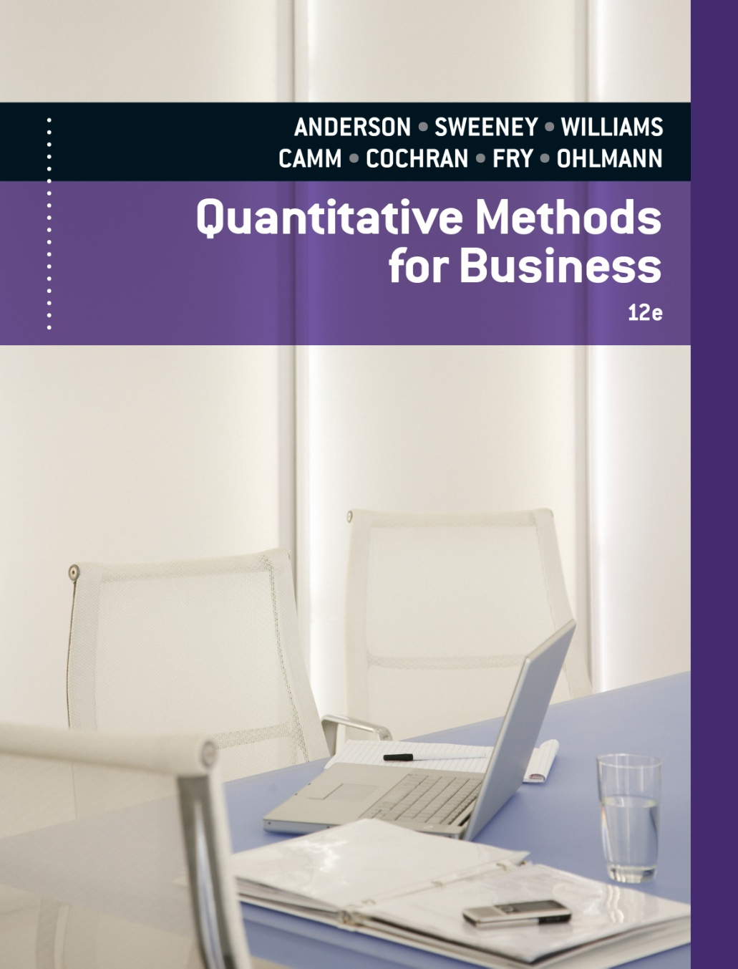
Slides by
.
.
.
.
.
.
.
.
.
.
.
.
John Loucks
St. Edward’s Univ.

Slide 2
Chapter 5 Utility and Game Theory
The Meaning of Utility
Utility and Decision Making
Utility: Other Considerations
Introduction to Game Theory
Mixed Strategy Games

Slide 3
Example: Swofford, Inc.
For the upcoming year, Swofford has three real estate
investment alternatives, and future real estate prices are
uncertain. The possible investment payoffs are below.
States of Nature
Real Estate Prices:
Go Up Remain Same Go Down
Decision Alternative s₁ s₂ s₃
Make Investment A, d₁ 30,000 20,000 -50,000
Make Investment B, d₂ 50,000 -20,000 -30,000
Do Not Invest, d₃ 0 0 0
Probability .3 .5 .2
PAYOFF TABLE

Slide 4
Example: Swofford, Inc.
Expected Value (EV) Approach
If the decision maker is risk neutral the expected value approach is applicable.
EV(d₁) = .3(30,000) + .5( 20,000) + .2(-50,000) = $9,000
EV(d₂) = .3(50,000) + .5(-20,000) + .2(-30,000) = -$1,000
EV(d₃) = .3( 0 ) + .5( 0 ) + .2( 0 ) = $0
Considering no other factors, the optimal decision appears to d₁ with an expected monetary value of $9,000……. but is it?

Slide 5
Example: Swofford, Inc.
Other considerations:
Swofford’s current financial position is weak.
The firm’s president believes that, if the next investment results in a substantial loss, Swofford’s future will be in jeopardy.
Quite possibly, the president would select d₂ or d₃ to avoid the possibility of incurring a $50,000 loss.
A reasonable conclusion is that, if a loss of even $30,000 could drive Swofford out of business, the president would select d₃, believing that both investments A and B are too risky for Swofford’s current financial position.

Slide 6
The Meaning of Utility
Utilities are used when the decision criteria must be based on more than just expected monetary values.
Utility is a measure of the total worth of a particular outcome, reflecting the decision maker’s attitude towards a collection of factors.
Some of these factors may be profit, loss, and risk.
This analysis is particularly appropriate in cases where payoffs can assume extremely high or extremely low values.

Slide 7
Steps for Determining the Utility of Money
Step 1:
Develop a payoff table using monetary values.
Step 2:
Identify the best and worst payoff values and assign
each a utility value, with
U(best payoff) > U(worst payoff).
Step 3: Define the lottery. The best payoff is obtained with probability p; the worst is obtained with probability (1 – p).

Slide 8
Example: Swofford, Inc.
Step 1: Develop payoff table.
Monetary payoff table on earlier slide.
Step 2: Assign utility values to best and worst payoffs.
Utility of −$50,000 = U(−50,000) = 0
Utility of $50,000 = U(50,000) = 10
Step 3: Define the lottery.
Swofford obtains a payoff of $50,000 with
probability p and a payoff of −$50,000 with
probability (1 − p).

Slide 9
Steps for Determining the Utility of Money
Step 4:
For every other monetary value M in the payoff table:
4a: Determine the value of p such that the decision maker is indifferent between a guaranteed payoff of M and the lottery defined in step 3.
4b: Calculate the utility of M:
U(M) = pU(best payoff) + (1 – p)U(worst payoff)

Slide 10
Example: Swofford, Inc.
Establishing the utility for the payoff of $30,000:
Step 4a: Determine the value of p.
Let us assume that when p = 0.95, Swofford’s
president is indifferent between the guaranteed
payoff of $30,000 and the lottery.
Step 4b: Calculate the utility of M.
U(30,000) = pU(50,000) + (1 − p)U(−50,000)
= 0.95(10) + (0.05)(0)
= 9.5

Slide 11
Steps for Determining the Utility of Money
Step 5:
Convert the payoff table from monetary values to utility values.
Step 6:
Apply the expected utility approach to the utility table developed in step 5, and select the decision alternative with the highest expected utility.

Slide 12
Example: Swofford, Inc.
Step 5: Convert payoff table to utility values.
States of Nature
Real Estate Prices:
Go Up Remain Same Go Down
Decision Alternative s₁ s₂ s₃
Make Investment A, d₁ 9.5 9.0 0
Make Investment B, d₂ 10.0 5.5 4.0
Do Not Invest, d₃ 7.5 7.5 7.5
Probability .3 .5 .2
UTILITY TABLE

Slide 13
Expected Utility Approach
Once a utility function has been determined, the optimal decision can be chosen using the expected utility approach.
Here, for each decision alternative, the utility corresponding to each state of nature is multiplied by the probability for that state of nature.
The sum of these products for each decision alternative represents the expected utility for that alternative.
The decision alternative with the highest expected utility is chosen.

Slide 14
Example: Swofford, Inc.
Step 6: Apply the expected utility approach.
The expected utility for each of the decision alternatives in the Swofford problem is:
EV(d₁) = .3( 9.5) + .5(9.0) + .2( 0 ) = 7.35
EV(d₂) = .3(10.0) + .5(5.5) + .2(4.0) = 6.55
EV(d₃) = .3( 7.5) + .5(7.5) + .2(7.5) = 7.50
Considering the utility associated with each possible payoff, the optimal decision is d₃ with an expected utility of 7.50.

Slide 15
Example: Swofford, Inc.
Comparison of EU and EV Results
Decision | Expected | Expected
Alternative | Utility | Value
Do Not Invest | 7.50 | 0
Investment A | 7.35 | 9,000
Investment B | 6.55 | -1,000

Slide 16
Risk Avoiders Versus Risk Takers
A risk avoider will have a concave utility function when utility is measured on the vertical axis and monetary value is measured on the horizontal axis. Individuals purchasing insurance exhibit risk avoidance behavior.
A risk taker, such as a gambler, pays a premium to obtain risk. His/her utility function is convex. This reflects the decision maker’s increasing marginal value of money.
A risk neutral decision maker has a linear utility function. In this case, the expected value approach can be used.

Slide 17
Risk Avoiders Versus Risk Takers
Most individuals are risk avoiders for some amounts of money, risk neutral for other amounts of money, and risk takers for still other amounts of money.
This explains why the same individual will purchase both insurance and also a lottery ticket.

Slide 18
Utility Example 1
Consider the following three-state, three-decision problem with the following payoff table in dollars:
s₁ s₂ s₃
d₁ +100,000 +40,000 -60,000
d₂ +50,000 +20,000 -30,000
d₃ +20,000 +20,000 -10,000
The probabilities for the three states of nature are: P(s₁) = .1, P(s₂) = .3, and P(s₃) = .6.

Slide 19
Utility Example 1
Risk-Neutral Decision Maker
If the decision maker is risk neutral the expected value approach is applicable.
EV(d₁) = .1(100,000) + .3(40,000) + .6(-60,000) = -$14,000
EV(d₂) = .1( 50,000) + .3(20,000) + .6(-30,000) = -$ 7,000
EV(d₃) = .1( 20,000) + .3(20,000) + .6(-10,000) = +$ 2,000
The optimal decision is d₃.

Slide 20
Utility Example 1
Decision Makers with Different Utilities
Suppose two decision makers have the following utility values:
Utility Utility
Amount Decision Maker I Decision Maker II
$100,000 100 100
$ 50,000 94 58
$ 40,000 90 50
$ 20,000 80 35
-$ 10,000 60 18
-$ 30,000 40 10
-$ 60,000 0 0

Slide 21
Utility Example 1
Graph of the Two Decision Makers’ Utility Curves
Utility
100
Decision Maker I
80
60
40
Decision Maker II
20
-60 -40 -20 0 20 40 60 80 100
Monetary Value (in $1000’s)

Slide 22
Utility Example 1
Decision Maker I
Decision Maker I has a concave utility function.
He/she is a risk avoider.
Decision Maker II
Decision Maker II has convex utility function.
He/she is a risk taker.

Slide 23
Utility Example 1
Expected Utility: Decision Maker I
Expected
s₁ s₂ s₃ Utility
d₁ 100 90 0 37.0
d₂ 94 80 40 57.4
d₃ 80 80 60 68.0
Probability .1 .3 .6
Note: d₄ is dominated by d₂ and hence is not considered
Decision Maker I should make decision d₃.
Optimal
decision
is d₃
Largest
expected
utility

Slide 24
Utility Example 1
Expected Utility: Decision Maker II
Expected
s₁ s₂ s₃ Utility
d₁ 100 50 0 25.0
d₂ 58 35 10 22.3
d₃ 35 35 18 24.8
Probability .1 .3 .6
Note: d₄ is dominated by d₂ and hence is not considered.
Decision Maker II should make decision d₁.
Optimal
decision
is d₁
Largest
expected
utility

Slide 25
Utility Example 2
Suppose the probabilities for the three states of nature in Example 1 were changed to:
P(s₁) = .5, P(s₂) = .3, and P(s₃) = .2.
What is the optimal decision for a risk-neutral decision maker?
What is the optimal decision for Decision Maker I?
. . . for Decision Maker II?
What is the value of this decision problem to Decision Maker I? . . . to Decision Maker II?
What conclusion can you draw?

Slide 26
Utility Example 2
Risk-Neutral Decision Maker
EV(d₁) = .5(100,000) + .3(40,000) + .2(-60,000) = 50,000
EV(d₂) = .5( 50,000) + .3(20,000) + .2(-30,000) = 25,000
EV(d₃) = .5( 20,000) + .3(20,000) + .2(-10,000) = 14,000
The risk-neutral optimal decision is d₁.

Slide 27
Utility Example 2
Expected Utility: Decision Maker I
EU(d₁) = .5(100) + .3(90) + .2( 0) = 77.0
EU(d₂) = .5( 94) + .3(80) + .2(40) = 79.0
EU(d₃) = .5( 80) + .3(80) + .2(60) = 76.0
Decision Maker I’s optimal decision is d₂.

Slide 28
Utility Example 2
Expected Utility: Decision Maker II
EU(d₁) = .5(100) + .3(50) + .2( 0) = 65.0
EU(d₂) = .5( 58) + .3(35) + .2(10) = 41.5
EU(d₃) = .5( 35) + .3(35) + .2(18) = 31.6
Decision Maker II’s optimal decision is d₁.

Slide 29
Utility Example 2
Value of the Decision Problem: Decision Maker I
Decision Maker I’s optimal expected utility is 79.
He assigned a utility of 80 to +$20,000, and a utility of 60 to -$10,000.
Linearly interpolating in this range 1 point is worth $30,000/20 = $1,500.
Thus a utility of 79 is worth about $20,000 - 1,500 = $18,500.

Slide 30
Utility Example 2
Value of the Decision Problem: Decision Maker II
Decision Maker II’s optimal expected utility is 65.
He assigned a utility of 100 to $100,000, and a utility of 58 to $50,000.
In this range, 1 point is worth $50,000/42 = $1190.
Thus a utility of 65 is worth about $50,000 + 7(1190) = $58,330.
The decision problem is worth more to Decision
Maker II (since $58,330 > $18,500).

Slide 31
Expected Monetary Value
Versus Expected Utility
Expected monetary value and expected utility will always lead to identical recommendations if the decision maker is risk neutral.
This result is generally true if the decision maker is almost risk neutral over the range of payoffs in the problem.

Slide 32
Expected Monetary Value
Versus Expected Utility
Generally, when the payoffs fall into a “reasonable” range, decision makers express preferences that agree with the expected monetary value approach.
Payoffs fall into a “reasonable” range when the best is not too good and the worst is not too bad.
If the decision maker does not feel the payoffs are reasonable, a utility analysis should be considered.

Slide 33
Introduction to Game Theory
In decision analysis, a single decision maker seeks to select an optimal alternative.
In game theory, there are two or more decision makers, called players, who compete as adversaries against each other.
It is assumed that each player has the same information and will select the strategy that provides the best possible outcome from his point of view.
Each player selects a strategy independently without knowing in advance the strategy of the other player(s).
continue

Slide 34
Introduction to Game Theory
The combination of the competing strategies provides the value of the game to the players.
Examples of competing players are teams, armies, companies, political candidates, and contract bidders.

Slide 35
Two-Person Zero-Sum Game
Two-person means there are two competing players in the game.
Zero-sum means the gain (or loss) for one player is equal to the corresponding loss (or gain) for the other player.
The gain and loss balance out so that there is a zero-sum for the game.
What one player wins, the other player loses.

Slide 36
Two-Person Zero-Sum Game Example
Competing for Vehicle Sales
Suppose that there are only two vehicle dealer-ships in a small city. Each dealership is considering
three strategies that are designed to take sales of
new vehicles from the other dealership over a
four-month period. The strategies, assumed to be
the same for both dealerships, are on the next slide.

Slide 37
Two-Person Zero-Sum Game Example
Strategy Choices
Strategy 1: Offer a cash rebate on a new vehicle.
Strategy 2: Offer free optional equipment on a
new vehicle.
Strategy 3: Offer a 0% loan on a new vehicle.

Slide 38
Two-Person Zero-Sum Game Example
Payoff Table: Number of Vehicle Sales
Gained Per Week by Dealership A
(or Lost Per Week by Dealership B)
Dealership B
Cash
Rebate
b₁
Free
Options
b₂
0%
Loan
b₃
Dealership A
Cash Rebate a₁
Free Options a₂
0% Loan a₃
2 2 1
-3 3 -1
3 -2 0

Slide 39
Two-Person Zero-Sum Game Example
Step 1: Identify the minimum payoff for each
row (for Player A).
Step 2: For Player A, select the strategy that provides
the maximum of the row minimums (called
the maximin).

Slide 40
Two-Person Zero-Sum Game Example
Identifying Maximin and Best Strategy
Dealership B
Cash
Rebate
b₁
Free
Options
b₂
0%
Loan
b₃
Row
Minimum
Dealership A
Cash Rebate a₁
Free Options a₂
0% Loan a₃
2 2 1
1
-3
-2
-3 3 -1
3 -2 0
Best Strategy
For Player A
Maximin
Payoff

Slide 41
Two-Person Zero-Sum Game Example
Step 3: Identify the maximum payoff for each column
(for Player B).
Step 4: For Player B, select the strategy that provides
the minimum of the column maximums
(called the minimax).

Slide 42
Two-Person Zero-Sum Game Example
Identifying Minimax and Best Strategy
Dealership B
Best Strategy
For Player B
Cash
Rebate
b₁
Free
Options
b₂
0%
Loan
b₃
Dealership A
Cash Rebate a₁
Free Options a₂
0% Loan a₃
2 2 1
-3 3 -1
3 -2 0
Minimax
Payoff
Column Maximum
3 3 1

Slide 43
Pure Strategy
Whenever an optimal pure strategy exists:
the maximum of the row minimums equals the minimum of the column maximums (Player A’s maximin equals Player B’s minimax)
the game is said to have a saddle point (the intersection of the optimal strategies)
the value of the saddle point is the value of the game
neither player can improve his/her outcome by changing strategies even if he/she learns in advance the opponent’s strategy

Slide 44
Pure Strategy Example
Saddle Point and Value of the Game
Dealership B
Value of the
game is 1
Cash
Rebate
b₁
Free
Options
b₂
0%
Loan
b₃
Row
Minimum
Dealership A
Cash Rebate a₁
Free Options a₂
0% Loan a₃
2 2 1
1
-3
-2
-3 3 -1
3 -2 0
Column Maximum
3 3 1
Saddle
Point

Slide 45
Pure Strategy Example
Pure Strategy Summary
Player A should choose Strategy a₁ (offer a cash rebate).
Player A can expect a gain of at least 1 vehicle sale per week.
Player B should choose Strategy b₃ (offer a 0% loan).
Player B can expect a loss of no more than 1 vehicle sale per week.

Slide 46
Mixed Strategy
If the maximin value for Player A does not equal the minimax value for Player B, then a pure strategy is not optimal for the game.
In this case, a mixed strategy is best.
With a mixed strategy, each player employs more than one strategy.
Each player should use one strategy some of the time and other strategies the rest of the time.
The optimal solution is the relative frequencies with which each player should use his possible strategies.

Slide 47
Mixed Strategy Example
Consider the following two-person zero-sum game. The maximin does not equal the minimax. There is not an optimal pure strategy.
Player B
b₁
b₂
Row
Minimum
Player A
4
5
Maximin
a₁
a₂
4 8
11 5
Column
Maximum
11 8
Minimax

Slide 48
Mixed Strategy Example
p = the probability Player A selects strategy a₁
(1 − p) = the probability Player A selects strategy a₂
If Player B selects b₁:
EV = 4p + 11(1 – p)
If Player B selects b₂:
EV = 8p + 5(1 – p)

Slide 49
Mixed Strategy Example
To solve for the optimal probabilities for Player A
we set the two expected values equal and solve for
the value of p.
4p + 11(1 – p) = 8p + 5(1 – p)
4p + 11 – 11p = 8p + 5 – 5p
11 – 7p = 5 + 3p
Hence,
(1 − p) = .4
-10p = -6
p = .6
Player A should select:
Strategy a₁ with a .6 probability and
Strategy a₂ with a .4 probability.

Slide 50
Mixed Strategy Example
q = the probability Player B selects strategy b₁
(1 − q) = the probability Player B selects strategy b₂
If Player A selects a₁:
EV = 4q + 8(1 – q)
If Player A selects a₂:
EV = 11q + 5(1 – q)

Slide 51
Mixed Strategy Example
To solve for the optimal probabilities for Player B
we set the two expected values equal and solve for
the value of q.
4q + 8(1 – q) = 11q + 5(1 – q)
4q + 8 – 8q = 11q + 5 – 5q
8 – 4q = 5 + 6q
Hence,
(1 − q) = .7
-10q = -3
q = .3
Player B should select:
Strategy b₁ with a .3 probability and
Strategy b₂ with a .7 probability.

Slide 52
Mixed Strategy Example
Expected gain
per game
for Player A
Value of the Game
For Player A:
EV = 4p + 11(1 – p) = 4(.6) + 11(.4) = 6.8
For Player B:
Expected loss
per game
for Player B
EV = 4q + 8(1 – q) = 4(.3) + 8(.7) = 6.8

Slide 53
Dominated Strategies Example
Suppose that the payoff table for a two-person zero-
sum game is the following. Here there is no optimal
pure strategy.
Player B
Row
Minimum
Player A
b₁
b₂
b₃
a₁
a₂
a₃
-2
0
-3
Maximin
6 5 -2
1 0 3
3 4 -3
Column
Maximum
6 5 3
Minimax

Slide 54
Dominated Strategies Example
If a game larger than 2 x 2 has a mixed strategy, we first look for dominated strategies in order to reduce the size of the game.
Player B
Player A
b₁
b₂
b₃
a₁
a₂
a₃
6 5 -2
1 0 3
3 4 -3
Player A’s Strategy a₃ is dominated by
Strategy a₁, so Strategy a₃ can be eliminated.

Slide 55
Dominated Strategies Example
We continue to look for dominated strategies in order to reduce the size of the game.
Player B
Player A
b₁
b₂
b₃
a₁
a₂
6 5 -2
1 0 3
Player B’s Strategy b₂ is dominated by
Strategy b₁, so Strategy b₂ can be eliminated.

Slide 56
Dominated Strategies Example
The 3 x 3 game has been reduced to a 2 x 2. It is now possible to solve algebraically for the optimal mixed-strategy probabilities.
Player B
Player A
b₁
b₃
a₁
a₂
6 -2
1 3

Slide 57
Other Game Theory Models
Two-Person, Constant-Sum Games
(The sum of the payoffs is a constant other than zero.)
Variable-Sum Games
(The sum of the payoffs is variable.)
n-Person Games
(A game involves more than two players.)
Cooperative Games
(Players are allowed pre-play communications.)
Infinite-Strategies Games
(An infinite number of strategies are available for the players.)

Slide 58
End of Chapter 5

